Slide 1

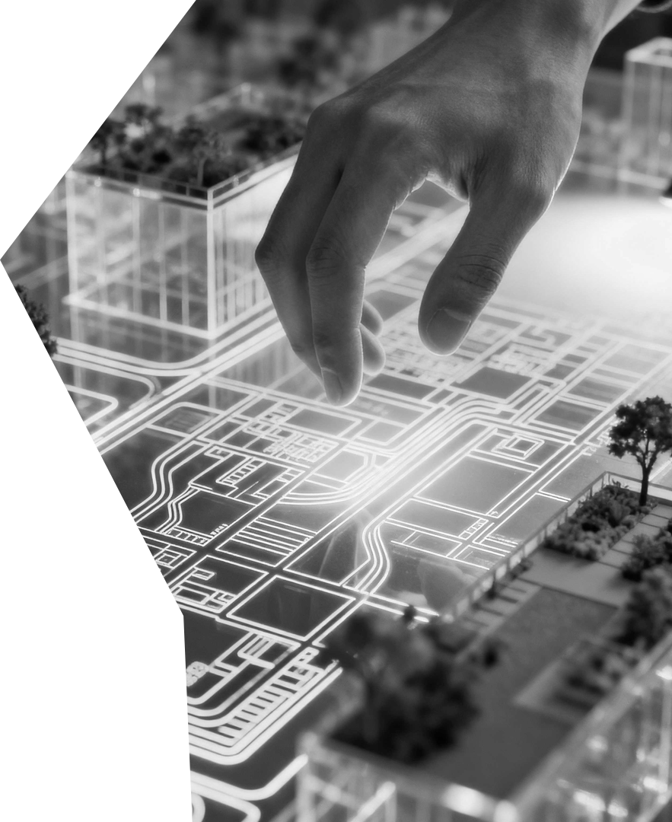


Hemanta Baral
Smart City Consultant
100-Ropani Smart
Micro-Township
A Premium Integrated Smart Eco-Township for a Future-Ready Nepal

Slide 2

Redefining Urbanism
Moving beyond traditional real estate by establishing high-density, mixed-use environments that operate as self-contained, digitally secure, and environmentally responsible micro-townships.
Eco-Sustainability
Smart Governance
Our development ensures long-term ecological responsibility while delivering a premium gated-community experience daily.
We establish a mixed-use, high-density environment operating as a self-contained, secure urban enclave for residents.

Slide 3
Defining the Challenge
Nepal Requires a Resilient Response
to Unplanned Urbanisation
1
2
3
Inefficient Development
Disaster Vulnerability
Service Fragmentation
Traditional urban growth in Nepal suffers from inefficient land use patterns, vulnerable overhead utility networks, and the total lack of integrated waste management systems.
Rapid urban expansion without smart infrastructure significantly increases vulnerability to seismic activity and extreme climate change events throughout the region.
The absence of centralised digital management results in fragmented service delivery, leaving residents struggling with inconsistent utility access and limited security.

Slide 4



The Smart Eco-Township
Smart Infrastructure
An integrated gated community concept combining high-density residential planning with smart underground infrastructure, IoT management, and AI-based security to ensure a premium, disaster-resilient living experience.
Utilizing disaster-resilient underground utility ducts to replace vulnerable overhead power lines.
AI-Driven Safety
Implementing AI-based security systems to provide comprehensive enclave protection 24 hours a day.
Eco-Friendly Living
Merging premium amenities with sustainable resource management for a nature-connected living space.

Slide 5







Optimising the 100-Ropani
Landscape for Community Value
Amenities
Residential
Community-focused facilities designed to enhance the quality of life for all residents.
Primary high-value land allocation focused on development to meet community housing needs.
Utilities
Mobility
Essential infrastructure and utility services allocated to support all site operations.
Infrastructure dedicated to roads and transit-oriented development for efficient movement.
Commercial
Green Space
Dedicated office and commercial space to support the local economic ecosystem effectively.
Open landscape zones designated to reduce carbon footprint and support environment goals.

Slide 6




Diversified Residential
Offerings
for Multi-Generational
Community
Smart Apartments
200–300 units across 8–12 storeys featuring automated smart systems and earthquake-resistant build.
Premium Homes
80–120 units offering private green spaces, rooftop solar energy panels, and rainwater harvesting.
Housing Units
60–100 low-rise units featuring shared courtyards designed to foster interaction and senior living.
Accommodating 2,000–3,500 residents through a mix of vertical and horizontal living spaces tailored to diverse market segments for modern community needs.
Integrated Tech
Smart metering and automated waste segregation systems integrated across all units for operations.

Slide 7

Invisible City
Our township utilizes a complete underground utility ducting system to ensure aesthetic purity and operational reliability for all residents.
Ducting Install
System Integration
Integrated conduits for electrical, fibre-optic, water, and sewerage lines are laid beneath the township's primary road networks.
Connecting high-speed Fibre-to-the-Home and smart electrical grids to every single residential and commercial node in the township.
Maintenance Access
Smart Grid Deploy
Strategically placed access points are installed to allow for repairs without ever disrupting surface-level traffic or delicate landscaping.
AI-based load balancing and motion-sensor LED street lighting systems are activated to significantly optimise total energy consumption.

Slide 8
Circular Water & Waste Goals
Sustainability metrics drive resource recovery. Key systems include freshwater reduction, water recycling, waste-to-energy conversion, and optimized smart irrigation.
40-50%
500-800K
5-10
100
%
Freshwater Red.
Recycled Water
Waste-to-Energy
Smart Irrigation
Reduction in dependency via rainwater harvesting
Sewage Treatment Plant daily capacity in kLD
TPD processing capacity for organic waste
Sensor-controlled drip systems optimization

Slide 9
Renewable Strategy
Powering the township with
clean, renewable energy sources
1
2
3
60–70% Renewable Share
Solar & Storage Systems
Rs. 2–4 Crore Savings
Environmental strategy prioritizes high-level integration across the entire development to ensure sustainability benchmarks are met for the future.
Installing 500–800 kWp of rooftop solar capacity, backed by BESS technology to maintain 24/7 energy reliability across the township infrastructure.
Transitioning to green energy delivers significant annual cost reductions, creating a competitive advantage for ESG-conscious investors and residents.

Slide 10
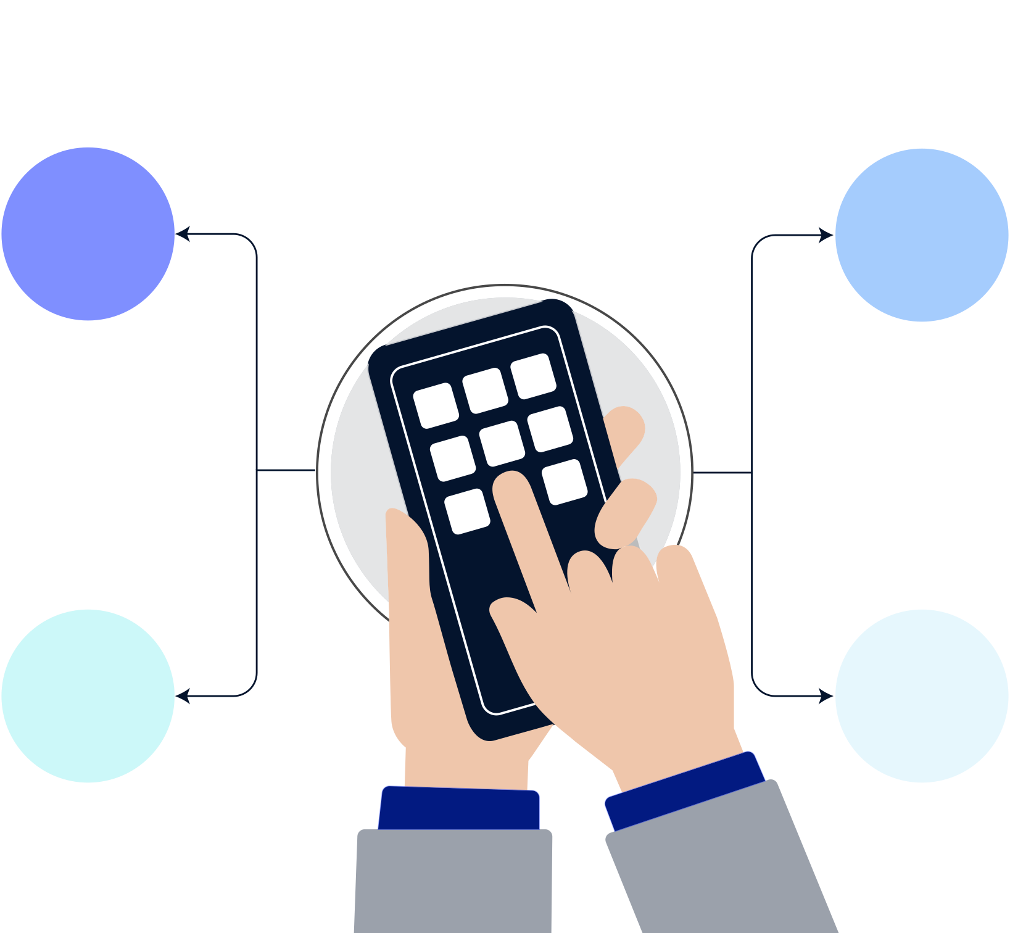




Digital Ecosystem
A unified digital architecture powering real-time township intelligence, safety, and infrastructure management.
Digital Centre
Management Sys
Centralised hub monitoring energy flow, environmental quality, and all township utility operations.
Unified platform tracking traffic flow, water levels, and utility billing across the entire enclave.
Resident App
AI Surveillance
Digital portal for facility booking, maintenance requests, and direct community communication channels.
24/7 monitoring with facial recognition, ANPR-enabled entry, and automated emergency response alerts.

Slide 11
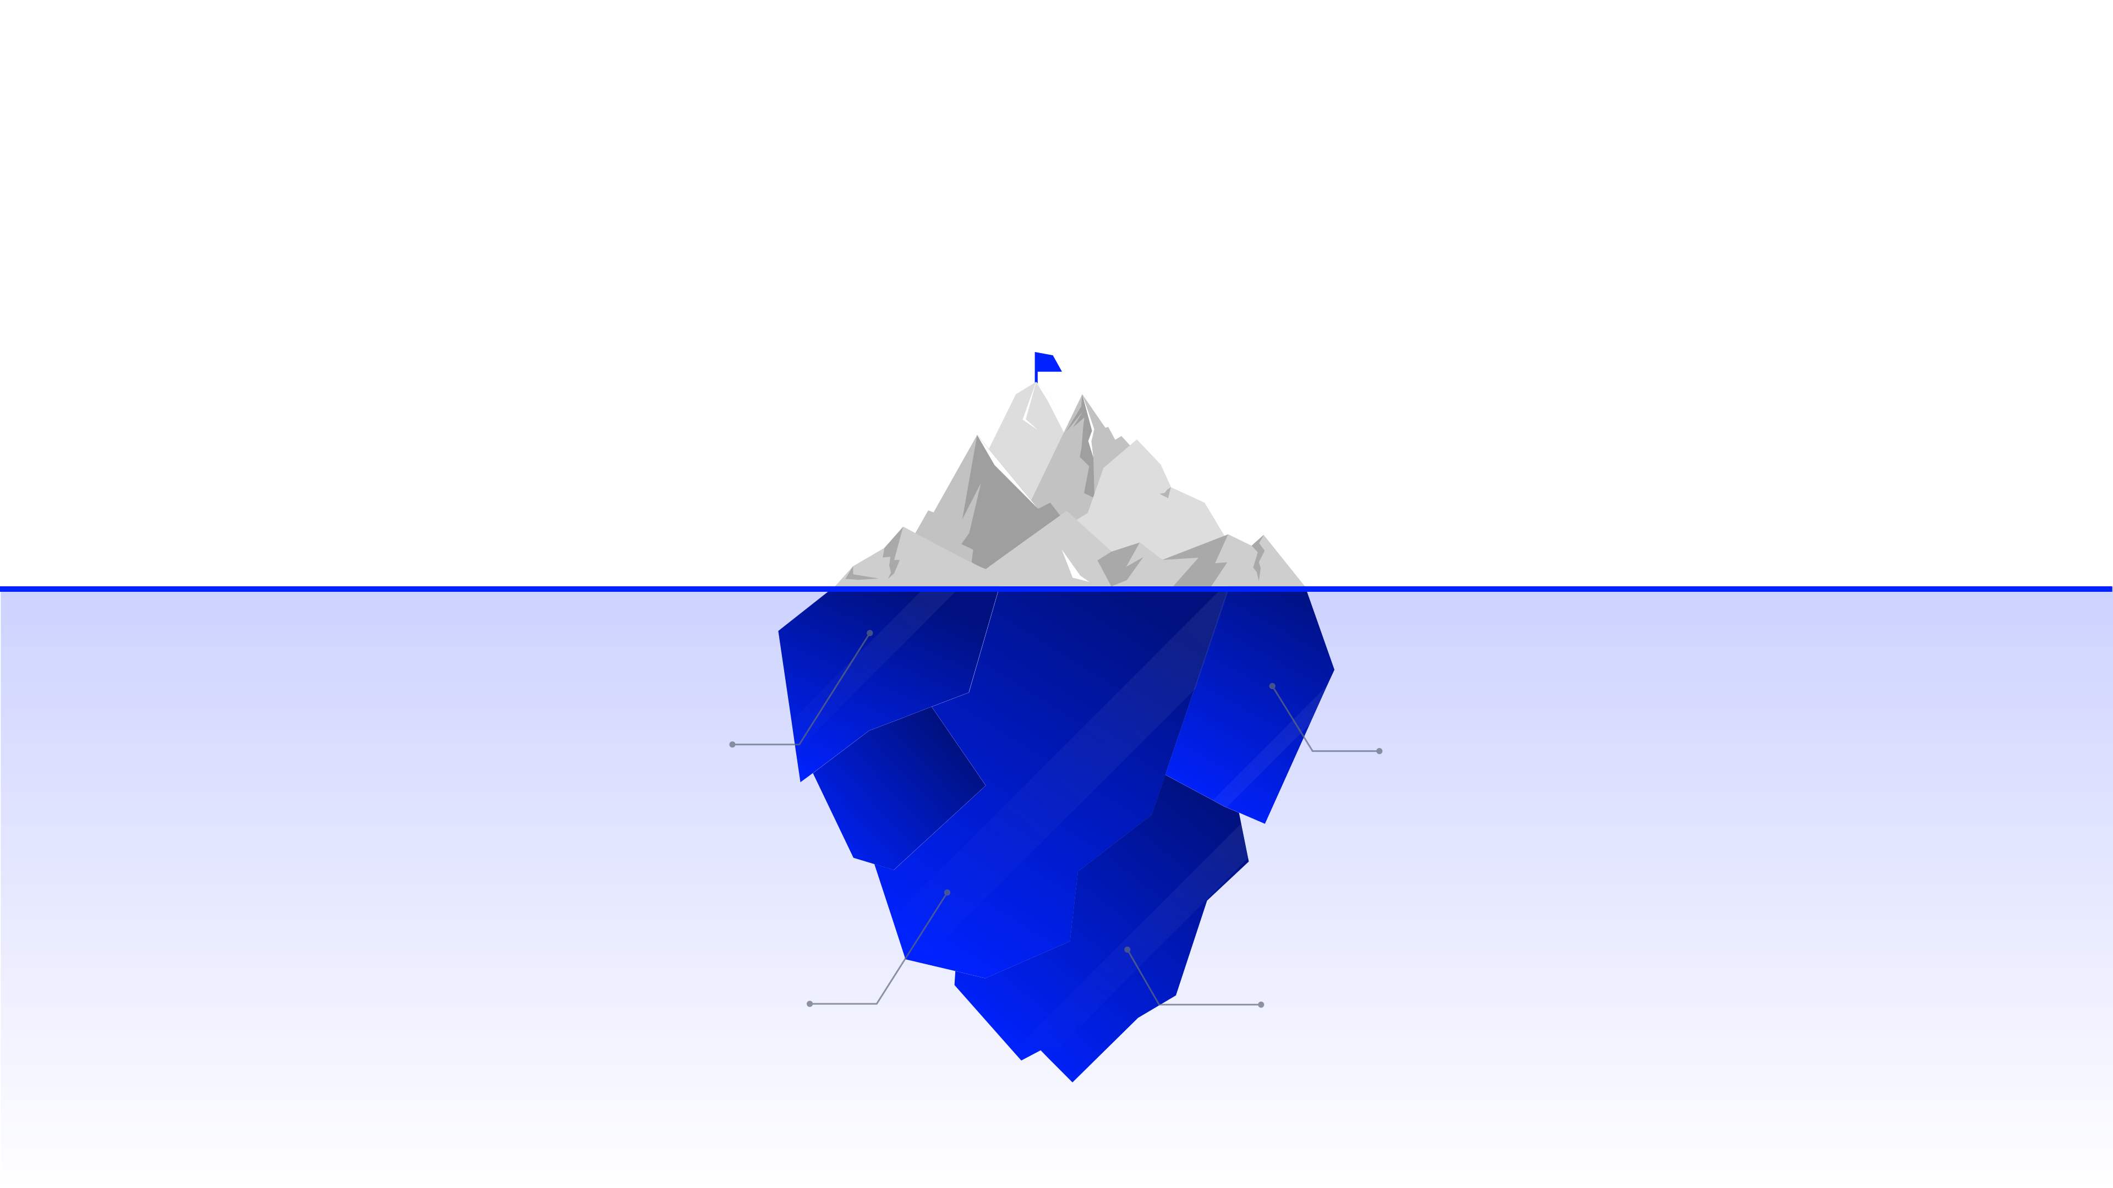
Prioritising Safety Through Advanced
Seismic and Fire Resilience
Seismic Design
Fire Suppression
Structures follow enhanced earthquake-resistant building codes with flexible utility connections.
Advanced smart detection systems integrated with on-site fire reserves and automated alerts.
Flood Management
Contingency Plans
Sustainable drainage systems handle extreme rainfall using pervious surfaces and recharge pits.
Dedicated backup power and water systems maintain essential services during regional failures.

Slide 12
Project Budget and Phased
Investment Requirements
1
2
3
4
5
Civil &
Infrastructure
Utilities & ICT
Vertical Build
Software &
Operations
Community
& Lifestyle
Allocating 15-27 Crore for FTTH, smart grids, solar energy, and IoT network systems.
Allocating 180-300 Crore for construction of residential towers and commercial spaces.
Allocating 22-38 Crore for roads, ducting, drainage, and perimeter security systems.
Allocating 5-11 Crore for TMS, AI surveillance technology, and command center setups.
Allocating 8-15 Crore for sports, wellness facilities, healthcare, and public parks.

Slide 13
Revenue & Investor Returns
350 - 550Cr
Gross revenue from 400-500 premium residential units
The financial model leverages diverse income streams, including real estate sales, commercial leasing, and recurring maintenance, to drive strong partner returns.
15 - 22%
Internal rate of return for institutional partners
8 - 14
Years to recover investment through gains and leasing
5 - 8Cr
Predictable income from township maintenance fees

Slide 14
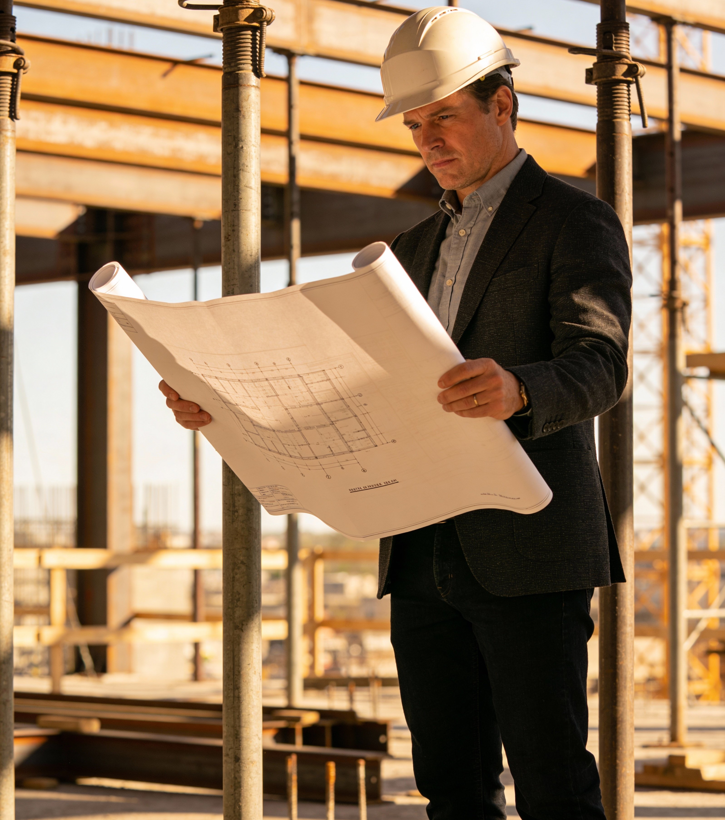
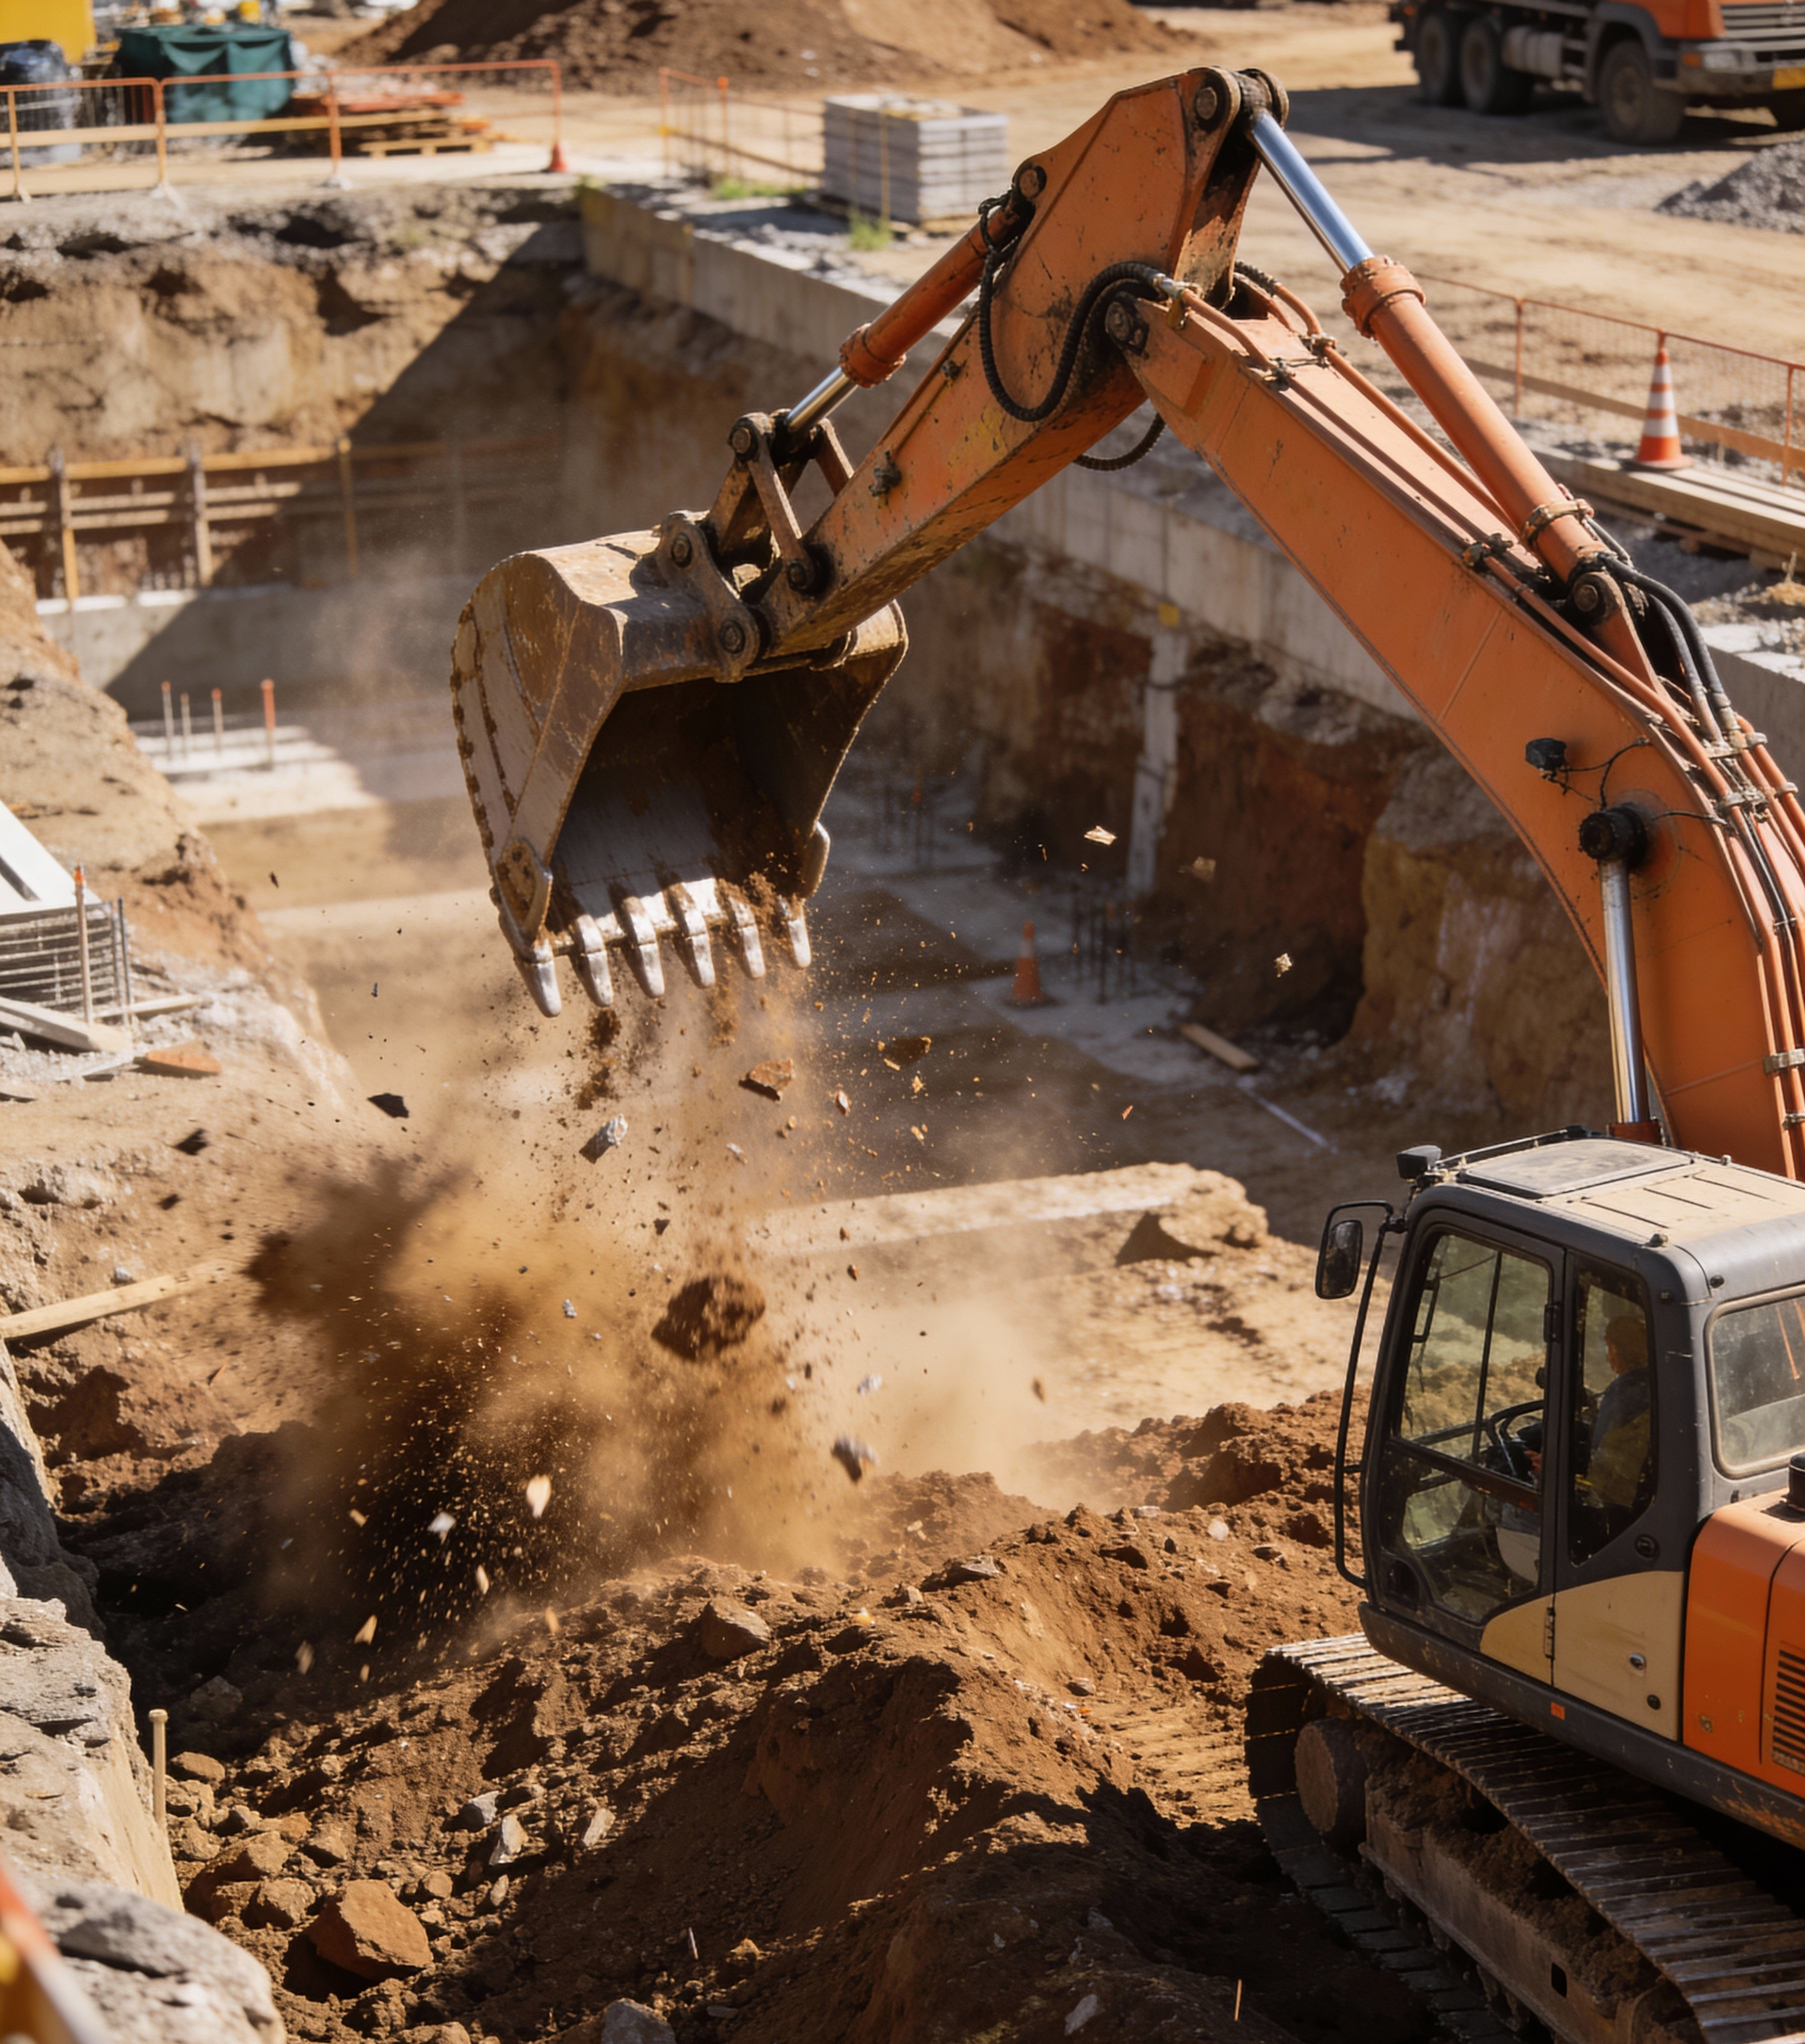
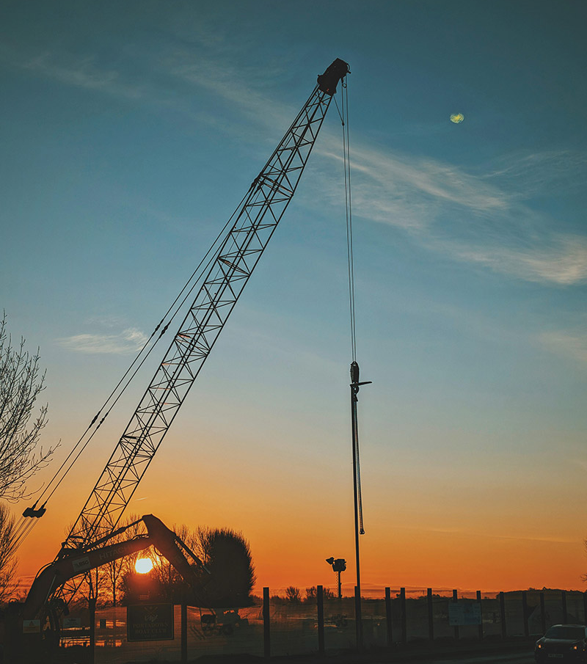
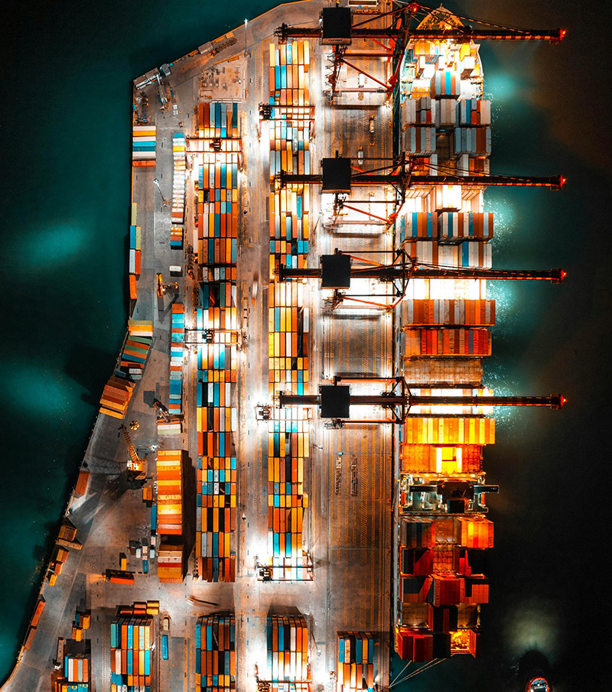
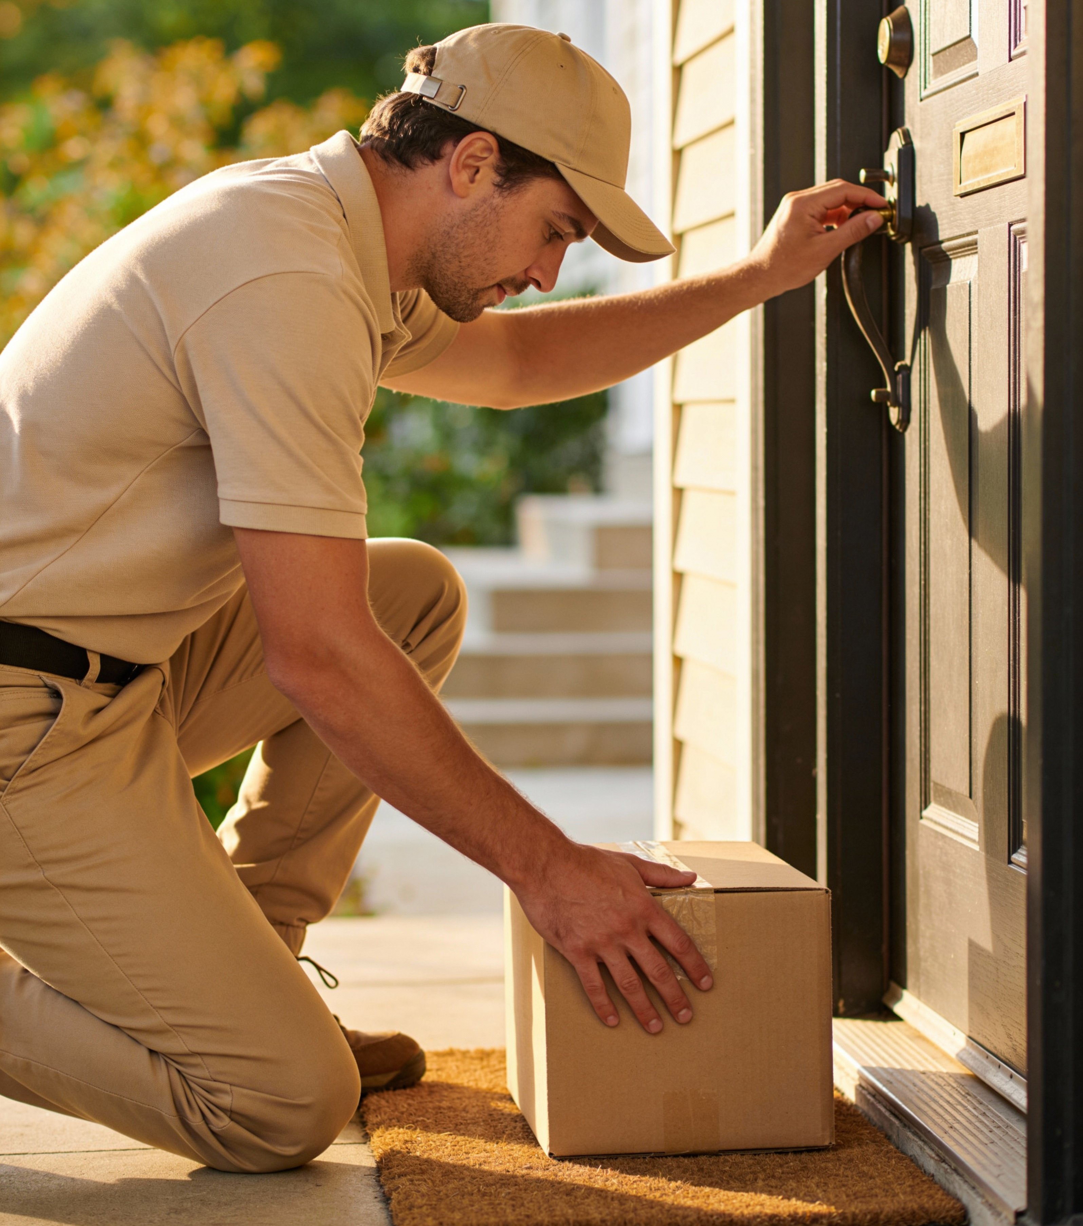
A Clear Roadmap From Master
Planning To Final Soft Launch
1.
Master Planning
2.
Core Infrastructure
3.
Vertical Building
4.
Smart Systems
5.
Launch & Handover
6–9 months dedicated to land surveys, geotechnical assessments, and master planning.
12–18 months for installing underground infrastructure, site roads, and utility lines.
24–30 months for constructing residential towers, row houses, and commercial zones.
6–9 months to integrate smart IoT sensors and the Central Command Centre systems.
6 months for finalizing resident onboarding, operations handover, and official launch.

Slide 15




Immediate Actions
Prioritising Governance, Design, and Partnerships

