Slide 1
WELCOME
to
Quiz @ CODAVATAR
TRIVIA CHALLENGE 2025
Host: Hemanta Baral; Quiz Master
Dec 12, 2025 Friday @Conference Hall

Slide 2
Answer Keys
1
2
3
4
5
6
7
8
9
10
11
12
13
14
15
16
17
18
19
20
21
22
23
24
25
26
27
28
29
30
31
32
33
34
35
36
37
38
39
40
Extra

Slide 3


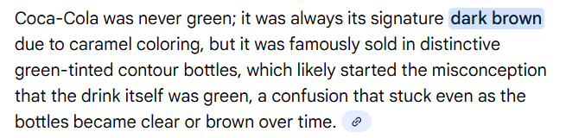
Question 1
What was the original color of Coca-Cola when it was first created?
Answer: Dark Brown

Slide 4
Question 2
What is the most common name in the world?
Answer: Muhammad or Mohammed

Slide 5
Question 3
Which animal cannot look up into the sky due to its physical structure?
Answer: Pigs

Slide 6
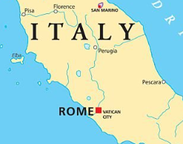
Question 4
What is the smallest country in the world? Where is this located in?
Answer: Vatican City, entirely within Rome, Italy (0.44 square km)

Slide 7
Question 5
नेपालको पहिलो प्रधानमन्त्री को हुन्? Who was the first Prime Minister of Nepal?
Answer: भीमसेन थापा

Slide 8
Question 6
From one to one hundred, how many times does the letter ‘A’ appear?
Answer: Zero (0) times - No A

Slide 9
Question 7
ज्ञानेन्द्र शाह, पारस शाहको के हो?
Answer: नाम (ज्ञानेन्द्र शाह, पारस शाहको नाम हो?

Slide 10
Question 8
सबैभन्दा उचाईमा रहेको नेपालको जिल्ला सदरमुकाम कुन हो ? Which district headquarters of Nepal is located at the highest altitude?
Answer: सिमिकोट/सिमकोट (Humla District)

Slide 11
Question 9
वेदव्यासका पिता को थिए? Who was the father of Veda Vyasa?
Answer: पराशर ऋषि Sage Parashara
(Parashara was the grandson of Vasishtha and the son of Shakti Maharishi)

Slide 12
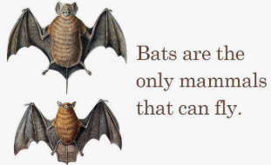
Question 10
साच्चिकै रुपमा उड्न सक्ने एक मात्र स्तनधारी जनावर कुन हो? What is the only mammal capable of true flight?
Answer: चमेरो (Bat)

Slide 13
Question 11
रामायणमा रावणको भाइ कुम्भकर्णलाई निद्रामा राख्ने वरदान कसले दिएका थिए? In the Ramayana, who granted the boon that kept Kumbhakarna (Ravana’s brother) asleep?
Answer: ब्रह्माले

Slide 14
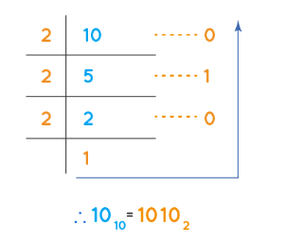
Question 12
What is the binary equivalent of decimal number 10?
Answer: 1010

Slide 15
Question 13
सबैभन्दा धेरै टापुहरू भएको देश कुन हो? Which country has the most islands?
Answer: Sweden (~267,570)

Slide 16
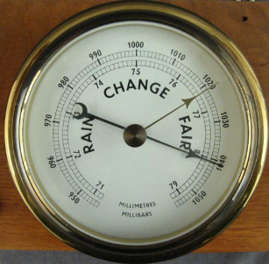
Question 14
वायुमण्डलीय चाप मापन गर्ने यन्त्र लाइ के भनिन्छ? Which instrument measures atmospheric pressure?
उत्तर: Barometer

Slide 17
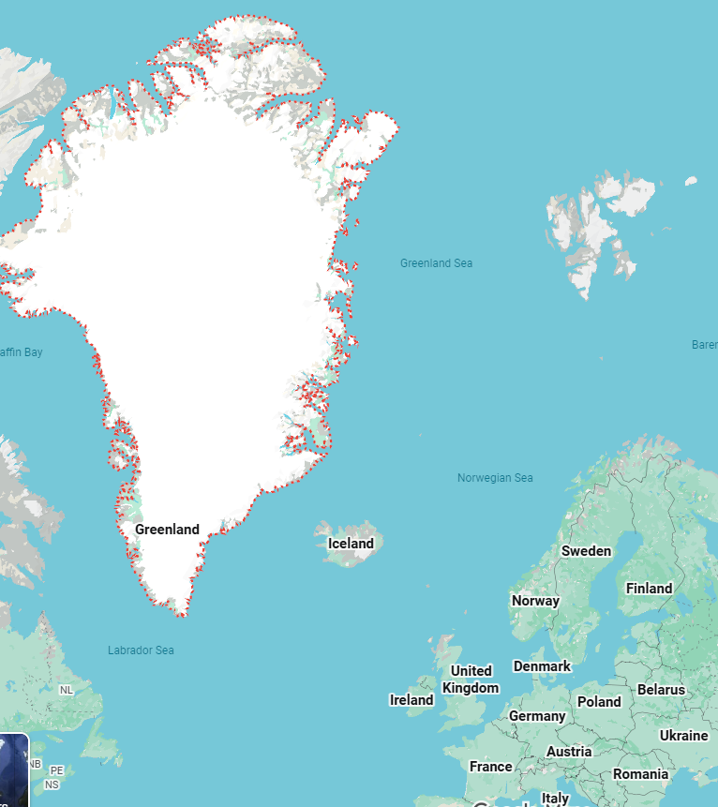
Question 15
संसारको सबैभन्दा ठूलो टापु कुन हो? Which is the largest island in the world?
Answer: Greenland

Slide 18
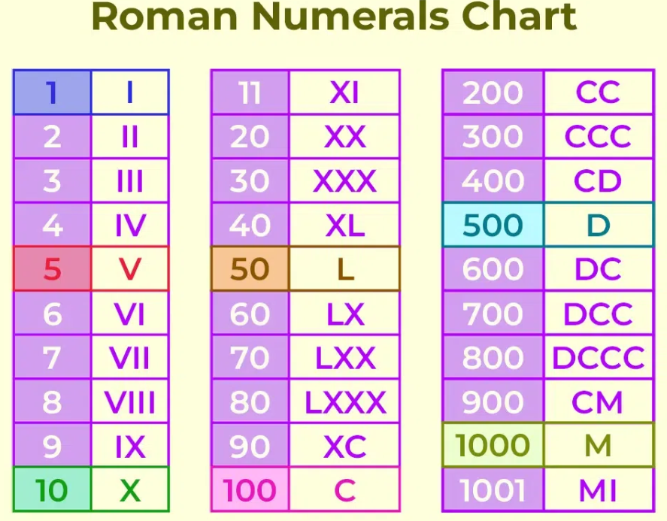
Question 16
What is the Roman numeral for 100?
Answer: C

Slide 19
Question 17
What does GPS stand for?
Answer: Global Positioning System

Slide 20
Question 18
एशियन हाइवेको सबैभन्दा कम खण्ड कहाँ पर्छ ? Where is the shortest section of the Asian Highway located?
Answer: सिंगापुर (Singapore) – 19 KM / 145,000 KM

Slide 21
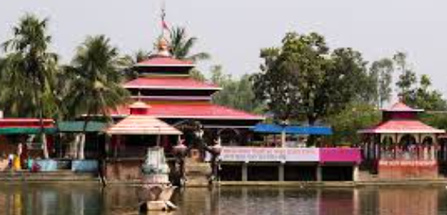
Question 19
छिन्नमस्ताको मन्दिर कुन जिल्लामा पर्छ ? In which district is the Chhinnamasta Temple located?
Answer: सप्तरी (Saptari)

Slide 22
Question 20
नेपालको सबैभन्दा कम पानी पर्ने जिल्ला कुन हो ? Which is the district of Nepal with the least rainfall?
Answer: मुस्ताङ्ग (Mustang)

Slide 23
Question 21
सबैभन्दा लामो समय गर्वधारण गर्ने स्तनधारी जीव कुन हो ? Which mammal has the longest gestation period?
Answer: हात्ती (18-22 months) Elephant

Slide 24
Question 22
कोशी ब्यारेजमा कति ओटा ढोका रहेका छन्‌ ? How many gates does the Koshi Barrage have?
Answer: ५६ ओटा

Slide 25
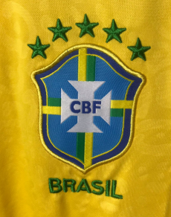
Question 23
सबैभन्दा धेरै फिफा वर्ल्ड कप जितेको देश कुन हो, र उनीहरूले कति पटक यो प्रतियोगिता जितेका छन्? Which country holds the record for the most FIFA World Cup victories, and how many times have they won the tournament?
Answer: Brazil (5 times)

Slide 26
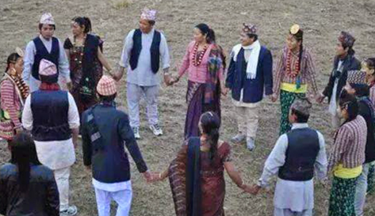
Question 24
धान नाच कुन जाति ले नाच्छ? Which ethnic group performs the Dhaan Naach (Rice Dance)?
Answer: लिम्बु The Limbu (Yakthung)

Slide 27

Question 25
What does ‘PNG’ stand for?
Answer: Portable Network Graphics

Slide 28
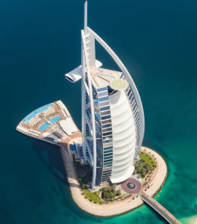
Question 26
संसारको सबैभन्दा अग्लो भवन भएको देश कुन हो, र त्यस भवनको नाम के हो? Which country has the tallest building in the world and what is its name?
Answer: UAE (Burj Khalifa, Dubai); (~828 meter)

Slide 29
Question 27
महाभारतमा "चक्रव्यूह" भित्र प्रवेश गर्ने तर बाहिर निस्कन नसक्ने योद्धा को थिए? In the Mahabharata, which warrior could enter the Chakravyuh formation but could not come out?
Answer: अभिमन्यु

Slide 30
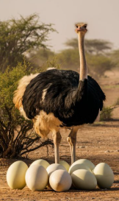
Question 28
सबैभन्दा ठूलो अण्डा पार्ने चराको नाम के हो? Which bird lays the largest egg?
Answer: Ostrich

Slide 31
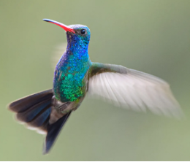
Question 29
पछाडि उड्न सक्ने एक मात्र चरा कुन हो? What is the only bird that can fly backward?
Answer: Hummingbird

Slide 32
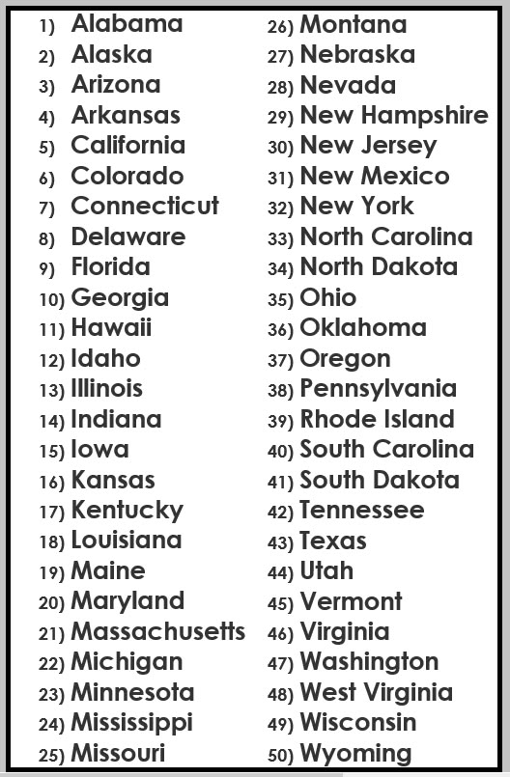
Question 30
What is the only letter that doesn’t appear in any U.S. state name?
Answer: Q

Slide 33
Question 31
Which English word contains all five vowels in alphabetical order?
Answer: Facetious (inappropriate humour)

Slide 34
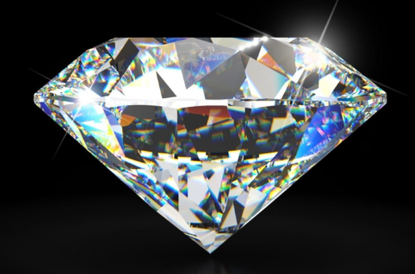
Question 32
What is the hardest natural substance on Earth?
Answer: Diamond

Slide 35
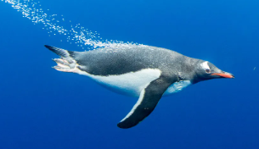
Question 33
What is the only bird that can swim but not fly? उडन नसक्ने तर पौडी खेल्न सक्ने चरा
Answer: Penguin

Slide 36
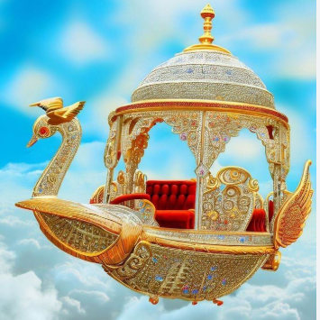
Question 34
रामायणमा रावणको सवारी साधन के थियो? What was Ravana’s vehicle in the Ramayana?
Answer: पुष्पक विमान

Slide 37
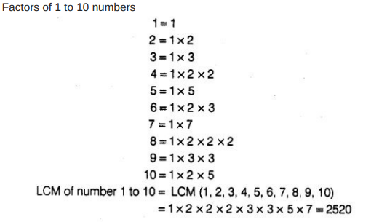
Question 35
What is the smallest whole number that is divisible by all numbers from 1 to 10?
Answer: 2520

Slide 38
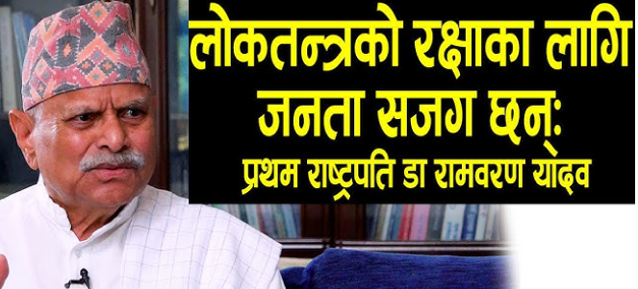
Question 36
Who was the first President of Nepal?
Answer: Dr. Ram Baran Yadav

Slide 39

Question 37
What is the only English word that ends with “mt”?
Answer: Dreamt

Slide 40
Question 38
कुन अंग्रेजी वाक्यमा सबै a to z अक्षर को प्रयोग भएको हुन्छ? Which English sentence uses all letters from A to Z?
Answer: "A quick brown fox jumps over the lazy dog"

Slide 41
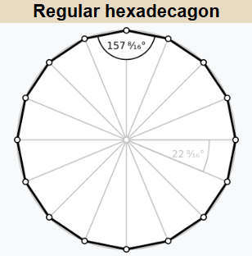
Question 39
What do you call a polygon with sixteen sides?
Answer: Hexadecagon

Slide 42
Question 40
सेतोहात्तिको देश भनेर कुन देशलाई चिनिन्छ ? Which country is known as the “Land of the White Elephant”?
Answer: थाइल्यान्ड

Slide 43
Question 41
How many sides does a circle have? Illogical Question.
Answer: Two (inside and outside)
outside
inside

