Slide 1




/fli^«o ;"rgf tyf k|ljlw lbj; 2080
;'zf;g / ;d[l$sf nflu
;"rgf k|ljlw / ;fOa/ ;'/Iff
May 4, 2023 (Thursday)
Annapurna Banquet, Janakpurdham
Organized by:
Supported by:
Co-ordinated by:
By: Hemanta Baral
ICT/Data Centre/Smart City Consultant
DHANUSHA
MADHESH PROVINCE

Slide 2
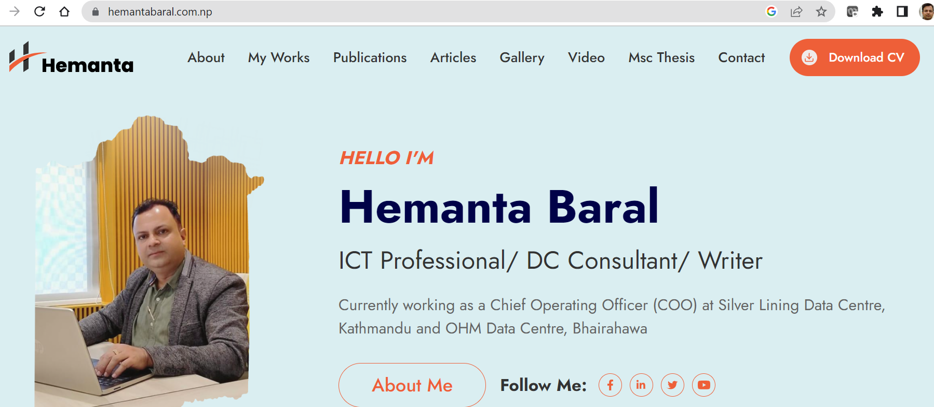
www.hemantabaral.com.np
*Writer (ICT Books) *Cyber Security Trainer for Nepal Police *Smart City Consultant *Data Centre Auditor

Slide 3
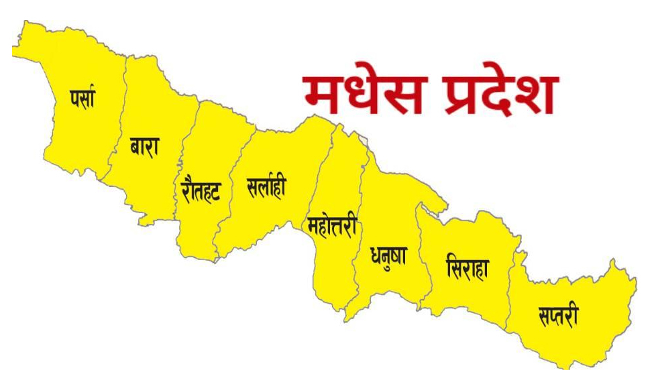
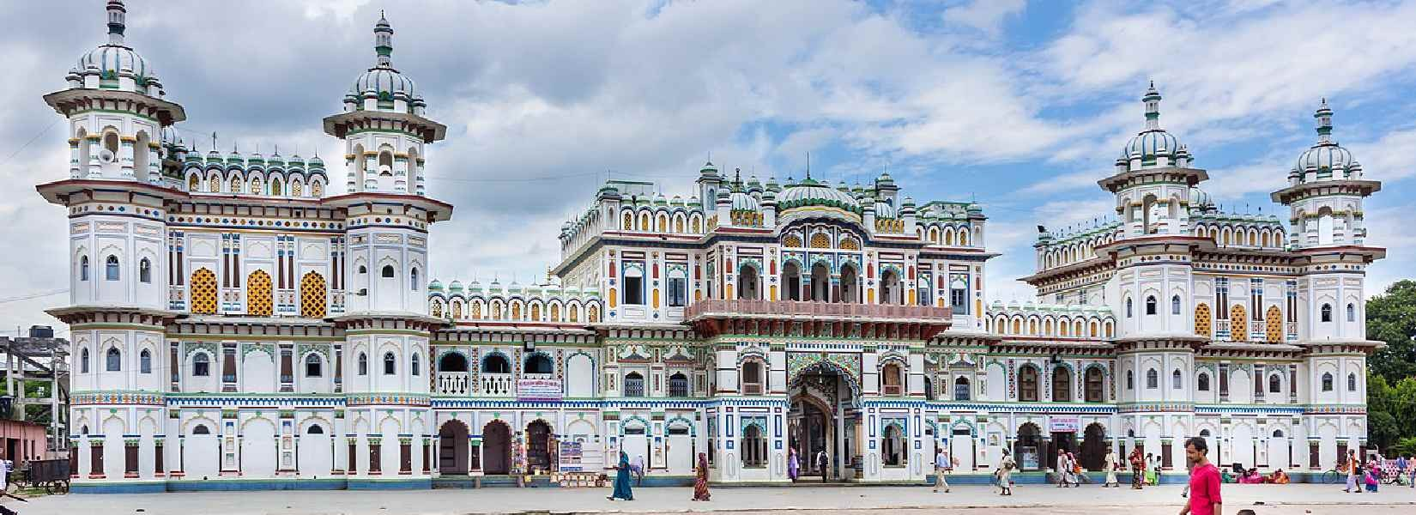
SMART
Madhesh Province

Slide 4
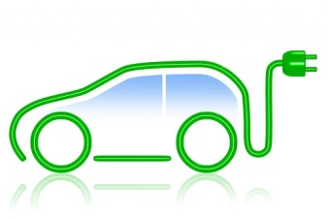
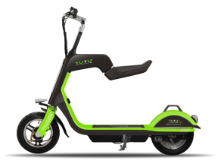

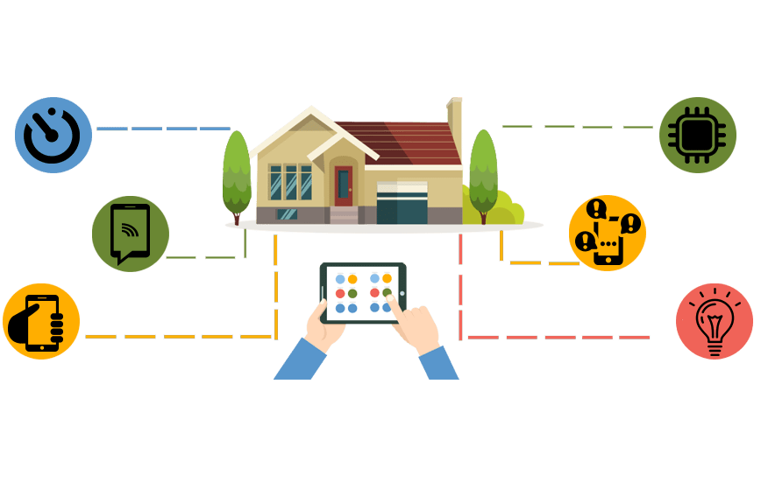
Unique Identity & Centralized Database - Mandatory
(Effective Implementation of National ID)
Why is it important?
Scattered Data
Birth Registration (MoFALD)
Population Census (CBS)
Citizenship (MoHA)
License (DoTM)
Passport (DoP)
Voter’s ID (Election Commission)
LaalPurja (DoLRM)
VAT/PAN (IRD)
Business Registration (OCR)
EPF/CIT
Bank (KYC)
Benefit
Centralized Data
Uniqueness
Banking
Travel
Shopping
Not necessary to fill
the form everywhere
Ease of Tracking
Crime Control

Slide 5
Basic things to be considered…
Corruption Control using automation (Faceless system – system driven)
Queue Management
Public Toilets
Public School Strengthening with Smart Education
Mobile Infra Ambulance for instant repair and maintenance
Call Centers for Government Services
Centralized HealthCare System
Automation for:
  Taxation
  Registration
  Vaccination
  8. Focus to Child, Women, Disable, Old Age people

Slide 6
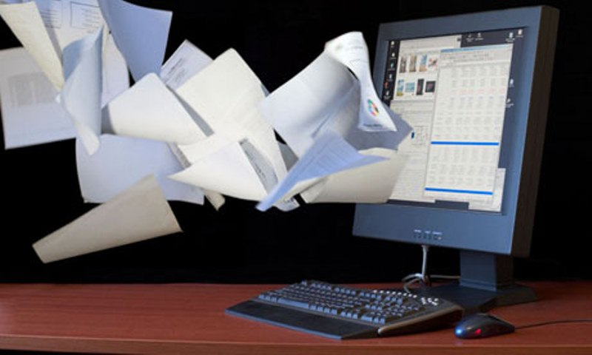
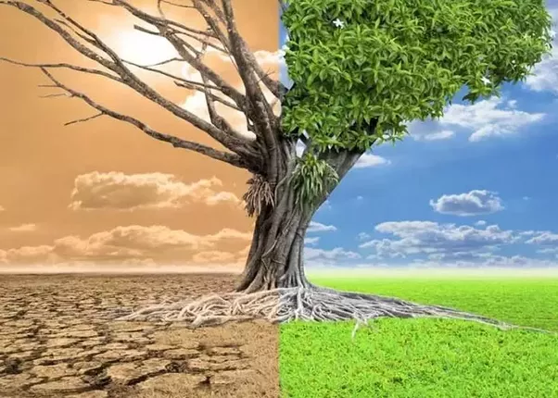
k|ljlw ;DkGg / ;'zfl;t -e|i6frf/ Go"lgs/0f_
Digitization of
Government Services
[Paperless Automation system]
Think BEFORE You Print: 1 ream of paper = 6% of a tree and 5.4kg CO2 in the atmosphere. 3 sheets of A4 paper = 1 liter of water
Citizen ➔ e-Governance (Application) ➔ Service Delivery ➔ No Corruption

Slide 7
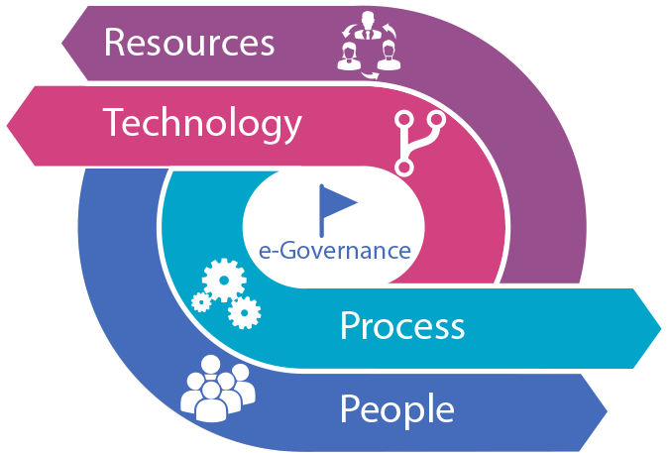
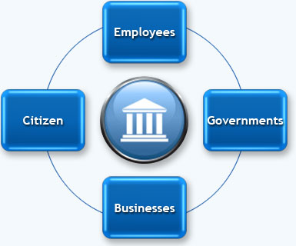
Digitization by implementing:
e-Governance: It is the transformation of government processes to provide efficient, convenient and transparent services to the Citizens and Business through Information and Communication.
G2C:
e-Registration (National ID)
e-Citizenship, License, Passport
e-Passport, Voter's ID
e-Taxation
e-Health
e-Education
e-Transportation
e-Land Registration
e-Payment (Electricity, Telephone, Water, Internet, Mobile)
G2C, G2B, G2G, G2E, C2G
(E-Governance Models)

Slide 8
Things to be done by the Palika:
Purchase required Hardware (Workstations, Server, Storage, Network/Security, Database)
Strong dedicated Connectivity (Internet/Intranet) – Centralized Palika to Ward Office
Network (Own fiber network from Palika to Ward office and important places like school/
hospitals, public places)
CCTV Surveillance
WiFi (Centralized system with WiFi controller)
Build Small Size Data Centre Infrastructure
Mobile App/ Web App (Dedicated Public IP needed) along with own Domain
Digital geographical mapping with proper street addressing
Get help from DOIT (G-Cloud) and GIDC for Application and VPS Service

Slide 9
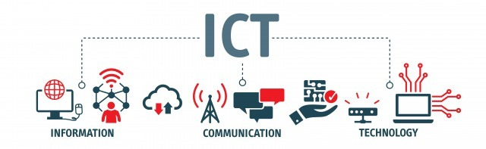
Contents at a Glance
Evolution of IT (IT, ICT, IoT, IoE, AI/BI)
Data Centre and its major components
Cloud Computing
Cyber Security

Slide 10
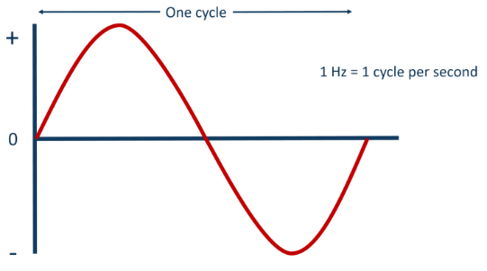
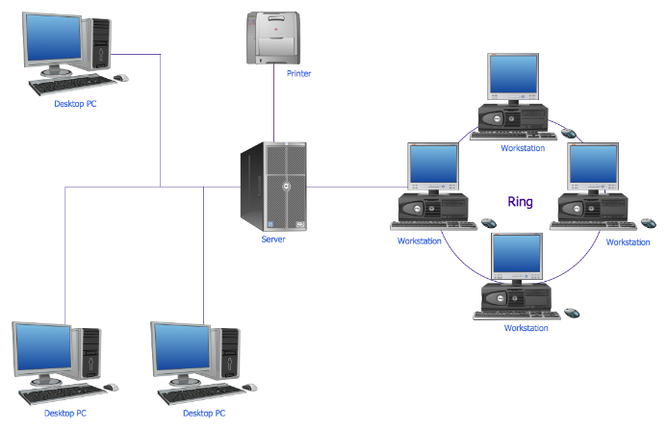
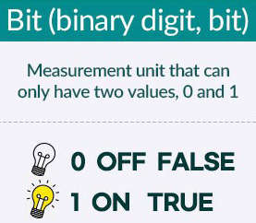
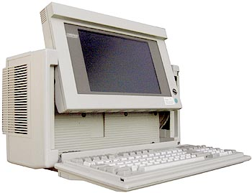
Evolution of IT
Electricity, Frequency, ON/OFF
0,1 – Binary Numbers, Computer Language
IT (Information Technology – Computing only; Standalone - IPO Cycle)
ICT (Information Communication Technology) – Networking; Internet

Slide 11
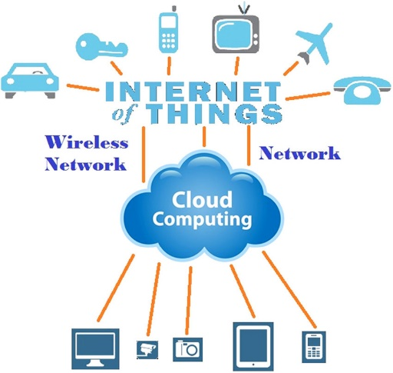
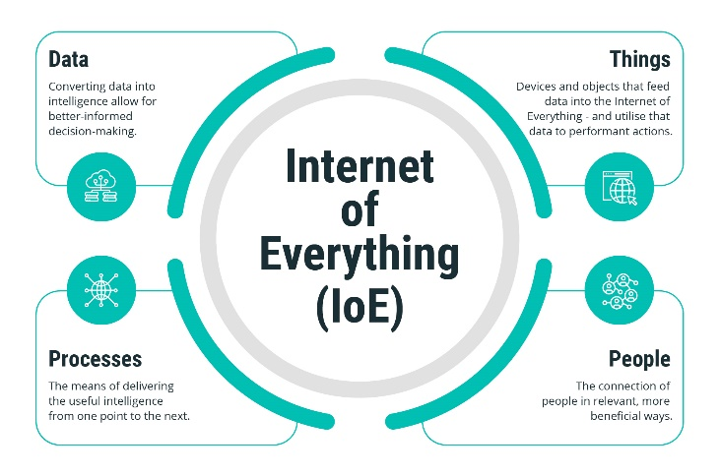

Evolution of IT..
IoT (Internet of Things) – Sensors, Devices, Internet and Cloud
IoE (Internet of Everything) – Data, Things, People, Processes
Artificial/Business Intelligence (AI/BI), Big Data (Blockchain)

Slide 12
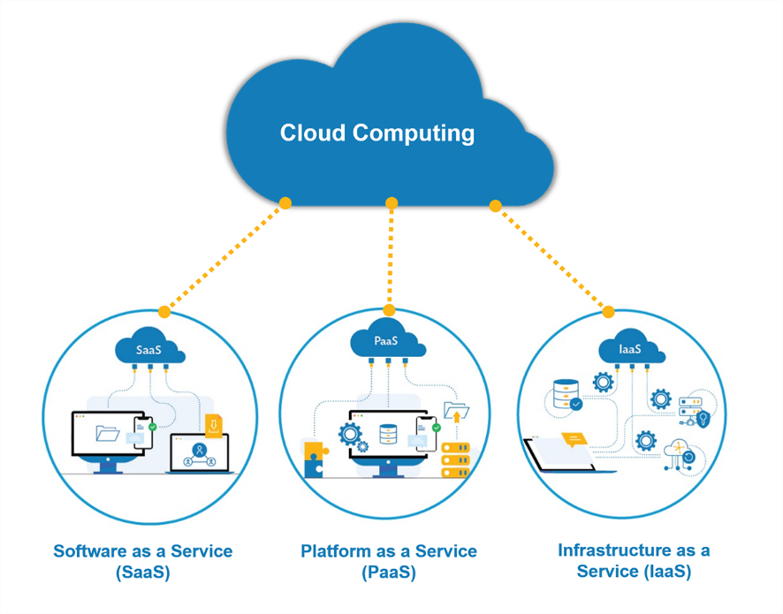
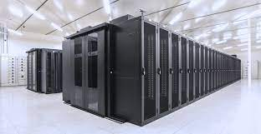
Evolution of IT..
Data Centre (On Premises, Cloud)
Cloud Computing (IaaS, PaaS, SaaS)

Slide 13
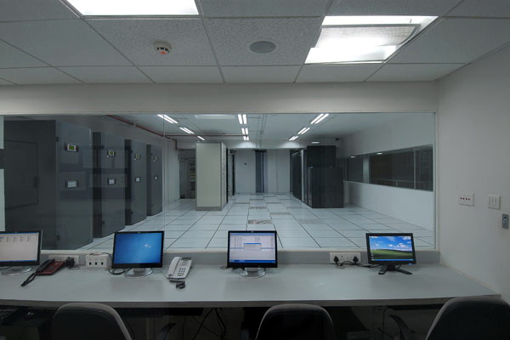
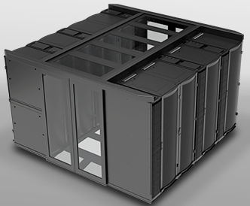
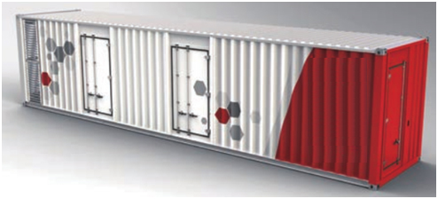
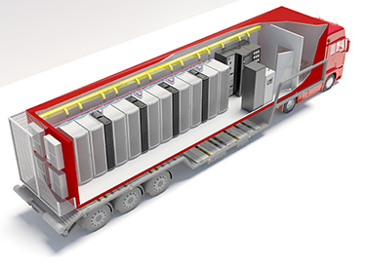
Data Centers:
Conventional
Prefabricated Modular
Container (All in One/
Clustered - Equipment, Cooling, Power, Control)
Conventional DC
Prefabricated
Modular DC
Containerized/
Mobile DC

Slide 14
Conventional Data Center
Conventional Data Centers are room or building based solution where each and every component has to be installed manually and separately.

Slide 15
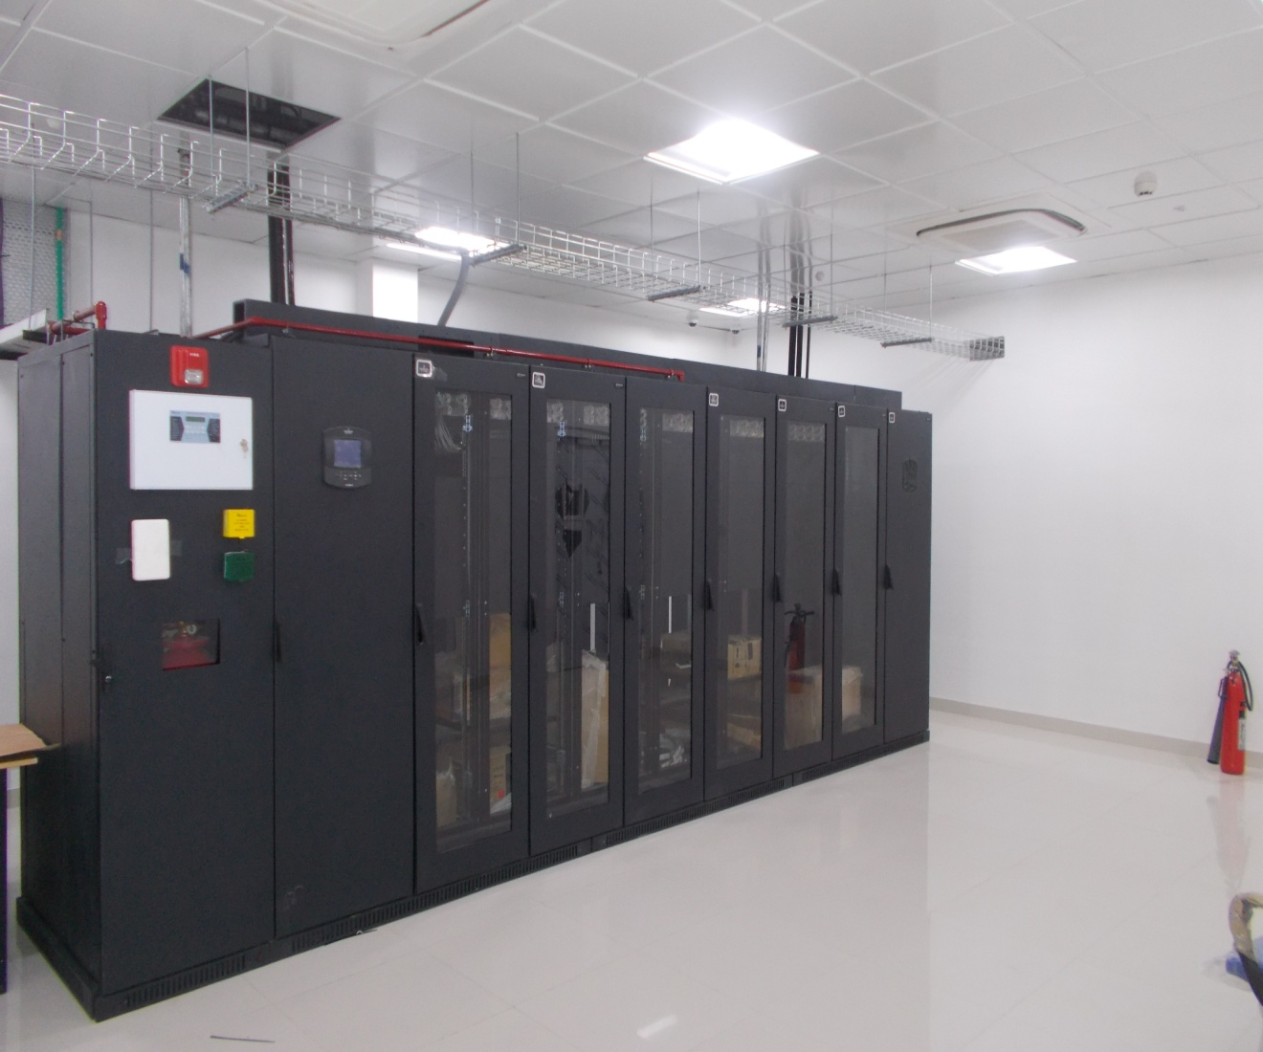
Prefabricated Modular Data Center
Modular Data Centers come in one single unit where all the major DC passive components are resides. It is a pre-fabricated unit that can be delivered to a site to fill an immediate need of the clients.

Slide 16
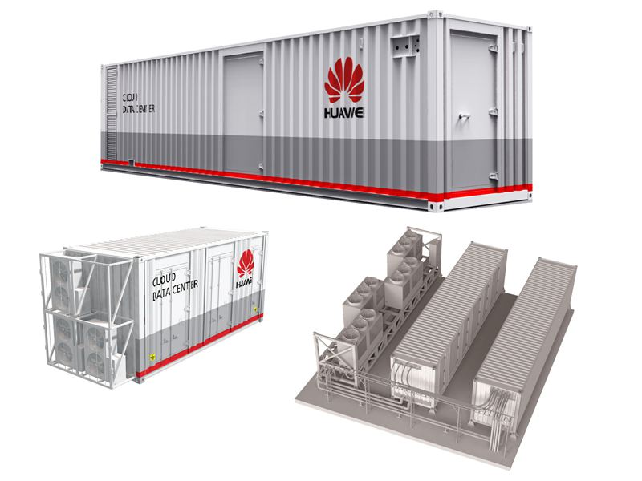
Pre-fabricated Modular Containerized Data Centre

Slide 17
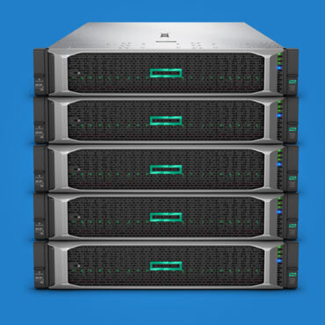
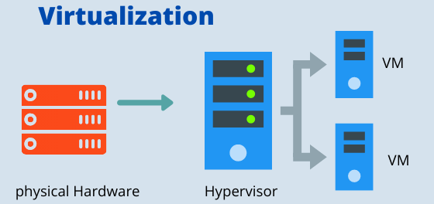
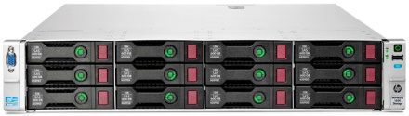
Major Components of Data Centre
Hardware
  Workstations,
  Servers – RISC (IBM, Sun), CISC (Intel based), HCI
    Virtualization
  Storage – HDD/SSD; DAS/NAS/SAN; Cloud
Connectivity (Internet/Intranet)
Network/ Security (Firewall – Network/Application)
Servers
Storage

Slide 18
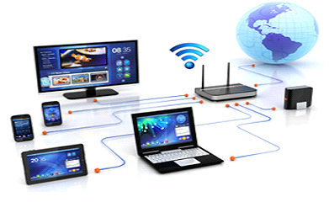
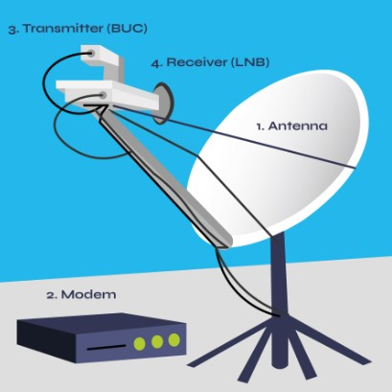
Connectivity
Intranet:
Data Link Layer (L2 Link)
Internet:
Network Layer (L3 Link)
Broadband Connection:
DSL (ADSL/ SDSL)
Cable Modem
Optical Fiber
Wireless (Radio)
Satellite (VSAT)
Broadband over
powerline (BPL)
VPN, Dark Fiber, Leased Line

Slide 19
Connectivity among Government Entities
Ward Offices
Government
Schools
Central/ Federal
Government
Province/ State
HQ
Metropolitan City
Other
Government
Offices
DC/DR Site
Hospitals

Slide 20
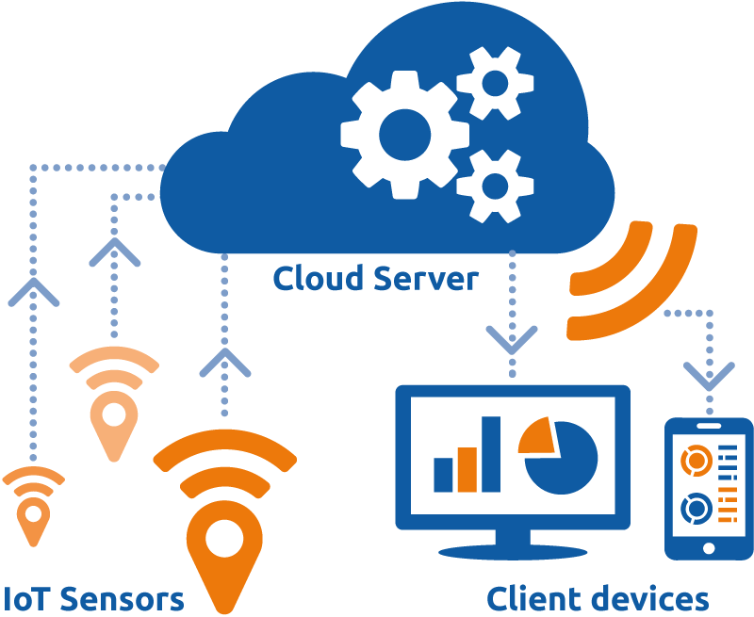
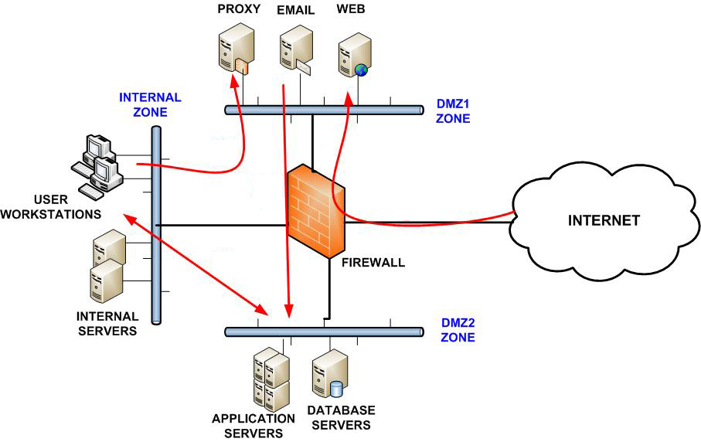
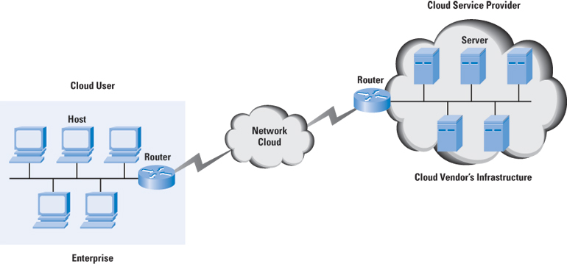
Data Centre Network
1. On-Premises Physical Network
2. Cloud Network
1. On-Premises
Physical Network
2. Today & Beyond Network
(Cloud)

Slide 21
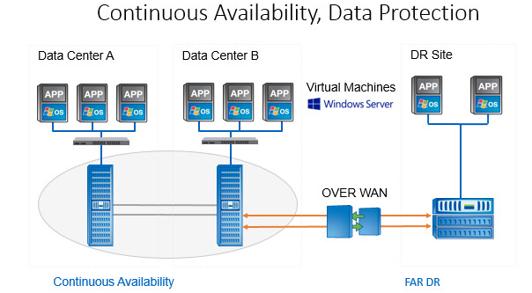
Data Centre
Concept
DC – Primary DC
NDC – Near DC or Failover DC
DR – Disaster Recovery

Slide 22
Data Centre Services:
Colocation
Managed Private Cloud
Public Cloud
Web and Email Hosting
Storage/Software as a Service (SaaS)
NOC/SOC (Network/Security Operation Centre)

Slide 23

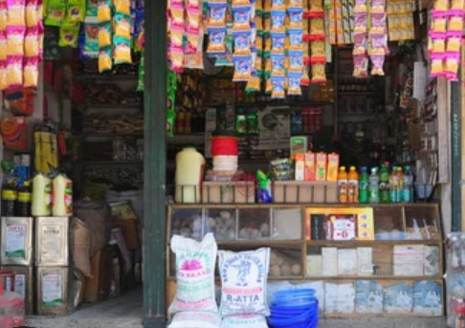
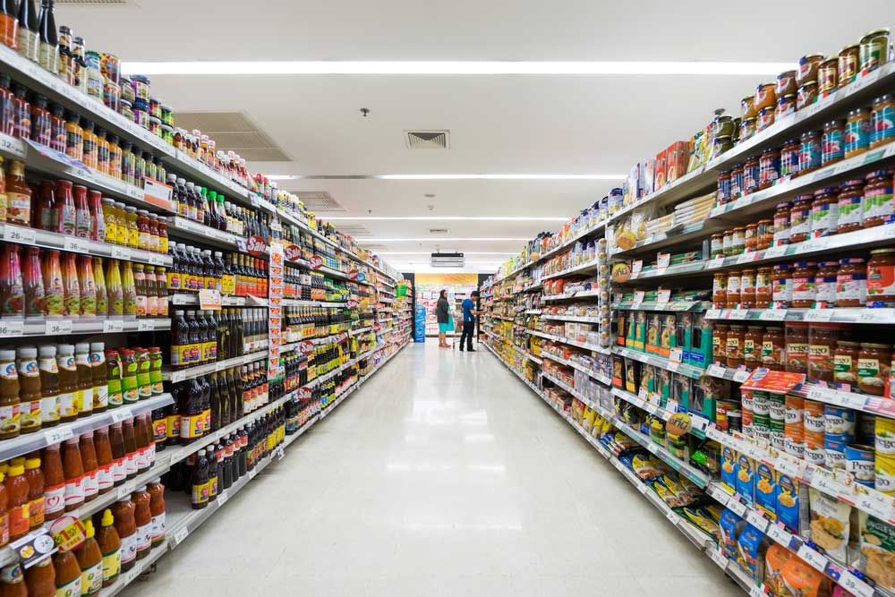
क्लाउड कम्प्युटिङ
कम्प्युट - प्रोसेसर (Sales Persons)
मेमोरी (Display Area)
स्टोरेज, डाटावेस (Store/Go down)
एप्लिकेशन (Multiple varieties)
Single PC/Laptop
Cloud Computing

Slide 24
क्लाउड कम्प्युटिङका फाइदा
१. कम लगानी (एकमुष्ट लगानी गर्नु नपर्ने)
२. आवश्यकता अनुसार स्रोतको प्रयोग
३. प्रयोग अनुसारको मासिक, त्रैमासिक, अर्धवार्षिक या वार्षिक रुपमा रकम भुक्तानी
४. लचिलो (आवश्यकता अनुसार स्रोतको थपघट गर्न सकिने)
५. सुरक्षित
६. डाटा नोक्सानी हुन बाट सुरक्षित
७. व्याकअपको राम्रो प्रवन्ध
८. आफ्नै नियन्त्रण

Slide 25
कति छन् नेपालमा डाटा सेन्टर/ क्लाउड ?
सरकारी स्तरबाट संचालनमा गरेको सिंहदरबार भित्रको जिआईडिसी (गभर्मेन्ट ईन्टिग्रेटेड डाटा सेन्टर) सरकारको एक मात्र डाटा सेन्टर हो । यसको डिजास्टर डाटा सेन्टर हेटौंडामा छ । प्राईभेट रुपमा संचालनमा रहेका भैरहवाको ओम डाटा सेन्टर नेपालको निजीस्तरको पहिलो डाटा सेन्टर हो । अन्य डाटा सेन्टरहरुमा दरबारमार्गको सिल्भर लाईनिङ डाटा सेन्टर, थापाथलीको डाटा हब, कुमारीपाटीको एक्सेस वर्ल्ड, थापाथलीको क्लाउड हिमालय, पुतलीसडकको डाटास्पेस, बालुवाटारको सुबिसु, एनसेल, डिशहोम आदि रहेका छन् ।
Amazon Web Services
Microsoft Azure
IBM Cloud
Google Cloud Platform
Huawei Cloud
Alibaba etc…
Major Public Cloud Providers:

Slide 26
Cyber Security
What is Cyber?
The electronic medium in which Online communication takes place.
What is Cyber Security?
Cyber security is the protection of systems, networks and data from unauthorized access, change or destruction in cyberspace (computer network).

Slide 27
How Cybercrime is carried out?
Using Crimeware*
A type of malicious* software that is designed to commit crimes on the Internet. Crimeware may be a virus, spyware# other distrust piece of software that can be used to commit identity theft and fraud.
*malicious = intended to harm
#Spyware = is software that aids in gathering information about a person or organization without their knowledge and that may send such information to another entity without the consumer's consent.

Slide 28
Dos/DDoS Attacks
A Denial-of-Service (DoS) attack is designed to delay or stop the normal functioning of a web site, server or other network resource. One common method is to flood a server by sending it more requests than it is able to handle. This will make the server run slower than usual (and web pages will take much longer to open), and may crash the server completely (causing all websites on the server to go down).
If an attacker uses a thousand systems to simultaneously launch smurf attacks against a remote host, this would be classified as a DDoS (Distributed Denial of Service) attack.
A DoS attack can be perpetrated in a number of ways:
Consumption of computational resources, such as bandwidth, disk space, or processor time
Disruption of configuration information, such as routing information.
Disruption of physical network components.
Obstructing the communication media between the intended users and the victim so that they can no longer communicate adequately.

Slide 29
O{G6/g]6 ck/fw
-;fO{a/ qmfO{d_

Slide 30
kl/ro
cfhsf] ljZjdf ;"rgf k|ljlwsf] ljsf; ;+u} o;sf r'gf}tLx? klg lbgk|ltlbg
?kdf a9\bf] 5g\ . o;sf] u}/sfg'gL k|of]u u/L O{G6/g]6 dfkm{t ul/g] o:tf ck/fwx?n] tkfO{+ xfdL sf]lx klg c5'tf] /x]sf 5}gf} . O{G6/g]6 dfkm{t x'g] u/]sf ljleGg ck/fw dWo] tnsf ck/fwx? k|d'v 5g\ .
Xoflsª\ -cj}w 3';k}7 u/L rf]/L ug'{_ – u}/sfg'gL 9+un] cg'dlt lagf s;}sf]
sDKo'6/ l;:6ddf k|j]z u/L ;"rgfx? rf]/L ug'{ . olb tkfO{+sf] sDKo'6/df
O{G6/g]6 ;'ljwf h8fg ul/Psf] 5 eg] Xofs/n] tkfO{+sf] sDKo'6/df k|j]z ug{
cl3 tkfO{+sf] l;:6dsf] cfO{lk P8«]; kQf nufp+b5 / ljljw pkfo lgsfn]/ tkfO{+sf] l;:6d leq k|j]z ub{5g .

Slide 31
lkml;ª\ -jf:tljstfsf] kl/ro lbO{ cgflws[t ?kdf 7uL ug'{_ – O{d]n dfkm{t cfkm'
jf:tljs JolQm of sDklg xf] elg p:t} k|sf/sf] j]a;fO{6 of nf]uf]x? agfO{ O{d]n
dfkm{t ljleGg k|nf]eg b]vfO{ 7uL ug]{ sfo{nfO{ lkml;ª\ elgG5 . o;n] tkfO{+sf]
JolQmut ljj/0f ;lhn} ;+u kQf nufO{ tkfO{+nfO{ ljljw tl/sfaf6 7uL ub{5g . o;df ljz]if ?kdf tkfO{+sf] JolQmut ljj/0fsf] k|of]u ul/ tkfO{+sf] gfdsf] unt a}+s
csfp06 agfO{ tkfO{+sf] gfdaf6 a}+s nf]g ;d]t lng ;Sb5g . o:tf k|sf/sf sfdx? ljz]if u/]/ ljsl;t d'n'sx?df cgnfO{g dfkm{t x'g] ub{5g\ .
tkfO{+sf] lk5f nfUg' – O{G6/g]6sf] dfWod tkfO{+sf] JolQmut ;"rgfx?sf] rf]/L
ul/;s]kl5 tyf tkfO{+sf] cfO{lk P8«]; kQf nflu;skl5 tkfO{+sf] lk5f ub{5g h;n]
tkfO{+sf] sDKo'6/ l;:6ddf k|j]z u/L ;"rgfx? rf]/L ug'{sf ;fy} tkfO{+sf O{d]nx?
x]g'{sf cltl/Qm tkfO{+n] s:tf s:tf j]a;fO{6x? k|of]u ug'{ ePsf] 5 ;lhn} ;+u kQf nufO{ tkfO{+;+u kmfO{bf p7fO{/x]sf x'G5g .

Slide 32
j]a;fO{6 Snf]lgª\ -j]a;fO{6sf] k|lt?k tof/ ul/ 7uL ug'{_ –
s'g}klg a}+s of ;+3;+:yfsf j]a;fO{6nfO{ x'ax' ?kdf k|ltlnlk tof/ u/L jf:tljs alg ljleGg tj/n] 7uL ub{5g . hltklg O{G6/g]6af6 x'g] u/]sf 7uLx?df O{d]nsf] k|of]u k|d'v ?kdf ul/Psf] kfO{G5 . Psvfn] O{d]ndf k|ToIf ?kdf tkfO{+sf] ljljw JolQmut ljj/0f dfluPsf] x'G5 eg] csf]{ lsl;dsf] O{d]ndf j]a;fO{6sf] ln+s k7fO{ pQm ln+s dfkm{t tkfO{sf] ljj/0f lnO{/x]sf x'G5g . o;df ljrf/ k'/\ofpg' kg]{ s'/f s] 5 eg] jf:tljs j}+lsª tyf kmfO{gflG;on ;+3 ;+:yfn] O{d]n dfkm{t tkfO{+sf JolQmut ljj/0f slxn] klg dfu]sf x'+b}gg\ .
;fO{a/ a'lnª –
hfltotf, n}lªutf, wfld{stf cflbsf] ljifonfO{ lnP/ hfgL hfgL c?nfO{ xf]Rofpg], luHofpg], b'vM lbg] cflb sfo{nfO{ a'lemG5 .

Slide 33
Wofg lbg'xf]nf ===

Slide 34
!= cgnfO{g af6 ;fdfg lsGb}x'g'x'G5 <
j]a;fO{6 dfkm{t x'g] lsga]r s;/L x'G5 ;f] sf] af/]df uxg cWoog u/]/ dfq cgnfO{g v/Lbdf xft xfNg'xf];\ . s'g}klg lrhsf] bfd xfNg' eGbf klxn] ljqm]tf / qm]tfsf] pQm v/Lbsf bfloTjx? s] s] 5g\ ljrf/ ug'{xf];\ .
;fdfg 8]lne/Lsf ;t{x? s] s] 5g\ <
ljqm]tfsf] af/]df a9L ;] a9L hfgsf/L lng'xf];\ .
cGo qm]tfx?n] pQm ljqm]tfsf] af/]df lbO{Psf k|ltlqmofx? cWoog ug'{xf];\ .
k};fsf] e'QmfgL s;/L dflu/x]sf] 5 ljrf/ ug'{xf];\ . s'g}klg k};f k7fpg] Ph]G6 dfkm{t
sbfkL k};f gk7fpg'xf];\ . hlxn] klg qm]l86 sf8{sf] k|of]u ug'{xf];\ .
o;/L cgnfO{g em'QmfgL ubf{ ;'/lIft j]a;fO{6sf] dfq k|of]u ug'{xf];\ .
cfkm\gf] b]z afx]s cGo b]zaf6 cgnfO{g sf/f]af/ e/;s gug'{xf];\ .
cfkm\gf] JolQmut ljj/0f cgfjZos ?kdf s'g}klg ljqm]tf nfO{ glbg'xf];\ .
sDkgLsf] j]a;fO{6 x]/]sf] e/df s'g}klg sf/f]af/ gug'{xf];\ .

Slide 35
@= 8]la6, qm]l86 sf8{sf] cgnfO{g k|of]u ub{} x'g'x'G5 <
cfkm'n] k|of]u ug]{ j]a;fO{6 ljZjfl;nf] / e/kbf]{ 5 5}g eGg] s'/f ljrf/ gu/L cfkm\gf]
qm]l86 sf8{sf] ljj/0f sbfkL glbg'xf];\ .
j]a;fO{6 e/kbf]{ / ;'/lIft 5 5}g eGg] s'/fsf] hfgsf/L kfpg j]a;fO{6sf] s'g} 7fp+df
tfnf c+lst ;]So'8{ afO{ ==== sf] lrGx x]g'{xf];\ .
j]a;fO{6sf] P8«]; Prl6l6lkP; af6 z'? ePsf] 5 5}g ljrf/ ug'{xf];\ . olb Prl6l6lk dfq eP klxnf ljrf/ u/]/ dfq sf/f]af/ ug'{xf];\ .
sDkgLsf] jf:tljs 7]ufgf kQf nufpg'xf];\ . O{d]n P8«]; / kf]i6 aS; g+= sf] cfwf/df dfq lj:jf; gug'{xf];\ .
sDklgn] k|bfg u/]sf] 6]lnkmf]g gDa/df kmf]g u/]/ / O{d]n P8«];df Pp6f O{d]n k7fP/ pQm P8«]; ;xL xf] ls x}g lglZrt ug'{xf];\ .

Slide 36
#= gfO{h]l/of of cGo s'g} clkm|sL of cGo d'n'saf6 s;}n] tkfO{+sf] a}+s csfp06df
k};f k7fO{lbg] k|nf]eg lbPsf 5g <
ljz]ifu/L clkm|sg of d'n'saf6 cfpg] o; k|sf/sf O{d]nx? af6 ljz]if ;fjwfgL ckgfpg'xf];\.
d]/f] a'af ;/sf/L hflu/] x'g'x'GYof], pxf+sf] c;dflos lgwg eof], pxf+n] cfkm\gf] ;DklQsf]
xsbf/ dnfO{ agfpg' ePsf] 5 t/ d]/f] b]zsf] sfg'g cg';f/ d}n] pxf+sf] k'/} ;DklQ kfpg
c;dy{ 5', t]/f] a}+s ljj/0f k7fO{b] clg t]/f] csfp06df k'/} k};f ;f/]kl5 cfwf cfwf x'g]5
cflb . tkfO{+ ha p;sf] e/ k/]/ cfkm\gf} a}+s ljj/0f k7fpg' x'G5 To;kl5 ljleGg b'vM b]vfP/ k};f 6«fG;km/ ug]{ ;Dd vr{sf] cefj b]vfP/ clnslt k};f k7fO{lbg' elg cfu|x ub{5g . To;kl5 k'gM csf]{ gf6s d~rg u/]/ km]/L tkfO{+sf] efjgf a'lem c? yk k};f dfUb5g / cGTodf tkfO{+nfO{ jf:t} g/flv nfktf x'G5g .
olb tkfO{+nfO{ o:tf k|sf/sf O{d]nx? k|fKt ePsf 5g eg] sbfkL hjfkm gkmsf{pg'xf];\ .

Slide 37
$= tkfO{+nfO{ lr6\7f k/]sf] of tkfO{+ of] j]a;fO{6sf] oltcf}+ k|of]ustf{ ePsf] x'+bf jwfO{ gfdsf O{d]n cfPsf 5g <
tkfO{+n] lhGbuLdf glsg]sf lr6\7fx? tkfO{+sf] gfddf k/]sf] e|d af+8\b} tkfO{+nfO{ O{d]n cfPsf x'g ;S5g . of s'g}klg j]a;fO{6 vf]Ngf;fy tkfO{ oltcf}+ efUozfln k|of]ustf{ aGg'ePsf]df
awfO{ ;lxt tkfO{+n] kmnfgf] lrh lhTg'ePsf] 5 ;Dks{ /fVg'xf];\ elg O{d]n cfPsf x'g ;Sb5g . o:tf] e|ddf sbflk gkg'{xf];\ .
%= cfkm'n] yfx} gkfPsf kf;{nx? tkfO{+sf] gfddf cfPsf 5g 8]lne/Lsf] nflu ;Dks{
ug'{xf]; eGg] cfzosf O{d]n cfPsf 5g <
cfkm';+u s'g} hfgsf/L g} gePsf ljleGg kf;{nx? cfPsf] / ;f] sf] ;+sngsf nflu ;Dks{
/fVg'xf]; eGb} O{d]n cfPsf x'g ;S5g . o:tf] cjZyfdf ;fdfg ax'd"No ePsf] / 8]lne/Lsf] rfh{ :jo+n] j]xf]g'{ kg]{ cfzosf O{d]nx? k7fPsf x'g ;Sb5g . o:tf] e|ddf sbflk gkg'{xf]; .

Slide 38
^= cfkm'n] k|of]u ub}{ u/]sf O{d]nx?sf kf;j8{ c?n] yfxf kfPsf / kl/jt{g ug'{ eGg] cfzosf O{d]n kfpg' ePsf] 5 <
o:tf] cjZyfdf w]/} g} ljrf/ k'/\ofpg' cfjZos b]lvG5 . o:tf] cjZyfdf tkfO{+sf] o'h/g]d,
k'/fgf] kf;j8{ / gof+ kf;j8{ ;lxtsf ;Dk"0f{ hfgsf/Lx? ;+sng ul/ tkfO{+sf] ljj/0fsf] em'7f k|of]u u/L 7uL ub{5g\ .

Slide 39
kf;j8{
;DjlGw hfgsf/L

Slide 40
cfhsf] o; ;"rgf tyf k|ljlwsf] ;+;f/df ;a}eGbf 7"nf] r'gf}ltsf] ljifo eg]s} ;'/Iff xf] .
tkfO{+sf] sDKo'6/sf] l;:6d xf];\ of s'g}klg sDKo'6/ g]6js{, Od]n, ;f];n d]l8of, cgnfO{g a}+lsË,
cgnfO{g ;lkË, dxTjk"0f{ 8s'd]G6 of cGo s'g} ljz]if j]a;fO{6x? cflb ;a}sf] k|of]udf kf;j8{sf]
;a}eGbf 7"nf] e"ldsf /x]sf] x'G5 . olx kf;j8{sf] sdhf]/Lsf] sf/0fn] ubf{ 7"nf7"nf ;fO{a/ b'3{6gfx?
x'g] u/]sf 5g\ .
s'g}klg l;:6d of PlKns]zgsf nflu ;a}eGbf dxTjk"0f{ s'/f eg]s} kf;j8{ xf] . olx kf;j8{n] g} tkfO{+nfO{ ;Dk"0f{ ;'/Iff k|bfg u/]sf] x'G5 . t/ tkfO{+ xfdL s;}n] klg o;sf] k|of]udf ljz]if ;fjwfgL
ckgfO{Psf] x'+b}g . olx kf;j8{sf] c;fjwflgs k|of]un] cgflws[t JolQmx?n] tkfO{+sf] l;:6ddf k|j]z
ug]{ df}sf kfp+b5g . To:tf JolQmx?n] tkfO{+sf] sDKo'6/ leq /x]sf kmfO{nx?df dfq clwsf/ hdfpg] geO{ tkfO{+sf JolQmut ljj/0f ;d]t kQf nufpg ;Ifd x'g]5g h;sf] kmn:j?k tkfO{+nfO{ unt
?kdf k|of]u u/L ljljw kmfO{bf p7fO{/x]sf x'G5g .
olb tkfO{+n] sdhf]/ kf;j8{sf] k|of]u ug'{ePsf] 5 eg] Xofs/x?nfO{ tkfO{+sf] kf;j8{ kQf nufpg s'g} sl7gfO{ kb}{g . ;fwf/0f kf;j8{ s|ofs ug{] k|f]u|fdsf] k|of]u u/L tkfO{+sf] kf;j8{ ;lhn} kQf
nufp+b5g . t/ olb alnof] kf;j8{sf] k|of]u ug'{ePsf] 5 eg] pQm sfo{ w]/} g} sl7g x'g] ub{5 .

Slide 41
alnof] kf;j8{ s;/L agfpg] <
kf;j8{ /fVbf sDtLdf klg * of ;f] eGbf a9L Sof/]S6/sf] k|of]u
ug'{xf];\ .
kf;j8{df 7"nf tyf ;fgf cIf/x?sf] ld>0f ug'{xf];\ .
sDtLdf Pp6f gDa/sf] k|of]u ug'{xf];\ .
sDtLdf Pp6f :k]zn cIf/sf] k|of]u ug'{xf];\ .
kf;j8{ agfp+bf s'g}klg cy{ gnfUg] zAbsf] ld>0f -hfu{g_
agfpg'xf];\ . h:tf] pbfx/0fsf] nflu cf] sf] 7fp+df lh/f], P; sf]
7fp+df 8n/sf] lrGx cflb cflb .

Slide 42
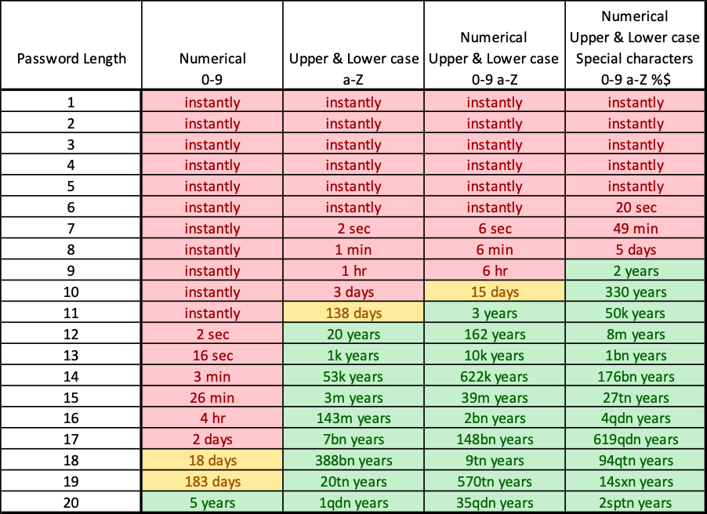
Password
Cracking
Time

Slide 43
kf;j8{ /fVbf Wofg lbg'kg]{ s'/fx?
s'g}klg l8S;g]/Ldf kfO{g] zAbx?sf] k|of]u gug'{xf];\ .
s'g}klg JolQmut ljj/0fx?sf] k|of]u e'n]/ klg gug'{xf];\ h:tf] cfkm\gf] gfd, y/, kl/jf/sf ;b:ox?sf] gfd, hGdldlt, df]afO{n gDa/, Nof08nfO{g gDa/, ufl8sf] gDa/ cflb .
lsaf]8{df kfO{g] cIf/sf nfO{gx? h:tf] 123456, 098765, qwert cflb .
;lhn} ;+u u]; ug{ ;lsg] lgDgfg';f/sf kf;j8{x?
  c+u|hL zAb password{
  ! b]lv ^ ;Ddsf c+sx?
  ^ b]lv ! ;Ddsf c+sx?
  Plal;!@#
  cfkm\gf] zx/sf] gfd
  cfkm\gf] sDkgLsf] gfd cflb .

Slide 44
kf;j8{ ;DjlGw s]lx ;'emfjx?M
s'g}klg sf/0f c? s;};+u -;flyefO{, kl/jf/sf ;b:o, lk|ohg, s'g}klg sDkgL tyf
j]a;fO{6 cflb _ cfkm\gf] kf;j8{ ;]o/ gug'{xf];\ .
;do ;dodf lgoldt ?kn] cfkm\gf] kf;j8{ kl/jt{g ug'{xf];\ .
kf;j8{nfO{ lj;{G5 ls eg]/ sbflk s'g}klg c;'/lIft 7fp+df n]v]/ g/fVg'xf];\ . k|foMh;f]
tkfO{+ xfld s'g}klg a}+ssf] ;]So'l/6L sf]8 xf]; of kf;j8{, cfkm\gf] 8fo/L, k;{, df]afO{n
cflbdf n]v]/ /fVg] ub{5f}+ . of] afgLnfO{ cfh} b]lv TofUg'xf];\ . olb tkfO{+sf] lj;{g] afgL 5 / w]/} kf;j8{x? 5g eg] To;sf] nflu cfkm'n] dfq a'em\g] efiffdf cfkm\g} sf]8 agfP/ n]v]/ /fVg ;Sg'x'G5 .
sDKo'6/df sfd ubf{ xf];\ of s'g}klg j]a;fO{6df, s'g}klg xfntdf c6f]d]l6s nucg, ;]e dfO{ kf;j8{, l/d]Da/ dfO{ kf;j8{ eGg] cK;gdf l6s gnufpg'xf];\ . k|foM dflg;sf] cfbt s] x'G5 eg] cf sDKo'6/df ;]e u/]/ /flvlbof] emGem6} ;fkm . To:tf] sfd sbflk gug'{xf];\

Slide 45
xfd|f] afgL s] 5 eg] kf;j8{ lj;{g ;lsG5 ls eg]/ h] df klg Pp6} kf;j8{ k|of]u ug]{ . ofx'df klg t]lx, x6d]ndf klg t]lx, o'6\o'adf klg t]lx, h] h] df kf;j8{ /fVg'kg]{ cjZyf cfp+5 ;a}df Pp6} . olb sydsbflrt s;}n]
kf;j8{ yfxf kfof] eg] s] xfnt x'G5 xf]nf <
sDKo'6/ of s'g}klg j]a;fO{6df sfd u/L ;s]kl5 ;fO{g cfp6 of nu cfp6 ug{ glj;{g'xf];\ .
O{d]n dfkm{t cfPsf cg'/f]wdf sbflk cfkm\gf] kf;j8{ / JolQmut ;"rgfx?
glbg'xf]nf .

Slide 46






;dfhdf ;fdflhs ;+hfnsf k|efjx?

Slide 47
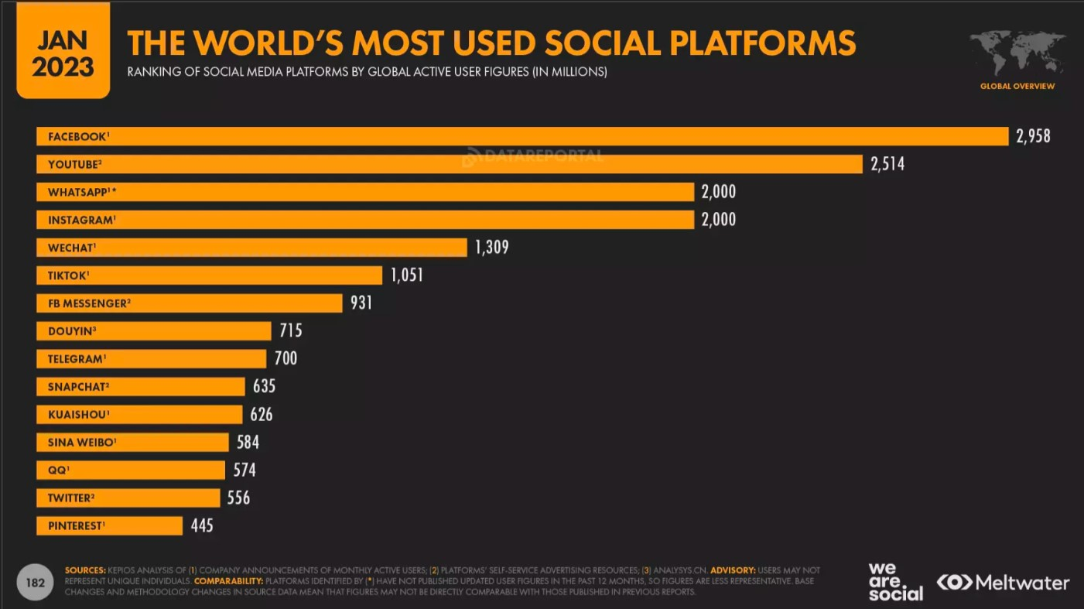

Slide 48
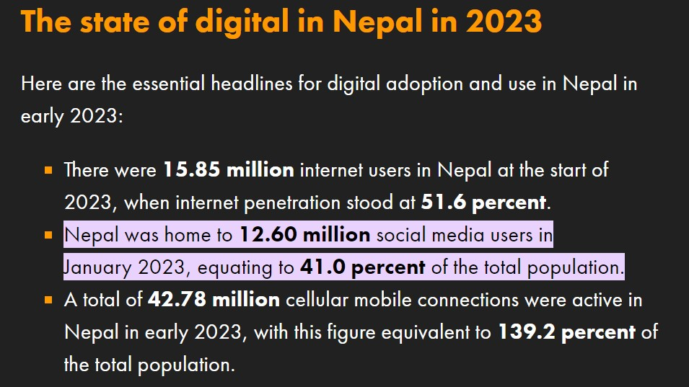

Slide 49
kl/ro
O{G6/g]6sf] k|of]un] cfhsf] ljZjnfO{ Pp6f ;fgf] sDKo'6/sf] afs;leq ;+s'lrt agfO{lbPsf]
5 . lxhf] ;Dd s'g} Jofkf/, Joj;fo, cf}iflw, pkrf/, ;ef, ;Dd]ng ug{ Ps b]z af6 csf]{
b]z ;Dd xhf/f}+ lsnf]ld6/ kf/ u/]/ hfg'kg]{ cjZyfnfO{ cfh Pp6f sf]7fdf a;]/ sDKo'6/ /
O{G6/g]6sf] ;xof]un] If0fe/ d} ;Dej agfO{lbPsf] 5 . cem ljleGg ;f];n g]6jls{ª ;fO{6sf]
ljsf;qmd ;+u} s'g}klg ;flyefO{, cfkmGtnfO{ e]6\g tyf ltgLx?sf] xfnva/ a'em\g 3/} 5f8]/ e]6\g hfg'kg]{ cjZyfsf] cGTo ePsf] 5 . ;fy} s'g}klg sDklg tyf ;+3;+:yfsf lqmofsnfkx? 3/} al; al; lgofNg tyf a'em\g ;Dej ePsf] 5 . cfhsf] lbgdf tkfO{+ xfdL hf] sf]xL klg
s'g} g s'g} ;f];n g]6jls{Ë ;fO{6sf] ;b:o ePsf 5f}+ / @$ 306fdf s'g} g s'g} ;do lgsfn]/ To;df ;xeflutf hgfO{/x]sf x'G5f}+ . cem cfhsf o'jflk9Lx? t 306f 306fsf] cGt/fndf o;df k|j]z u/]/ :6\of6; tyf sd]06x? r]s ul//x]sf x'G5g t sltn] cfkm\gf] kmf]g d} To:tf
;fO{6x?nfO{ nfO{e agfO{ x/kn cfkm'nfO{ ;Dks{df /fv]sf x'G5g\ .

Slide 50
;f];n g]6jls{· ;fO{6sf kmfO{bfx?M
!= ljZjJofkL ;Dks{ — cfkm'n] k|of]u ug]{ s'g}klg ;f];n g]6jls{Ë ;fO{6 dfkm{t ljZjsf]
s'g}klg s'gfdf /x]sf cfkmGt ;flyefO{x?;+u ;lhn} ;Dks{ :yfkgf ug{ ;lsG5 .
@= ;dfg ?lr ePsf JolQmx?sf] 5'6\6} ;d"x tyf ;+hfn — ;dfg ?lr ePsf tyf cfkm\gf
;flyefO{ tyf kl/jf/sf ;b:ox?nfO{ dfq ;dfj]z ul/ 5'6\6} u|‘'k agfO{ ;"rgfx? cfbfgk|bfg ug{
;lsG5 .
#= x/]sf knsf ;"rgfx?sf] cfbfgk|bfg — o:tf ;fO{6x?df k|To]s ;b:ox?n] s'g}klg a]nf
cfkm\gf] jfndf :6\of6; ck8]6 ug{ ;Sb5g . o;n] sf] ;fly s'gj]nf, sxf+, s] ul//x]sf] 5 eGg] s'/f
a'em\g ;lsG5 .
$= lgz'Ns lj1fkg tyf k|rf/ k|;f/ — tkfO{+n] o:tf ;fO{6x?df ;lhn} ;+u 5'6\6} k]hx?
agfO{ cfkm\gf] pTkfbg, Jofkf/, Joj;fosf] ultljwLx? ck8]6 ug{ tyf lj1fkg agfO{ /fVg ;lsG5 .
cfhsn s'g}klg lj1fkgx? kqklqsf, /]l8of], 6]lnlehgdf lbg'sf] ;6\6f w]/} eGbf w]/} ;b:ox?nfO{
cfkm\gf] ;+hfndf NofO{ o:tf ;fO{6x? dfkm{t lj1fkg ug'{ k|efjsf/L dflgG5 .

Slide 51
%= ;dfrf/x?sf] b|'t km}nfj6 — o:tf ;fO{6x?sf] k|of]un] ljZjsf] s'g 7fp+df s]
eO{/x]sf] 5 eGg] s'/fsf] hfgsf/L /]l8of], 6]lnlehg / kqklqsf eGbf rf+8f] yfxf kfpg
;lsG5 .
^= vr{sf] jrt — o:tf ;fO{6x?n] lgz'Ns ?kdf pknAw u/fPsf :k]; tyf
;b:otfsf sf/0f cfkm\gf] of cfkm\gf] kl/jf/sf ljljw ;dosf kmf]6f] tyf lel8of]x? cgnfO{g :6f]/ u/]/ /fVg ;lsG5 / cfjZostf k/]sf] a]nf k|of]u ug{ ;lsG5 . ;fy} e]63f6sf vr{x?sf] jrt x'G5 .

Slide 52
a]kmfO{bfx?M
!= ;fdflhs sfo{df ;xeflutfsf] sdL — o:tf ;fO{6x?sf] k|of]un] k|of]ustf{nfO{ hlta]n} klg
sf]7fdf l;ldt /fVg] ePsf]n] 3/df sf] cfof], uof] To;sf] s'g} dtna x'+b}g / s'g} ;fdflhs sfo{df s'g} ?lr /fVb}gg\ . pgLx?nfO{ cfkm\gf] sDKo'6/, O{G6/g]6 / To:tf ;fdflhs ;+hfnx? g} cfkm\gf] kl/jf/ nfUb5 .
@= g}/fZotf — cfkm\gf ;flyefO{ tyf cfkmGtx?n] cfkm' ljleGg 7fp+x? 3'Dg, /]i6'/]G6, l8:sf],
lkslgs, kfl6{ cflb 7fp+x?df uPsf, /fd|f /fd|f n'uf tyf uxgfx? nufPsf] kmf]6f]x? cknf]8 u/]sf] b]Vbf / cfkm'nfO{ To;sf] a/fa/Ldf gkfp+bf g}/fZotfn] uf+h]sf] x'G5 . ;fy} cfkm'n] cknf]8 u/]sf :6\of6;, kmf]6f] tyf lel8of]df slt nfO{s tyf sd]G6x? cfP < c? ;flysf] :6\of6; / kmf]6f]df a9L nfO{s / sd]G6 cfpg]
cfkm\gf]df r}+ lsg sdL eGg] dgf]j}1flgs c;/ k/]sf] x'g ;Sb5 .
#= zf/Ll/s Jofofdsf] sdLn] sdhf]/L, dGb a'l4, clgb|f — o:tf ;fO{6x?sf] k|of]un] v]Ng] s'b\g]
;dosf aRrfx? aflx/ v]Ng / s'b\g eGbf sf]7fd} a:g ?rfp+5g / o;sf] kmn:j?k zfl//Ls Jofofdsf]
sdLn] c?lr, ckr, clgb|f cflbsf] ;d:of b]vf kb{5g . o;n] a'l4 ljsf;df ;d]t afwf k'/\ofp+b5 .

Slide 53
$= lg0f{o tyf tfls{s Ifdtfdf sdL — aflx/L ;+;f/df 3'nldn Psbd} sd ePsf sf/0f
dflg; Psf]xf]/f] ePsf] x'G5 h;sf] sf/0f s'g}klg lg0f{o lng c?sf] ;xof]u vf]Hb5 ;fy} tfls{s
Ifdtfsf] Xf; x'G5 .
%= jfbljjfb tyf ;ef ;Dd]ngdf c?lr — hj dflg; ;dfh tyf kl/jf/df 3'nldn x'g sd ub{5 o;n] dflg;nfO{ Psnsf+6] agfO{lbG5 . pgLx? s;} ;+u s'g} ljjfb ug{ rfxb}gg tyf
s'g} ;ef ;Dd]ngdf efu lng dg k/fp+b}gg . o:tf ;fO{6x?df cfkm'nfO{ dg gkg]{ dflg;nfO{
;lhn} cgkm|]G8 tyf cgkmnf] ug]{ ;lhnf] dfWod pknAw ePsf] x'+bf s'g}klg ljifodf sf]lx ;+u
jx; ug{ ?rfp+b}g a? kg k/]g ls cgkm|]G8 tyf cgkmnf] ulb{of] a;\ .
^= ;fO{a/ qmfO{d, a'lnª\ — o:tf ;fO{6x?df ;a}vfn] dflg;x? pknAw x'g] x'+bf s;sf]
lgot s:tf] 5 eGg] s'/f yfxf x'+b}g . ljleGg kfln;] s'/fx? u/]/ tyf em'7f l:sdx?sf] e|d
km}nfP/ Psn] csf{nfO{ n'6\g] sfd e}/x]sf] x'G5 . xfn;fn} g]kfndf cfof]hgf x'g nfu]sf] elgPsf]
elh{g ;]S; kfl6{sf] ;dfrf/n] o:tf s'/fx?sf] k'li6 ub{5 . ;fy} Psn] csf{nfO{ xf]Rofpg], p8fpg], wDsL lbg] cflb unt sfo{x? klg x'g] ub{5g\ .

Slide 54
&= JolQmut ;"rgfsf] cgflws[t k|of]u — tkfO{+n] cknf]8 ug'{ePsf tkfO{+sf JolQmut
;"rgfx?sf] b'?kof]u ul/ c?n] kmfO{bf lnO{/x]sf x'G5g\ . tkfO{+n] cfkm\gf] k|f]kmfO{ndf s'g} O{d]n P8«]; of kmf]g g+ /fVg'ePsf] 5 eg] y8{ kf6L{x?n] tkfO{+sf] cg'dlt ljgf g} tkfO{+sf] O{d]n P8«]; of kmf]g g+ sf] k|of]u ul/ O{d]n tyf Dof;]h k7fpg] ub{5g\ . sltko sDklgn] t tkfO{+nfO{ yfx} glbO{ tkfO{+sf] kmf]6f] nfO{ cfkm\gf] sDklgaf6 pTkflbt ;fdfu||Lx?sf] lj1fkgdf k|of]u ul/ kmfO{bf p7fO{ /x]sf x'G5g . ;fy} tkfO{+sf] kmf]6f] k|of]u ul/ km]s cfO{l8 agfO{ tkfO{+sf] gfddf kmfO{bf p7fO{/x]sf x'G5g\ .
*= ;dosf] gf]s;fgL — xfn} ul/Psf] ;j]{If0f cg';f/ o:tf ;fO{6x?sf k|of]ustf{x?n]
cf};t?kdf Pshgfn] xKtfsf] @) 306f ljtfpg] ub{5g\ . cem #) k|ltzt /]u'n/ k|of]ustf{x?n] t lbgs} sDtLdf # b]lv $ 306fsf] b/n] ;do gi6 ul//x]sf x'G5g . ca cfkm}+ lx;fa ug'{xf]; xfd|f] h:tf] ljsf;f]Gd'v b]zsf] nflu pQm ;do slt dxTjk"0f{ ;fljt x'GYof] xf]nf .
(= cgfjZos lj1fkgsf] l;sf/ — o:tf ;fO{6x?n] ljleGg lj1fkgx? cfkm\gf] k]hdf ljgf cg'dlt /flvlbg] ub{5g\ . s'g} s'g} lj1fkg t xfd|f] ;fdflhs w/ftn eGbf dfly p7]/ agfO{Psf
x'G5g o;n] gsf/fTds c;/ kfg'{sf ;fy} cfkm\gf] k]hdf ePsf sf/0f cgfjZos lbdfuL af]em
yf]kl//x]sf x'G5g\ .

Slide 55
!)= unt ;dfrf/sf] l;sf/ — o:tf ;fO{6x?df s'g}klg ;"rgfx? cgnfO{ kf]i6 ul/g]
x'+bf To;sf] j}wflgstf x'+b}g t/ ltg} ;"rgfsf] cfwf/df s'g}klg ;dfrf/x? cfuf] km}lnP h:tf] km}lnPsf x'G5g .
!!= >Ldfg >LdtL aLrsf] ;DaGwdf lr;f]kg
o;sf cltl/Qm s;}n] u/]sf cknf]8x?df sd]G6 ubf{ cfkm' pQm JolQmsf] ;fd'Gg] geO{ ul/g]
x'+bf pQm cfkm'n] u/]sf] sd]G6n] gsf/fTds c;/ kfg{ ;Sb5 / o;sf] kmn:j?k p;n]
tkfO{+nfO{ Ans of cgkm|]G8 ug{ ;Sb5 . olb pQm s'/f tkfO{+nfO{ yfxf eof] eg] b'O{hgfsf] lar 6s/fj pTkGg x'g hfG5 . ;fy} tkfO{+sf uf]Ko kmf]6f]x? c? s;}n] cknf]8 u/]sf] cjZyfdf
tkfO{+ / tkfO{+sf] kl/jf/ lar kmf6f] cfpg ;Sb5 . o;sf cltl/Qm kl/jf/sf ;a} ;b:ox?
cgnfO{gdf Jo:t x'+bf vfgf slta]nf lr;f] ePsf] x'G5 s;}nfO{ kQf] x'+b]g clg hf] cgnfO{g
x'+b}g p;nfO{ s:tf] cg'ej x'G5 xf]nf<
t;y{ s'g}klg s'/f lnld6 df u/]sf] /fd|f] x'G5 . ;f];n g]6jls{Ë ;fO{6 s] sf nflu agfO{Psf]
xf] / slt ;do vr{ ubf{ plrt x'G5 eGg] s'/f :jo+ tkfO{n] lgwf{/0f ug]{ s'/f xf] .

Slide 56
ckgfpg' kg]{ ;fjwfgLx?M
cgfjZos kmf]6f] tyf lel8of]x? cknf]8 gug'{xf];\ .
lghL O{d]n P8«];, hGdldlt tyf JolQmut kmf]gg+ x? e'n]/ klg cknf]8
gug'{xf];\ .
a}+lsË· hfgsf/L sbfkL s;}nfO{ cgnfO{g glbg'xf];
s;}sf] :6\of6; tyf cknf]8x?df w]/} ljrf/ ljd;{ ul/ dfq sd]G6 ug'{xf];\ .
s;}n] k|m]G8 l/Sj]:6 k7fPsf] 5 eg] tkfO{+n] pQm JolQmnfO{ lrg]sf] 5 eg] dfq
l:jsf/ ug'{xf];\ . Do'rn k|m]G8 w]/} ePtfklg pQm JolQmnfO{ tkfO{+n] glrg]sf] x'g ;Sb5 .
s'g}klg k]hx?nfO{ nfO{s ug]{ l/Sj]:6 cfof] eGb}df ljrf/ gu/L nfO{s
gug'{xf];\ .

Slide 57
o:tf ;fO{6x?sf] kf;j8{ j]nf j]nf kl/jt{g ub}{/xg'xf];\ .
cgnfO{g dfkm{t cfPsf s'g}klg ln+sx?df hyfeflj lSns gug'{xf];\ .
uf]Ko ;"rgfx? slxn] klg cfbfg k|bfg gug'{xf];\ .
o:tf ;fO{6x?df k|fKt x'g] cgfjZos PlKns]zgx? 8fpgnf]8 gug'{xf];\ . To:tf PlKns]zgx?n] tkfO{+sf] JolQmut ljj/0f k|of]u ug]{ cg'dlt dfu]sf x'G5g . tkfO{+nfO{ :kfd d]nx? cfpg] k|d'v sf/0f log} x'g] ub{5g\ .
ufnL, c;Eo tyf ceb| zAbx?sf] sbfkL k|of]u gug'{xf];\ .
kn kndf cfkm' /x]sf] nf]s]zgsf] af/]df hfgsf/L gu/fpg'xf];\ .
o:tf ;fO{6x?df ;s];Dd sd ;do Joltt ug'{xf];\ .

Slide 58
;fO{a/ ck/fw ;DaGwL k|d'v sfg'gx?
ljB'tLo sf/f]af/ P]g, @)^#
d'n'sL ck/fw ;+lxtf, @)&$
d'n'sL b]jfgL ;+lxtf, @)&$
k|ltlnkL clwsf/ P]g, @)%(
k|df0f P]g, @)#! -@-u_
a}lÍª s;"/ tyf ;hfo P]g, @)^$

Slide 59
ljB'tLo sf/f]af/ P]g, @)^# / sDKo'6/ ;DaGwL s;'/ tyf ;hfo

Slide 60
s;"/ | ;hfoF
sDKo'6/ ;|f]t ;Í]tsf] rf]]/L, gi6 jf kl/jt{g -bkmf $$_ | # aif{ h]n ;hfoF jf @ nfv ;Ddsf] hl/jfgf jf b'j}
sDKo'6'6/ ;fdu|Ldf cglws[t kx'Fr -bkmf $%_ | # aif{ h]n ;hfoF jf @ nfv ;Ddsf] hl/jfgf jf b'j
sDKo'6/ / ;"rgf k||0ffnLdf Iflt k''¥ofpg] -bkmf $^_ | # aif{ h]n ;hfoF jf @ nfv ;Ddsf] hl/jfgf jf b'j
ljB''tLo :j?kdf u}sfg"gL s''/f k|sfzg ug]{ -bkmf $&_ | % aif{ h]n ;hfoF jf ! nfv ;Ddsf] hl/jfgf jf b'j}
uf]kgLotf eË ug]{ -bkmf $*_ | # aif{ h]n ;hfoF jf @ nfv ;Ddsf] hl/jfgf jf b'j
e'm7f Joxf]]/fsf] ;"rgf lbg] -bkmf $(_ | @ aif{ h]n ;hfoF jf ! nfv ;Ddsf] hl/jfgf jf b'j}
e'm7f Ohfhtkq jf k||df0fkq k]z ug]{ jf b]vfpg]-bkmf %)_ | @ aif{ h]n ;hfoF jf ! nfv ;Ddsf] hl/jfgf jf b'j}
tf]lsPsf] ljj/0f jf sfuhft bflvnf gug]{ -bkmf %!_ | %) xhf/ ;Ddsf] hl/jfgf
sDKo'6'6/ hfn;fhL ug]{ -bkmf %@_ | lauf] s;"/ ug{]af6 e/fO{ Ps nfv ?k}ofF;Dd hl/afgf jf b'O{ jif{;Dd s}b jf b'j}
o; P]g cGtu{t s;"/ 7xl/g] s'g} sfd cGo s'g} k|rlnt sfg"g adf]lhd klg s;"/ 7xl/g] /x]5 eg] To:tf] s;"/ pk/ 5'6[} sf/afxL rnfO{ ;hfo ug{ ;lsG5 .

Slide 61
d'n'sL kmf}hbf/L -;+lxtf_ P]g, @)&$

Slide 62
clZnn lstfa, krf{ OToflb agfpg jf laqmL ug{ gx'g] -bkmf !@!_
-!_-s_ zf/Ll/s sfdfQ]h]gf a9fpg] jf sfdjf;gfdf cfzQm u/fpg] jf rl/qxLg agfpg] s'g} cZnLn lstfa, krf,{ /]vflrq, rnlrq, t:jL/, /]s8{ jf c? s'g} j:t' agfpg, d'b|0f ug{ jf k|sflzt ug{ jf ljB'tLo ;~rf/ dfWodaf6 k|rf/ k|;f/ ug{,
-v_ To:tf] cZnLn j:t' v/Lb laqmL jf ljt/0f ug{ jf ef8fdf lbg jf ;j{ ;fwf/0fnfO{ b]vfpg jf To:tf] ug{] lgotn] cfkm\gf] ;fydf /fVg,
-u_ s'g} JolQmaf6 To:tf] clZnn j:t' o; k|sf/ k|fKt x'g ;S5 egL lj1fkg lbg,
-3_ To:tf] clZnn j:t' laqmL ljt/0f ug]{ p2Z]on] lgsf;L jf k}7f/L ug{ jf cfk"m;Fu af]Sg .
-@_ s;/" ug]{ jf u/fpg] JolQmnfO{ Ps jif{;Dd s}b jf bz xhf/ ?k}ofF ;Dd hl/afgf jf b'j} ;hfo x'g]5 .
-#_ o; bkmfdf cGoq h'g;'s} s'/f nl]vPsf] ePtfklg j}1flgs, z}lIfs, snfTds, ;flxlTos, cg';Gwfg d"ns, 1fgj4{{s dxTj jf cle?rLsf] jf wfld{s k|of]hgsf] nflu /flvPsf] jf agfOPsf] s'g} s[ltsf] xsdf o; bkmfsf] Joj:yf nfu" x'g] 5}g .

Slide 63
csf{sf] s'/f ;'Gg jf WjgL c+sg ug{ gx'g] -bkmf @(#_
-!_ s;}n] b'O{ jf b'O{ eGbf a9L JolQmx?sf] ljrdf ePsf s'g} s'/f clwsf/ k|fKt clwsf/Lsf] cg'dltn] jf To;/L s'/f ug]{{ JolQmx?sf] d~h'/L ljgf s'g} oflGqs pks/0fsf] k|of]u u/]/ ;'Gg jf To:tf] s'/fsf] WjgL c+sg ug{ x'Fb}g .
-@_ pkbkmf -!_ adf]lhdsf] s;"/ ug]{ jf u/fpg] JolQmnfO{ b'O{ jif{ ;Dd s}b jf aL; xhf/ ?k}ofF ;Dd hl/jfgf jf b'j} ;hfo x'g]5 .
t/ ;fj{hlgs ?kdf ul/Psf] efif0f jf jQmJosf] xsdf of] bkmf nfu" x'g] 5}g .

Slide 64
cg'dlt ljgf s'g} JolQmsf] tZjL/ lvRg jf tZjL/sf] :j?k ljufg{ gx'g] -bkmf @(%_
!_s;}n] s'g} JolQmsf] cg'dlt ljgf tZjL/ lvRg jf lghsf] tZjL/;Fu c? s;}sf] tZjL/ /fvL csf]{ tZjL/ agfpg x'Fb}g .
t/, s;}n] s'g} ;fj{hlgs :yfgsf] tlZj/ lvRbf To:tf] :yfgdf /x]sf] s'g} JolQm ;d]tsf] tlZj/ lvlrg uPsf] /x]5 eg] o; bkmf adf]lhd s;"/ u/]sf] dflgg] 5}g .
-@_pkbkmf -!_ adf]lhdsf] s;"/ ug{] jf u/fpg] JolQm nfO{ Ps jif{ ;Dd s}b jf bz xhf/ ?k}ofFF ;Dd hl/jfgf jf b'j} ;hfoF x'g]5 .
-#_ s;}n] Pssf] t:jL/sf] s]xL efu csf{] JolQmsf] csf]{ efu;Fu /fvL jf cGo s'g} lsl;dn] ljs[t ?ksf] t:jL/ agfpg jf k|sfzg ug{ xF'b}g .
-$_ pkbkmf -#_ adf]lhdsf] s;"/ ug]{ jf u/fpg] JolQmnfO{ b'O{ jif{ ;Dd s}b jf aL; xhf/ ?k}ofFF;Dd hl/afgf jf b'j} ;hfo x'g]5 .

Slide 65
cg'dlt ljgf Pssf] t:jL/ c?nfO{ lbg jf laqmL ug{ gx'g] -bkmf @(^_
-!_ s;}n] s'g} JolQmsf] t:jL/ lghsf] cg'dlt ljgf c?nfO{ lbg jf laqmL ug{ jf lghnfO{ lememo\fpg jf ;tfpg], x}/fg kfg]{ jf lghaf6 s'g} cg'lrt kmfO{bf lng] jf tZjL/sf] Jofkfl/s k|of]u u/L kmfO{bf lng lgotn] k|sfzg ug{ k|rf/ jf vl/b laqmL ug{ x'Fb}g .
-@_pkbkmf -!_ adf]lhdsf] s;"/ ug]{ jf u/fpg] JolQmnfO{ tLg jif{ ;Dd s}b jf tL; xhf/ ?k}ofFF;Dd hl/jfgf jf b'j} ;hfo x'g]5 .

Slide 66
ufnL ug{ gx'g] -bkmf #)%_
-!_ s;}n] s;}nfO{ ufnL ug{ x'Fb}g .
-@_ pkbkmf -!_ sf] k|of]]hgsf]nflu s;}n] s;}nfO{ xf]Rofpg] lgotn] af]nL jf jrgn] ckdfghgs zAb k|of]u u/]df lghn] ufnL u/]sf] dflgg]5 .
-#_ pkbkmf -!_ adf]lhdsf] s;"/ ug{] jf u/fpg] JolQmnfO{ Ps jif{;Dd s}b jf bz xhf/ ?k}ofF ;Dd hl/afgf jf b'j} ;hfo x'g]5 .

Slide 67
a]OHhtL u/]sf] dflgg]
-s_ c?sf] OHhtdf wSsf k'¥ofpg] lgotn] jf wSsf k'Ug ;S5 eGg] hfgLhfgL jf ljZjf; ug]{ dgfl;a sf/0f eO{ n]v]/ , cfr/0f jf cfsf/ jf lrXg jf k|rf/ k|;f/åf/f jf c? s'g} lsl;daf6 k|ToIf jf ck|ToIf ?kn] To:tf] JolQmnfO{ c?sf] bl[i6df lghsf] JolQmut rl/q, cfr/0f, g}ltstf jf VofltnfO{ xf]Rofpg] u/L rl/q xTof u/]df jf lghsf] z/L/ ;fdfGotM 3l[0ft cj:yfdf 5 eGg] c?nfO{ ljZjf; kg{] u/L bf]if nufPdf jf To:tf] bfi]f nufPsf] s'/f k|rf/,k|;f/ jf k|sfzg u/]df jf s;}sf] a]OHhtL x'g] ;fwgsf] ?kdf k|of]u ul/Psf] s'g} lrh hfgLhfgL laqmL jf lat/0f u/]df,

Slide 68
a]OHhtL u/]sf] dflgg] ===
-v_ d[tsnfO{ s'g} cfIf]k nufOPsf]df To:tf] cfIf]k nufpFbfsf avt lgh hLljt /x]sf] eP lghsf] OHhtdf wSsf k'Ug] /x]5 eGg] hfgL hfgL lghsf] kl/jf/ jf glhssf] cGo gft]bf/x?sf] efjgfdf rf6] k'¥ofpg] lgotn] s'g} cfIf]k nufPsf]df,
-u_ Jo+Uo u/L jf c? s'g} 3'dfp/f] tj/n] s'g} cfIf]k nufPdf .

Slide 69
xbDofb
ljB'tLo sf/f]af/;Fu ;DalGwt s;"/ 7xg]{ s'g} s'/f ePsf]df To:tf] pNn+3g jf s;"/ eP u/]sf] yfxf kfPsf] ldltn] k}+tL; lbgleq ph'/ ug'{ k5{ .

Slide 70
b'?T;fxg tyf dltof/
ljB'tLo sf/f]af/ P]g adf]lhdsf] s'g} s;"/ ug{ s;}nfO{ b'?T;fxg ug]{ jf To:tf] s;"/ ug{ pBf]u ug]{ jf if8\oGqdf ;fd]n x'g] JolQmnfO{ s;"/sf] dfqf x]/L krf; xhf/ ?k}ofF;Dd hl/afgf jf 5 dlxgf;Dd s}b jf b'j} ;hfo x'g]5 . -bkmf %#_
P]g adf]lhdsf s'g} s;"/ ug{ ;3fpg] jf cGo s'g} Joxf]/fn] dltof/ eO{ sfo{ ug]{ JolQmnfO{ d'Vo s;"/bf/nfO{ ePsf] ;hfosf] cfwf ;hfo x'g]5 . -bkmf %$_

Slide 71
cbfntL cEof;
! Rof6
@ ;f];{sf]8
# a}+ssf] 8f6f
$ cfO{P;kLsf] 8f6f
% s]6L ;fyLsf] lel8of]
^ /fhgLlt1 ;DaGwL
& k|x/Lsf] sDKn]g

Slide 72
Reporting to Cyber Bureau
साइबर ब्यूरो - CONTACT US
Contact Us
Mobile Number (Field Officer) : 9851286771
Mobile Number (Duty Officer) : 9851286770
Phone Number: 01-5319044
Email: cyberbureau@nepalpolice.gov.np

Slide 73

Any Questions???
Thank You

