Slide 1


Data Centre
Infrastructure and
Components
Data Centre | Smart City Consultant
Hemanta Baral
Certified Data Centre Professional (CDCP)

Slide 2








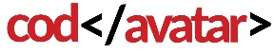
Hemanta Baral
Masters in Computer Network Security (UK) with over 28 years of ICT experience; trusted by national agencies for data centre advisory
DATACENTRE/ Smart City Consultant/ Auditor FOR:
Department of Customs (DoC)
Civil Aviation Authority of Nepal (CAAN)
Contact:
Department of Transport Management (DoTM)
Rastriya Banijya Bank Limited (RBBL)
9843067142
hemanta.baral@gmail.com
www.hemantabaral.com.np
Government’s Integrated Data Centre (GIDC/NITC)
Office of Attorney General (OAG), funded by DFID, UK
Digital Karnali, Hetauda & Budhanilkantha Metropolitan City

Slide 3
Data Centre
It is a centralized, high-security facility engineered to house an organization’s most critical IT infrastructure, including servers, storage arrays, and telecommunications hardware.
To ensure maximum uptime and data integrity, these environments are equipped with:
- Power Resilience: Redundant power supplies supported by robust backup systems.
- Climate Control: Precision Air Conditioning (PAC) and redundant cooling architectures.
- Safety & Security: Automated fire detection/suppression, biometric access control, and 24/7 CCTV surveillance.
- Infrastructure Monitoring: Comprehensive environmental tracking, including Water Leak Detection (WLD), Automatic Rodent Repellent (ARR), and real-time temperature/humidity sensors.

Slide 4


Major Categories
Depending on who owns them and how they are used
Data Centre Infrastructure
Cloud Data Centres
Key Infrastructure Features
Provider Hosted Services
1.
Secure physical space
1.
Operated by Cloud Service Providers like: AWS, Azure, Google
2.
Power and cooling systems
3.
Connectivity and management for servers, storage, and network systems
2.
Massive scale for millions
3.
Remote resource access
4.
Can design and develop own Enterprise Cloud.

Slide 5
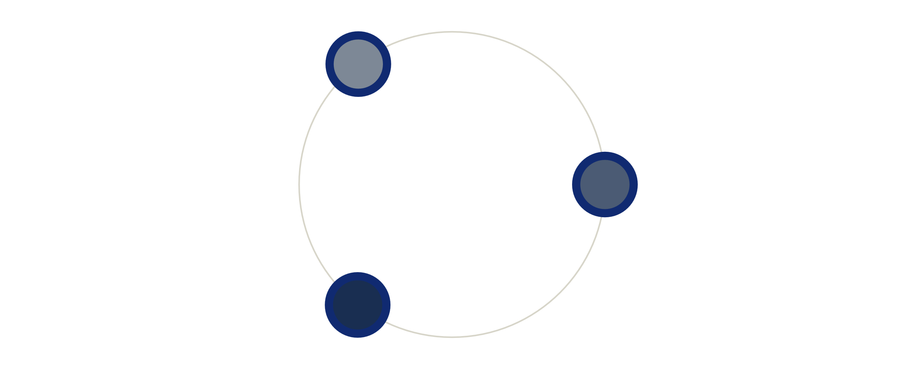



The Three Primary Layers of
Data Centre Architecture
IT Infrastructure
Computers, servers, storage, network & security systems that perform computations and hold vast data.
Support Infrastructure
Critical power supplies, cooling systems, and physical security measures for facilities.
Software Layer
Management software monitoring energy usage, temperature, and overall server health.

Slide 6

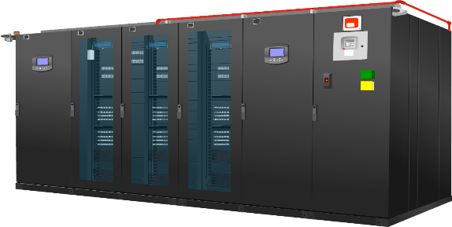
DC Infra Solutions
An overview of three distinct facility deployment strategies for modern data center architecture, ranging from onsite construction to portable, integrated containerized systems.
Conventional
Pre-fabricated Modular
Room or building based solution where every component is installed manually and separately.
Single unit housing major passive DC components, delivered to sites for immediate deployment.

Slide 7
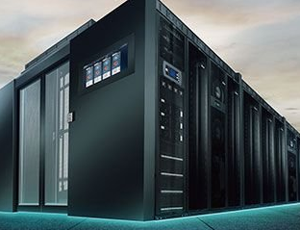
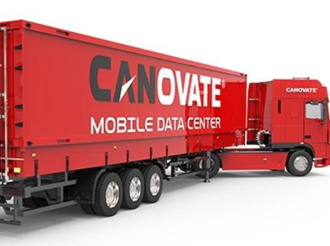
Modular/Mobile Data Centre
Fre-fabricated Modular DC
Container/Mobile DC

Slide 8




Industry Compliance Standards
Globally Accepted
Data Centre
Semi-Standards Overview
TIA-942
ISO/IEC 22237
Telecommunications Industry Association standard provides specific ratings for facility infrastructure.
An international standard offering a holistic approach to the planning, construction, and operation of data center facilities.
Key Compliance and Security Standards
EN 50600
ISO 27001: Covers Information Security Management Systems (ISMS).
SOC 2: Focuses on security, availability, and processing integrity.
PCI DSS: Mandatory for data centers handling credit card information.
GDPR: Crucial for data privacy in European operations
A European series of standards covering building construction, power supply, environmental control, and security systems.
Vendor Guidelines
Proprietary frameworks from Uptime Institute, Oracle, IBM, HP, and APC-Schneider guide facility tiers.
ASHRAE 90.4-2019
Energy-efficiency standard specifically for data center mechanical and electrical systems.

Slide 9

Data Centre
Tier (Rating) Overview
2
1
Single path with N+1 redundant components.
Single path for power and cooling; no redundancy.
4
3
Fault-tolerant with multiple active paths.
Understanding the infrastructure standards defined by the Uptime Institute for data centre reliability, ranging from basic single-path systems to fully fault-tolerant, multi-path environments.
Multiple power/cooling paths; concurrently maintainable.

Slide 10
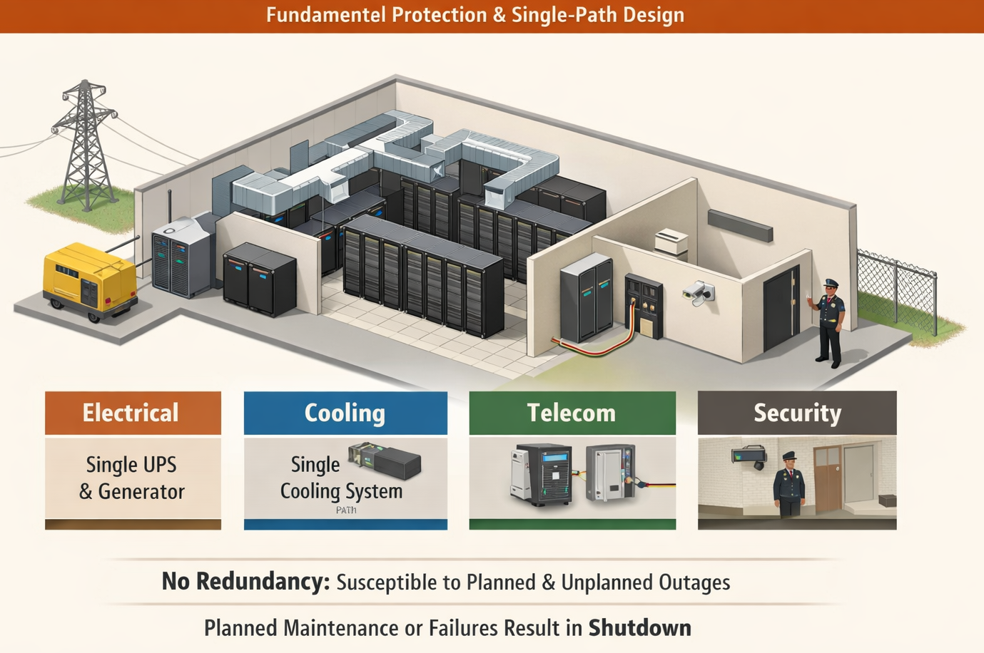




A Tier I data center operates with a single path (N capacity) and lacks redundancy. It is highly susceptible to disruptions from both planned maintenance and unexpected system failures, leading to an expected availability of approximately 99.671%.
Data Center Standards
Tier I DC Infrastructure
Single Path Design
No Redundant Units
Utilizes a single path for power distribution without any redundant modules or backup generators.
Features a single path for cooling distribution and lacks redundant cooling units for support.
Single Entrance
Basic Security
Restricted to a single entrance room and pathway for all telecommunications infrastructure needs.
Maintains only basic physical security standards and lacks any dedicated or isolated zoning.

Slide 11
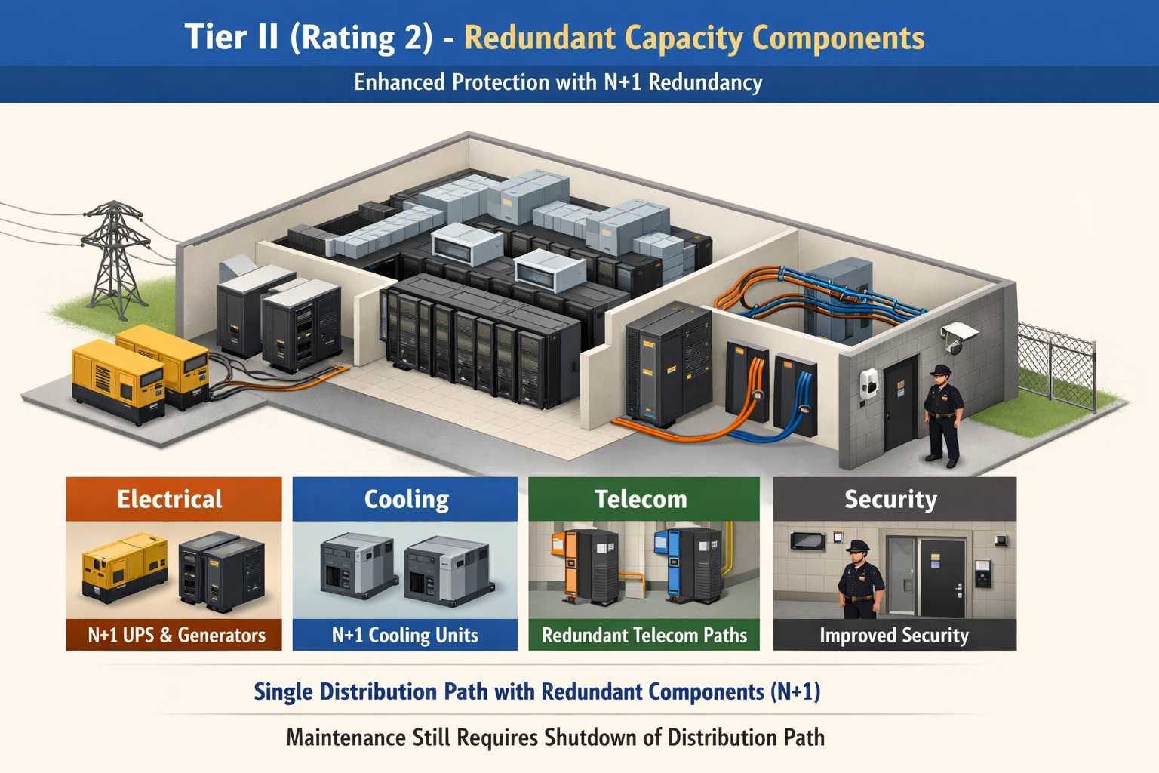




Facility Standards
Tier II: Component
Redundancy
Tier II facilities introduce N+1 redundancy for critical components while maintaining a single distribution path. This design ensures individual component failure does not cause downtime, though path maintenance requires a shutdown. Availability is rated at approximately 99.741%.
N+1 Power Systems
Redundant Cabling
Physical Protection
N+1 Cooling Units
Incorporates enhanced physical security measures and reinforced structural protection to secure critical assets.
Utilizes a single active distribution path featuring redundant critical components, such as generators and UPS units.
Relies on a single cooling distribution path equipped with redundant chillers or CRAC units for climate stability.
Features a single primary entrance room while implementing redundant pathways to ensure reliable cable routing.

Slide 12
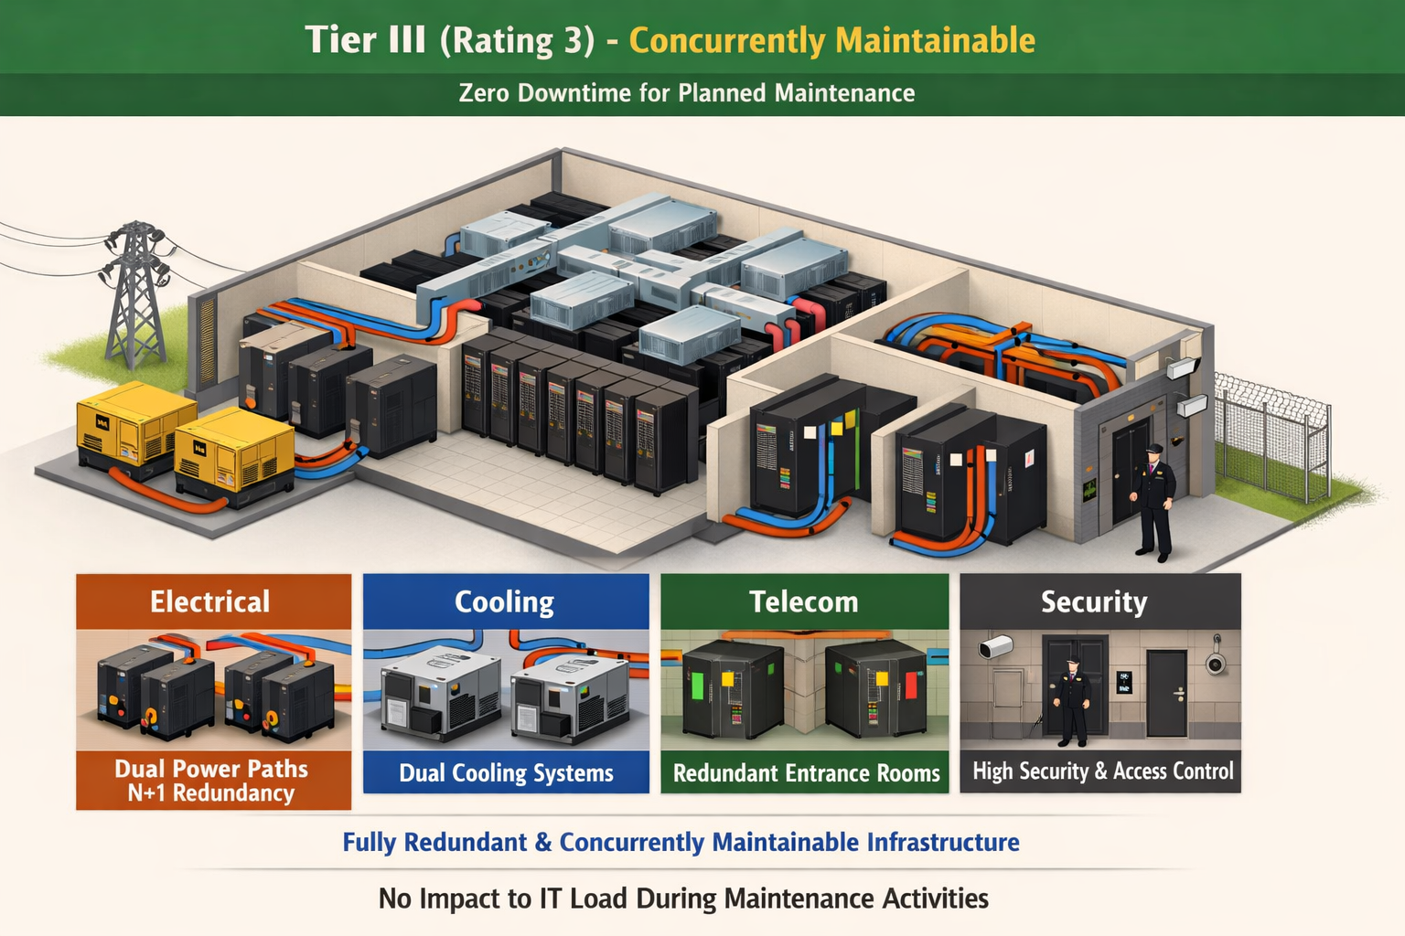



Data Center Standards
Tier III Data
Center Design
Tier III classification enables concurrent maintainability, ensuring that planned maintenance activities on power or cooling infrastructure can occur without disrupting the critical IT load. This redundancy model provides an expected uptime availability of approximately 99.982%.
Redundant Distribution
Cooling Redundancy
Entrance Rooms
Facility Security
Utilizes multiple independent distribution paths including one active and one alternate.
Multiple independent cooling distribution paths with dual-powered IT equipment systems.
Requires fully redundant entrance rooms and physically separated infrastructure pathways.
Dedicated facility structure with high-level physical security including biometric logs.

Slide 13




Tier IV - Fault
Tolerant Infrastructure
Breakdown
Redundant Power Paths
Utilizes multiple, physically isolated active paths with 2N or 2(N+1) redundancy levels.
Active Cooling Systems
Features multiple cooling paths with automatic failure detection and load shifting tech.
Diverse Network Routes
Requires redundant entrance rooms, pathways, and MDAs using distinct, isolated routes.
Analyze the rigorous requirements for Tier IV infrastructure, designed to sustain unplanned failures with zero impact and maintain 99.995% availability.
Maximized Security
Systems are physically separated into distinct fire and security zones for protection.

Slide 14
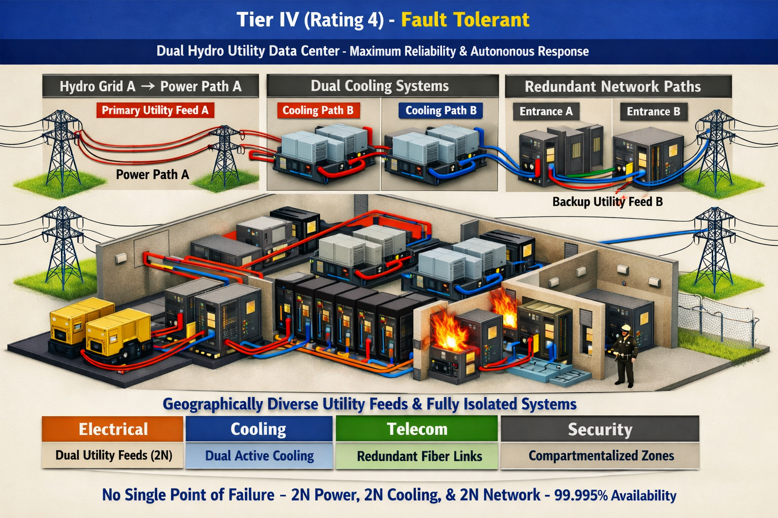

Slide 15




Core Requirements for Tier IV DC
Limitations
स्वतन्त्र शक्ति स्रोत
NEA राष्ट्रिय ग्रिड
Tier IV को लागि दुईवटा पावर स्रोत पूर्ण रूपमा स्वतन्त्र र भौगोलिक रूपमा भिन्न हुनुपर्छ।
नेपालका सबै सबस्टेशनहरू एउटै केन्द्रीय ग्रिडमा जोडिएका छन्, जुन Tier IV का लागि चुनौती हो।
ग्रिड निर्भरता
ब्याकअपको सीमा
एउटै राष्ट्रिय ग्रिडमा जोडिएका स्रोतहरूलाई Tier IV का लागि 'स्वतन्त्र' मानिँदैन।
डिजेल वा ब्याट्री ब्याकअपहरू केवल 'ब्याकअप' हुन्, यिनीहरू 'स्वतन्त्र सक्रिय स्रोत' होइनन्।
जलविद्युत चुनौती
एकै ग्रिड असफलता
छुट्टाछुट्टै हाइड्रो प्लान्टबाट समर्पित लाइन आएमात्र Tier IV मापदण्ड पूरा गर्न सकिन्छ।
एउटा मात्र ग्रिड फेल हुँदा दुवै पावर स्रोतहरू एकैसाथ असफल हुन सक्ने जोखिम रहन्छ।

Slide 16
हालको अवस्था
नेपालको पूर्वाधारमा Tier IV प्रमाणीकरण प्राप्त गर्न विद्यमान ग्रिड प्रणाली र पावर स्रोतका चुनौतीहरूको विश्लेषण।
विवरण
वर्तमान अवस्था
Independent Power
दुई छुट्टाछुट्टै स्रोत उपलब्ध छैन
NEA Substations
एउटै ग्रिडका कारण जोखिम
Practical Maximum
हाल Tier III मात्र सम्भव
Tier IV को शर्त
डेडिकेटेड ट्रान्समिसन लाइन आवश्यक
Future
पूर्वाधार विकास पछि मात्र सम्भव

Slide 17
Tentative Costing
Data Centre Type | Density (kW/Rack) | Qty (Racks) | Per Rack Cost (NPR) | Total Cost (NPR) | Total Power Required in kW
Conventional | 10 kW | 100 | 2.5 Crore | 250 Crore | 15 kW/ Rack (with 1.5 PUE) Modular/ Container: PUE 1.2 to 1.3
Modular | 15 kW | 20 | 3.5 Crore | 70 Crore
Container (20ft) | 15 kW | 6 | 7.5 Crore | 45 Crore
Container (40ft) | 15 kW | 12 | 7.75 Crore | 95 Crore
These prices are "all-inclusive" of:
CapEx: Design, Civil/Container work, High-density Power & Cooling.
OpEx Support: 3 years of after-sales maintenance and a critical spare parts inventory.
Compliance: Designed to Tier III standards with N+1 redundancy.

Slide 18





नेपाल Tier IV नीति तथा पूर्वाधार
Policy and Infrastructure Requirements for Tier IV Development
नियामक सुधार
नीति प्रोत्साहन
निजी क्षेत्र (IPPs) लाई सीधा विद्युत बिक्री अनुमति दिने र NEA को भूमिका नियमनमा सीमित गर्ने।
National Data Center Policy को घोषणाका साथै Tax Incentives र SEZ सुविधाहरू प्रदान गर्ने।
पावर ग्रिड
ब्याकअप क्षमता
Dedicated Transmission Lines, Smart Grid System, र PPA को भरपर्दो व्यवस्था स्थापना गर्ने।
Advanced Monitoring, Backup, र नवीकरणीय ऊर्जाको दीर्घकालीन दिगो विस्तार गर्ने।

Slide 19



Training Matrix
Data Center
Manpower Training
Facility Expertise
Engineers attain critical data center credentials including CDCP, CDCS, and CDCE benchmarks.
Connectivity Skills
Comprehensive training programs covering Cisco (CCNA, CCNP) and Juniper (JNCIA to JNCIE) suites.
Essential professional certifications and specialized training programs designed to upskill data center personnel across critical infrastructure, network operations, cybersecurity systems, and database management.
Cyber Defense
Advanced security certifications via Cisco, Juniper, PaloAlto (PCNSE), and F5 technical experts.
DBMS Operations
Essential administration skills for IBM, Oracle Database, Linux, and VMWare virtualization stacks.

Slide 20
Major Cloud Service Providers:
Global and Nepali Market Landscape
AWS & Microsoft Azure
Google & IBM
Huawei & Alibaba
Amazon Web Services and Microsoft Azure dominate global infrastructure and compute.
Google Cloud Platform and IBM Cloud offer enterprise-grade storage and analytics.
Huawei Cloud and Alibaba Cloud provide scalable regional infrastructure and services.
Silverlining & Partners
Subisu/WorldLink & Telecoms
GIDC & G Cloud
Silverlining, Data Hub, Access World, Cloud Himalaya serve the local private sector demand.
Subisu Cablenet, WorldLink, Dish Home, and Ncell integrate cloud solutions with telecom access.
Government Integrated Data Centre and G Cloud handle vital national infrastructure.
Thank You for Your Attention
Hemanta Baral

