Slide 1
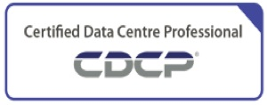
PRESENTATION on
DATA CENTRE INFRASTRUCTURE
&
Product/Service Portfolio of SLPL and OhmDC
By: Hemanta Baral
Chief Operating Officer (COO)
Silver Lining Data Centre

Slide 2




Profile:
Hemanta Baral
Masters in Computer Network Security, UK
Over 20⁺ years experience in ICT sector
Data Centre Consultant for:
DoC (Department of Customs)
CAAN (Civil Aviation Authority of Nepal
DoTM (Department of Transport Management)
Expertise/Certification:
Certified Data Center Professional (CDCP)
European Computer Driving License (ECDL)
ICT Examiner for University of Cambridge (AS & A Level)
Regular Trainer for Cyber Security to Nepal Police Senior Officers
M: 9843067142
E-mail: hemanta.baral@gmail.com;
hemantabaral@yahoo.com
Web:
www.hemantabaral.com.np
https://hemantabaral.wordpress.com
Writer
ICT Consultant
Former IT Officer, GoN)
DFID Consultant
DC Auditor for GIDC, DOLMA

Slide 3

Brief Introduction
SLPL and OhmDC
Hemanta Baral
Chief Operating Officer
SLPL || OhmDC

Slide 4

Silver Lining Pvt. Ltd. (SLPL)
2nd Floor, Mercantile Office Complex,
Narayanhiti Path, Hitti Pokhari, Kathmandu
T: 01-4425221 W: www.silverlining.com.np
Complete
Data Centre Solution

Slide 5

Ohm Data Centre Pvt. Ltd. (OhmDC)
Narayanpath, Bhairahawa
T: 071-520604 W: www.ohmdc.com
Nepal’s first Data Centre
Complete
DC/NDC/DR Solution

Slide 6
DC, NDC, DR Concept
DC – Primary DC
NDC – Near DC or Failover DC
DR – Disaster Recovery

Slide 7
Current Employees
Silver Lining Data Centre
36
(Sajan Shrestha – Buss Dev Intern has recently joined from 15 Jestha 2079)
Ohm Data Centre
15

Slide 8
SLPL - 36
Technical |  | Designation
1 | Pradeep Kumar Lamichhane | CTO
2 | Raj Kamal Thapa | Sr. IT Manager (Network/Security/System)
3 | Sanjiv Sthapit | IT Manager (Infra/Storage)
4 | Shanti Tiwari | Asst. IT Manager
5 | Ronit Shakya | Network & Security Administrator
6 | Anup Khanal | System Administrator
7 | Prasanna Gautam | System Administrator
8 | Kiran Humagain | System Administrator
9 | Suchit Kafle | NOC Supervisor
10 | Amrit Shrestha | Data Centre Technician
11 | Nisha Shrestha | Data Centre Technician
12 | Zirash Shrestha | Data Centre Technician
13 | Sajan Das | Data Centre Technician
14 | Sushant Moktan | Data Centre Technician
15 | Pinku Karki | Consultant (Link)
16 | Sabin Tiwari | Data Centre Technician
17 | Sandesh Dhakal | Data Centre Technician
18 | Yogesh Bastola | Data Centre Technician
19 | Upendra Subedi | Data Centre Technician
20 | Sabin Bhattarai | Interns
21 | Bishal Phuyal | Interns
Non-Technical |  | Designation
1 | Hemanta Raj Baral | COO
2 | Sameer Shrestha | Business Dev Manager
3 | Prashant Mool | Account Manager
4 | Satish Raut | Sr. Executive (Business Dev/Admin)
5 | Mega Subba | Assistant Executive (Business Dev)
6 | Shiva Bdr. Bista | Office Assistant (Business Dev)
7 | Biond Shrestha | Security Incharge
8 | Sudip Shrestha | Security Officer
9 | Gulam Sarvar | Power Technician
10 | Januka Shrestha | House Keeping
11 | Suraj Yogi | Buss Dev Executive
12 | Sandhya Poudel | Interns (Business Dev)
13 | Aasha Gumanju Shrestha | Interns (HR/Admin)
14 | Rajan Pandeya | Account Executive
15 | Sajan Shrestha | Interns (Business Dev)

Slide 9
OhmDC - 15
Technical
S.N. | Name | Designation
1 | Raj Kumar Sharma | Technical Manager
2 | Bijay Chaudhary | L2 Technical Support
3 | Sagar Rasaily | L2 Technical Support
4 | Sumit Thapa | L1 Technical Support
5 | Resh Bahadur Gurung | L1 NOC Support
6 | Shamshad Alam | Senior Electrican
Non-Technical
S.N. | Name | Designation
1 | Anil Regmi | Operation Manager
2 | Binod Kandel | Sr. Business Development Officer
3 | Ramnath Yadav | Security Guard
4 | Surya Bhan Ahir Yadav | Security Guard
5 | Geeta Khatri | House Keeping
6 | Sanjeeb Rijal | Accountant
Interns
1 | Manish Chaudhary
2 | Ghanshyam Gharti
Support (Outsourced/Interns)
S.N. | Name | Designation
1 | Manoj Gupta | Senior Support Engineer (Power)

Slide 10
Contents at a Glance
Terminologies (IT, ICT, IoT, Cloud Computing, Data Centre)
Data Centre Standards, ISO Standards, Data Centre (Rating/Tiers)
Data Centre Manpower Certification
Types of Data Centre
Major Components of Data Centre Infrastructure
Major Components of Data Centre
Data Centre Infrastructure

Slide 11
1. Terminologies
Electricity, Frequency, ON/OFF (0,1 – Binary Numbers), Machine Level Programming Language
IT (Information Technology – Computing only; Standalone - IPO Cycle)
ICT (Information Communication Technology) – Networking; Internet
IoT (Internet of Things) – Sensors, Devices, Internet and Cloud
Data Centre (On Premises, Cloud)
Cloud Computing (IaaS, PaaS, SaaS)

Slide 12
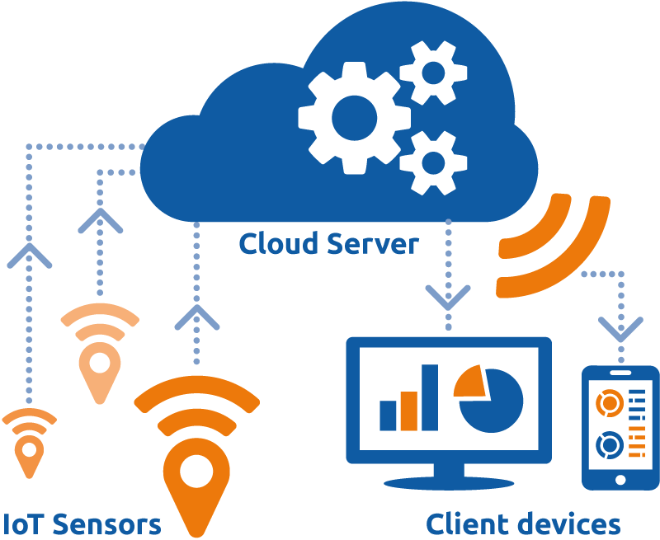
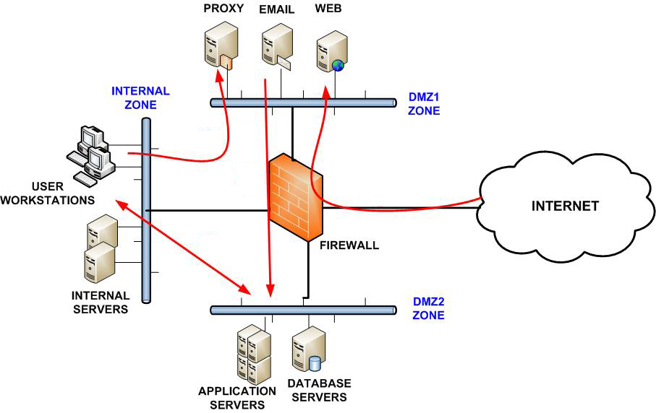
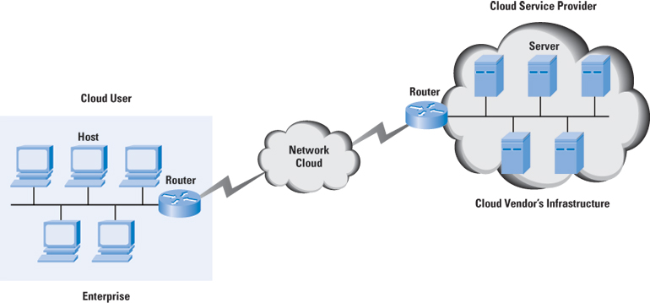
Data Centre Network
1. On-Premises Physical Network
2. Cloud Network
1. On-Premises
Physical Network
2. Today & Beyond Network
(Cloud)

Slide 13

INTERNET of THINGS (IoT)
The INTERNET of THINGS
(IoT) is the network of physical
devices, vehicles, home appliances,
and other items embedded with
electronics, software, sensors, motors, and connectivity which enables these
things to connect and exchange data
via the internet

Slide 14
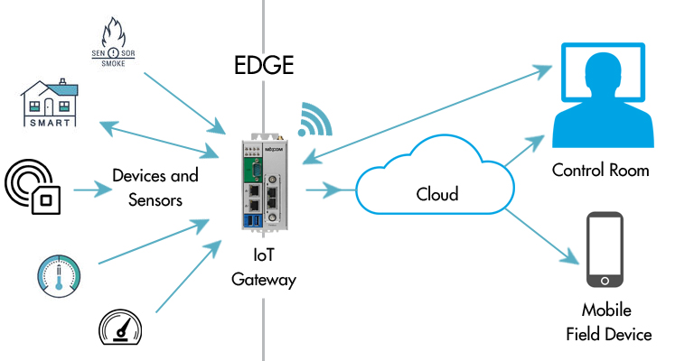
IoT Architecture

Slide 15
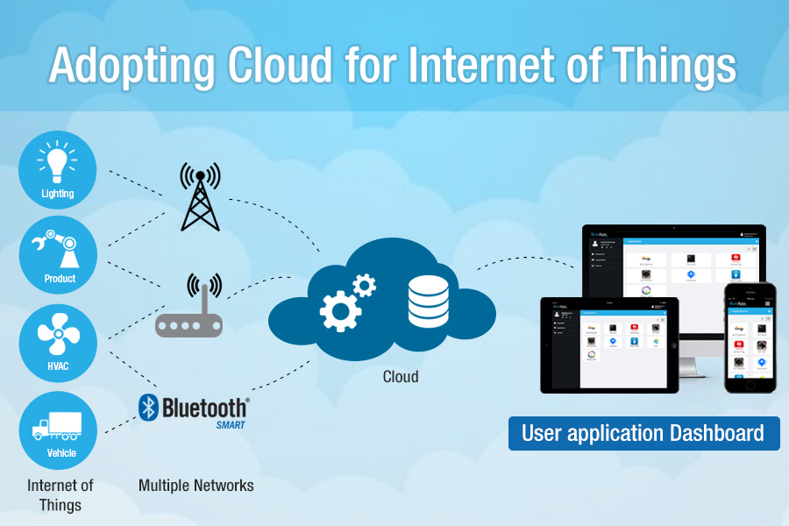

Slide 16
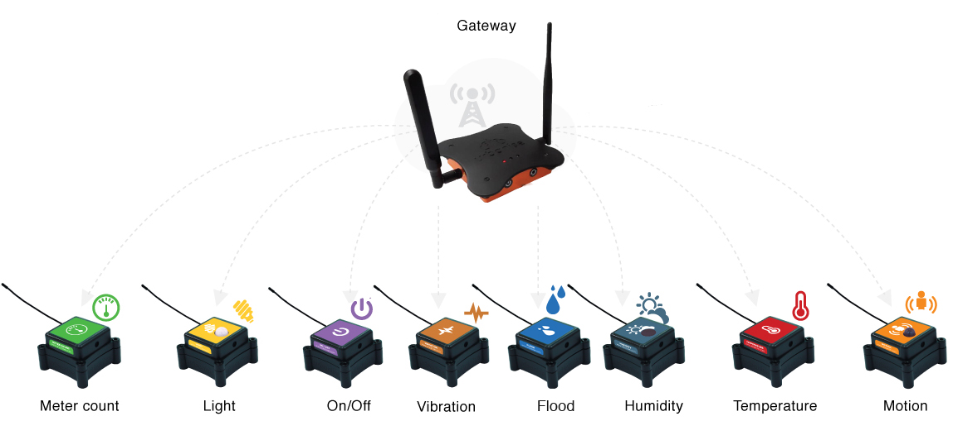
IoT Sensors

Slide 17
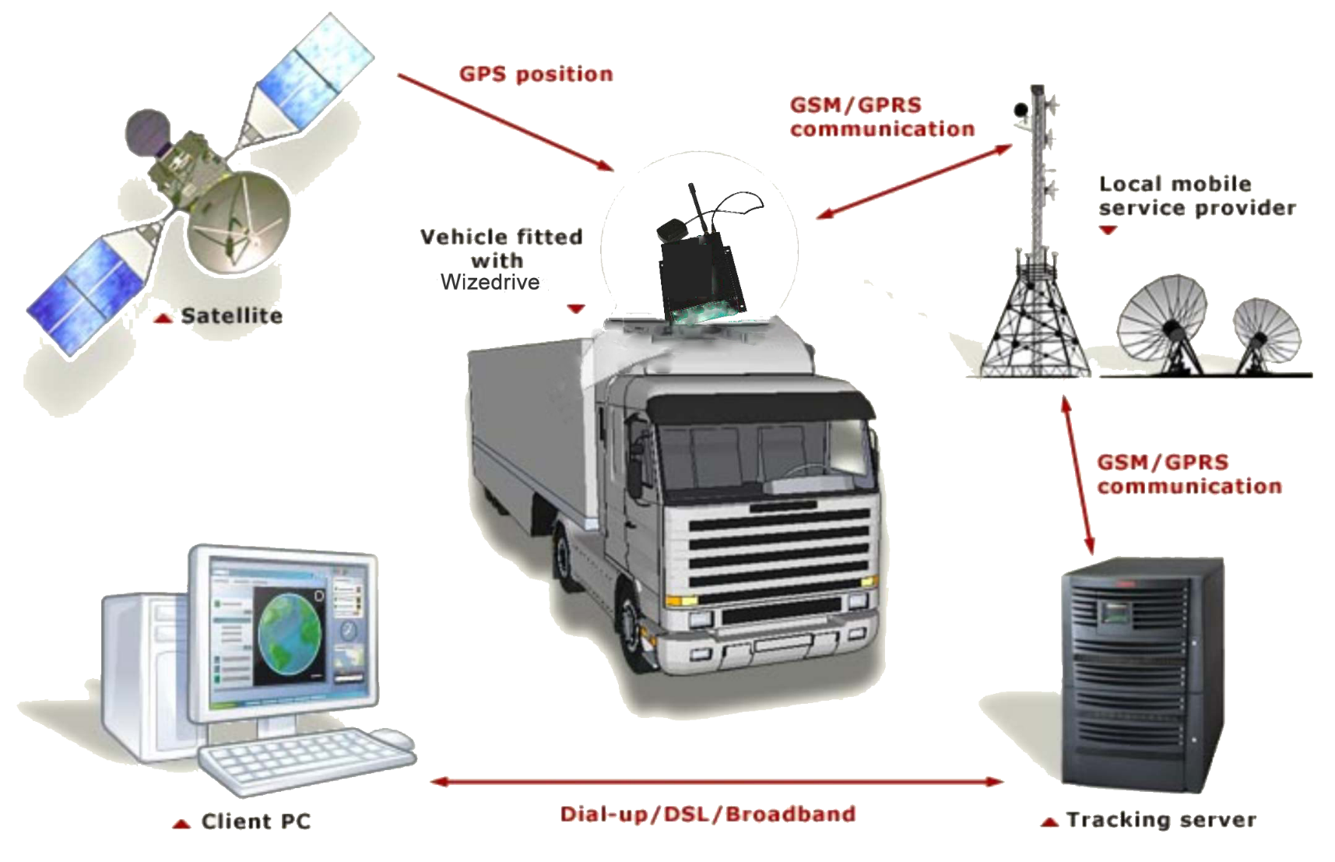

Example of IoT and Cloud: Real-Time Global Positioning System (GPS) Tracking System
With IoT Sensor
(GPS Tracking Device)
Internet
Computer, Laptop or Mobile
Tracking Server on Premises or Cloud

Slide 18
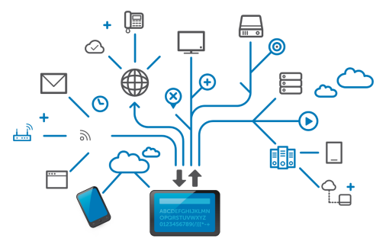
Major Components of Data Centre
Hardware (Workstations)
Connectivity (Internet/Intranet)
Network
Security (Firewall – Network/Application)
Server – RISC (IBM, Sun), CISC (Intel based)
Storage – HDD/SSD; DAS/NAS/SAN; Cloud
Data Centre Infrastructure

Slide 19
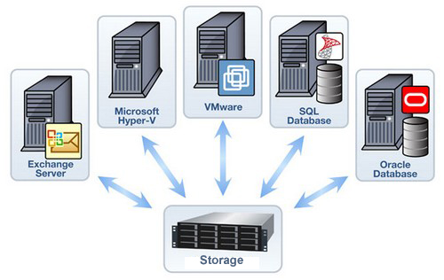
HP Synergy Blade Servers
HP 3 PAR/Primera storage with all SSD
HCI
Server/Storage
Servers:
Application Servers (CBS, E-mail, Web, Mobile Banking etc…)
Database Server
Network Storage:
SAN (Storage Area Network) –
high-end servers, high-capacity disk arrays (Ethernet or Fibre Channel and SAN Switch)
NAS (Network Attached Storage) –
NAS devices onto the LAN via TCP/IP (Ethernet Based with Switch)
Storage on Cloud

Slide 20

Connectivity
Intranet:
Data Link Layer (L2 Link)
Internet:
Network Layer (L3 Link)
Broadband Connection:
DSL (ADSL/ SDSL)
Cable Modem
Optical Fiber
Wireless (Radio)
Satellite (VSAT)
Broadband over
powerline (BPL)
VPN, Dark Fiber, Leased Line

Slide 21
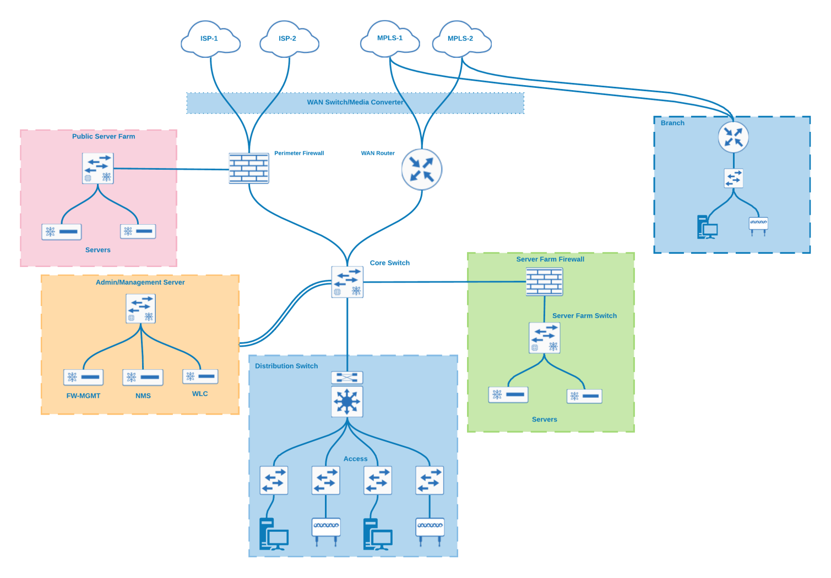
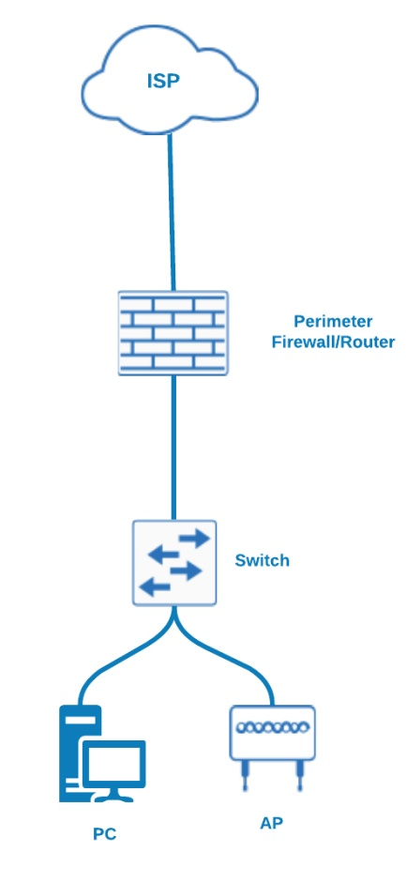
Network/Security
Medium/Big size Network
Small Size Network

Slide 22
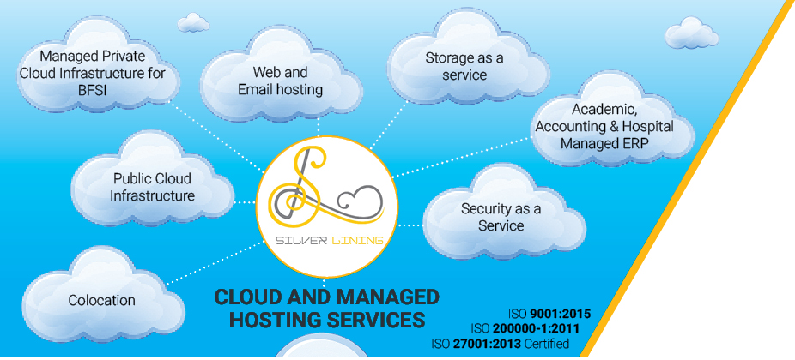
Our
Services

Slide 23
Our Services:
Colocation
Managed Private Cloud
Public Cloud
Web and Email Hosting
Storage/Software as a Service (SaaS)
NOC/SOC (Network/Security Operation Centre)

Slide 24
Colocation
A colocation data center, often referred to as a ‘colo,’ is any datacenter facility that rents out rack space to third parties for their servers or other network equipment.
The hardware is usually owned by the company’s themselves, and simply housed by the data center staff.

Slide 25
Private Cloud
Types of Cloud Computing:
Private Cloud and Public Cloud
A private cloud hosting solution, resides on company’s intranet or hosted data center where all of your data is protected behind a firewall. This can be a great option for companies who already have expensive data centers because they can use their current infrastructure.
Public Cloud
The main differentiator between public and private clouds is that you aren’t responsible for any of the management of a public cloud hosting solution. Your data is stored in the provider’s data center and the provider is responsible for the management and maintenance of the data center.

Slide 26
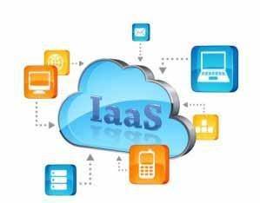
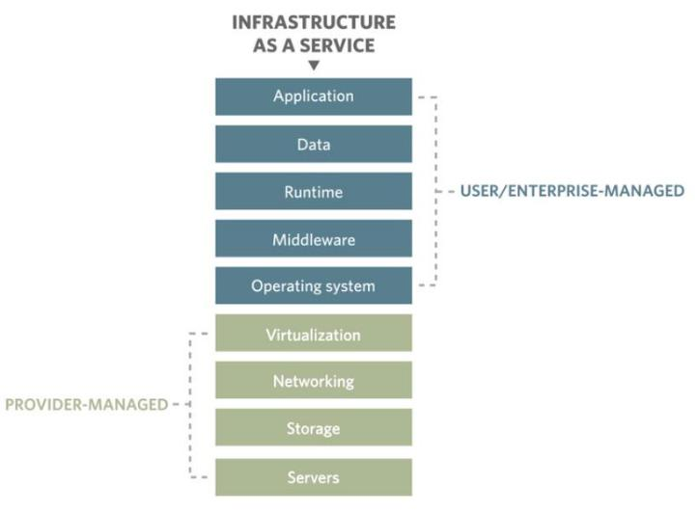
Types of Cloud Services
Infrastructure as a Service (IaaS):
IaaS Services: computing infrastructure, physical (bare metal) or virtual machines, networking, storage (Disk image library, Block and File-based Storage), networking services (e.g. firewalls, load balancers, IP addresses, virtual local area networks) etc.
Public Cloud Service Provider for IaaS: Amazon EC2, Windows Azure, Rackspace, Google Compute Engine, Cisco Metapod, Joyent etc.
IaaS users are responsible for:
Installing
Maintaining and,
Managing

Slide 27
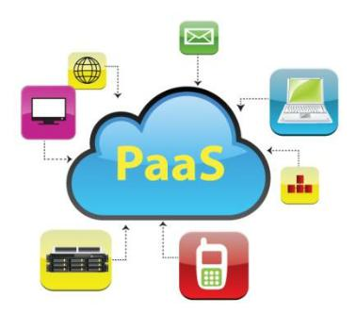
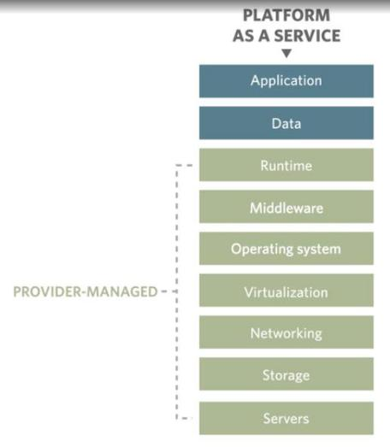
Types of Cloud Services
Platform as a Service (PaaS):
PaaS Services: computing platforms which typically includes operating system, programming language execution environment, Runtimes (like java runtimes), database (like mySql, Oracle), web server (tomcat) etc.
Public Cloud Service Provider for SaaS: AWS Elastic Beanstalk, Windows Azure, Heroku, Force.com, Google App Engine, Apache Stratos.
PaaS users are responsible for:
Application and,
Data

Slide 28
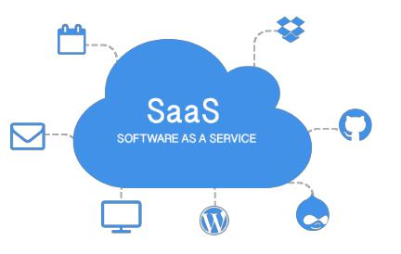
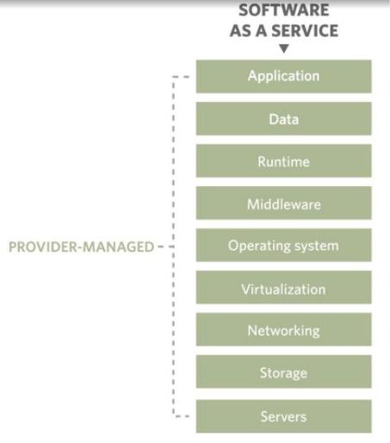
Types of Cloud Services
Software as a Service (SaaS):
SaaS Services: Google Apps, Microsoft Office 365, Cisco WebEx, Salesforce, Workday, Concur, Citrix GoToMeeting, Applications like email (Gmail, Yahoo mail etc), Social Networking sites (Facebook etc)
In SaaS, providers are responsible for:
Purchase
Install
Configure
Upgrade
Secure and,
Manage

Slide 29
Leading Public Cloud Computing Providers:
Amazon Web Services
Microsoft Azure
IBM Cloud
Google Cloud Platform
Major Private Cloud Service Providers in Nepal
Silverlining (www.silverlining.com.np)
Data Hub (www.datahub.com.np)
Cloud Himalaya (www.cloudhimalaya.com)
Accessworld (www.accessworld.net)
Syntegrate Services Pte. Ltd. (www.syntegrate.com.np)
Ohm Data Centre (www.ohmdc.com) etc..
Government Data Centre:
Government Integrated Data Centre (GIDC) www.nitc.gov.np
G Cloud (www.doit.gov.np)

Slide 30
Build/Design your own DATACENTRE

Slide 31
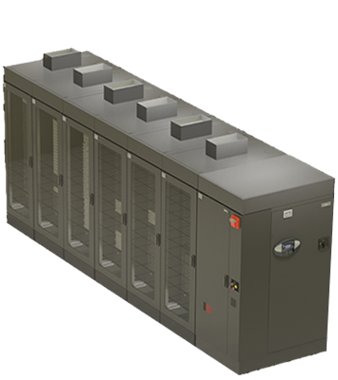
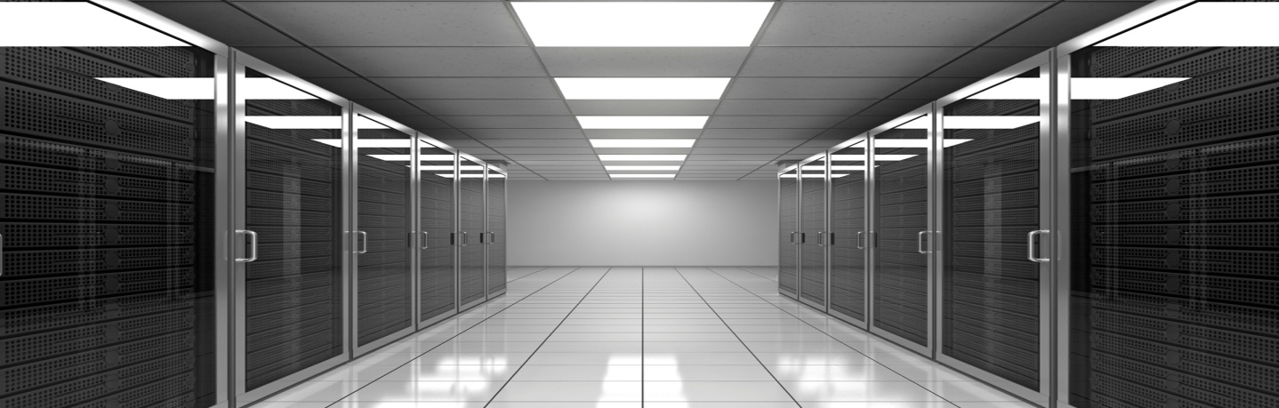
Data Center Infra:
Dedicated and well organized space with:
Redundant Power with Backup
Redundant Cooling (PAC)
Auto Fire Fighting System
Environmental Monitoring
Security System (Access Control, CCTV)
Other DC passive components like WLD, ARR, Temp & Humidity etc.

Slide 32
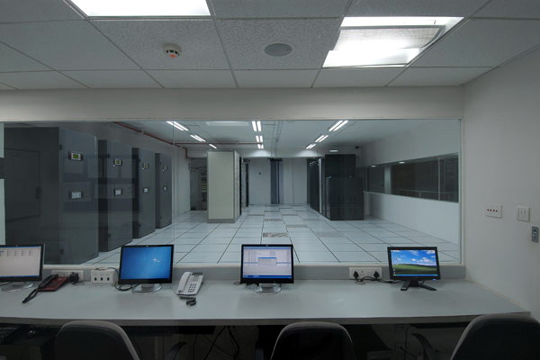
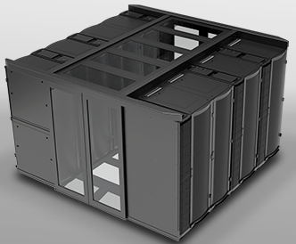
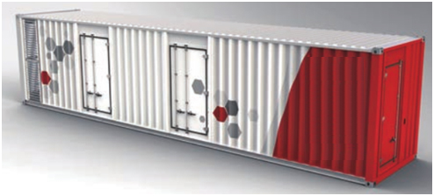
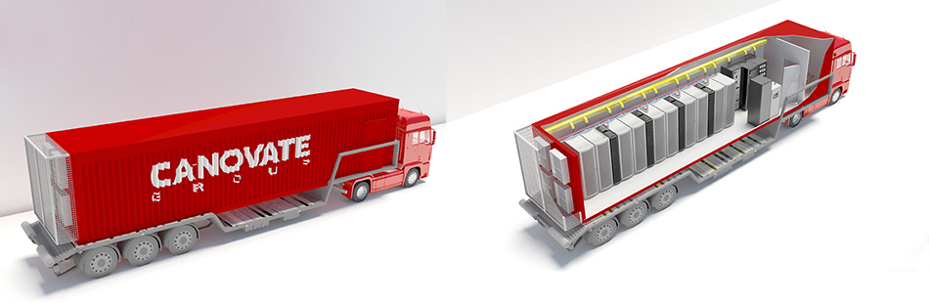
Major Types of Data Center:
Conventional
Prefabricated Modular
Container (All in One/
Clustered - Equipment, Cooling, Power, Control)
Conventional DC
Prefabricated
Modular DC
Containerized/
Mobile DC

Slide 33
Conventional Data Center
Conventional Data Centers are room or building based solution where each and every component has to be installed manually and separately.

Slide 34
Data Centre Standards, ISO, Ratings
There is NO world-side recognized standard
However,
Globally accepted Data Center Semi-Standards:
TIA 942 (Telecommunications Industry Association)
BICSI 002 (Building Industry Consulting Service International)
EN 50600 (European Standard)
+ Vendor/Commercial Guidelines (Uptime Institute, Oracle, IBM, HP, APC-Schneider and Others)
* Standard Guidelines for redundancy of the critical infrastructure (Power/ Cooling/ Fire) and other passive equipment. This certification can be obtained from Uptime Institute, epi (EXIN) etc.

Slide 35
Mandatory ISO certification required for DC
ISO Certifications for the guidelines:
9001:2015 Quality Mgmt. System
27001 Information Security Mgmt.
20000 IT Service Mgmt.
14000 Environmental Mgmt.
22301 Business Continuity Mgmt.
50000 Energy Mgmt. System
PCI/DSS for Card Payment System (Mandatory once National Payment Gateway has started)
* PCI/DSS: Payment Card Industry Data Security Standard

Slide 36
Training/Certification for DC Manpower
DC Infra: CDCP/ CDCS/ CDCE
Network: Cisco (CCNA/ CCNP), Juniper (JNCIA, JNCIS, JNCIP, JNCIE)
Security: Cisco (CCIE), Juniper (JNCIS, JNCIP, JNCIE-Sec), PaloAlto (PCCSA, PCNSA, PCNSE), F5 (Administrator, Technology Specialist, Solution Expert, Engineer) & Others
System/DBMS: IBM (System Administrator), Oracle (Database Administrator), Linux, VMWare etc.

Slide 37
Data Center Ratings (Tiers)
Rated – 1 Data Center; BASIC
(Single path for Power and Cooling without redundancy)
Rated – 2 Data Center; Redundant Components
(Single path for Power and Cooling with component redundancy i.e. N+1)
Rated – 3 Data Center; Concurrently Maintainable
(Multiple paths for power and cooling of which one path is active; redundant components)
Rated – 4 Data Center; Fault Tolerant
(Multiple active paths for power and cooling with redundancy in each path)

Slide 38
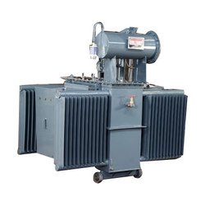
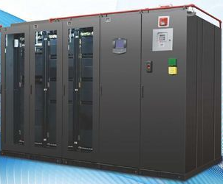
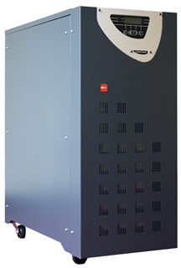
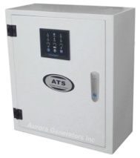
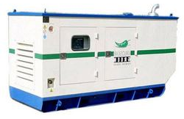
Power Infrastructure
Rated – 1 Data Center; BASIC
(Single path for Power and Cooling without redundancy)
Single PAC (Cooling)

Slide 39
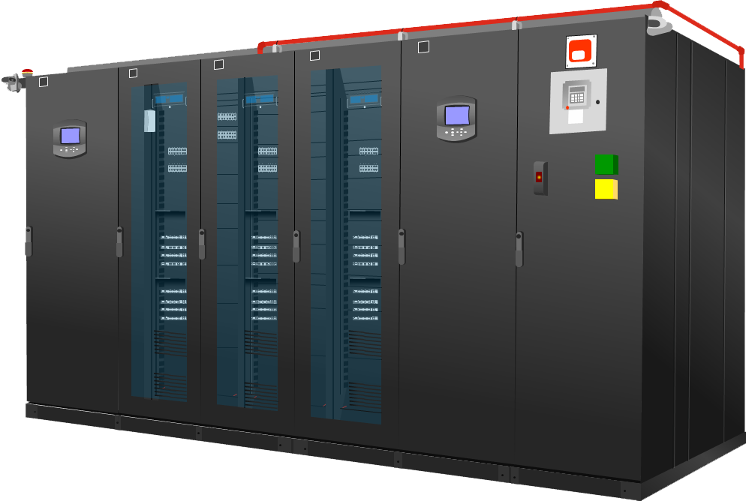

Rated – 2 Data Center; Redundant Components
(Single path for Power and Cooling with component redundancy i.e. N+1)
PAC (Cooling with redundancy)

Slide 40




Rated – 3 Data Center; Concurrently Maintainable
(Multiple paths for power and cooling of which one path is active; redundant components)
PAC (Cooling with redundancy)

Slide 41




Rated – 4 Data Center; Fault Tolerant
(Multiple active paths for power and cooling with redundancy in each path)
PAC (Cooling with redundancy)
Note: This is not possible in Nepal due to single active power supplier i.e. NEA only.

Slide 42
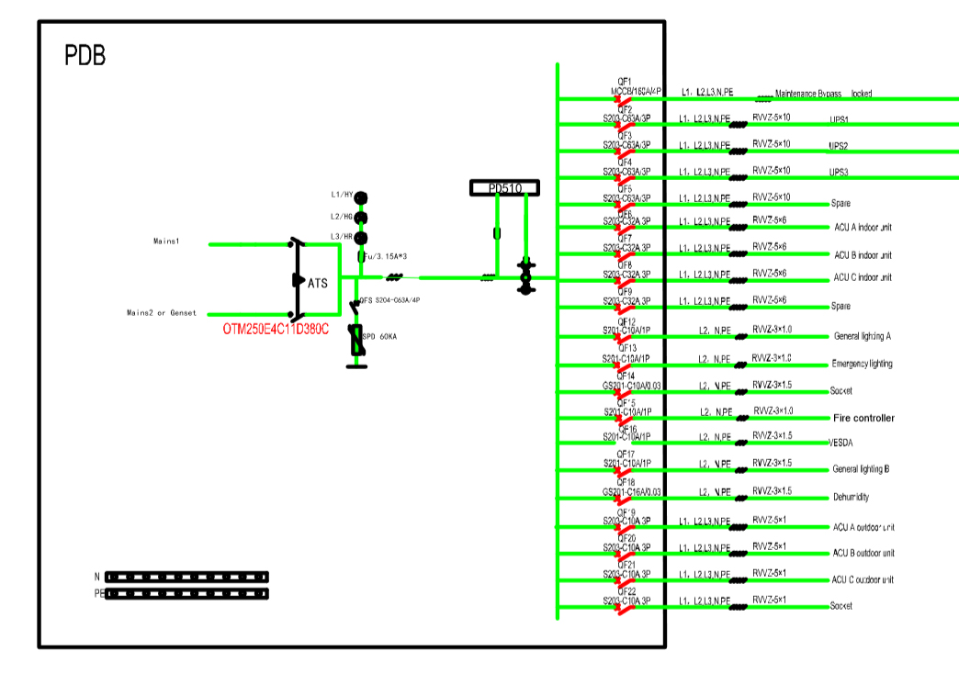
Power Distribution System 1

Slide 43
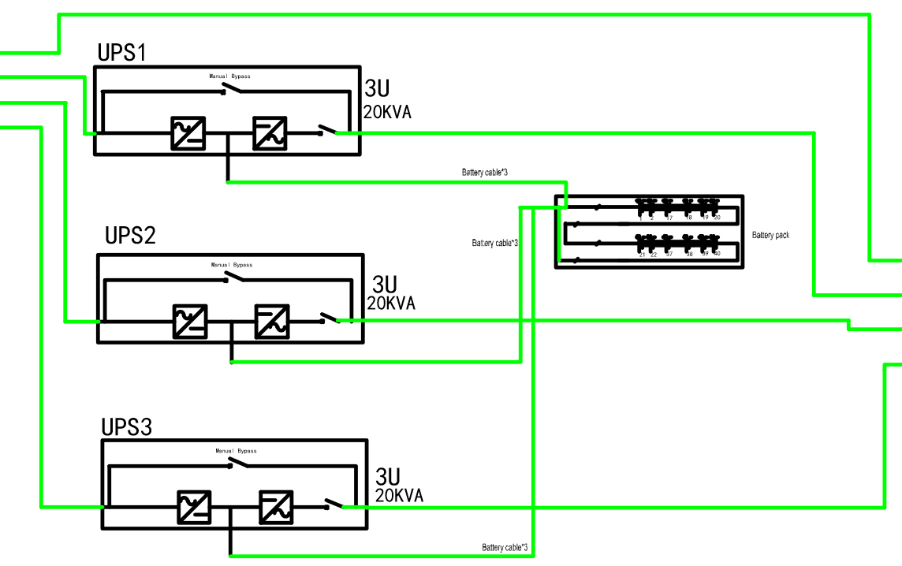
Power Distribution System 2

Slide 44
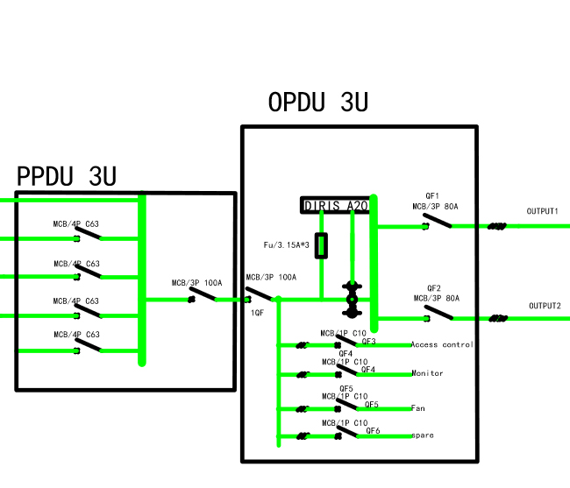
Power Distribution System 3

Slide 45
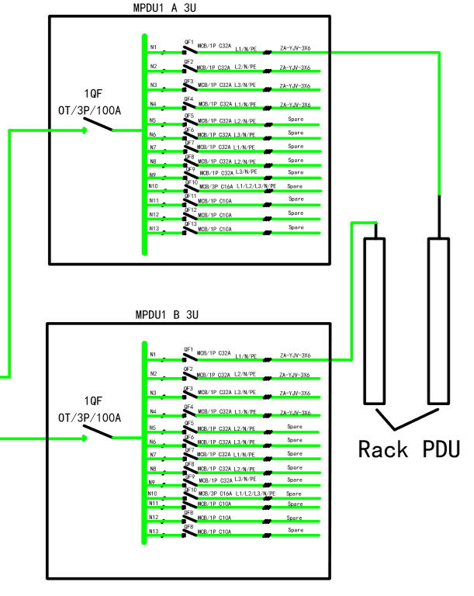
Power Distribution System 4

Slide 46
Major components of Data Center Infrastructure:
Raised Floor/Fire Partition/False Ceiling
Server Racks
Precision AC (PAC)
Fire Detection/Suppression System
Power Backup (UPS & Batteries Backup)
Power Management System (PDM/ PDU)
Water Leak Detection
Temp & Humidity Control
Automatic Rodent Repellent
Biometric Access Control
IP Surveillance (CCTV)
Data Center Infrastructure Monitoring (DCIM) etc…

Slide 47
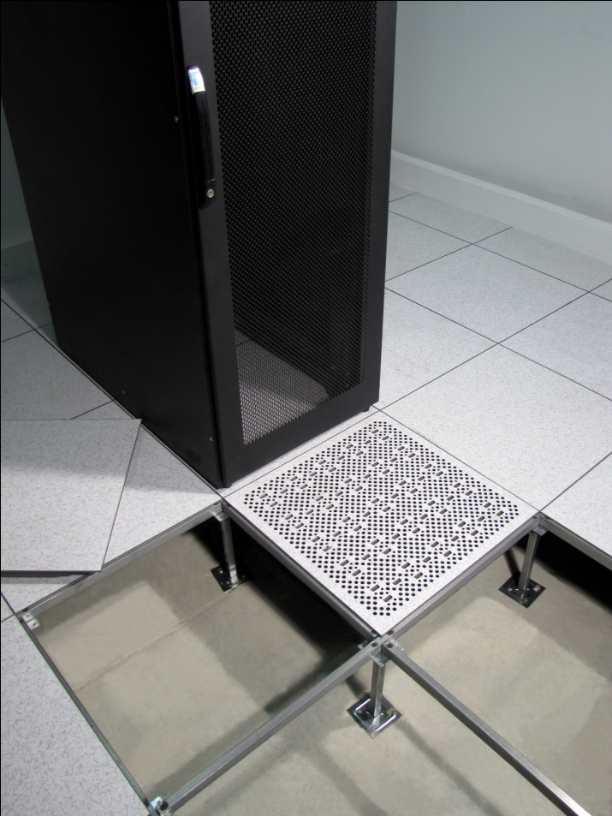
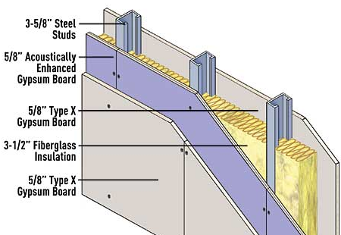
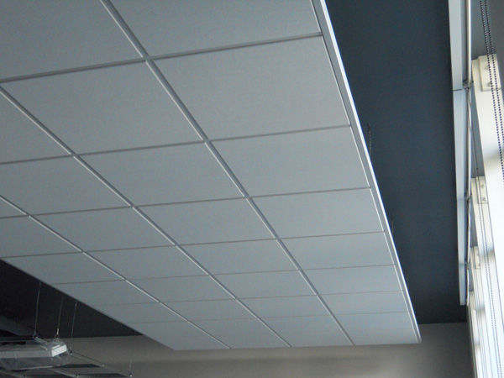
Raised Floor/Fire Partition/False Ceiling
Fire Proof partition
Network Cabling
Electrical Cabling

Slide 48
Standard Room size required for Raised Floor and False Ceiling
Height of 42” Server Rack = 1991mm (2000mm) = 6.5 ft
Height of Precision AC = 1970mm (2000mm) = 6.5 ft
Free space required on the top of Precision AC (for air circulation) = 1.5 ft (Consideration of light fixtures)
Height of Raised Floor = 1.5 ft
False Ceiling Height Clearance = 1.5 ft
=================================================
Total room height required = 11 ft
(should not be beam in place i.e. excluding beam structure)

Slide 49
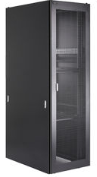
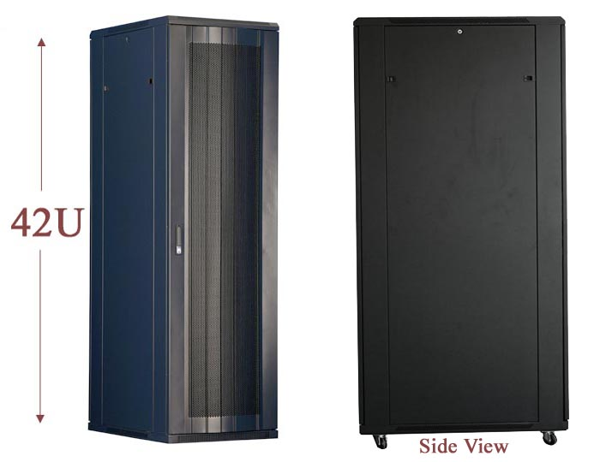
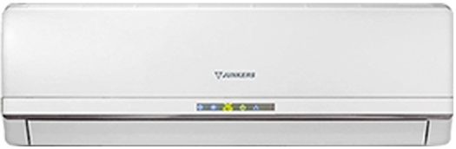
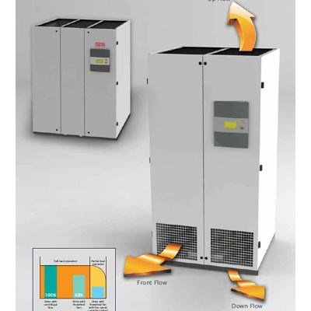
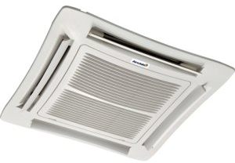
Server Racks
(In-Row Cooling Compatible)
Cooling Infrastructure
Comfort AC
Precision AC

Slide 50
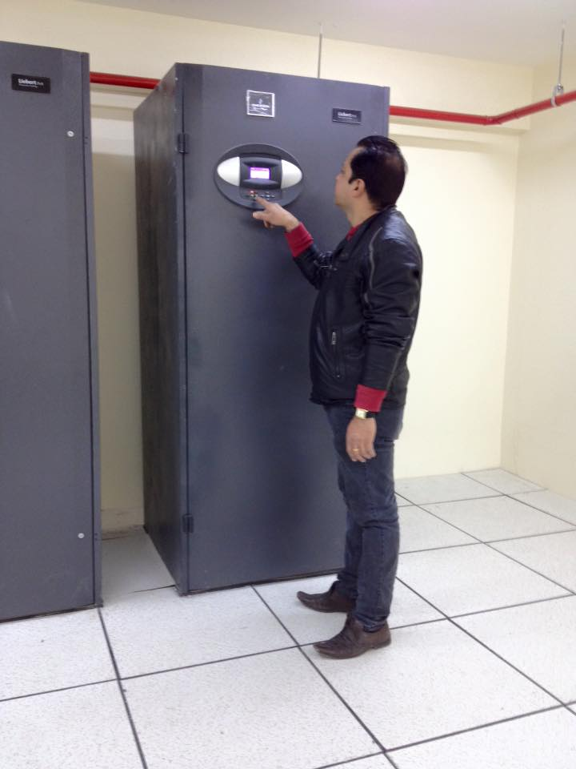
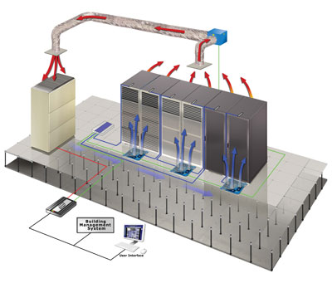
Why Precision AC is required in Data Centre?
Precise Temperature Control by +/- 1% used for highly sensible machines
Relative Humidity Control (Heater + Humidifier)
Dust Control (High efficiency filter - 5 microns whereas 20 microns in Comfort AC)
24/7 operation
Energy efficiency by 30% (1TR PAC = 1.30TR Comfort Cooling)
Step less Cooling as per IT load
* Water Supply is required for Humidity Control

Slide 51
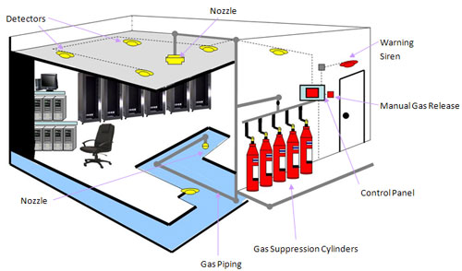
Fire Detection/Suppression System

Slide 52
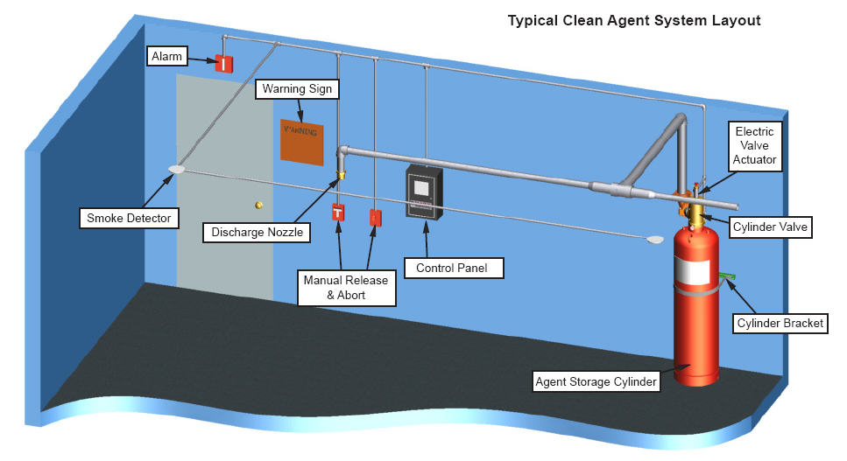

Slide 53
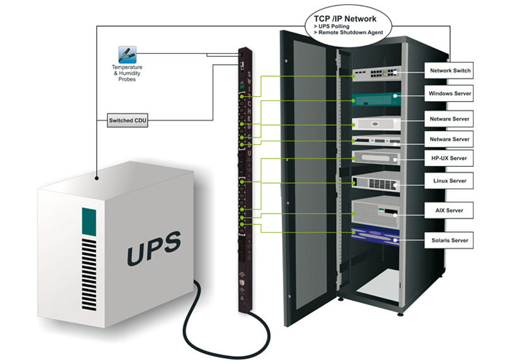
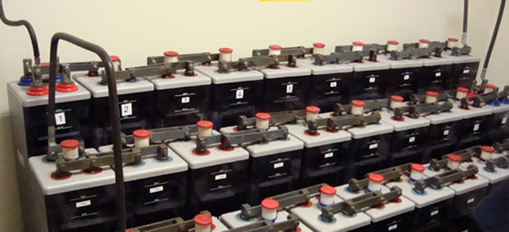
Power Backup (UPS with PDU & Batteries Backup)
Battery Breaker and Battery racks are required along with Power Distribution Panel
For Power Backup - Nos. of batteries requirement depends upon the voltage range of UPS. If voltage range of UPS is 384 to 440V then 32 to 40 nos. of 12V batteries are required. i.e. 32x12V = 384V to 40x12V=480V

Slide 54
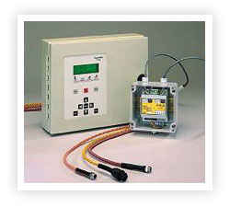


Water Leak Detection
Temp & Humidity Control

Slide 55


Access Control

Slide 56


Automatic Rodent Repellent System
IP
Surveillance

Slide 57


Data Center Infrastructure Monitoring (DCIM)

Slide 58

Prefabricated Modular Data Center
Modular Data Centers come in one single unit where all the major DC passive components are resides. It is a pre-fabricated unit that can be delivered to a site to fill an immediate need of the clients.

Slide 59



Types of Prefabricated Modular Data Center
Cabinet based – 24, 36 & 42U
Row based (Single Row or Double Row) with Hot/Cold Aisle containment – 2 to 8 racks for single row and 6 to 24/32 racks for double row
Modular DC Solution comes in different models depending up on client's requirements.

Slide 60


Modular DC
Cabinet Based
Row Based
Rack
Row
Deciding Factors
Capacity: 1-10kW
Moderate Density: load/rack ≤ 5KVA
Cooling capacity 3.5 to 7 KW
UPS capacity 3 to 10 KVA
No of racks 1 to 2
Capacity: 10-35kW
High Density: load/rack ≥ 5KVA
Cooling capacity 10 to 40 KW
UPS capacity: 10 to 40KVA
No of racks ≥ 2 to 6 & can be added 2 more

Slide 61

Beacon Alarm
Camera
RDU
Motion Sensor
Single Cabinet
Temp. Sensor
Server
Equipments
Glass Door
2100
19" Rack Mount UPS 3 kVA (2U)
19" Rack Mount Battery Module (2U)
19" Rack Mount (6U) Cooling Unit (3.5 kW)
800
Cable Entry from Bottom

Slide 62
Beacon Alarm
Camera
RDU
Motion Sensor
Temp. Sensor
Class Door
Double Cabinet
19" Rack Mount Battery Module (2U)
19" Rack Mount (6U) Cooling Unit (3.5 kW)
Cable Entry from Bottom

Slide 63


Smart Cabinet – Cooling Approach
Cold Air
Hot Air
Rack Cooling Unit

Slide 64
Row Based Modular DC

Slide 65










Basic Components
CRV Unit (20 kW)
Emergency
Exhaust Fan
POD 20kVA
Server Rack HD Series
(Open Type)
42U 2000x600x1000
(H x W x D)
{without front & rear door & without side covers}
Vertical PDU
Liebert RDU-A
Fire Fighting & POD Cabinet
CRCA Sheet fitted
on all open space in frame
Glass Door
Fitted on Frame Both Sides
Rear Side
(Hot Cont.)
Containment Frame
Structure Isometric View
Liebert ITA UPS
Front Side
(Cold Cont.)
Frame Structure
Side View
CRCA: Cold Rolled Close Annealed

Slide 66
Air Flow Circulation of Smart Row
RH Side
Top View
Hot Air Exhaust Through
Rack Rear Side and goes to CRV unit for cooling
Cold Air Through CRV Unit flows in containment to Racks

Slide 67

Air Flow Circulation in case of cooling unit fails
Cold Containment doors open automatically though magnetic lock for the availability of ambient air from outside to racks .
Hot air exhaust through
Fans in case of cooling unit fails or
overheating in hot containment which got activated by RDU-A
Racks takes ambient air in case of cooling unit fails when Containment front door opens automatically which is triggered by magnetic lock.
Fan Trey is equipped with gravity
Dampers & lets close during
emergency fan is in off condition.

Slide 68
Containerized/Mobile Data Center:
Containerized Data Center Infrastructure is a complete data center solution installed into a container, combining Racks (IT Container), Precision Cooling (Cooling Container), UPS System (Power Container) and Monitoring solutions (Network Operation Center Container).
The mobile container provides a protected housing for the server cabinets, power distribution system, cooling system, monitoring system, fire control system, and lighting system.
The container performs the following functions:
Houses the container components which can be interconnected inside in a centralized and manner.
Provides a protected environment to protect the container from external impact
Flexible
Modular
Energy Efficient
Green
Integrated
Secure

Slide 69

Pre-fabricated Modular Containerized Data Centre
40Ft Container with 6-8 Racks
Suitable for max. of 48kW (60kVA)
20Ft Container with 4-5 Racks
Suitable for max. of 32kW (40kVA)

Slide 70

Inside Layout
AC (Outdoor) Unit
Cold Aisle
AC (Indoor) Unit
Hot Aisle
Server Cabinet
Locker
Utilities (Fire Cylinder, DB)
UPS Cabinet, Batteries

Slide 71


Cooling

Slide 72

Fire Fighting System
Smoke detector
Heat detector
Fire alarm horn strobe
Buzzer
Fire extinguishing pipeline and nozzles
Fire control box
Fire control panel
Fire cylinder

Slide 73
Why Prefabricated Modular Data Center is recommended?
Reliability - One Vendor Solution (Genuine - World’s renowned brands)
Relocation (Business Continuity) - 100% relocate (in case of natural disasters)
CAPEX/OPEX – Low (Energy Efficiency by 30% due to Digital Scroll cooling Technology, Space Saving by 33% over the conventional, Less manpower required
Easy to manage (Remote Monitoring )

Slide 74
Why Prefabricated Modular Data Center is recommended? Contd…
  Modular and Scalable - Customizable Solution as per the requirement
  Integrated system (Containment Approach)
  Manufactured at Factory and assembled at site
  Contains all passive components that
  goes in DC
  Easy to Deploy (8-10 weeks)
  Secure – use of Biometric
  Access Control System
  Right Sizing and Automated
Reduce Energy by up to 30%
Reduce Space up to 33%
Reduce
Go Live time
(8-9 Weeks)
Reduce Ops Cost

Slide 75
Recommendations for DC:
Room based Smoke Detection System
Hand Held Fire Extinguisher (CO2 based)
Water Supply is needed for Row-based Solutions
There are Outdoor Units in all models so there should be a provision of keeping outdoor units.
Extra Monitor is required for Display
Extra NVR with HDD are required to keep the surveillance records

Slide 76
Reasons for designing your own Data Centre
Ownership
Complete control over an operating environment including access.
Ability to control and share existing space
Resilience (Stability)
Security measures
Saving on OPEX

Slide 77
Sections required for Data Center
Holding Area (Goods received, unpacked, physically inspected and prepared for movement into the staging area)
Staging Area (Equipment Inspection and Power Testing, HW/SW configuration)
Core/Server Room (Environment where equipment can be expected to run on a 24/7 basis)
Media Storage (Safe and Secure area where media – Documentation, Tapes, CD-ROMs can be stored in a controlled manner)
Power Room [UPS Room/Battery Room/Generator Room]
Service Corridor (Secure area where supporting facilities can be serviced and monitored on a 24/7 basis without disturbing the data center – PAC, Electrical DB etc)
Meet-Me Room (Carrier handover point i.e. ISP/NSP service area)
NOC (Network Operations Control)/Command Center – Monitoring Room

Slide 78
Detection System
VESDA (Very Early Smoke Detection Apparatus) or HSSD (Highly Sensitive Smoke Detection)
Works via air-sampling
As much as 1000 more sensitive than standard smoke detectors
2. Smoke Detectors for Fire Panels
Ionization Detectors (Uses low radiation material. When smoke enters detector the ions create electrical path setting alarm condition.
Photoelectric Detector (Uses a light source (i.e. LED) and photocell, when smoke enters, deflection of light will activate photocell triggering alarm.

Slide 79
Fire Suppression System
FM 200
Widely used in data center
Not harmful to humans in itself but harmful gas will develop when FM200 is ‘burned’. Advisable to leave area when FM is released
Gas containers should be reasonably close to data center
2. NOVEC – 1230
Cost effective installation and maintenance
Very effective for Fire Suppression
Environmentally safe
Gas containers should be reasonably close to data centers
3. Others: Halon 1301, CO2, Inergen, Argonite, FE13

Slide 80
Handheld Extinguishers
Class A (Water based)
Suitable for Wood, Cloth, Paper, Plastics etc…
2. Class B (Carbon dioxide or a dry chemical agent)
Suitable for Flammable liquids such as Gasoline, Kerosene and many chemical agents including gases.
3. Class C (Carbon dioxide, Halon, Dry chemical agent)
Suitable for Data Centers and for electrical equipments such as appliances of all kinds, computers, motors…
4. Class D (Dry Powder based)
Suitable for metals such as sodium, lithium, titanium, magnesium etc…)
5. Class K (Liquid chemicals)
- Suitable for Kitchen for fires involving cooking fats and oils

Slide 81
A Quote
“Train people well enough so they can leave. Treat them well enough so they don’t have to.”
– Sir Richard Branson

Slide 82

Any Questions???
Thank You

