Slide 1
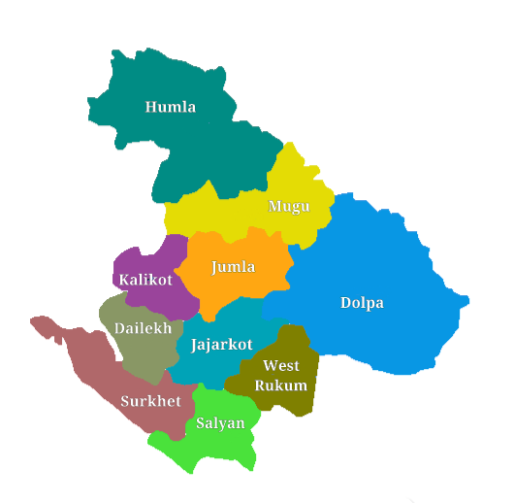

DIGITAL
KARNALI
By: Hemanta Baral
SMART CITY Consultant

Slide 2

Profile:
Hemanta Baral (Damak, Jhapa)
Smart City/ Data Centre/ ICT Consultant
Masters in Computer Network Security, UK
Writer (35+ IT related Books)
www.hemantabaral.com.np
 9843067142
 hemanta.baral@gmail.com

Slide 3
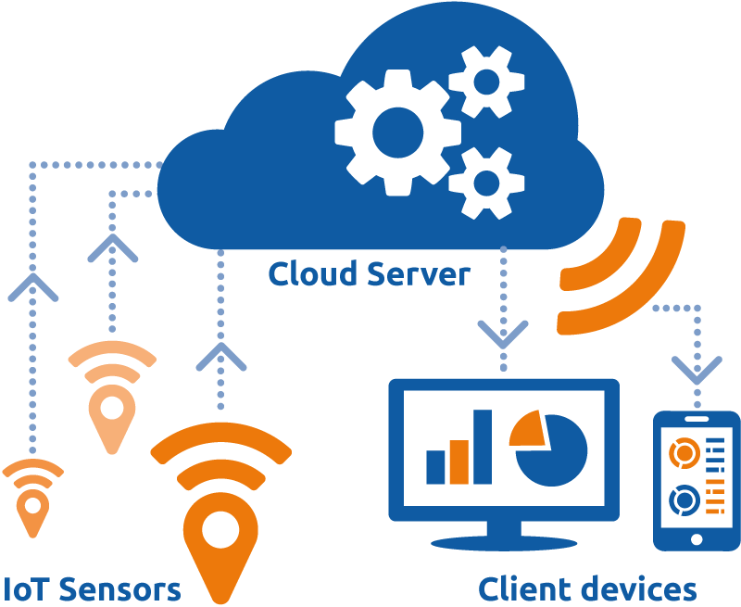
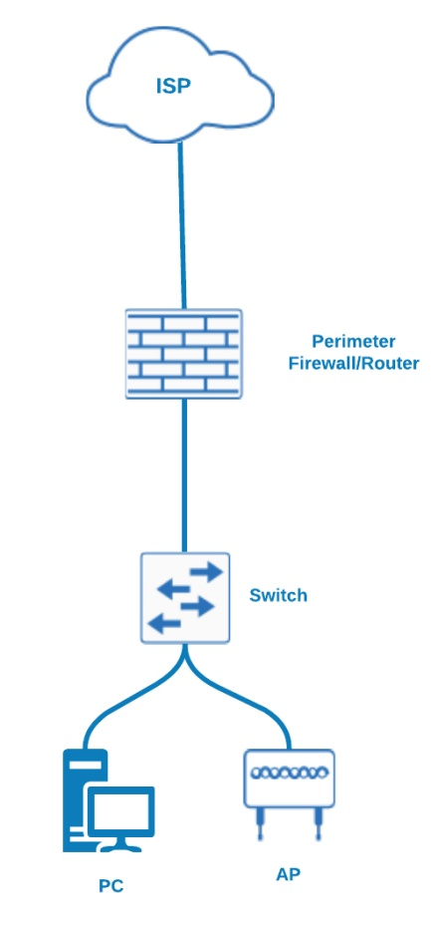
Technology:
Information Technology (IT) – Computing
Information Communication Technology (ICT) – Computing,
Networks
Internet of Things (IoT) – Sensors, Network,
Internet & Cloud
Network:
On Premises
Cloud
Today & Beyond Network
On Premises Network

Slide 4
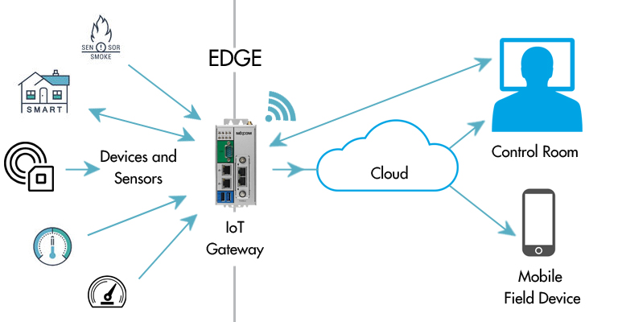
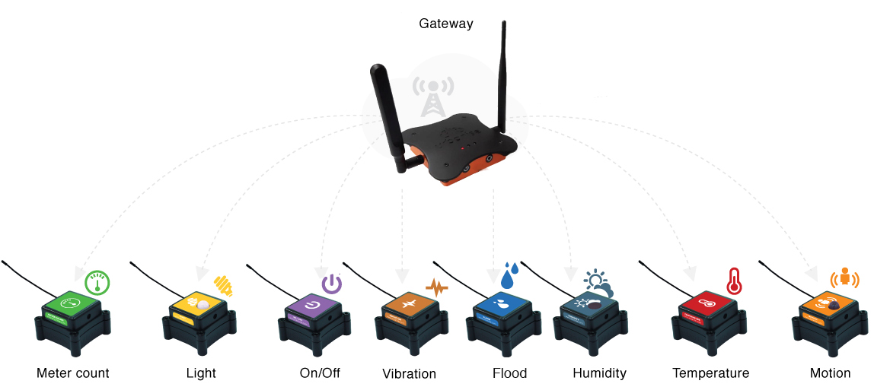
IoT Architecture
IoT Sensors
Communication Media: GPS, WiFi, RFID, Tracker, Bluetooth, QR Code, Bar Code

Slide 5
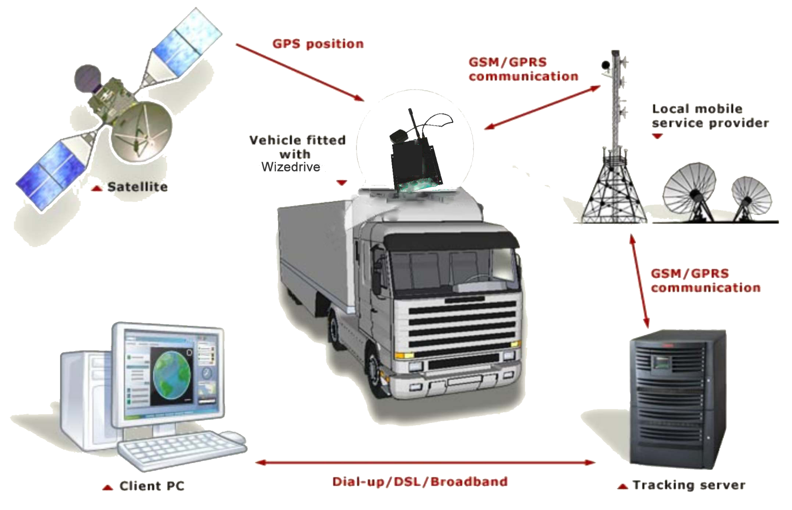
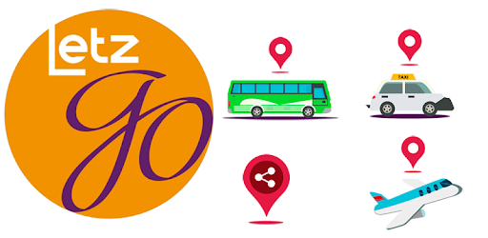
Example of IoT and Cloud: Real-Time Global Positioning System (GPS) Tracking System
With IoT Sensor
(GPS Tracking Device)
Application (Sample)
Internet
Computer, Laptop or Mobile
Tracking Server on Premises or Cloud

Slide 6

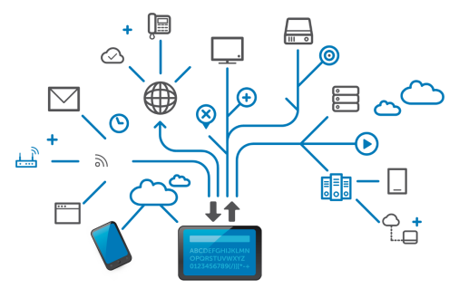
DIGITAL KARNALI Parameters
Infrastructure
Data Centre
Infrastructure
Hardware
Connectivity
Network/Security
Server/Storage
Application
Enterprise E-mail
Website
Mobile/ Web Apps for
Online Payment
Local Govt. Applications
Central Govt. Applications
Apps as per Smart City
Components
Smart City Components
Smart People
Smart Home/Living
Smart WiFi
Smart Communication
Smart Education
Smart Health
Smart Transport/Mobility
Smart Water/Electricity Supply
Smart Energy
Smart Agriculture
Smart Tourism/Heritage
Smart Waste Management
Smart Livestock farming
Smart Crime Control
Smart Banking

Slide 7

Infrastructure

Slide 8
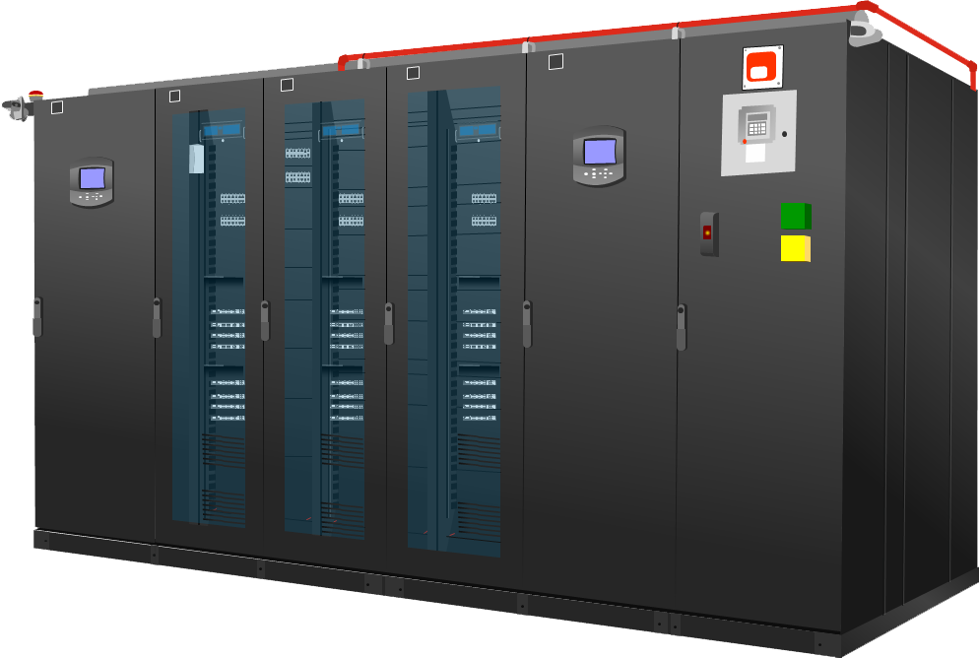
Data Centre Infrastructre

Slide 9
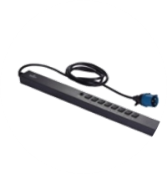
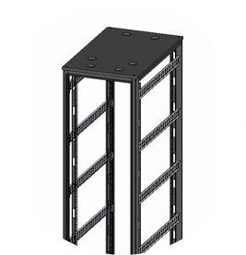
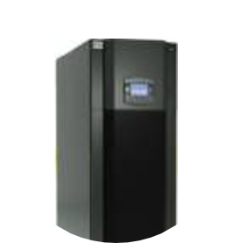
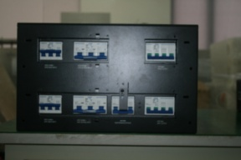
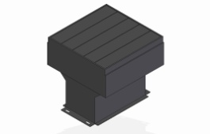
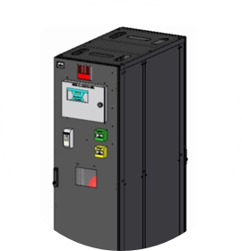

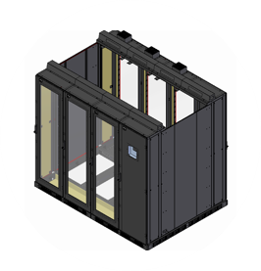
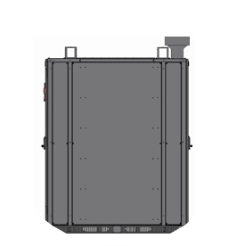
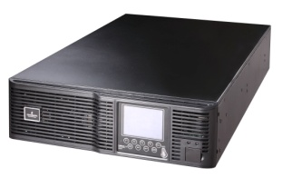
Data Centre Infrastructure Components
CRV Unit (20 kW)
Emergency
Exhaust Fan
POD 20kVA
Server Rack HD Series
(Open Type)
42U 2000x600x1000
(H x W x D)
{without front & rear door & without side covers}
Vertical PDU
Liebert RDU-A
Fire Fighting & POD Cabinet
CRCA Sheet fitted
on all open space in frame
Glass Door
Fitted on
Frame Both Sides
Rear Side
(Hot Cont.)
Containment Frame
Structure Isometric View
Liebert ITA UPS
Front Side
(Cold Cont.)
Frame Structure
Side View
CRCA: Cold Rolled Close Annealed

Slide 10
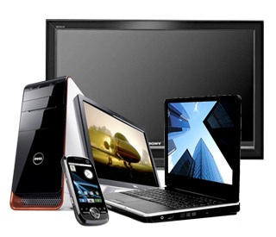
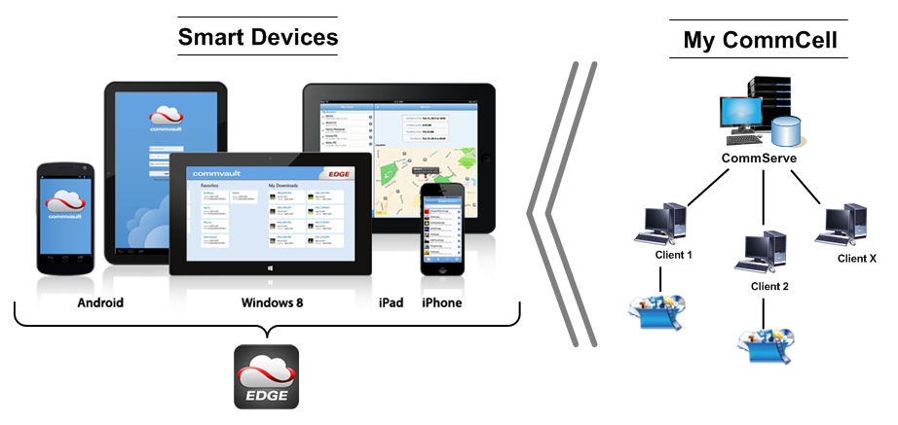
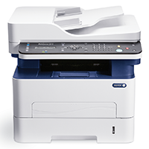
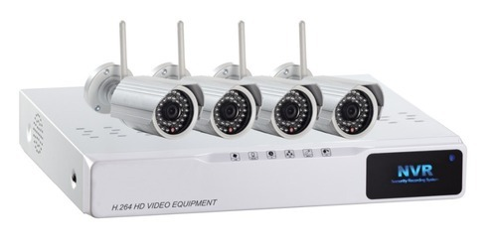
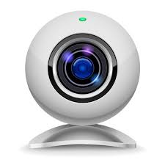
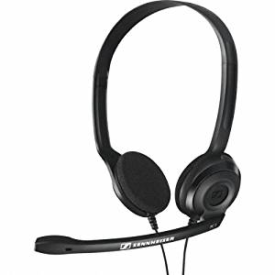
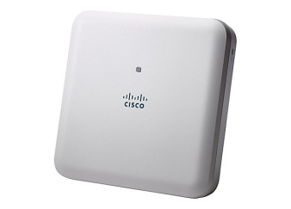
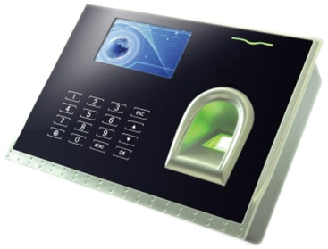
Hardware
Desktop, Laptop, Notebook, TV

Slide 11
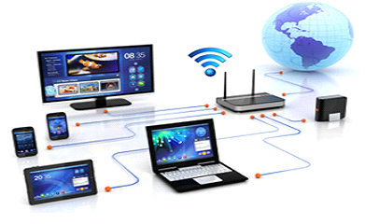
Connectivity
Intranet:
Data Link Layer (L2 Link)
Internet:
Network Layer (L3 Link)
Broadband Connection:
DSL (ADSL/ SDSL)
Cable Modem
Optical Fiber
Wireless (Radio)
Satellite (VSAT)
Broadband over
powerline (BPL)
Fiber Connectivity:
Government Offices
Schools
Hospitals

Slide 12
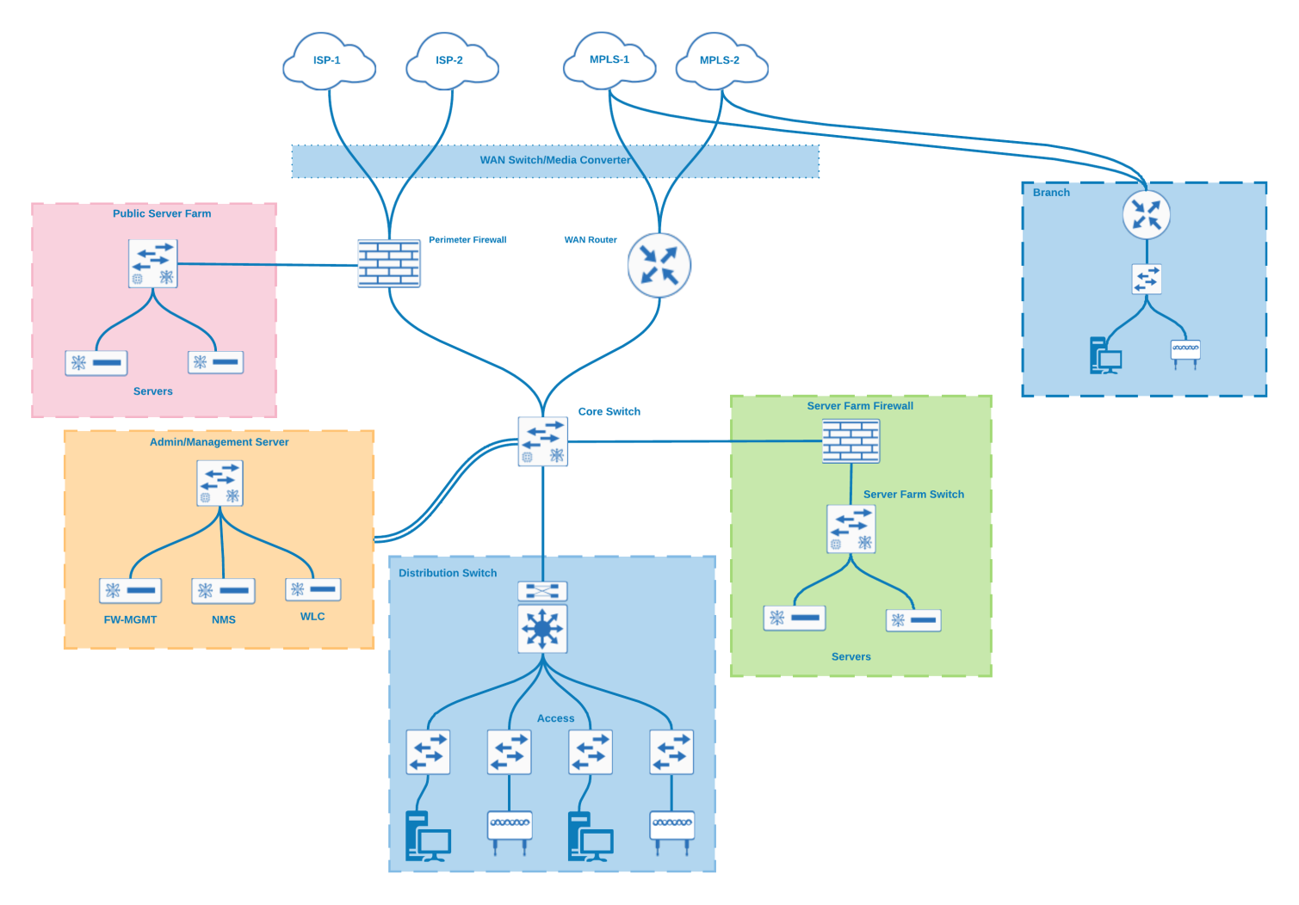
Network/Security
Province Level
Network
Municipality Network

Slide 13
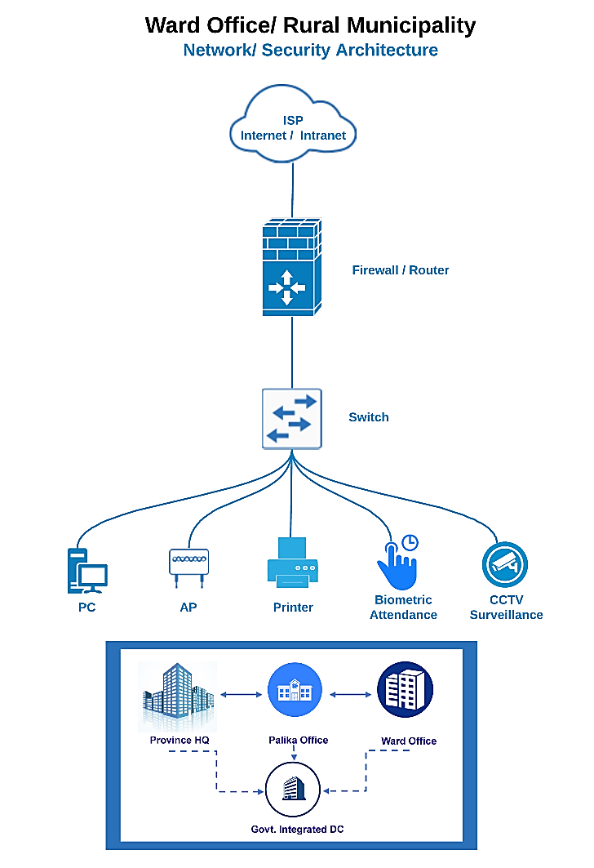
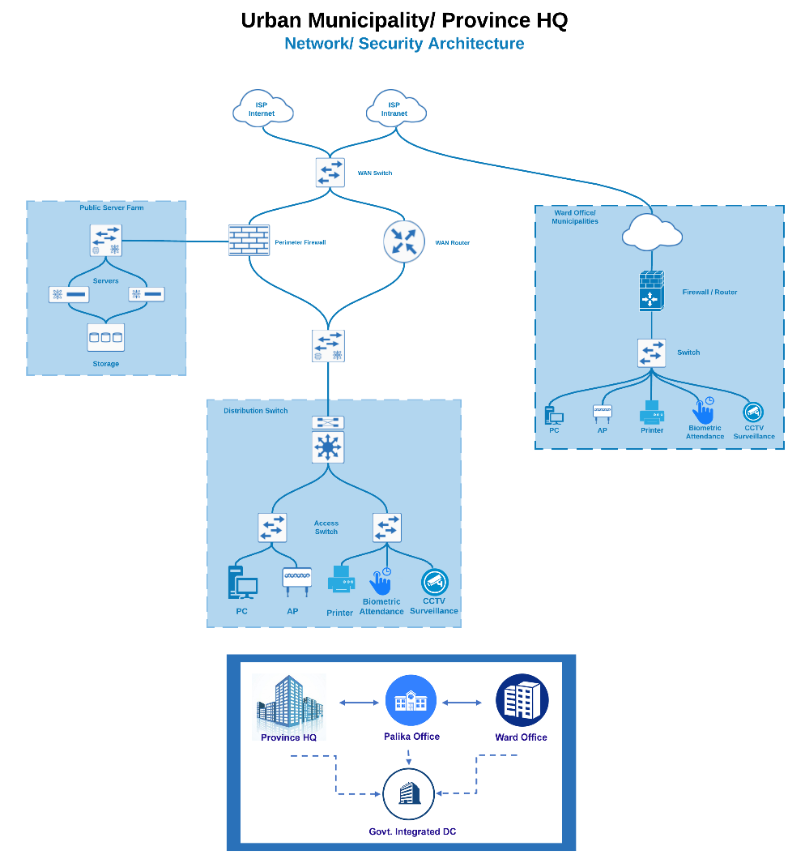

Slide 14
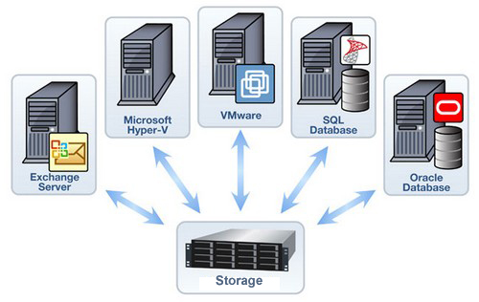
Server/Storage
Servers:
Application Servers
Database Server
Network Storage:
SAN (Storage Area Network) –
high-end servers, high-capacity disk
arrays, and Fibre Channel
NAS (Network Attached Storage) –
NAS devices onto the LAN via TCP/IP
Storage on Cloud

Slide 15
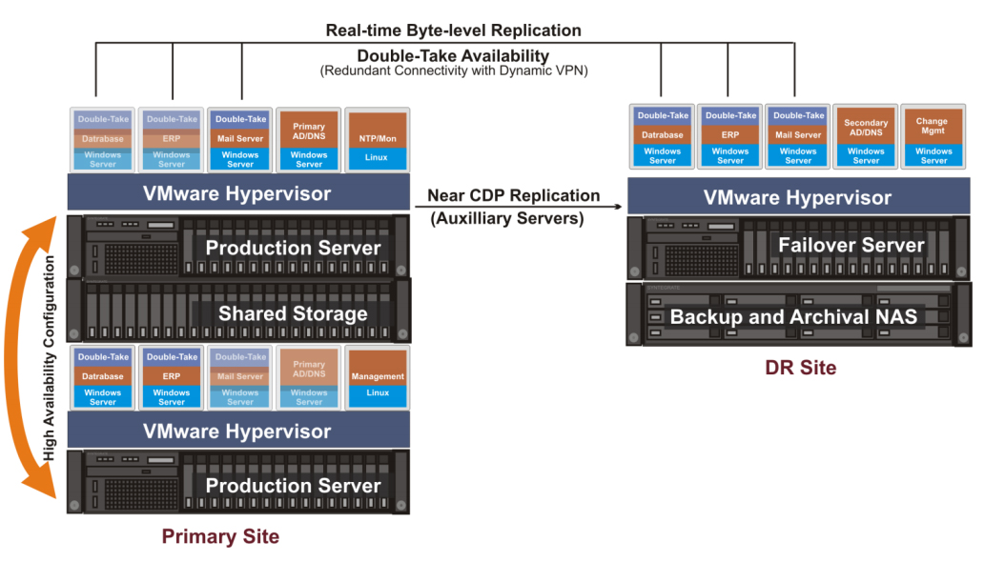
DC-DR System (Server/Storage) Architecture

Slide 16
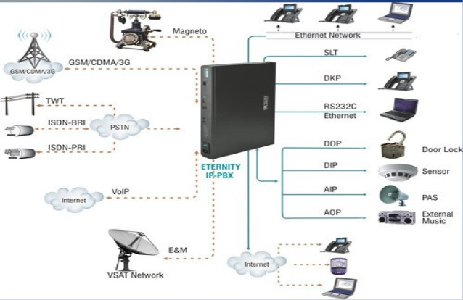
ePABX
(Unified
Communication)

Slide 17
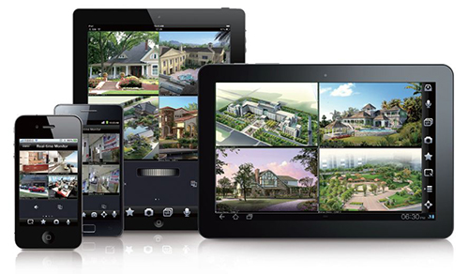
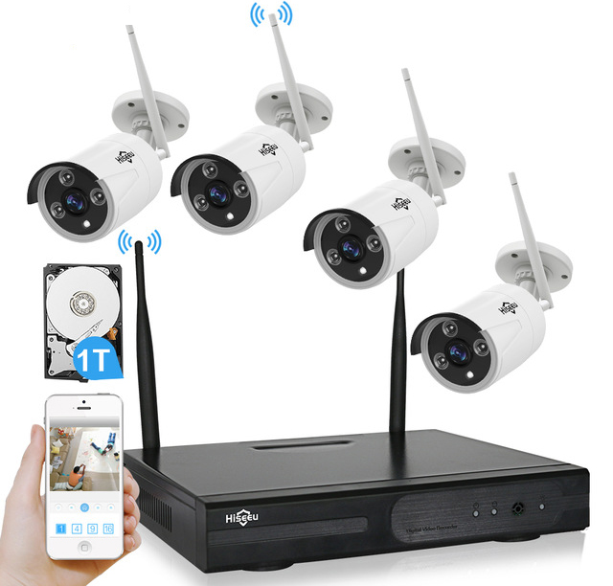
CCTV Surveillance System

Slide 18
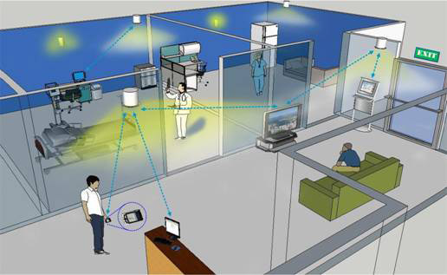
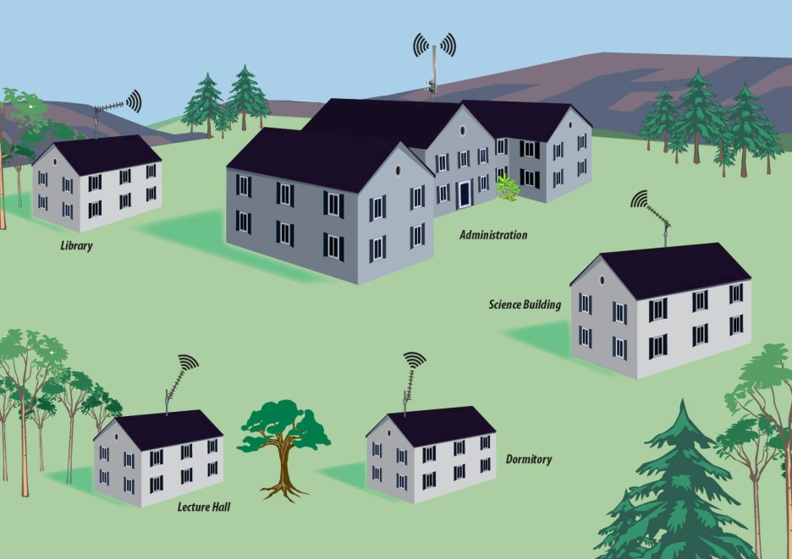
Smart WiFi (WiFi Zones - Hotspots)
Indoor
Outdoor

Slide 19
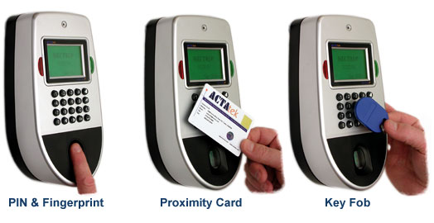
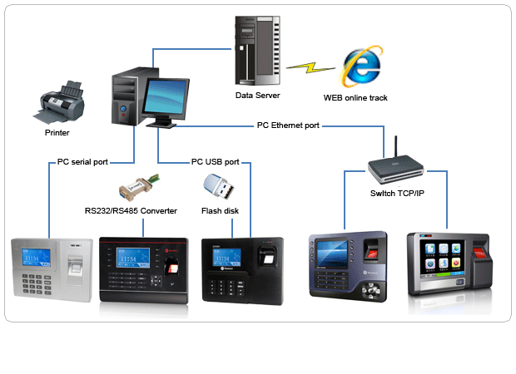
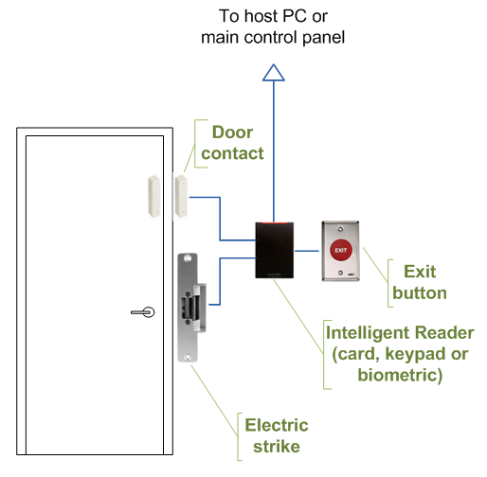
Biometric Access Control & Time Attendance System

Slide 20
Applications

Slide 21
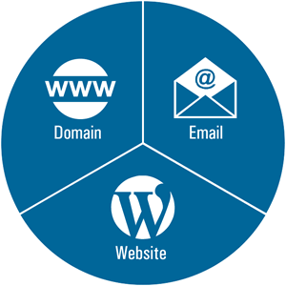





Centralize E-mail & Web Service
Web Mail (existing solution)
e-mail Client
Read or send email through browser and the web mail interface
Or.. web mail service provided with ISP
Application that runs on PC/Tablet/Mobile
Enables to send, receive and organize e-mail
Faster and more accessible
E.g. Microsoft Exchange, IBM Lotus Notes, Outlook/Outlook Express, Thunderbird
Centralize E-mail and Web service to entire
Municipalities through Email & Web Server

Slide 22
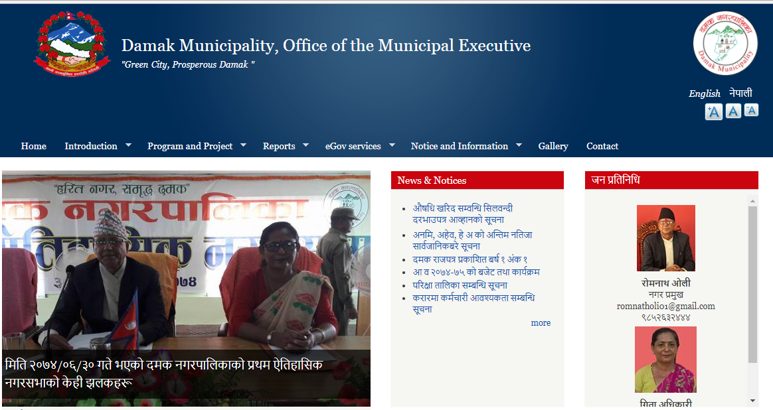
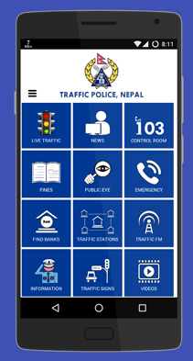
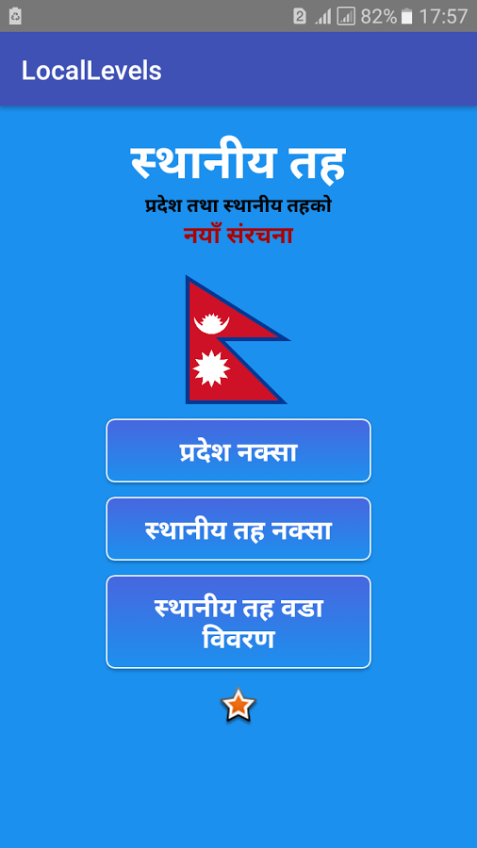
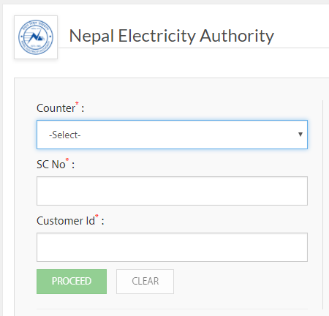
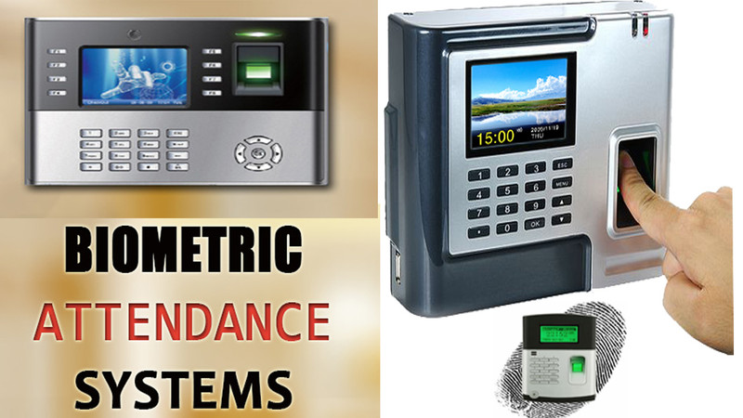
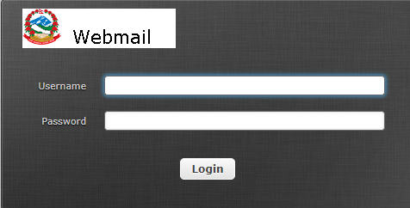
Application
Local Government Applications

Slide 23
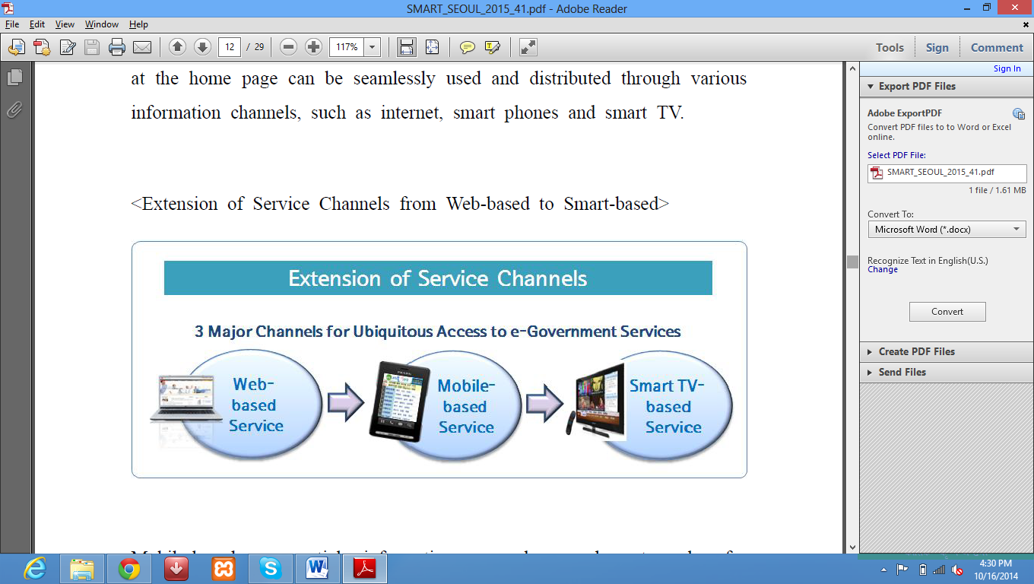
Implementation of E-Governance Stages at Municipality
Automation of all internal activities of Rural Municipality
(Accounting, Payroll, Inventory, HR, e-Attendance, Office Automation)
Online Registration System for Vital Registration System (Birth, Death,
Marriage, Migration)
Online Registration and Issuance of Certificates
Online Tax Payment System
Online Building Permit System
Online Bill Payment Facilities
Digital Portal of Rural Municipalities enriched with Data & Information
Online Registration and Processing System for all services to Public

Slide 24
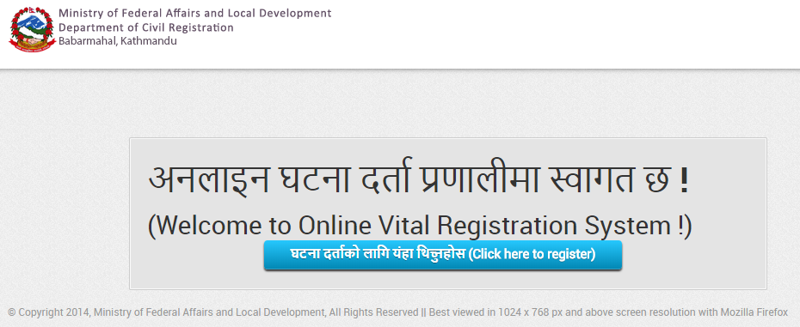
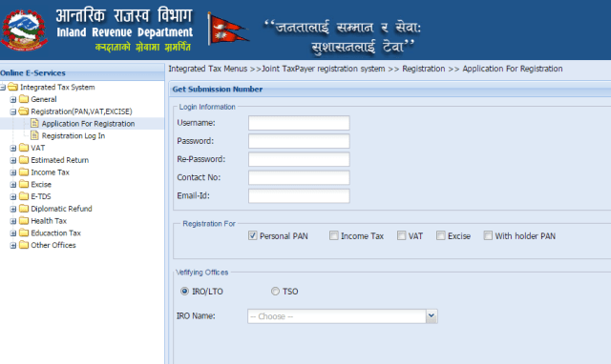




Integration with existing Government Applications

Slide 25



Smart Communication
Secured Inter-Connection among Government Authorities
(Voice, Chat, Video – Example: Skype for Business)

Slide 26
Key Factors for Digital KARNALI
Unique Identity
Centralized Database System
Centralized secured Network
Central system for Government Website Hosting
Centralized Government E-mail system with common Email ID
to each Government Employees
Province wide Data Centre
Cloud Computing (Global
Access)
Web/Mobile Applications
  Citizen Charter
  Government Activities
  Online Utilities Payments
  Taxation System
  Tourism/Heritage
  Transportation
  Health/ Education
  Agriculture/ Heritage
  Banking/share investment
  Employment (Job sites)

Slide 27




Unique Identity & Centralized Data - Mandatory
(National ID should be in place)
Why is it important?
Scattered Data
Birth Registration (MoFALD)
Population Census (CBS)
Citizenship (MoHA)
License (DoTM)
Passport (DoP)
Voter’s ID (Election Commission)
LaalPurja (DoLRM)
VAT/PAN (IRD)
Business Registration (OCR)
EPF/CIT
Bank (KYC)
Benefit
Centralized Data
Uniqueness
Banking
Travel
Shopping
Not necessary to fill
the form everywhere
Ease of Tracking
Crime Control

Slide 28
SMART KARNALI
 ;kmf -k|b'if0f /lxt_
 ;'Gb/ -xl/ofnL ;lxt_
 JojlZyt -af6f], ejg, vfg]kfgL, 9n, lah'nL, 6]lnkmf]g, O{G6/g]6, 6«flkms÷a;kfs{, ahf/ cflbsf] j}1flgs JojZyfkg_
 k|ljlw ;DkGg / ;'zfl;t -e|i6frf/ /lxt_
 cfly{s ;DkGg -/f]huf/L, ul/aL Go"lgs/0f, snsf/vfgf, s[lif pTkfbg, ahf/ JojZyfkg_
 lzIff, :jf:Yo, s[lif, l;+rfO{, a}+lsª, ko{6g, ;Dkbf, Gofo÷sfg"g, v]ns'b
 ;'/lIft tyf afn÷ckf· d}qL
hgtf;+u k|ToIf ;/f]sf/ ePsf ;Dk"0f{ ;/sf/L sfd sf/jfxLx? l56f], 5l/tf] / kf/bzL{ 9+un] ;a}n] cg'ej ug{ ;Sg] u/L ;"rgf ;+rf/ / k|ljlwsf] dfWodaf6 :yflkt ePsf]] ;'JojlZyt zx/nfO{ :df6{ l;6L elgG5 .

Slide 29
FIRST Phase (1)
1. Smart Governance
Paperless Digital & Automated e-Governance System
2. Electricity, Telephone & Internet
3. Smart Mobility & Infrastructure
Smart Households/Building with greenery
Pollution free Smart Road with:
  Smart Drainage/Sewerage
  Smart Ducting for Cables & Pipes
  Smart Light with Solar Panel (underground Cables)
  Intelligent Traffic System with CCTV, WiFi & IoT Sensors
  Separate Bicycle, Pedestrian & Wheelchair Lane
3. Integrated Security System (Fire, Flood, Landslide, Crime
Emergency Alarming System)
4. Smart Waste Management
SMART
KARNALI
Phases

Slide 30


k|ljlw ;DkGg / ;'zfl;t -e|i6frf/ Go"lgs/0f_
Digitization of
Government Services
[Paperless Automation system]
Think BEFORE You Print: 1 ream of paper = 6% of a tree and 5.4kg CO2 in the atmosphere. 3 sheets of A4 paper = 1 liter of water
Citizen ➔ e-Governance (Application) ➔ Service Delivery ➔ No Corruption

Slide 31






Clean & Pollution Free

Slide 32


Visible improvements
Replacing overhead wires…
Greenery

Slide 33

Ducting System

Slide 34

Pedestrian friendly
Road with separate Bicycle Lane

Slide 35
SECOND Phase (2)
Smart Education
Smart Health
Smart Banking/ Billing/ Payment /Investment /Share
Smart Agriculture & Sanitation
Smart Energy (Hydro, Solar)
Smart Water/Electricity (with Smart Meters)
Smart Tourism/Heritage
Smart Security (Crime Control & Communication)
Smart Delivery/Logistic
Smart Shopping (e-Commerce)
Smart Livestock Farming
SMART
KARNALI
Phases
Smart People (Citizen) ➔ Smart Living ➔ Smart Government ➔ Smart City

Slide 36


Smart Education
  Centralized Student Database
  Interactive learning with Audio/Video
  Online progress report
  Online resources
  Remote education
  Online tutorials

Slide 37



Slide 38


Smart Healthcare
  Online common patient and diagnosis recording
  and accessible from the entire hospitals
  Online Ambulance Booking
  Online Appointment to the major hospitals
  Online Report Access

Slide 39



Slide 40



Smart Agriculture
& Smart Sanitation

Slide 41


Slide 42


Smart Waste Management

Slide 43


Slide 44


Intelligent Traffic Management System (Smart Traffic Light, CCTV)
Smart Lighting with photo sensing switching (Auto)
Smart Sight (CCTV)
  Main Road Junctions
  Bus Stops
  Other Public places
  like Court, Police/Traffic
  Stations
Smart Traffic Light
Digital Signage

Slide 45



Smart Banking
Should have common banking societies

Slide 46





Smart Shopping & Delivery

Slide 47





Smart Tourism and Heritage
  Online Reservation
  Online ticketing
  Online Map
  GPS based
  real time information
  Online Information
  System for Heritage Sites

Slide 48




Smart Power/Water (Smart Digital Meter at Households)
Smart Water meter with
GSM SIM card
Smart Power meter with GSM SIM card

Slide 49


Smart Transport
  Smart Bus Stops with real time information using GPS + WiFi + CCTV
  Interactive digital screens
  Advertising Boards
  Smart Ticketing through
  automated ticketing machine
  Travel Cards

Slide 50


Slide 51

Smart Stadium

Slide 52
How SMART KARNALI
can be achieved?
1. Smart Citizen
2. Smart Home
3. Smart Society (Ward/Community)
3. Smart Palika (City)
4. Smart Province (State)
6. Smart Nation

Slide 53

SMART Citizen
At least Smart Phone on Pocket
Data Pack or Easy WiFi Access
Familiar with Technology [2G - GPRS (General Packet Radio Service), 3G, 4G)
Compatible Set, Settings to activate 3G/4G, Service Providers
Familiar with Government Activities (Citizen Charters)
Familiar with available Government Applications
Application download from Play Store (Android), App Store (iOS) & Others
Proper use of the available Applications (Mobile/Web apps)
Government Service Centres
Awareness (Neat & Tidy, Hygiene, Foods, Birth Control, Marriage etc…)

Slide 54

SMART Home/Building
(Home/Building Automation)
PC (Desktop, Laptop), Smart TV
Internet, WiFi
Surveillance System
Access Control
Security Sensors (Smart Locks – Anti Theft, Emergency Services etc…)
Smart Light
Smart Appliances (Remote ON/OFF system)
Auto Cooling (Temperature/Humidity)
Automatic Door (Swing, Slide)
Fire Fighting System
Smart Blinds
Smart Meter (Water, Electricity) etc…

Slide 55




Building Power Management

Slide 56


Main Gate Automation with Remote Control

Slide 57


Auto Swing Main Entrance Door (Sliding)

Slide 58


Smart Blinds, Smart Lights

Slide 59

Remote Control for Building Appliances

Slide 60


Temperature & Humidity Control

Slide 61


Payment Kiosk Terminal and ATM

Slide 62

Smart Water Tank (Auto Power-Cut System)

Slide 63




Smart Wash Room

Slide 64



Smart Urinal (Water Less System)

Slide 65

SMART Village/Society
(Community/Ward)
Hardware (PC, Printer, Photocopy, Attendance, Surveillance etc…)
Network with basic level of security
(Basic LAN and WAN connectivity to connect Palika)
Connectivity (Internet L3/Intranet L2)
Email Access
Paper Less system (Digitalization)
Citizen Charter through Local Government Applications (Mobile/Web Apps)
Security system to the public (Ambulance, Anti-theft alarm, public siren etc..)
Citizen to Government (Complaints/Feedback)
Awareness to the public about available government services
Government Service Centre
Facilities provided by the Government
Trained IT Officers (Through LGCDP)

Slide 66
SMART Palika
(Rural/Urban)
Hardware (PC, Printer, Photocopy, Attendance, Surveillance etc…)
Medium Level Data Centre: Network with moderate level of Security
(Basic LAN and WAN to the Province/State), Server/Storage system
Connectivity (Internet L3/Intranet L2)
Email and Website
Paper Less system (Digitalization)
Government Service Centre to facilitate Government Services
Smart City Components (Varies from one Palika to another)
  Smart WiFi
  Smart Health
  Smart Education
  Smart Agriculture and Irrigation
  Smart Waste Management
  Smart Water and Electricity

Slide 67
SMART Province (State)
Data Centre to connect entire Palikas (Rural/Urban Municipalities) with:
Wide Area Network with High level of Security (Access to Rural/Urban
Municipalities and connectivity to the Central Government)
Servers for Email (Client based email like Ms. Exchange, IBM Lotus 123, Open
Source Zimbra etc…), Web, Smart Cities Applications and Storage System
Integration with Central Government Applications like: Passport, License
Smart City Parameters rather than Smart Palikas…
  Smart Transportation using Intelligent Traffic Management System
  Smart Energy (Solar, Windmill)
  Smart Transportation
  Smart Tourism/Heritage
  Smart Payment Gateway
5. Poverty reduction
6. Employment Opportunities

Slide 68
SMART Nation
High Level of Government Cloud/ Government Integrated Data Centre
Mobile Data Centre (Incase of Huge Natural Disaster)
National ID, Smart License, Smart Citizenship (Central Database)
Smart Roads, Electric Railways
Smart Transportation and Accident Response
Smart Energy/Grids (Hydropower, Solar, Wind, Nuclear)
Smart Banking
Smart Taxation
Smart Land Reform Management
Poverty Alleviation
Employment Opportunities
Placement opportunities for highly skilled manpower

Slide 69



Educate/Aware Citizens through Digital Online Media
Solution:
Create Social Media Pages
  YouTube Channel
  Face book Page
  Twitter Page etc..
  Upload educational and
  awareness Contents in
  Social media pages and
  Share it publicly.
  Develop user friendly Mobile
  Apps
Association of
Academic
Institution
Traffic Rules Video
College & School
Principals
Parents & Societies
College & School
Teachers
Students

Slide 70

SMART
KARNALI
Indicators
&
Phases

Slide 71




Slide 72

RESULT

Slide 73

Thank You
Contact:
Hemanta Baral (ICT Consultant)
M: 9843067142
hemanta.baral@gmail.com
www.hemantabaral.com.np
https://hemantabaral.wordpress.com
Any Questions?

