Slide 1
PRESENTATION
on
Fire Safety
Date: May 30, 2025 Friday
Time: 3PM to 4PM
Venue: CodAvatar Conference Hall, 5th Floor
By: Hemanta Baral
Director of Operations
Fire Marshal

Slide 2







Profile:
Hemanta Baral
(Writer/ICT Consultant)
Masters in Computer Network Security, UK
Over 25⁺ years experience in ICT sector
www.hemantabaral.com.np

Slide 3
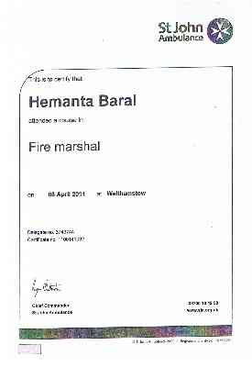
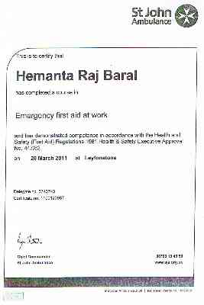

Slide 4
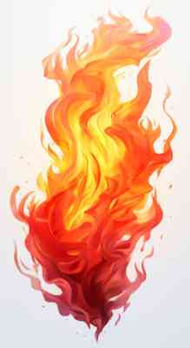
What is Fire?
Fire is a chemical reaction among heat, oxygen in the atmosphere and some sort of fuel (for example: wood or gasoline).
So, fire needs three elements to occur.
  Heat
  Oxygen
  Fuel

Slide 5
FIRE Triangle
OXYGEN
+
Combustible (FUEL)
+
HEAT
Oxygen
Heat
Combustible

Slide 6
NO TRIANGLE – NO FIRE
‘a fire can only start
when all 3 are present’
Remove the HEAT
Oxygen
Heat
Combustible
Remove the OXYGEN
Oxygen
Heat
Oxygen
Heat
Combustible
Combustible
Remove the COMBUSTIBLE (FUEL)

Slide 7
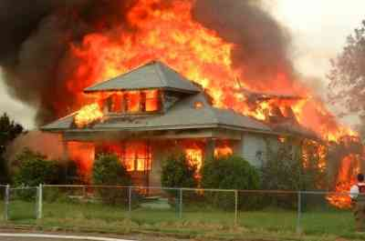
DON’T LET THIS HAPPEN TO YOUR HOME/OFFICE!

Slide 8
HOW TO FIGHT WITH FIRE?
Detect: - To Find Actual Sources of Fire.
Protect: - Protect yourself first before to save others.
Fight: - Use Proper Agent to Fight with Fire.
Knowledge of the chemistry of fire
is an important factor
to use
the proper extinguishing agent / equipment

Slide 9
CAUSES OF FIRE
Incidental/Accidental
(Natural Calamities, Ignorance, etc.)
Negligence
(Unattended Fire, Children, Electricity, etc.)
Intentional
(Vulgarism, Riots, Revenge, etc.)

Slide 10
FIRE - FIGHTING
Knowledge of the chemistry of fire is an important factor.
Fires have many characteristics. Therefore, the fire-fighters or [user] must be able to recognize these characteristics as well as how to use theproperextinguishing agentor equipment .

Slide 11
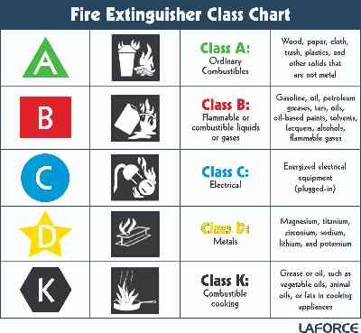
CLASSIFICATION
OF FIRE

Slide 12
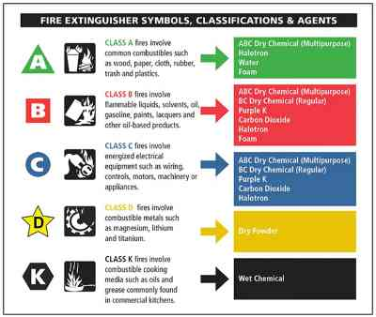
Fire Extinguisher Symbols and
Agents required to suppress

Slide 13
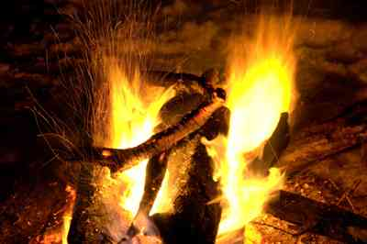

CLASS
WOOD – PAPER – PLASTIC-Clothes, etc.

Slide 14
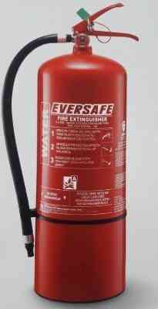
Water Extinguisher
Used for class ‘A’ fires e.g: wood / paper etc
Direct the jet at the base of the flame and keep it moving across the area of the fire.
Seek out any hot spots after the main fire is extinguished.
A fire spreading vertically should be attached at it’s lowest point and followed upwards.

Slide 15
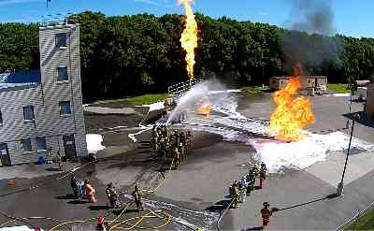

CLASS
PETROL – KEROSENE – DIESEL etc.

Slide 16
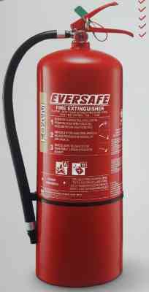
Foam Extinguisher
Used for class ‘A’ and ‘B’ fires eg:
Wood, paper, petrol etc
Direct the jet with a gentle sweeping movement, and allow the foam to drop down and lie on the surface liquid.
DO NOT aim the jet directly into the liquid as this will drive the foam beneath the surface and render it ineffective. In addition it may splash the fire to the surrounding area.

Slide 17
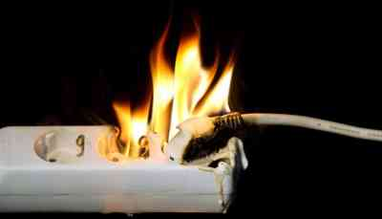

CLASS
ELECTRICALLY IGNITED Invisible, Explosion Type

Slide 18

Carbon Dioxide Extinguisher
Used for class ‘B’ and ‘C’ fires eg: petrol and electrical
DO NOT hold the horn – it becomes extremely cold during use.
DO NOT use in confined spaces as there is a danger of asphyxiation.

Slide 19
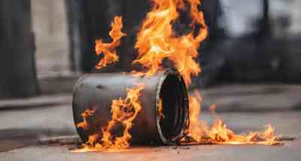

CLASS
METAL FIRE

Slide 20
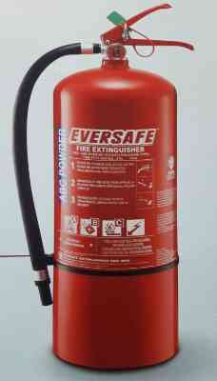
Dry powder extinguisher
Used for class ‘A’, ‘B’, ‘C’, ‘D’ fires eg:
Wood, paper, petrol, gas, electrical
Liquid fires – direct the nozzle towards the near edge of the fire. With a rapid sweeping motion drive the fire towards the far edge until extinguished.
Electrical equipment – switch off the apparatus / power supply if possible.

Slide 21
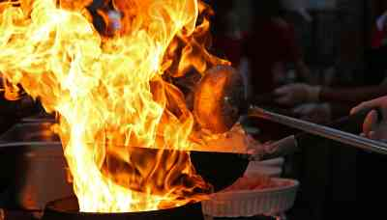
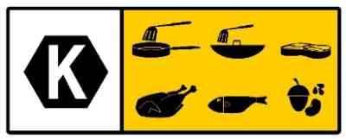
CLASS
Kitchen FIRE

Slide 22
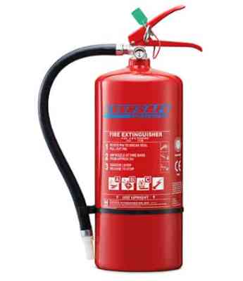
Wet Chemical Extinguisher
Used for class ‘A’, ‘B’, ‘C’, ‘K’ fires eg:
Wood, paper, petrol, gas, electrical, kitchen
Kitchen Fires

Slide 23
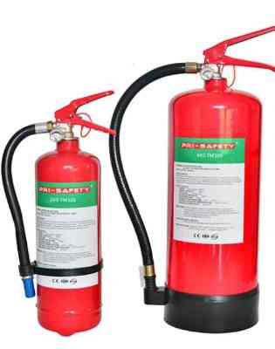
FM 200/ NOVEC 1230
Used for Server Room/Data Centre equipment
FM200 is a non-flammable gas used for fire suppression. It doesn't damage electronic products, used correctly it's safe for people to breathe in and can be used in an enclosed space, making it ideal for colocation data centers.
Novec 1230 is an eco-friendly option that rapidly extinguishes fires by removing heat. It's electrically non-conductive and leaves no residue.

Slide 24
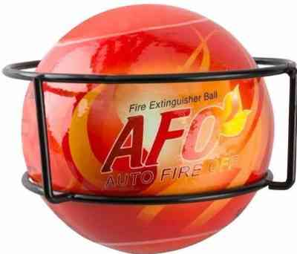
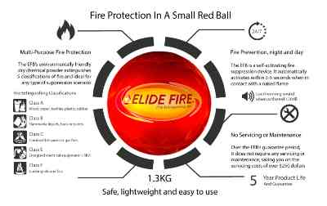
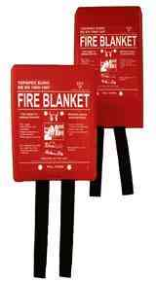
Fire Ball

Slide 25
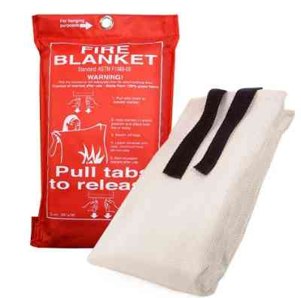
Fire Blanket
Ensure you are positioned between the fire and the fire escape route / door.
Pull the tapes to remove the blanket from it’s container.
Hold blanket by the handles and using as a shield to protect your face completely cover the fire.
Turn off the electric / gas supply.
Leave the area closing all fire doors behind you and contact the fire brigade.
DO NOT remove a fire blanket for at least 30 minutes.

Slide 26
Handheld Extinguishers Types
Class A (Water based)
Suitable for Wood, Cloth, Paper, Plastics etc…
2. Class B (Carbon dioxide or a dry chemical agent)
Suitable for Flammable liquids such as Gasoline, Kerosene and many chemical agents including gases.
3. Class C (Carbon dioxide, Halon, Dry chemical agent)
Suitable for Data Centers and for electrical equipments such as appliances of all kinds, computers, motors…
4. Class D (Dry Powder based)
Suitable for metals such as sodium, lithium, titanium, magnesium etc…)
5. Class K (Liquid chemicals)
- Suitable for Kitchen for fires involving cooking fats and oils

Slide 27
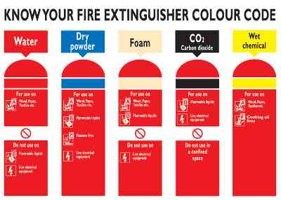
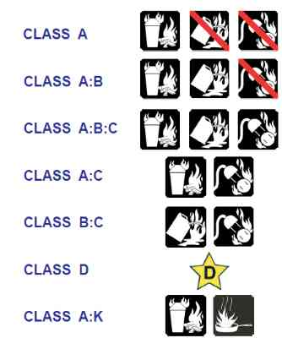

Slide 28
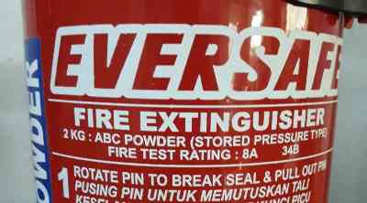
How to choose right Fire Extinguishers?
Description | A Solid Fire | B Liquid Fire | C Electrical Fire
Water Type | √
Foam Type | √ | √
Gas Type |  | √ | √
ABC Type | √ | √ | √
8A: 8 Gallon of Water (8x3.7Ltr. = 29.6 Ltr)
34B: Fire caused by 34 Liter flammable liquids

Slide 29
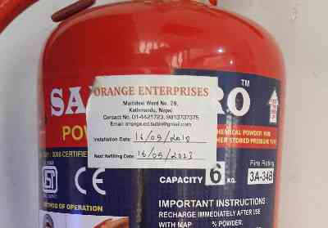
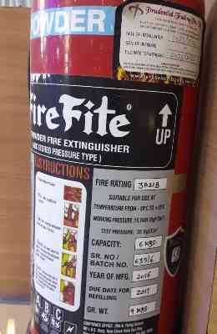
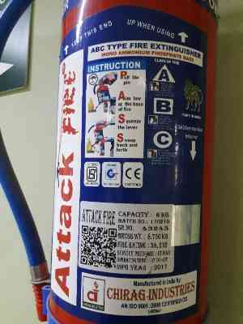
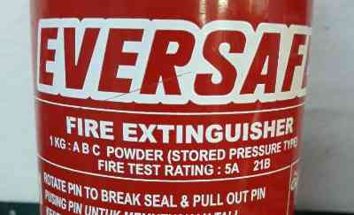
How to choose right Fire Extinguishers?

Slide 30
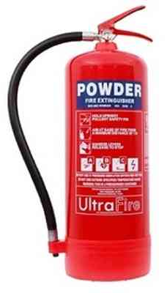
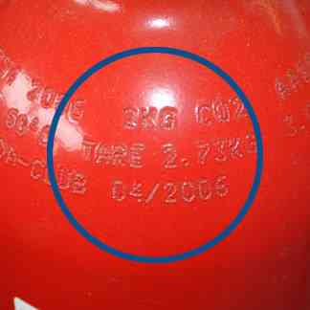
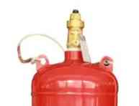
How to identify branded Fire Extinguishers?
Locally made (Not authentic and safe)
external labels for information
handwritten information
manual welding
Branded (Authentic and safe)
No external labels for information
No handwritten information
(carved)
No manual welding

Slide 31
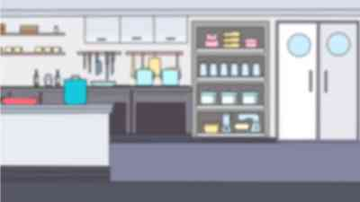
How to use of Fire Extinguishers?

Slide 32
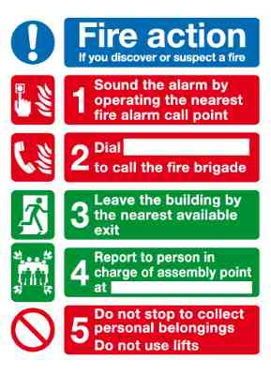
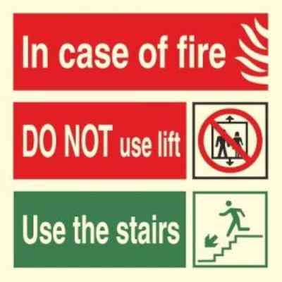
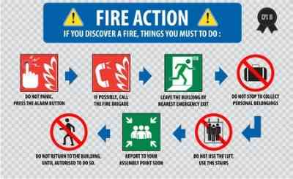
In case of Fire

Slide 33
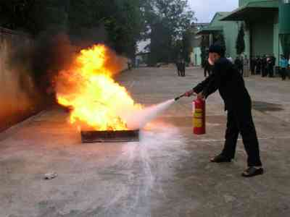
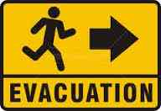
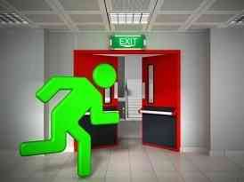
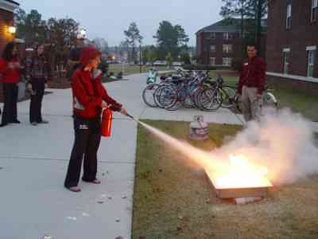
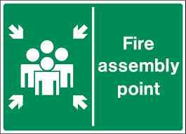
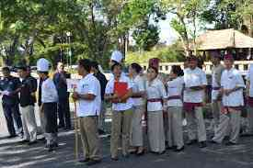
In case of Fire
EVACUTION FROM FIRE…..

Slide 34
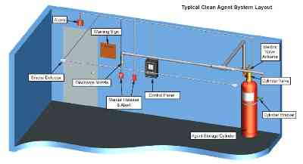
Fire Detection/Suppression System

Slide 35
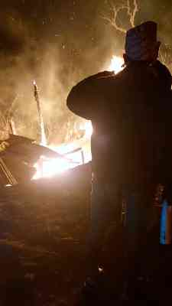
Fire Destruction

Slide 36
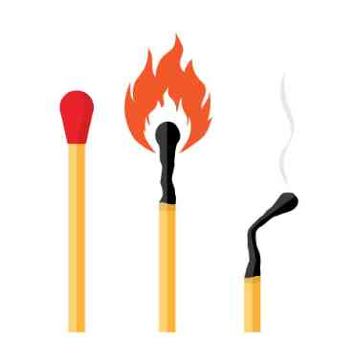
! BEWARE!
TAKE FIRE PREVENTION CARE
“Matches have heads but no brain,
while you use them use your brain.”

Slide 37
A Quote
“Train people well enough so they can leave. Treat them well enough so they
don’t have to.”
– Sir Richard Branson

Slide 38
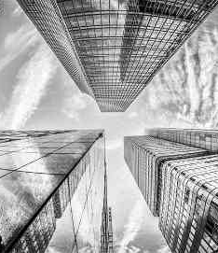
Thank you…

