Slide 1

Pre-Sales/
Sales Training
How to deal with the Customers?
HEMANTA BARAL
CEO; TECH-PRO Pvt. Ltd.

Slide 2


Profile:
Hemanta Baral
Masters in Computer Network Security, UK
Over 20⁺ years experience in ICT sector
Data Centre Consultant for:
DoC (Department of Customs)
CAAN (Civil Aviation Authority of Nepal
DoTM (Department of Transport Management)
Expertise/Certification:
Certified Data Center Professional (CDCP)
European Computer Driving License (ECDL)
ICT Examiner for University of Cambridge (AS & A Level)
Regular Trainer for Cyber Security to Nepal Police Senior Officers
M: 9843067142
E-mail: hemanta.baral@gmail.com;
hemantabaral@yahoo.com
Web:
www.hemantabaral.com.np
https://hemantabaral.wordpress.com
Writer
ICT Consultant
Former IT Officer, GoN)

Slide 3
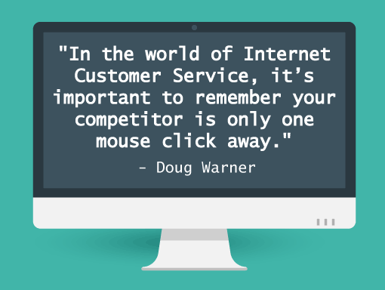

Slide 4
How to talk to the customers?

Slide 5
Key Notes:
89% of consumers will begin doing business with a competitor after a poor customer experience
Talking to your customers is just like going on your 1st date. First impression you make on them is crucial to make the long term relationship.

Slide 6
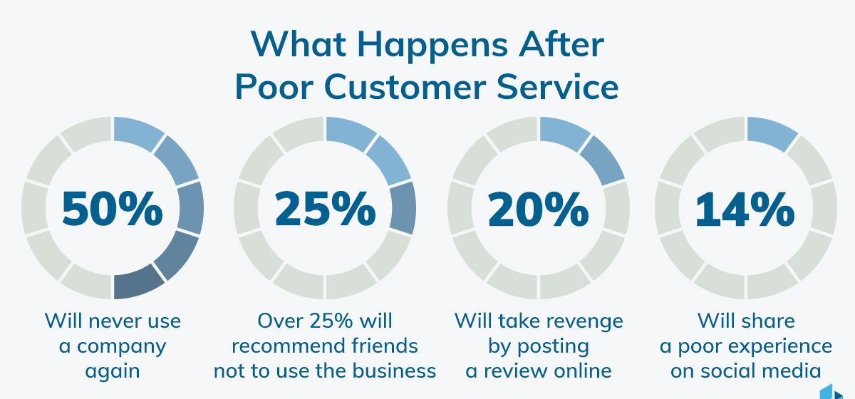

Slide 7
Advice 1
Always need to start by saying “Hello sir, Namaste/Good Morning, Afternoon, Evening”.
Advice 2
Introduce yourself and present your Business Card.
Example: Sir, I am Jenisha Khadka, Sales Executive for TECH-PRO.

Slide 8
Advice 3
Memorize customer’s name and make sure also that you always use customer’s name during the meeting.
Speak about your company’s core business i.e. about products/services you offered.

Slide 9
Advice 4
You don’t need to use formal words that you wouldn’t use in real life.
Be Real and use your own specific language.
  Make sure that you’re using a vocabulary that your customer will understand as well.
Just remember you’re not here to shine your light of knowledge on him but instead teach him how to go through the issues he’s encountering in the easiest way possible. Always keep it as short as possible.

Slide 10
Advice 5
If customer asks for a product/services you haven’t had, Never say NO.
  Avoid as much as possible negative sentences like “that isn’t possible”, “we don’t”, “we won’t”, “we can’t”.
Try replacing them by “we’re working on it”, “it will be available soon”, “I’ll talk about it with the team and get back to you”, “you can try this instead”. Remember: you’re here to bring solutions to your customers.

Slide 11
Advice 6
Have a look at customers’ websites, their Facebook, LinkedIn or twitter account, their blog posts and try to find out about their strength and prior knowledge. All these information help you to connect with our customers in a more personal way and to personalize how you help them.

Slide 12
Advice 7
Always approach them in positive way.
  Instead of “please let me know if you have any questions”, try “does this help you?”
  Instead of “if you have any other problems, just let me know”, try “Did that answer your question? And does it make sense?
  Instead of “if there is anything else you need, please let me know”, try “Anything else that I can help with today?”
It shows the customers that you’re really listening to them and that you sincerely want to help them out.

Slide 13
Advice 8
“a customer service apology”.
instead of a simple “thank you for reporting this bug”, maybe you can try “I understand how painful this must be”, or “we’re encountering the same difficulty here and are trying our best to resolve it quickly”. Let your customers know their problem is also your problem and that you are taking the matter into your own hands.
Advice 9
Always use: “nice to meet you”, “thank you”, and “goodbye”.

Slide 14
How to deal with the customers?

Slide 15
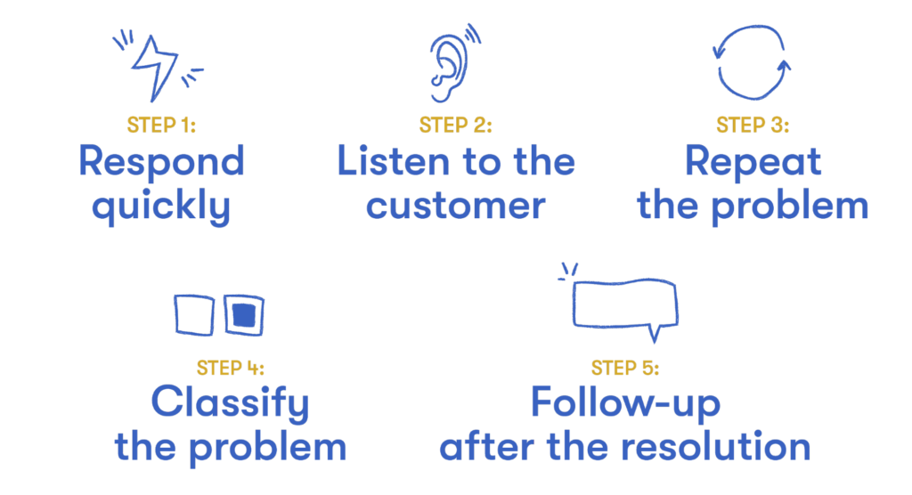

Slide 16
How to deal with the customers?
1. Get to the point
When dealing with clients, it’s important to remember that your clients are busy. They have other meetings to attend, phone calls and emails to return, and problems to solve. Time is their most precious asset.
So don’t waste their time by arriving late, fumbling with the projector, or making long introductions. Get to the point, preferably in the first minute.
2. Ask questions
After you’ve spoken for a few minutes, stop and ask your client a question.

Slide 17
How to deal with the customers?
3. Sell a vision first
Don’t walk into the meeting and immediately start talking about yourself or your company or your products. If you do this, your client will immediately focus on cost and product features.
Instead, focus on selling a vision first. Your clients want to know how they can beat their competitors, reach new customers, retain existing customers, and increase profit margins.

Slide 18
How to deal with the customers?
4. Lead with stories, not data
Introduce stories first, then the data to back it up. Come to the presentation armed with customer experiences and competitor moves. Your clients are far more interested in what you are saying and what their competitors are doing.
5. Use PowerPoint or Keynote wisely
If you’re going to use PowerPoint or Keynote in your presentation, do so wisely. Avoid complex design — too much text, distracting designs, and unrelated images.
  You should only put one picture and one line of text on a slide.

Slide 19
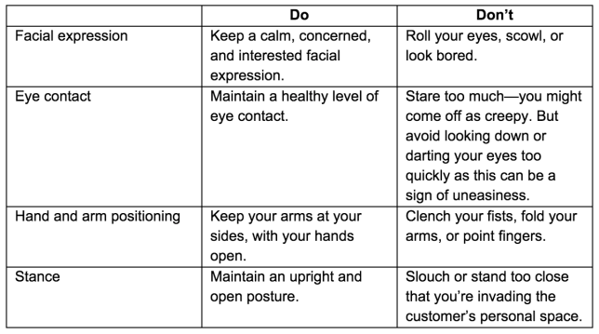
How to deal with the customers?
6. Keep it short
Keep your presentation as short as possible, about 15-20 minutes. The more you try to tell your clients, the less they remember.

Slide 20
How to deal with the customers?
7. Have a clear agenda
Your presentation must also have a clear agenda.
Challenge/Opportunity. Begin your presentation by illustrating the opportunity or challenge that your client is overlooking. Make sure it’s compelling enough to motivate your client to listen to the rest of your presentation.
Benefits. Discuss the benefits that your client will achieve by adopting your solution. Use a customer case study or testimonial to support your point.

Slide 21
How to deal with the customers?
Plan. Present your plan or options to resolve the client’s challenge/opportunity.
Company. Briefly share your company’s background, including who your company helps with these issues.
Recommend. Before closing your presentation, be sure to ask for the business. You might close by asking the client, “Do you believe that the solution that I’ve presented to you will effectively help you overcome your challenges and achieve your goals? Do you want our help?”

Slide 22
Ways to increase sales

Slide 23
Ways to increase sales
1. Be bold. Increase your success in retaining and growing current customers by focusing your efforts on calling on the right people in the right accounts with innovative and unique ideas.
2. Be a true consultant for your customer. Talk business strategy with your customers. Show how your product or service advances their strategy. Create solutions that solve your customers’ problems. Customers expect solutions that support and drive their central business strategies.

Slide 24
Ways to increase sales
3. Talk results with customers. Show how your product or service can positively affect customers’ performance.
4. Be innovative. Increase credibility as a trusted advisor by bringing to the table innovative, highly differentiated solutions that respond to customers’ unique business challenges. Customers want new ideas and insights from your experience with issues like theirs.
5. Do your homework. Focus on both results and the relationship. Before getting in front of a customer, know about his or her own customers, competitors, strengths and weaknesses.

Slide 25
Ways to increase sales
6. Resist the pressure to overpromise. Overpromising is a frequent trap that some salespeople fall into.
7. Focus on results and relationships. Show commitment to your customer by adding value.
8. View each customer’s company as a market. Focus efforts on segmenting and capturing share of this market.
9. Be clear on price.
10. Let your customers build a relationship with your product.
11. Be honest.

Slide 26
10 Ways to Make Customers Fall in Love with Your Business

Slide 27
Ways to increase sales
Nurturing relationships with your customers is a crucial part of growing a successful business. At any moment, an unhappy customer can share their opinion with the masses through social media and the web and negatively affect your business.
“Do what you do so well that they will want to see it again and bring their friends.”
Creating love between your company and your customers can help scale positive word of mouth that’s absolutely priceless.
Creating a customer-focused culture of this nature is a business opportunity that should not be overlooked.
  As many as 89% of consumers began doing business with a competitor following a poor customer experience.
  Up to 60% of consumers will pay more for a better customer experience.

Slide 28
1. Treat your Customers Right – Genuinely Interact
Happy customers who get their issue resolved tell 4 to 6 people about their experience.
2. Don’t Come on Too Strong – Respect Your Customers
A third of consumers say they experience rude customer service at least once a month, and 58% of them tell their friends.

Slide 29
3. Always Listen – Hear What Your Customers are Saying
At a time when it’s easy to have a two-way dialogue with your customers, it’s important to truly listen.
Use the following methods to gather feedback from your customers:
  Surveys
  Customer Service
  Social Media
  Communities and Groups
  Email and Web Forms

Slide 30
4. Continue to Satisfy – Offer Ongoing Support and Specials
The #1 reason for customer attrition is dissatisfaction with customer service. Do everything in your power to provide excellent service to your customers on an ongoing basis. Respond quickly and enthusiastically, and be ready to present a special offer or discount with the hope of up-selling the customer to buy more.
5. Treat a Customer Like a Valued Partner – Communication is Two Way
As previously mentioned, take your customer’s feedback seriously and act upon reasonable requests. What’s the point of listening if you’re not going to act on that feedback? Make sure it’s clear that you want your customer’s feedback and that your business truly values them as a partner.

Slide 31
6. Build Trust – Alert Customers to Large Scale Changes, Good or Bad
It takes 12 positive service experiences to make up for 1 negative experience. This is how sensitive trust is between a business and its customers. No matter your size, keep your customers in the know when it comes to positive and negatives changes to your products and services that affect them. It’s crucial to tread lightly when making changes to your products and services because your customers have become accustomed to what you’ve already got.

Slide 32
7. Be Transparent – Honesty is Crucial When it comes to Mistakes
Being transparent in the digital age is a must. Much like the principles discussed above, transparency is a critical factor in building trust, satisfaction, and love from your customers. What does it mean to be transparent?
  Transparency means that you are not afraid of feedback.
  Transparency means that you have nothing to hide.
  Transparency means you like to have conversations with your customers.

Slide 33
8. Follow Through on Your Word – Follow Up on Promises
Your word is your bond. Following up on your promises helps show the transparency of your business, while helping to build a feeling of trust and dependability with your audience.
9. Recognize Responsibility – The Customer is Always Right
No matter the circumstance, the customer is always right. This is a rule to guide your business through its growth, from customer service to user experience to product development.
10. Always Say “Thank You” – Kindness and Gratitude will Take You Far
Last, but certainly not least, always say “Thank you.” As many as 3 out of 4 customers say they have spent more with a company because of a history of positive experiences.

Slide 34
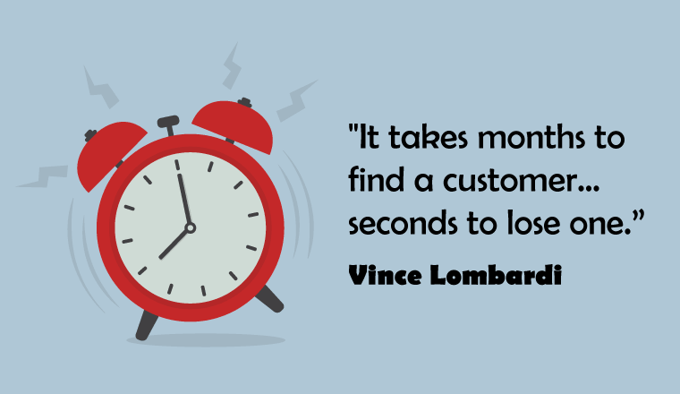

Slide 35

Any Questions???
Thank You

