Slide 1

PRESENTATION on
Emerging Technologies and Trends
Job market statistics and projections
Current IT sector overview (Nepal and Global Context)
Key players and market leaders
Use of ICT in Good Governance to control corruption
By: Hemanta Baral

Slide 2
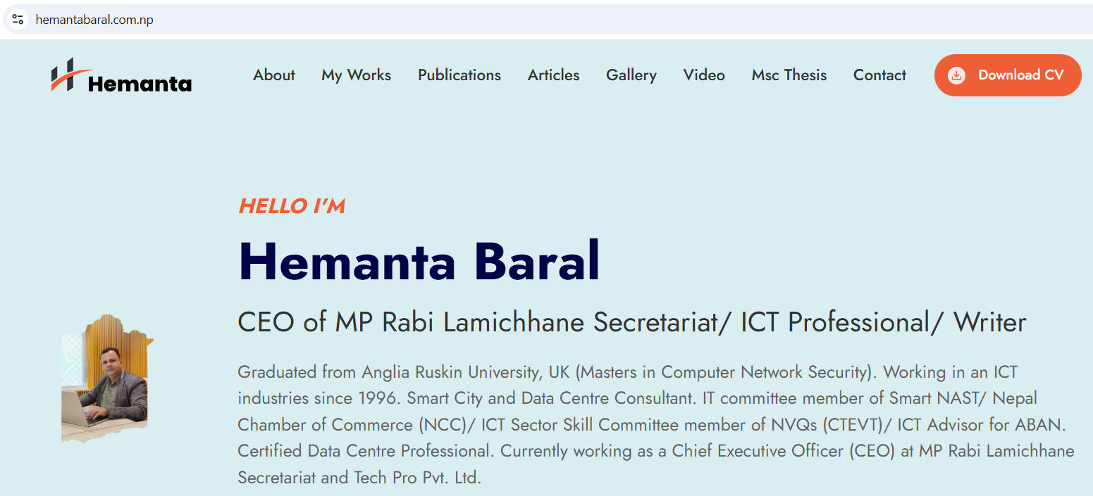
www.hemantabaral.com.np
*Writer (ICT Books) *Cyber Security Trainer for Nepal Police *Smart City Consultant *Data Centre Architect
ICT Professional/ Writer

Slide 3
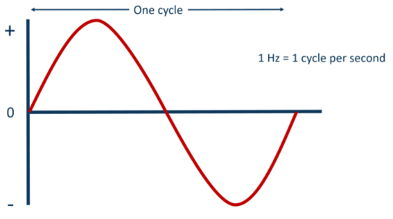
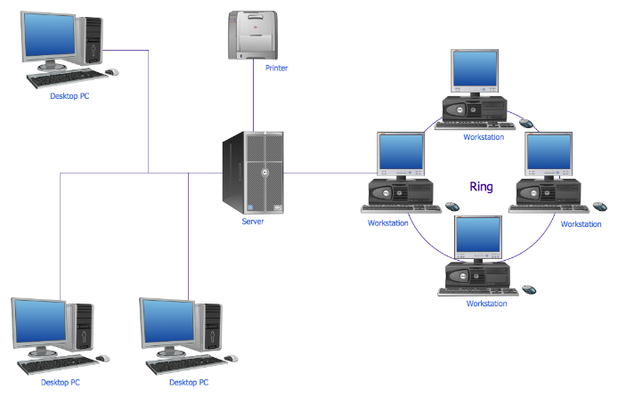
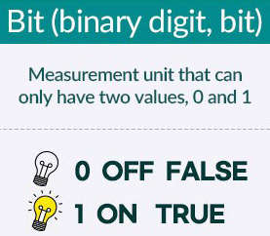
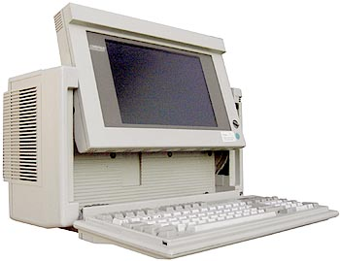
Evolution of IT
Electricity, Frequency, ON/OFF
0,1 – Binary Numbers, Computer Language
IT (Information Technology – Computing only; Standalone - IPO Cycle)
ICT (Information Communication Technology) – Networking; Internet

Slide 4

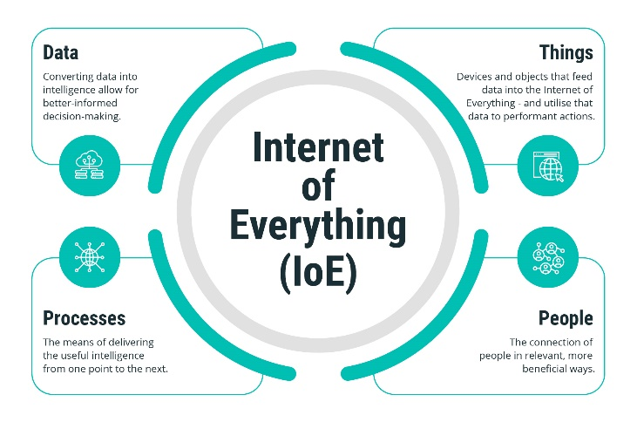
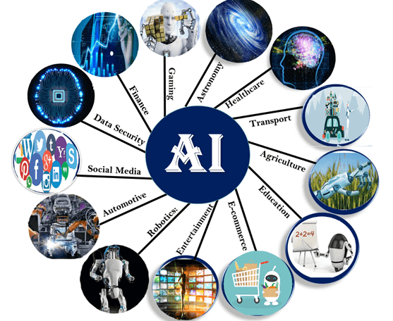
Evolution of IT..
IoT (Internet of Things) – Sensors, Devices, Internet and Cloud
IoE (Internet of Everything) – Data, Things, People, Processes
Artificial/Business Intelligence (AI/BI), Big Data (Blockchain)

Slide 5
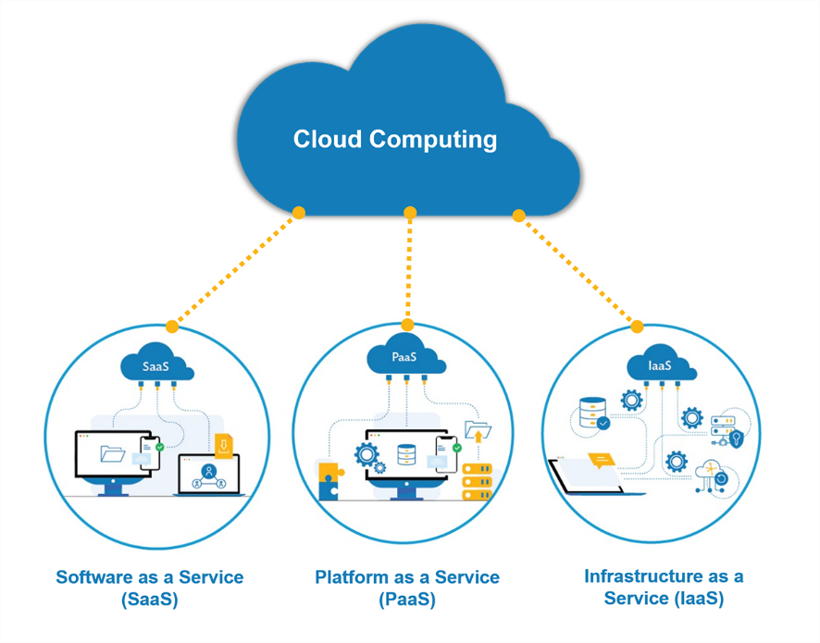

Evolution of IT..
Data Centre (On Premises, Cloud)
Cloud Computing (IaaS, PaaS, SaaS)

Slide 6

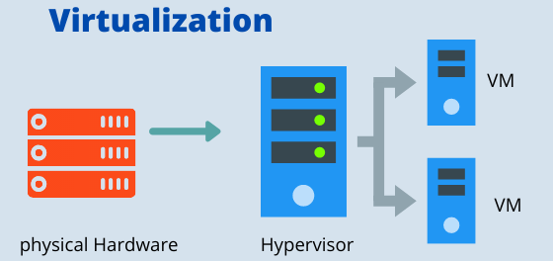
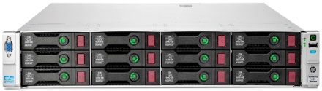
Major Components of Data Centre
Hardware
  Workstations,
  Servers – RISC (IBM, Sun), CISC (Intel based), HCI
    Virtualization
  Storage – HDD/SSD; DAS/NAS/SAN; Cloud
Connectivity (Internet/Intranet)
Network/ Security (Firewall – Network/Application)
Servers
Storage

Slide 7



क्लाउड कम्प्युटिङ
कम्प्युट - प्रोसेसर (Sales Persons)
मेमोरी (Display Area)
स्टोरेज, डाटावेस (Store/Go down)
एप्लिकेशन (Varieties of Goods)
Single PC/Laptop
Cloud Computing

Slide 8
1. Emerging Technologies and Trends in ICT sector
1. Artificial Intelligence (AI) and Machine Learning (ML)
Trends: AI and ML are transforming business operations through predictive analytics, automation, and intelligent decision-making.
Applications: Chatbots, autonomous vehicles, fraud detection, personalized marketing, and healthcare diagnostics.
Emerging Focus: Generative AI (e.g., ChatGPT, DALL-E), AI-powered coding tools, and ethical AI.
2. Cloud Computing and Edge Computing
Trends: Organizations are migrating to cloud platforms for scalability, cost efficiency, and flexibility.
Edge Computing: Data processing closer to the source (e.g., IoT devices) to reduce latency and improve performance.
Key Growth Areas: Multi-cloud strategies and hybrid cloud solutions.
3. Cybersecurity Innovations
Trends: Advanced security solutions to combat rising cyber threats, including AI-driven threat detection and response.
Technologies: Zero Trust Architecture, Secure Access Service Edge (SASE), and quantum cryptography.
Focus Areas: Strengthening critical infrastructure and protecting against ransomware and phishing attacks.

Slide 9
4. 5G and Next-Gen Connectivity
Trends: Deployment of 5G networks to enable faster, more reliable connectivity.
Applications: Smart cities, autonomous vehicles, IoT, and immersive experiences in AR/VR.
Next Phase: Research into 6G technology for ultra-high-speed and low-latency networks.
5. Internet of Things (IoT) and Industrial IoT (IIoT)
Trends: Proliferation of connected devices across homes, industries, and healthcare.
Applications: Smart homes, wearable health devices, and smart manufacturing.
Focus Areas: IoT security and standardization to ensure compatibility and safety.
6. Blockchain and Decentralized Technologies
Trends: Expanding use of blockchain beyond cryptocurrencies into supply chain, finance, and healthcare.
Applications: Decentralized finance (DeFi), digital identity management, and NFT marketplaces.
Emerging Concepts: Web3 and metaverse economies powered by blockchain.

Slide 10
7. Quantum Computing
Trends: Accelerated research and development in quantum computing for solving complex problems.
Applications: Cryptography, drug discovery, financial modeling, and logistics optimization.
Challenge: Making quantum computing accessible and practical for businesses.
8. Extended Reality (XR): AR, VR, and MR
Trends: Increasing adoption of augmented reality (AR), virtual reality (VR), and mixed reality (MR) in entertainment, education, and training.
Applications: Immersive gaming, remote collaboration, virtual classrooms, and healthcare simulations.
Future Direction: Integration with the metaverse and digital twins.
9. Green ICT and Sustainability
Trends: Growing focus on energy-efficient technologies and sustainable practices in the ICT sector.
Technologies: Green data centers, renewable energy-powered systems, and carbon footprint tracking tools.
Key Drivers: Climate change initiatives and government regulations.

Slide 11
10. Autonomous Systems and Robotics
Trends: Advancements in autonomous vehicles, drones, and industrial robots.
Applications: Logistics, agriculture, delivery services, and manufacturing.
Emerging Trends: Collaboration between humans and robots (cobots).
11. Digital Transformation and Automation
Trends: Accelerated adoption of digital tools for remote work, e-commerce, and digital government services.
Technologies: Robotic Process Automation (RPA) and intelligent workflows.
Focus: Enhancing operational efficiency and customer experience.
12. Big Data and Analytics
Trends: Leveraging massive data sets for actionable insights.
Applications: Predictive analytics, real-time decision-making, and personalized services.
Emerging Focus: Data ethics and privacy regulations like GDPR and CCPA.

Slide 12
13. Software-as-a-Service (SaaS) and Everything-as-a-Service (XaaS)
Trends: Shift toward subscription-based IT services and platforms.
Applications: Scalable business solutions like ERP, CRM, and cloud-hosted collaboration tools.
Growth Drivers: Flexibility and lower upfront costs.
14. Metaverse
Trends: Development of shared virtual spaces where users can interact and conduct business.
Applications: Virtual offices, gaming, social networking, and e-commerce.
Key Players: Meta (formerly Facebook), Microsoft, and Nvidia.
15. Digital Inclusion
Trends: Bridging the digital divide by providing internet access and ICT tools to underserved regions.
Focus Areas: Affordable connectivity, digital literacy programs, and infrastructure development in remote areas.
These technologies and trends are reshaping industries, driving innovation, and presenting new opportunities for businesses worldwide. The ICT sector's future lies in integrating these advancements to address global challenges and improve quality of life.

Slide 13
ICT Sectors and Occupational Titles

Slide 14
NC VIII
Data Scientist
Big Data Expert
Block Chain Architect
Machine Learning Engineer
Software Architect
Python Data Engineer
NC VII
Data Architect
AR/VR Architect
SEO Specialist
WordPress Developer
Full Stack Developer
Software Analyst
Full Stack Developer
Data Engineer
CMS Developer
Python Developer
Software/ DevOp Engineer
Python Developer
NC VI
Computer Masters
Data Analyst
Multimedia Developer
SEO Manager
Web Developer
WordPress Programmer
Android App Developer
API Developer
AR/VR Developer
eCommerce Manager
PHP Developer
React Native Developer
iOS App Developer
Desktop App Developer
3D Printing Software Developer
Drone Developer
QA Analyst/ Engineer
Java Developer
Robotic Developer
.NET Engineer
Python Developer
NC V
Computer Professional
Database Administrator
3D Animator
Digital Marketing Manager
UI/UX Designer
Front End Developer
Jr. Android Developer
NC IV
Sr. Computer Operator
Presentation Designer
Logo Designer
Digital Marketing Officer
Web Designer
Graphics Designer
Desktop Designer
2D Animator
Technical Content Writer
NC III
Computer
Operator
BPO
Database Operator
Video Editor
NC II
Computer Typist
Data Entry Clerk
1. Software Services & Development

Slide 15
NC VIII
CTO
CIO
NC VII
Sr. IT Manager
Hardware Engineer
Data Centre Expert
IoT Solution Architect
NC VI
IT Manager
Enterprise Support Manager
Data Centre Specialist
Remote Engineer
CCTV Expert
e/PABX Expert
Access Control Expert
NC V
Asst. IT Manager
Tech Support Executive
Data Centre Professional
CCTV Professional
e/PABX Professional
Access Control Professional
NC IV
Enterprise Support
Professional Support
Data Centre Technician
Repair & Maintenance Technician
CCTV Technician
e/PABX Technician
Access Control Technician
IT Helpdesk
NC III
Computer Technician
Computer Support
Laptop Technician
Printer Technician
CCTV Installer
e/PABX Installer
Access Control Installer
NC II
Computer Assembler
OS & App. Installer
NC I
IT Helper
2. Hardware and Infrastructure

Slide 16
NC VIII
Network Architect
NC VIII
System Architect
Cloud Architect
NC VIII
SOC Architect
IT Forensic Specialist
NC VII
Network Analyst
NC VII
System Engineer
System Developer
Cloud Consultant
NC VII
Security Consultant
Network Security Specialist
Network Engineer
System Integrator
Virtualization Expert
AI/BI Analyst
SOC Analyst
SIEM Engineer
IoT Security Specialist
NC VI
Sr. Network Administrator
NC VI
Sr. System Administrator
System Analyst
NC VI
Cyber Security Analyst
Cyber Security Analyst
Incident Response Analyst
Vulnerability
Assessor
Penetration Tester
Network Security Consultant
Security Administrator
NC V
Network Administrator
NC V
System Professional
NC V
Ethical Hacker
SOC Manager
System Administrator
Information Security Manager
NC IV
Network Associate
NC IV
System Associate
NC IV
Incident Responder
Fiber Technician
NC III
NOC Technician
NC III
Windows/Linux OS Installer
NC III
Anti Virus/ End Point Installer
NC II
NOC Operation
NC II
NC II
3. Networking
4. Systems
5. Information System Security

Slide 17
2. ICT Job market Statistics and Projections in Nepal
The Information and Communication Technology (ICT) job market in Nepal is growing steadily, driven by increasing digitalization, IT outsourcing, and government focus on digital transformation. Below are some key statistics and projections related to the ICT job market in Nepal:
Current Status of ICT Job Market in Nepal
Contribution to Employment:
  The ICT sector contributes significantly to employment, particularly in urban areas like Kathmandu, Pokhara, and Lalitpur.
  It is estimated that over 50,000 professionals are currently employed in the ICT sector, including software developers, IT support staff, and telecom engineers.

Slide 18
Key Job Roles:
  Software Developers (Web, Mobile, and Enterprise Applications)
  IT Support and Network Engineers
  Cybersecurity Analysts
  Data Scientists and Analysts
  Digital Marketers
  UI/UX Designers
  System Administrators and Cloud Engineers
Outsourcing Opportunities:
  Many companies in Nepal provide IT outsourcing services to clients in the U.S., Europe, and Australia. This has created jobs in fields like software development, AI/ML, and data processing.
Salaries:
  Salaries in the ICT sector vary widely based on experience and specialization. Entry-level software developers earn an average of NPR 25,000–50,000 per month, while senior roles can go up to NPR 150,000–300,000 per month or higher.

Slide 19
Challenges in the ICT Job Market
Skills Gap:
  A lack of professionals skilled in emerging technologies like AI, blockchain, and cybersecurity.
  The education system is often criticized for not aligning with industry requirements.
Brain Drain:
  Many skilled ICT professionals migrate abroad for better job opportunities and salaries, contributing to a shortage of high-level expertise in Nepal.
Limited Female Participation:
  The ICT sector in Nepal is male-dominated, with less than 30% participation from women. However, initiatives are being implemented to encourage more female participation.

Slide 20
Projections and Trends in the ICT Job Market
Job Market Growth:
  The ICT job market is projected to grow by 10–15% annually over the next five years, driven by:
    Increased IT outsourcing to Nepal.
    Growing demand for digital services within Nepal (e-commerce, fintech, digital payments, etc.).
    Government initiatives in e-governance and digital Nepal frameworks.
Demand for Specific Skills:
  Emerging fields such as AI/ML, blockchain, cloud computing, and cybersecurity will see higher demand for skilled professionals.
  Traditional roles like web and mobile development will continue to be in demand.
Government Initiatives:
  The "Digital Nepal Framework" aims to create over 100,000 ICT-related jobs by 2030, focusing on sectors like e-governance, e-commerce, and digital infrastructure.
  Programs like the ICT Startup Grant Program and skill development workshops are expected to boost the ICT workforce.
Rise of Freelancing and Remote Work:
  Platforms like Upwork, Fiverr, and Toptal have seen an increase in Nepalese ICT professionals offering services like web development, graphic design, and digital marketing to international clients.
  Remote work opportunities have also expanded due to the global shift post-COVID-19.

Slide 21
Key Sectors Driving ICT Job Growth in Nepal
Telecommunications:
  Companies like Nepal Telecom, Ncell, and ISPs are creating jobs in network engineering and IT support.
Software Development and IT Services:
  Firms like Deerwalk, Leapfrog, and Fusemachines are major employers in custom software development and AI.
E-Commerce and Fintech:
  Companies like Khalti, Esewa, and Daraz are driving demand for tech professionals in digital payments and online platforms.
Startups:
  Nepal's startup ecosystem is growing, particularly in IT and software, generating demand for developers, marketers, and data analysts.

Slide 22
Statistical Highlights
Employment Growth: ICT employment in Nepal is projected to grow by 15–20% by 2025.
Top Skills in Demand:
  Programming Languages: Python, Java, JavaScript, and PHP.
  Cloud Computing: AWS, Microsoft Azure, and Google Cloud.
  Cybersecurity and Ethical Hacking.
  Digital Marketing and SEO.
  Data Science and Analytics.
Freelancing Market: Nepalese freelancers earn an estimated $20–30 million annually through global platforms.
Future Outlook
As Nepal continues its digital transformation journey, the ICT sector is expected to remain a key driver of economic growth and job creation.
Bridging the skills gap through education reforms, government programs, and private-sector training initiatives will be crucial for sustaining growth in the ICT job market.

Slide 23
3. Current IT sector overview in Nepal’s context
Nepal's Information and Communications Technology (ICT) sector has experienced significant growth in recent years, emerging as a key contributor to the nation's economy. The government has prioritized this sector, recognizing its potential to drive economic development and create employment opportunities.
Key Developments:
Government Initiatives: The Government of Nepal has implemented policies to attract foreign direct investment (FDI) in the ICT sector, aiming to foster a favorable environment for technological advancement.
Infrastructure Expansion: Efforts have been made to enhance ICT infrastructure, including expanding internet connectivity to rural and urban areas. The Nepal Telecommunications Authority (NTA) has played a pivotal role in regulating and promoting telecommunications services across the country.
Digital Literacy and Education: Organizations like Open Learning Exchange (OLE) Nepal have been instrumental in integrating technology into education, developing digital learning materials, and training teachers to utilize ICT resources effectively.

Slide 24
Challenges:
Despite these advancements, the ICT sector in Nepal faces several challenges:
Infrastructure Gaps: Inadequate infrastructure, particularly in remote areas, limits access to reliable internet services, hindering the sector's growth.
Skilled Workforce Shortage: There is a need for more skilled professionals in the ICT field to meet the demands of a rapidly evolving industry.
Regulatory Hurdles: Complex regulatory frameworks can impede the swift implementation of ICT projects and deter potential investors.

Slide 25
Opportunities:
The ICT sector in Nepal holds substantial potential for growth:
Business Process Outsourcing (BPO): With a growing pool of English-speaking graduates, Nepal is well-positioned to become a hub for BPO services, offering cost-effective solutions to international clients.
E-Governance: The government's focus on digital transformation presents opportunities for ICT companies to develop and implement e-governance solutions, enhancing public service delivery.
Start-up Ecosystem: A burgeoning start-up culture, supported by incubators and accelerators, is fostering innovation and entrepreneurship within the ICT sector.
In summary, while Nepal's ICT sector has made notable progress, addressing existing challenges through strategic investments and policy reforms is essential to fully realize its potential and contribute to the nation's socio-economic development.

Slide 26
Current Global IT sector overview
The global Information and Communication Technology (ICT) sector in 2024 is characterized by mixed challenges and growth opportunities:
1. Innovation and Growth: Following economic challenges such as inflation, high interest rates, and global uncertainties, the ICT sector is poised for a recovery. Analysts anticipate modest growth in 2024, driven by advancements in cloud computing, cybersecurity, and artificial intelligence (AI). Investment in generative AI is particularly notable, with its application expected to enhance efficiency across industries​
2. Key Trends:
Cloud Adoption: Organizations are moving towards more complex multi-cloud systems, focusing on resilient architectures and operational efficiencies. Cloud spending is projected to grow by over 20% in 2024​
​Cybersecurity: The demand for robust cybersecurity measures continues to rise due to increasing cyber threats and evolving regulations. Spending on security technologies is expected to see double-digit growth, emphasizing its critical role in protecting digital assets​
Generative AI: This emerging technology is expected to transform productivity and innovation, with global investments potentially reaching $200 billion by 2025​

Slide 27
3. Workforce and Skills: The sector faces significant skill shortages, particularly in cybersecurity and AI expertise. Companies are addressing this by upskilling existing employees and hiring specialists to meet demand​
4. Globalization and Resilience: Geopolitical instability and supply chain challenges remain pressing issues. The industry is balancing the need for globalization with increased self-reliance and supply chain transparency to mitigate risks​
5. Market Evolution: The role of IT distributors is expanding as they adapt to cloud-based and multi-vendor solutions, enabling businesses to integrate technologies effectively​
Overall, the ICT sector in 2024 is navigating challenges while leveraging opportunities in digital transformation, AI, and cybersecurity to drive innovation and growth.

Slide 28
4. Key Players and Market Leaders - Nepal
In Nepal, the Information and Communications Technology (ICT) sector has a growing number of key players and market leaders. These organizations play significant roles in telecommunications, software development, IT services, and digital innovation. Here are some of the most prominent players:
A. Telecommunication Companies
Nepal Telecom (NTC):
  The largest telecom service provider in Nepal, offering internet, mobile, and fixed-line services.
Ncell Axiata:
  A major private-sector telecom company providing mobile services, internet, and value-added services.
WorldLink Communications:
  The largest private ISP, specializing in broadband internet and related services.

Slide 29
B. Software and IT Companies
  Fusemachines Nepal:
    Specializes in artificial intelligence (AI) and software development.
  Deerwalk Services:
    Focuses on healthcare IT solutions, particularly analytics and software.
  Verscend Technologies (Cotiviti Nepal):
    Provides IT-enabled healthcare solutions and analytics.
  LogPoint:
    A leader in cybersecurity solutions, including SIEM platforms.
C. E-Governance and Public Sector IT
  National Information Technology Center (NITC):
    Oversees e-governance and the development of IT infrastructure for government use.
  Kathmandu Metropolitan City IT Department:
    Promotes ICT-driven urban governance.

Slide 30
D. Start-ups and Innovation Centers
  Paaila Technology:
    A startup known for innovative software and AI-based solutions.
  Khalti:
    A digital wallet service offering online payments and e-commerce solutions.
  Pathao Nepal:
    A ride-sharing and logistics app leading in digital transformation.
E. E-Commerce Platforms
  Daraz Nepal:
    Nepal’s leading e-commerce platform for online shopping.
  Hamrobazaar:
    A growing local e-commerce company offering a wide range of products.
F. Internet Service Providers (ISPs)
  Vianet Communications/ Dish Home:
    Offers internet and IPTV services, known for reliability and customer service.
  Subisu Cablenet/ Classic Tech/ Websurfer/ Techminds/ Broadlink:
    Provides broadband internet, cable television, and networking solutions.

Slide 31
G. IT Training and Education Providers
  Broadway Infosys Nepal/ IT Training Nepal/ Laba/ Computer Point:
    Offers professional IT training and certifications.
  Institute of Engineering, Pulchowk Campus:
    A leading institution for IT education in Nepal.
H. ICT Associations and Support Organizations
  CAN Federation (Computer Association of Nepal):
    Promotes IT growth and represents the ICT industry in Nepal.
  Nepal Telecommunications Authority (NTA):
    Regulates the telecom and internet sector and fosters development.
These players are instrumental in driving Nepal's ICT industry, supporting both domestic innovation and global collaborations.

Slide 32
IT Outsourced Companies in Nepal
Nepal is increasingly becoming a hub for IT outsourcing due to its cost-effective workforce, growing talent pool, and expertise in software development, digital solutions, and IT services. Below is a list of some prominent IT outsourcing companies operating in Nepal:
1. Deerwalk Services
Specialization: Healthcare software development, analytics, and IT services.
Clients: Primarily U.S.-based healthcare providers and insurance companies.
Strength: Expertise in healthcare data and solutions.
2. Leapfrog Technology
Specialization: Custom software development, cloud services, and product design.
Clients: International startups and enterprises.
Strength: Agile development with a focus on user-centered designs.

Slide 33
3. Verscend Technologies (Cotiviti)
  Specialization: IT-enabled healthcare and analytics solutions.
  Clients: Healthcare companies globally, especially in the U.S.
  Strength: Data-driven healthcare solutions.
4. CloudFactory
  Specialization: Workforce solutions for AI and machine learning data processing.
  Clients: Global companies leveraging AI, including those in tech and finance.
  Strength: Scalable and trained workforces for data labeling and management.
5. Fusemachines Nepal
  Specialization: Artificial intelligence (AI) and software engineering.
  Clients: International companies in AI-related domains.
  Strength: AI talent and training programs to bridge the global talent gap.
6. Young Innovations
  Specialization: Open data platforms, custom software, and digital solutions for development sectors.
  Clients: Nonprofits, INGOs, and development agencies worldwide.
  Strength: Experience with open-source technologies and data-driven solutions.

Slide 34
7. Braindigit IT Solutions
  Specialization: Enterprise resource planning (ERP), web and mobile app development, and CMS.
  Clients: Small to medium-sized businesses in the global market.
  Strength: User-friendly business software solutions.
8. Janaki Technology
  Specialization: Messaging platforms, app development, and business automation tools.
  Key Product: Sparrow SMS (widely used for bulk SMS solutions).
  Clients: Domestic and international companies.
9. EB Pearls
  Specialization: Web design, app development, and e-commerce solutions.
  Clients: Australian and European businesses.
  Strength: End-to-end digital product solutions.
10. LogPoint
  Specialization: Cybersecurity, SIEM solutions, and IT security services.
  Clients: Enterprises in Europe and beyond.
  Strength: Advanced cybersecurity products and analytics.

Slide 35
Why Nepal for IT Outsourcing?
Cost Efficiency: Lower operational costs compared to other countries.
Skilled Workforce: A growing number of IT professionals with expertise in cutting-edge technologies like AI, cloud, and big data.
English Proficiency: Most IT professionals are fluent in English, facilitating global communication.
Time Zone Advantage: Nepal’s time zone supports near-shore and offshore operations for Asian and European markets.
Emerging Sectors in IT Outsourcing
AI and Machine Learning: Companies like Fusemachines and CloudFactory are driving AI outsourcing.
Data Analytics: Firms like Deerwalk and Verscend are leaders in healthcare analytics.
Web and App Development: Companies like Leapfrog and EB Pearls specialize in creating global solutions.
These companies are instrumental in putting Nepal on the global map as a reliable IT outsourcing destination.

Slide 36
5. Use of ICT in Good Governance to control corruption
स्वाचालित स्मार्ट ई–गभर्नेन्स (फेसलेस र पेपरलेस) प्रणाली नै भ्रष्टाचार न्यूनिकरणका एकमात्र उपाय हो ।
आई टी को प्रयोग गरेर देश कसरी सिस्टमेटिक र विकसित हुन्छ?
१) प्रत्येक व्यक्तिको लागि एकल अद्वितीय पहिचान (राष्ट्रिय परिचय पत्रको प्रभावकारी कार्यान्वयन जसभित्र जन्म प्रमाणपत्र, नागरिकता, राहदानी, ड्राइभिङ लाइसेन्स, प्रहरी प्रतिवेदन, प्यान, मतदाता परिचय पत्र, भूमि दर्ता, कर्मचारी संचय कोष, नागरीक लगानी कोष, सामाजिक सुरक्षा कोष, शिटरोल, बीमा, जस्ता सम्पूर्ण पहिचानहरूको एकीकरण। विद्युत, पानी आपूर्ति, सञ्चार – इन्टरनेट÷टिभी÷सिम, सबै करहरू आदि...को समावेश)
२) जिपीएसमा आधारित डिजिटल ठेगाना
३) अप्टिकल फाइबर र स्याटेलाइटमा आधारित सुरक्षित संचार सेवा ।
४) केन्द्रीय क्लाउडमा आधारित केन्द्रीकृत डाटा केन्द्र (मुख्य, फेलओभर र डिजास्टर रिकभरी) र केन्द्रीय जस्तै समान संरचना भएको प्रान्तीय डाटा केन्द्रहरू।
५) सम्पूर्ण सरकार र उपयोगिताका सेवाहरूको मोबाइल÷वेबमा आधारित एप्लिकेशनहरु।
६) एपिआई प्रयोग गरी प्रत्येक सेवाहरूको एकीकरण
७) एकल राष्ट्रिय भुक्तानी गेटवे मार्फत अनलाइन भुक्तानी प्रणाली
८) अनलाइन डेलिभरी प्रणाली (हुलाक सेवाको प्रभावकारी कार्यान्वयन)
नतिजाः भ्रष्टाचाररहित पारदर्शी, भरपर्दो, छिटो, प्रभावकारी अनि कुशल सेवाको प्रवाह

Slide 37





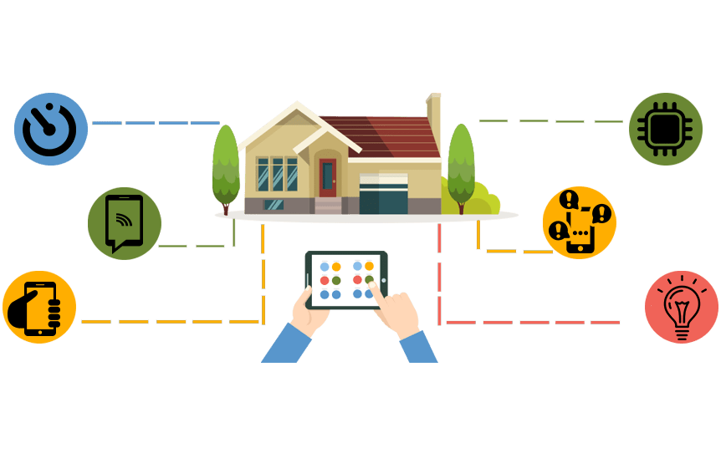
k|ljlw ;DkGg / ;'zfl;t -e|i6frf/ Go"lgs/0f_
Digitization of
Government Services
[Less paper (later on paperless) Automation system]
Think BEFORE You Print: 1 ream of paper = 6% of a tree and 5.4kg CO2 in the atmosphere. 3 sheets of A4 paper = 1 liter of water
Citizen ➔ e-Governance (Application) ➔ Service Delivery ➔ No Corruption

Slide 38
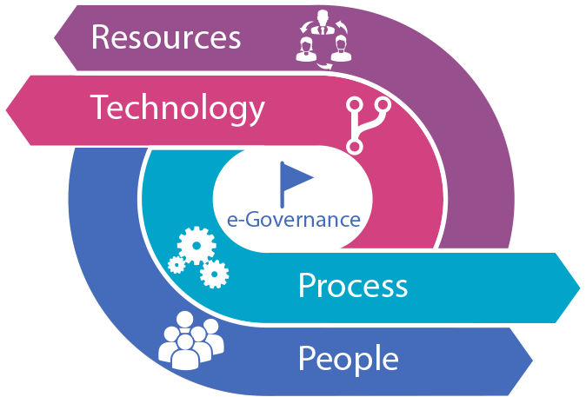
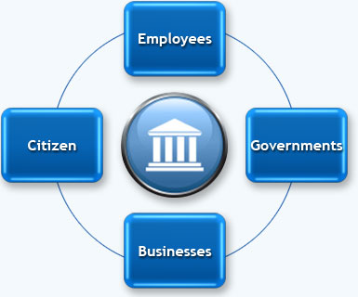
Digitization by implementing:
e-Governance: It is the transformation of government processes to provide efficient, convenient and transparent services to the Citizens and Business through Information and Communication.
G2C:
e-Registration (National ID)
e-Citizenship, License, Passport
e-Passport, Voter's ID
e-Taxation
e-Health
e-Education
e-Transportation
e-Land Registration
e-Payment (Electricity, Telephone, Water, Internet, Mobile)
G2C, G2B, G2G, G2E, C2G
(E-Governance Models)

Slide 39
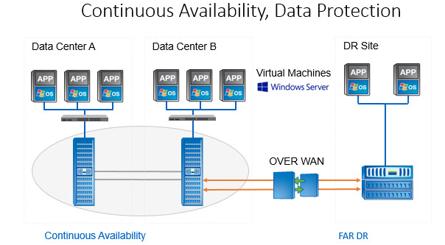
Things to be DONE to control CORRUPTION
Unique Identity – Effective Implementation of National ID
Digital Street Addressing - GIS Mapping
Centralized Database Management System (DBMS)
Cloud based Data Centre [a. Primary, b. Secondary (Near DC or Failover
DC) and c. Disaster Recovery (DR)]
  Central
  Province-wide
  Use of Applications (Automated and Integrated)
  and Mobile Applications for End-users (Android
  and iOS version)
Centralized Secured Network (Optical Fiber)
Central System for Government Website Hosting and centralized
Government E-mail system with common Email ID to each
Government Employees

Slide 40
Why Unique Identity & Centralized Database?
Why is it important?
Get rid of scattered Data
Birth Registration (MoFALD)
Population Census (CBS)
Citizenship (MoHA)
License (DoTM)
Passport (DoP)
Voter’s ID (Election Commission)
LaalPurja (DoLRM)
VAT/PAN (IRD)
Business Registration (OCR)
EPF/CIT
Bank (KYC)
Benefits:
Centralized Data
Uniqueness
Banking
Travel
Shopping
Not necessary to fill
the form everywhere
Ease of Tracking
Crime Control

Slide 41

Any Questions???
Thank You

