Slide 1

Codavatar Tech
presents: Academia to
industry excellence
A tailored career roadmap for the Engineering and Science &
Technology Department at Mid West University, Surkhet.
Hemanta Baral

Slide 2

Nepal’s IT evolution from local
support to a global ecosystem
Understanding the rapid transformation of the technology landscape in which you will build your career.
Fintech
Financial technology services
AI
Artificial Intelligence development
Product Design
User-centric solution design
Evolving Global
IT Ecosystem
Cloud Computing
Enterprise cloud solutions
Data Science
Data analysis and insights
Cybersecurity
Infrastructure
Digital protection and defense
Core technical frameworks

Slide 3



Bridging the critical gap between qualification and employability
Why a degree from Mid West University is your foundation, but your skills are your currency.
Exam-based solver
Industry solver
Focuses on writing perfect code to
pass paper-based examinations.
Uses Git in team environments, deploys
to cloud infrastructure, and secures APIs.

Slide 4




Dominant sectors in the Software and Mobile landscape
Specializing in a complete technology stack to stand out in the competitive job market.
Frontend/Backend
Mobile
Database
API focus
Focus on JavaScript,
TypeScript, Python, or .NET.
Mobile developers must
master API integration and
secure authentication.
Practical knowledge of
PostgreSQL or SQL Server is
essential for production-
grade apps.
Modern development is built
on robust REST and GraphQL
architectures.

Slide 5
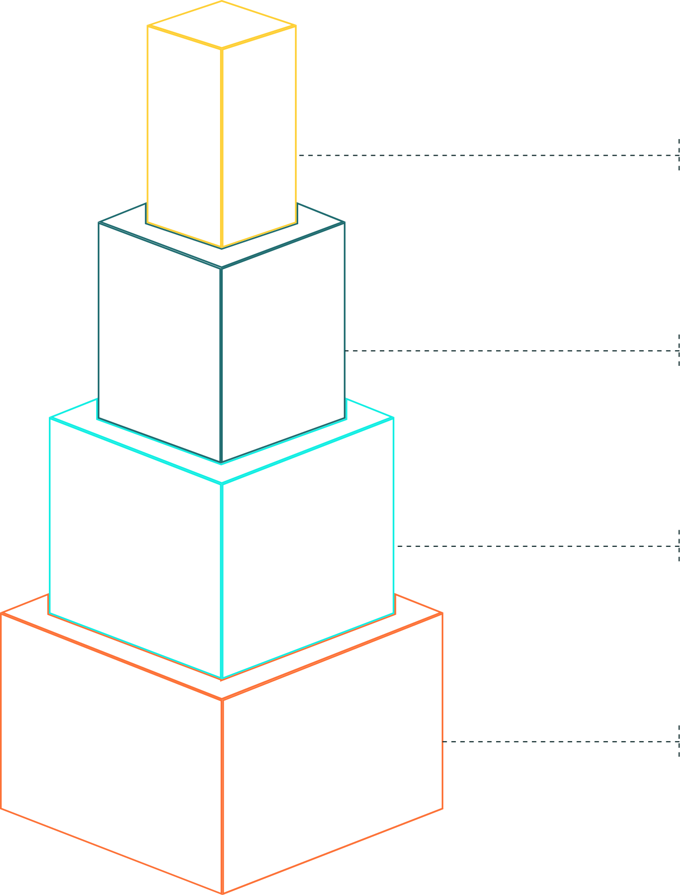
Infrastructure
Networking specialists remain critical for
organizational reliability.
High-growth
specializations in
Cloud, DevOps, and
Cybersecurity
Cybersecurity
Protect digital identities as a SOC
Analyst or Penetration Tester.
DevOps & SRE
Learn Linux, Docker, Kubernetes, and
Terraform to automate software
delivery.
Strategic technical paths that offer
higher compensation and global
mobility.
Cloud Engineering
Master AWS, Azure, or GCP to manage
global-scale infrastructure.

Slide 6

The frontier of AI, Machine
Learning, and Fintech
Leveraging mathematical foundations to drive the next wave of digital
transformation.
01
Fintech and Digital Wallet Demand
Rapid adoption of platforms like eSewa and Khalti is driving
demand for engineers specialized in transaction security.
02
Generative AI Integration
Generative AI is transforming work practices, functioning as a
powerful tool to augment and evolve one's chosen profession.
03
Core Technical Competencies
Mastery of Python, SQL, and frameworks like TensorFlow or
PyTorch is essential to build intelligent systems for clients.

Slide 7
Navigating the financial
landscape of Nepal's IT market
Indicative monthly salary ranges for entry-level and experienced professionals in 2025-2026.
Career Sector | Entry-Level (Monthly) | Experienced (Monthly)
Backend Development | NPR 28,000–50,000 | NPR 100,000–220,000
DevOps / Cloud | NPR 40,000–70,000 | NPR 100,000–220,000
AI / ML / Data Science | NPR 30,000–60,000 | NPR 150,000–400,000+
Cybersecurity | NPR 35,000–55,000 | NPR 100,000–250,000
IT Project Management | NPR 60,000–100,000 | NPR 120,000–250,000+
UI/UX Design | NPR 25,000–45,000 | NPR 70,000–150,000+

Slide 8




Expanding your horizon across three pathways
How to leverage your location in Surkhet to work for international organisations.
Pathway 1: Domestic Employment
Pathway 2: Remote International
Join established firms like Codavatar Tech,
Leapfrog, or F1Soft to build the local
ecosystem.
Stay in Nepal while earning international
market rates from overseas clients.
Global Career
Pathways
Pathway 3: Global Migration
Use specialized skills to move to hubs like
Australia, Germany, or the US.

Slide 9
Building the professional
toolkit that
employers actually value
01
Version Control
Git and GitHub are non-negotiable tools for version
control.
Moving beyond the syllabus to master the tools of the
modern tech workplace.
02
Environment and Collaboration
Mastery of Linux environments and tools like Jira,
Slack, and Microsoft Teams is required.
03
Professional Certifications
AWS Cloud Practitioner, CCNA, or CompTIA Security+
provide objective proof of skill.
04
Practical Experience
Certifications serve as a seal of approval on a
foundation of real projects and hands-on laboratory
work.

Slide 10
The power of a portfolio
and meaningful internships
01
GitHub is your Resume
Maintain active repositories and contribute to open-source
projects.
02
Deploy Live
A recruiter is more impressed by one live, working application
than ten theoretical projects.
03
Documentation
Show that you can write clear technical guides and explain
your architectural choices.
04
Real-world focus
Showing, not just telling, what you are
capable of delivering to an employer.
Use internships to learn about Agile methodologies, code
reviews, and client communication.

Slide 11
A structured 4-year roadmap for
Mid West University students
A year-by-year guide to transitioning from a student to a job-
ready professional.
Year 2
Year 4
Exploration
Employability
Experiment with Web, Mobile, and
Cyber. Discovery your passion through
workshops and small projects.
Complete a meaningful internship, build
a professional portfolio, and prepare
your LinkedIn presence.
Year 1
Year 3
Foundations
Specialization
Focus on core programming, networking,
logical thinking, and improving English
communication.
Pick a track (e.g., Cloud, AI, or Dev) and
develop deep technical skills and pursue
relevant certifications.

Slide 12
Avoiding the common
pitfalls in your
career journey
Certificate Collection
Ignoring Soft Skills
Don't collect certificates
without building the
corresponding practical skills.
A brilliant engineer who
cannot communicate with a
non-technical manager will
face limited career
progression.
Copy-Pasting Projects
Salary Obsession
Employers value genuine
understanding. If you can't
explain why you chose a
specific technology, the
project adds no value.
For your first job, prioritize
mentorship, learning
opportunities, and project
quality over a slightly higher
salary.
Learning from the mistakes that often stall the
growth of young Nepali graduates.

Slide 13

The formula for success
in the modern IT industry
Degree + Specialisation + Projects + Internship + Certification + Communication = Employability.
Degree
Foundational academic qualification
providing core theoretical knowledge
for IT.
Specialisation
Becoming very good at something
valuable within the evolving IT
landscape.
Employability
The ultimate goal: becoming a valuable
contributor to the digital economy.
Projects
Practical application of knowledge;
letting your work speak for your
capabilities.
Communication
Essential soft skill for articulating ideas
and collaborating in global markets.
Internship
Certification
Real-world experience contributing to
industry demands and digital
economies.
Validating technical skills to remain
competitive as the industry evolves.

