Slide 1

KPI
(Key Performance Indicator)
Presentation
By: Hemanta Baral
Director of Operations

Slide 2







Profile:
Hemanta Baral; ICT Professional
(Data Centre/Smart City Consultant/Writer)
Masters in Computer Network Security, UK
Over 28⁺ years experience in ICT sector
www.hemantabaral.com.np

Slide 3
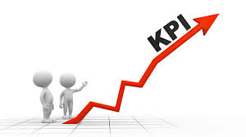
What is KPI?
A key performance indicator (KPI) is a business metric* (*metric is a system or standard of the measurement) used to evaluate factors that are crucial to the success of an organization.
A Key Performance Indicator is a measurable value that demonstrates how effectively a company or individual is achieving their objectives.
In one sentence, KPI is the tracking and monitoring system of the success of the business or individuals.

Slide 4
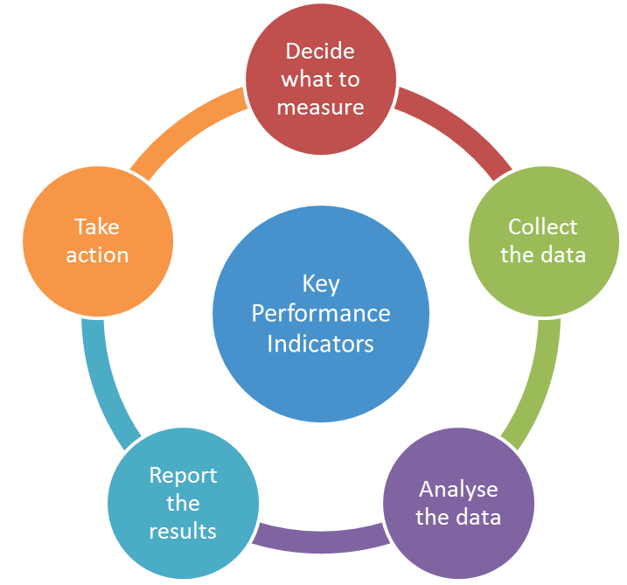
Crucial Factors to make an organization successful
Right People in the Right Place at the Right Time with proper Job Description (JD)
Appropriate designation/level to the Employees
Marketing Strategy (Reach to the Customers) – Pre Sales Activities
Brand/Image/Reputation/Logo/Slogan
Right Product/Services to the Customers – Sales Activities
Profit (Financial Target Achievement)
Organized System
Better Working Environment
Discipline
After sales support – Post Sales Activities

Slide 5
Points to be included while designing KPI – An Example
Preparation of Database (Prospects)
Pre Sales Activities – Customer Visit Schedule/Requirement Identification
Customer Reach with attractive Company Profile/Product-Service Portfolio
Products/Solution as per the Customers’ Requirement (Technical Solution)
Financial Proposal as per Customers’ budget
Regular Follow-up
Work together to materialize and deploy
Business Relationship with the customers
After sales support activities

Slide 6
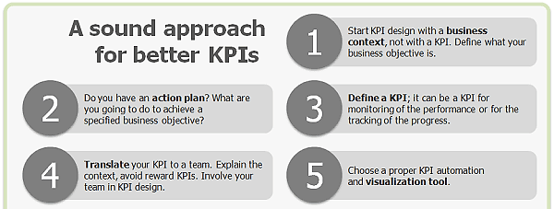
Points to be focused while designing KPI
Financial Target
Activities to be performed to achieve the given target
Benefits declaration after meeting given target in relation with KPI
Appraisal in timely manner
Training
Motivation

Slide 7
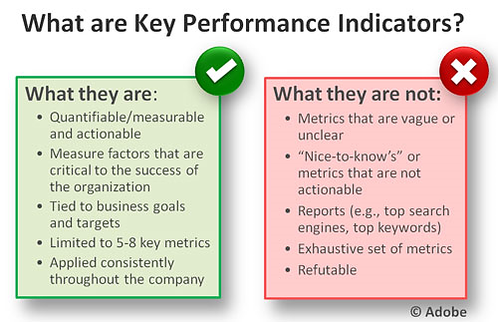
Key factors to be consider while designing KPI
Specific
Measureable
Achievable
Realistic
Relevant
Time Phased
Should reflect to the Job Description

Slide 8
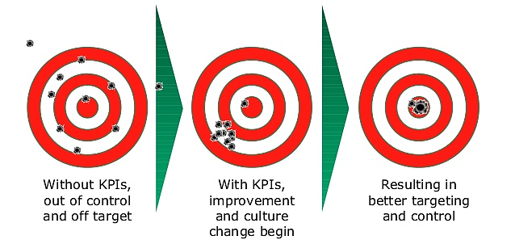
How KPI helps to the Business?
Keeps Employees’ daily activities on track
Employee engagement
Business Analysis
Competitor’s analysis
Marketing Strategy
Discipline
Mutual benefit between Company and its Employee
Benefit distribution, Up gradation, Motivation

Slide 9
Annual KPI –Sales Division – An Example
KPI Category | Total Targeted KPI
Prospects Visit (In-person) | 200 | in a year
Company Profile (in-person/E-mail) | 200 | in a year
Products/Service Information (in-person/E-mail) | 150 | in a year
Presentation to the Clients | 50 | in a year
Technical Proposal | 50 | in a year
Budgetary Price Quotation | 50 | in a year
Market Campaign/ Events (Inside/Outside valley) | 4 | In a year
Appraisal on quarterly basis | 4 | In a year
Financial Target | xxxxxxx | In a year
Other activities: Maintain Database Relationship with customers & Regular Followup Competitors’ analysis Technical/Motivational/Leadership Training

Slide 10
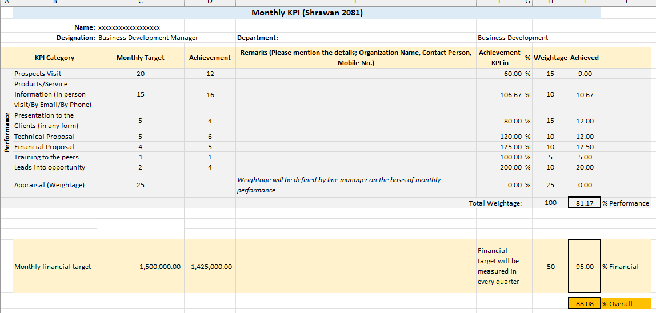
Individual Monthly KPI Example

Slide 11
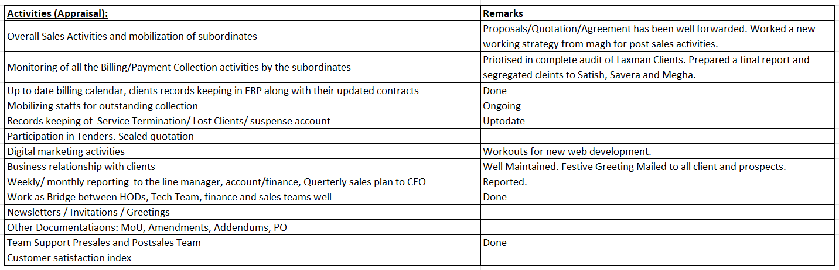
Activities for Appraisal

Slide 12
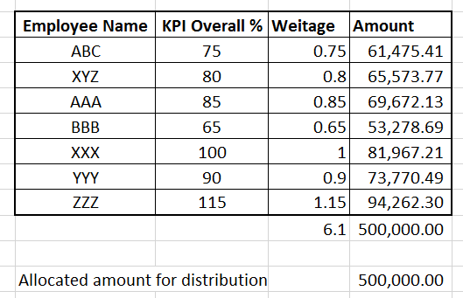
Benefit Distribution – An Example

Slide 13
Thank You

Slide 14
Any Questions???

