Slide 1

Training and
Presentation Skills
How to be a good Trainer or Presenter?
By: Hemanta Baral
Chief Operating Officer

Slide 2






Hemanta Baral
(Writer/ICT Consultant)
Masters in Computer Network Security, UK
Over 25⁺ years experience in ICT sector
www.hemantabaral.com.np
https://hemantabaral.wordpress.com

Slide 3
Training Schedule
Date: xxxxxxxxx
11:00 Introduction Session
11:20 Ice-Breaker (How Intelligent you are?)
11:35 Training Room Preparation
11:50 Structuring a Training Session
12:15 Adult Learning
End of 1st Session (Break 15 Minutes)
12:30 Experimental Learning Model
12:45 Ice-Breaker (Chinese Whisper)
12:55 BREAK (10 Minutes)
13:15 Presentation Skills
13:30 End of Session
Trainer:
Hemanta Baral

Slide 4


  Name
  Role, Department
  Main Strength
  Main Weakness
  Your Expectation from this training
<<Name Tag on the Desk>>

Slide 5

How Intelligent you are?
2 Minutes Exercise

Slide 6
Training Room
Preparation

Slide 7
Before the Training STARTS
Create the Proper Environment for Training

Slide 8
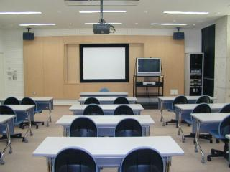
The Training Room
Room temperature, light, noise, etc.
Sitting arrangements
Audio/Visual
Resources
Materials
Water, tea, coffee, & snacks
W.C. locations (Water Closet i.e. Bathroom)
Fire Exit

Slide 9
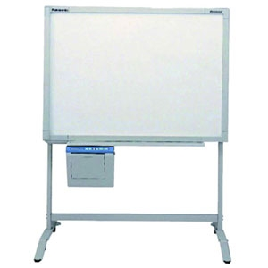




Recommended materials
White board and markers
Projector
Laptop or desktop computer
Name tags
Certificates of completion

Slide 10
During the Training

Slide 11
Once participants are present
Welcome participants and introduce yourself.
Distribute name tags.
Explain your role in this training and your experience.
Ask participants to introduce themselves (if 20 participants or less)
Present the training schedule and agenda (handouts)
Start the training

Slide 12
Once the training is over
Make sure you answer all participants’ questions
Ask participants to complete the Training Satisfaction Survey
Provide your contact information and a follow-up plan for questions
Thank participants for their time

Slide 13
STRUCTURING A TRAINING SESSION
When presentations are poorly organized, the impact of the message is reduced, and the audience is less likely to learn.
POINT

Slide 14
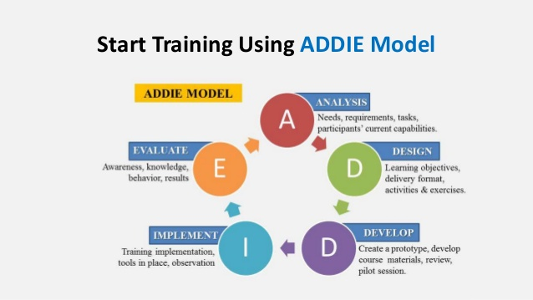

Slide 15
Structuring a Training Session
2. Main
presentation
1. Introduction
3. Summary
4. Questions/Answer Session

Slide 16

1. An Effective Introduction
  Keep it brief
    Don’t go into details of lecture
  Set the objectives
  Set expectations
  Relate to prior knowledge
  Try to get attention

Slide 17
2. Main Presentation
Logical flow
  Every point leads to the next.
  Don’t jump from one topic to other.
  Connect the points.
Explain the details
  Use simple words.
  Use graphics when needed.
Use Examples

Slide 18
2. Main Presentation (Cont.)
  Use Syllabus
  Refer to Handouts
  Answer only content relevant questions
  Ask questions
  Don’t read from slides

Slide 19

3. Summary/Conclusion
  Summary of main points
  Provides a sense of closure
  Time for questions & answers

Slide 20

4. Questions
  Listen to the entire question.
  Repeat the question out loud.
  Pause to think if needed.
  Credit the person.
  Respond to the question.

Slide 21

4. The Answer!
  Always tell the truth!!!
    If you don’t know the answer, promise to research.
    Get back to trainee with answer.
  Answer directly.
    Simple answer to simple question.
    Stay on track, brief and to the point.
  Refer to your speech.
    Helps reinforce (support) & clarify presentation.

Slide 22

Adult Learning
Know Your Audience

Slide 23
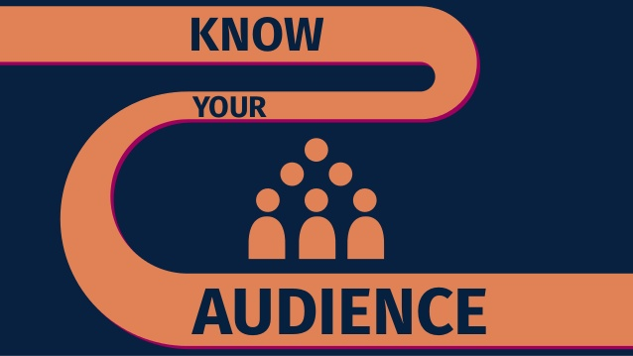
Know Your Audience
  Key principle of a successful presentation.
  Preparation must include gathering information about your audience and their needs.
A well prepared speech given to the wrong audience can have the same effect as a poorly prepared speech given to the correct audience. They both can fail terribly.

Slide 24
Know your A-u-d-i-e-n-c-e
Analysis - Who are they? How many will be there?
Understanding - What is their prior knowledge?
Demographics - What is their age, sex, background?
Interest - Why are they there?
Environment - Where will I stand? Can they all see?
Needs - What are their needs?
Customized - What specific needs to address?
Expectations - What do they expect to learn or hear?

Slide 25
Principles of Adult Learning
Need to know how adults learn best.
Adult learners have special needs.
Six characteristics of adult learners.
Notes:
Principles of Adult

Slide 26
Six characteristics of adult learners
Are autonomous and self-directed.
Have a foundation of life experiences and knowledge.
Are goal-oriented.
Are relevancy-oriented.
Are practical.
Need to be shown respect.

Slide 27
1. Adult learners are autonomous and self-directed.
Implications:
Involve participants.
Serve as facilitator.
Determine interests of learners.
2. Adult learners have a foundation of life experiences and knowledge.
Implications:
Recognize expertise of participants.
Encourage participants to share their experiences and knowledge.
Notes:
•

Slide 28
3. Adult learners are goal-oriented
Implications:
Be organized.
Have clear objectives.
4. Adult learners are
relevancy-oriented
Implication:
Explain how training objectives relate to training activities.
5. Adult learners are practical
Implication:
Show relevance of training to job.

Slide 29
6. Adult learners need to be respected.
Implications:
Acknowledge the wealth of knowledge and experiences the participants bring to the training.
Treat the participants as equals rather than subordinates.

Slide 30

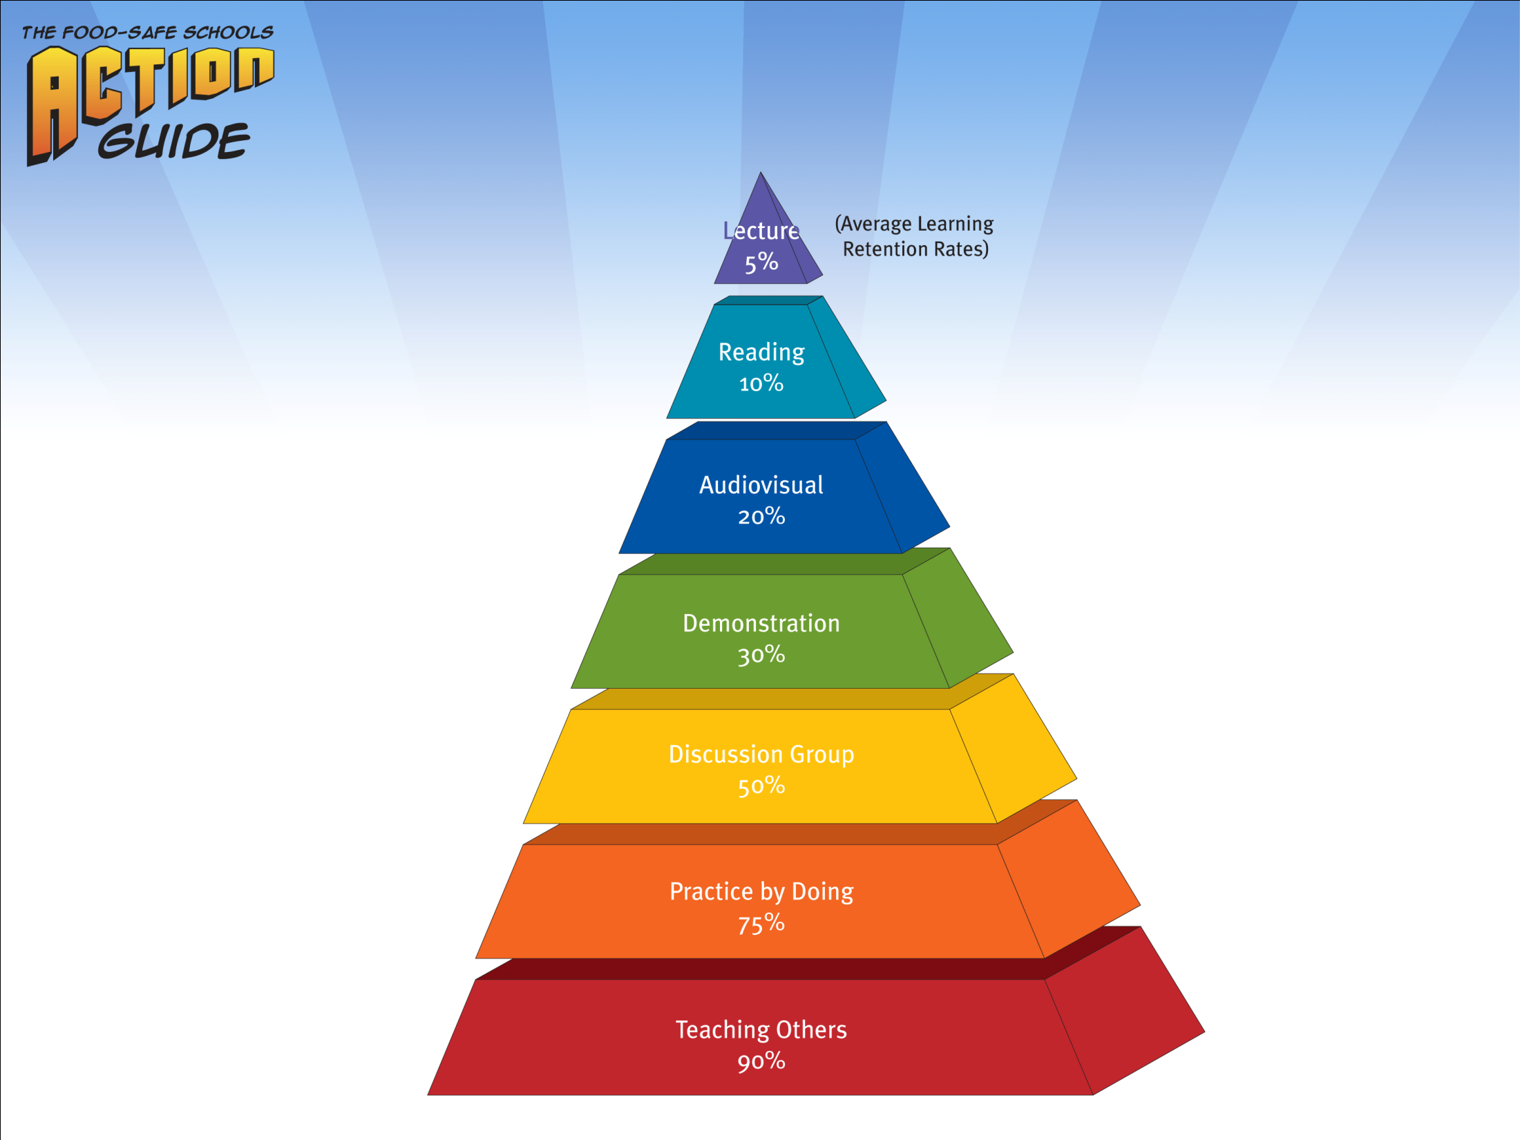
Learning Pyramid*
30
* National Training Laboratories for Applied Behavioral Sciences, Alexandria, VA.

Slide 31
Summary
How Intelligent you are?
Structuring a training session
Adult Learning
Six characteristics of Adult Learners

Slide 32
End of 1st Session
BREAK – 10 Minutes

Slide 33

Experiential Learning Model

Slide 34
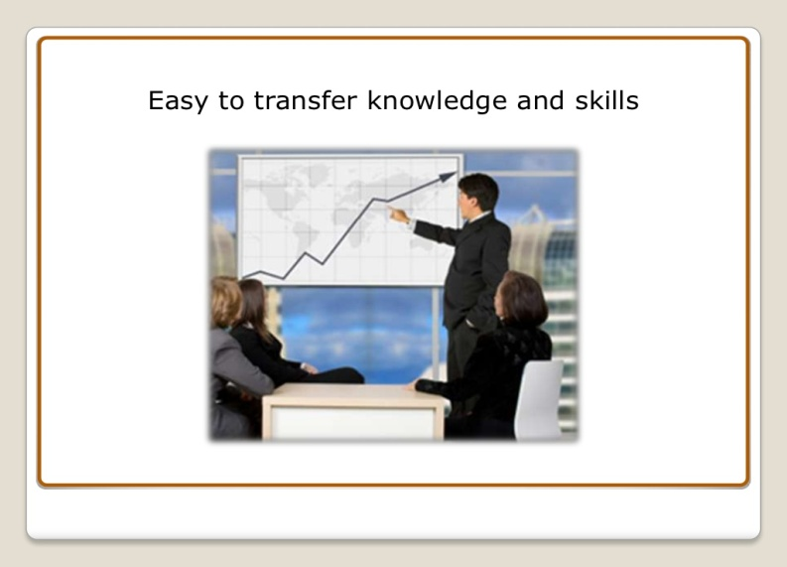
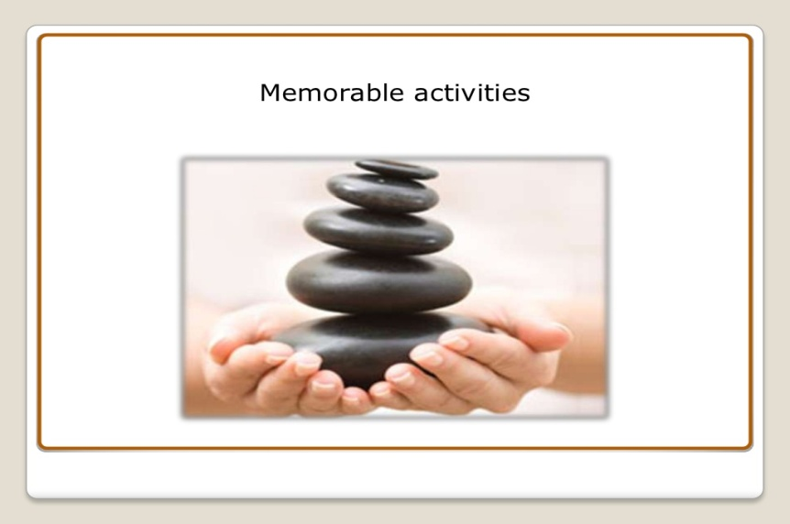
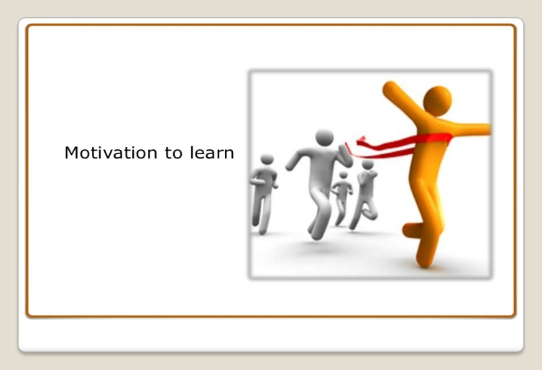
Experiential Learning
Interactive
Practical
Enjoyable

Slide 35
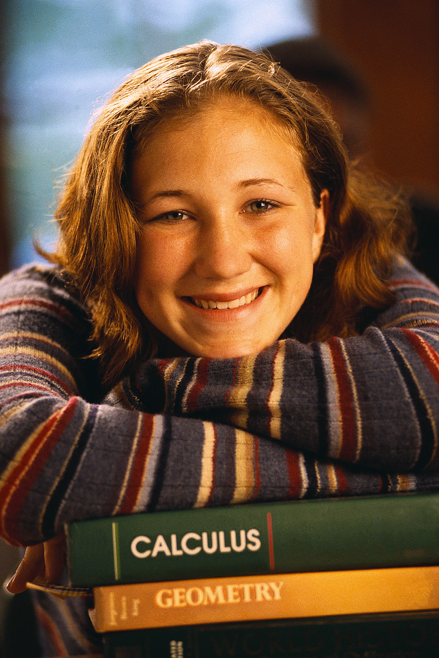
Principles of Active Learning

Slide 36

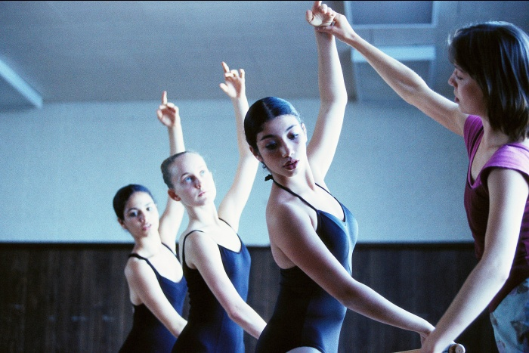
Telling vs. teaching (I)
Telling only
Does not require an active audience.
Teaching
Requires an active role by the person who learns.

Slide 37
Telling vs. teaching (II)
Teaching
Bidirectional
Telling only
Unidirectional
Can somebody tell me what
addiction is?
Let’s use some examples
Blah blah blah…and more blah blah…
Zzz
?
Addiction is a brain disease
Why?

Slide 38

Active Listener - VIDEO Presentation

Slide 39
Things to remember while designing Presentation

Slide 40
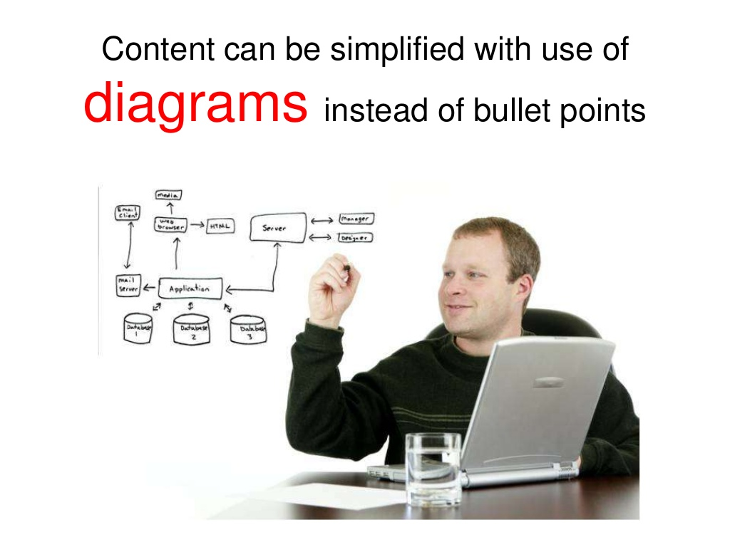

Slide 41
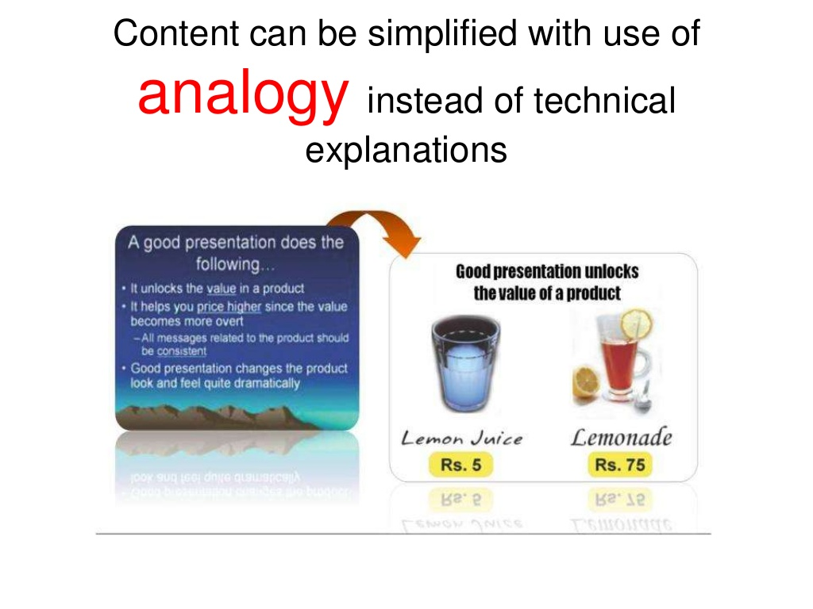

Slide 42
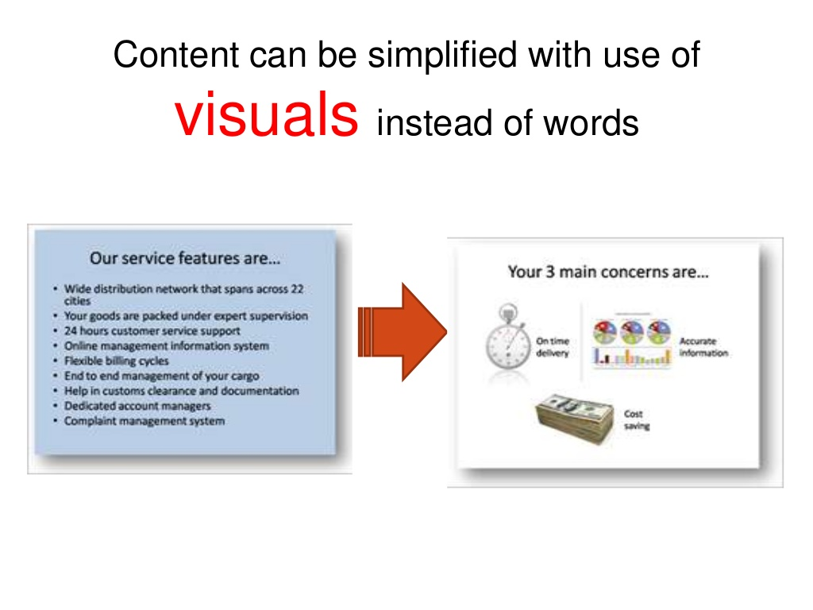

Slide 43
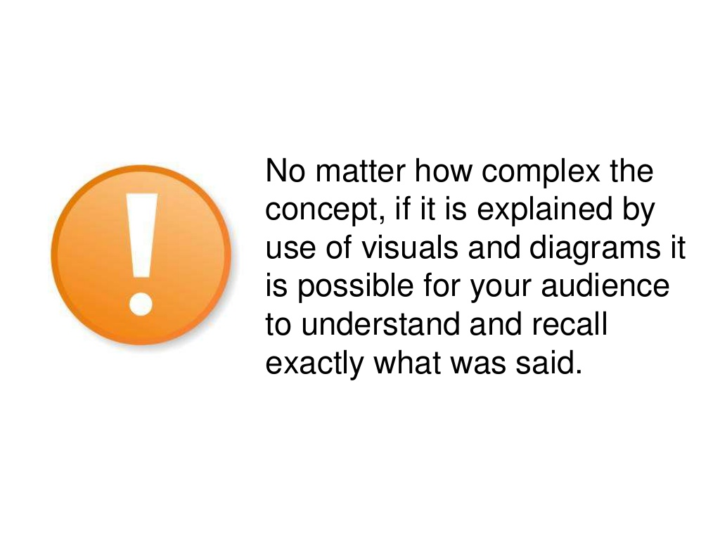

Slide 44




Slide 45
Presentation Skills

Slide 46


Slide 47
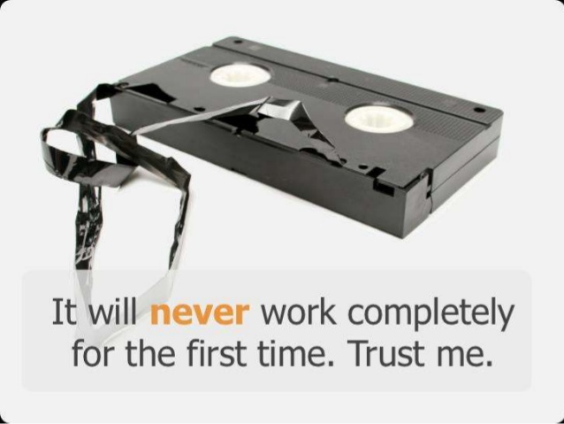
Don’t Give UP!

Slide 48

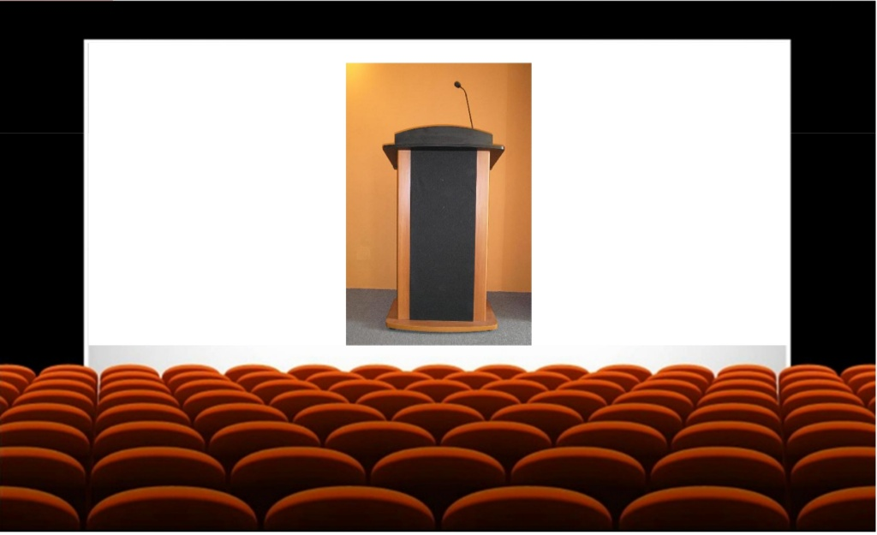
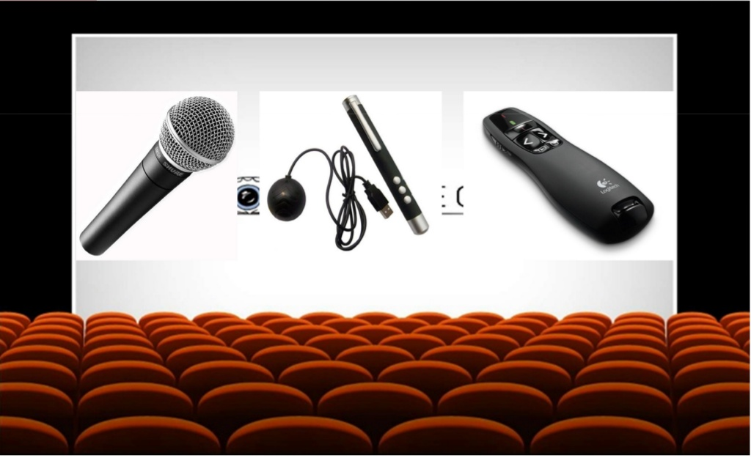
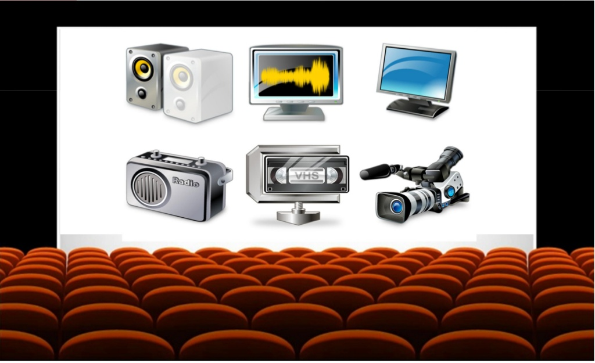

Slide 49
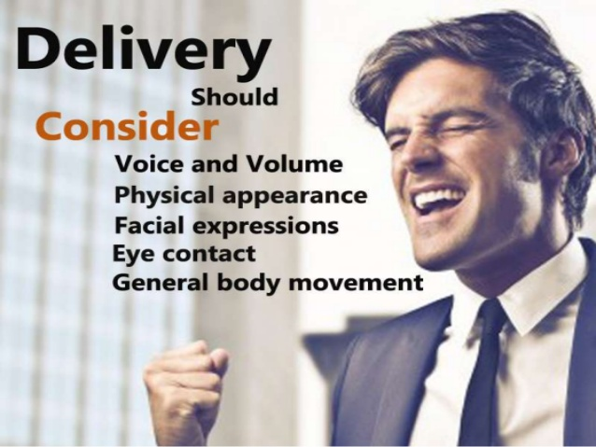

Slide 50


Slide 51
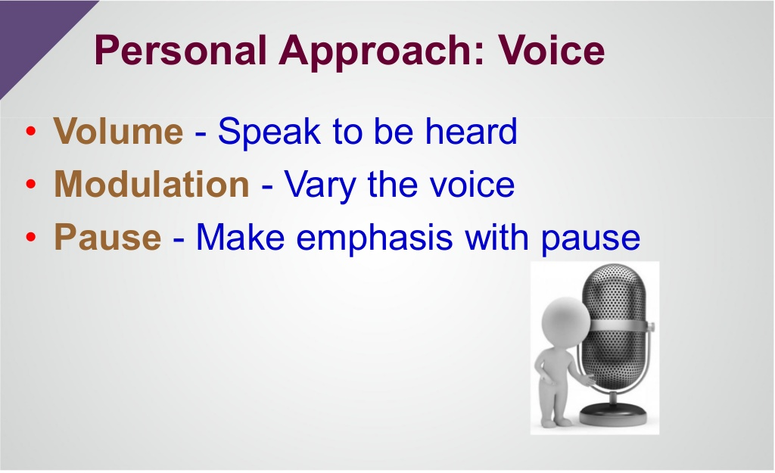

Slide 52
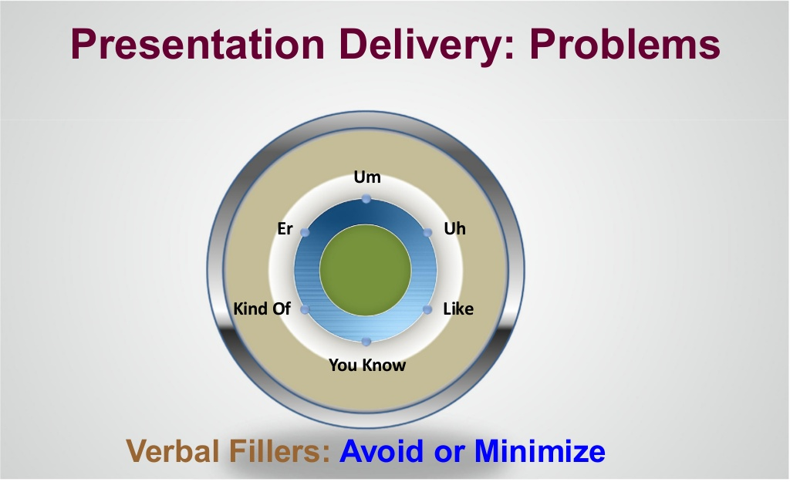

Slide 53
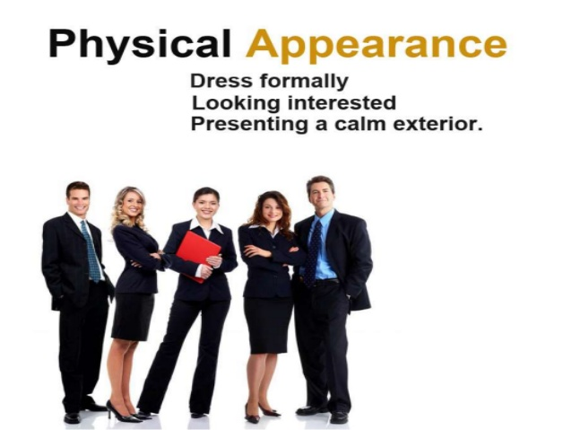

Slide 54
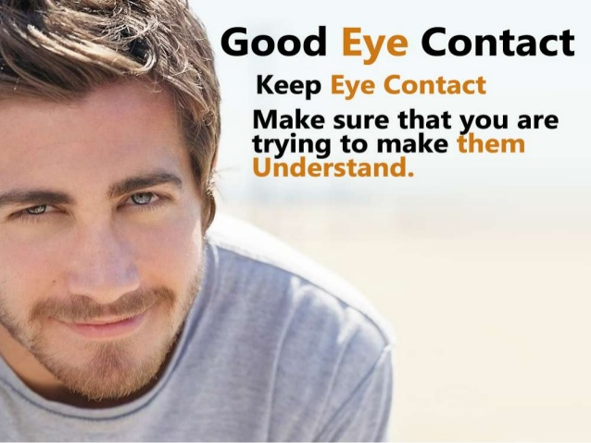

Slide 55
Eye-to-Eye Communication
  Engages audience, gains attention, improves impression, provides feedback.
  HOW?
    Connect with audience, one person at a time.
    Look directly.
    Move eyes after 3-5 seconds.
    Speak to everyone.
    Do not shift gaze - left to right.
    Talk to audience not screen, projector, ceiling.
Notes:
Connect with audience - engage a person for a brief moment.
Look directly - side glances do not install confidence
From 3-5 seconds - If you gaze at a person for longer they will begin to feel uncomfortable, and you appear figety
Speak to everyone- do not only direct attention at high ranking person. Even when answering a question, keep the whole group in the dialog.
Do not shift gaze - audience will feel that you are watching a ping pong game

Slide 56
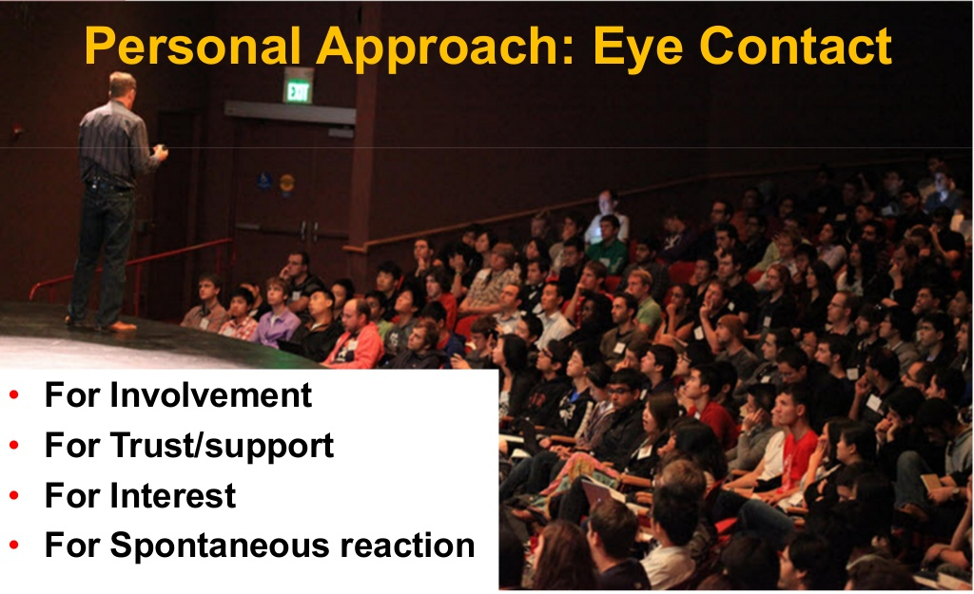

Slide 57
Facial Communication
  Vary facial expression - put emotion into speaking.
  Don’t forget to SMILE!

Slide 58


Slide 59


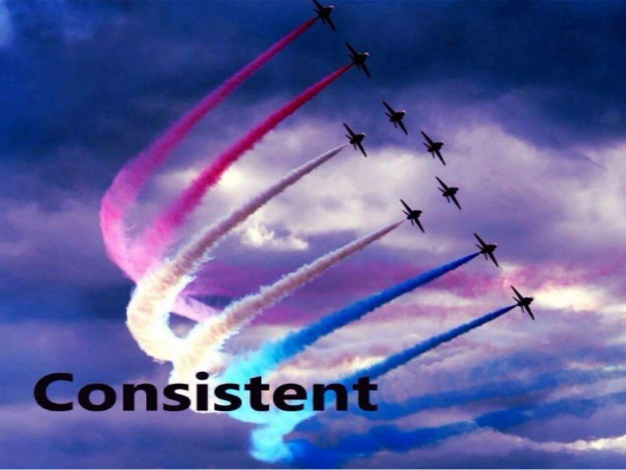

Content Should be…..

Slide 60



Slide 61
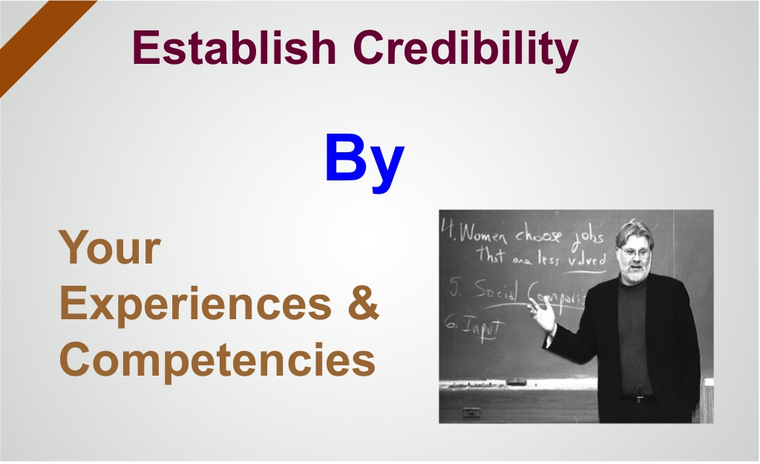

Slide 62
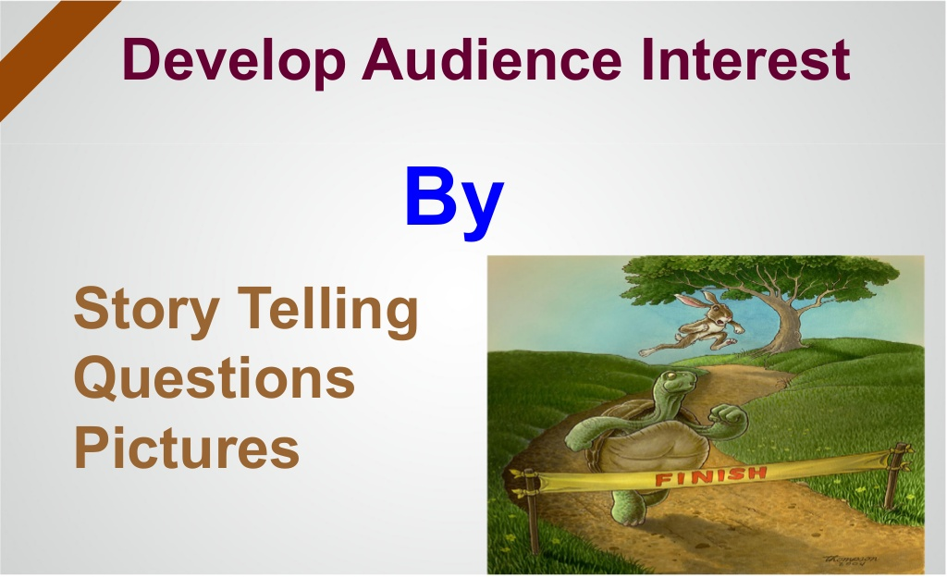

Slide 63
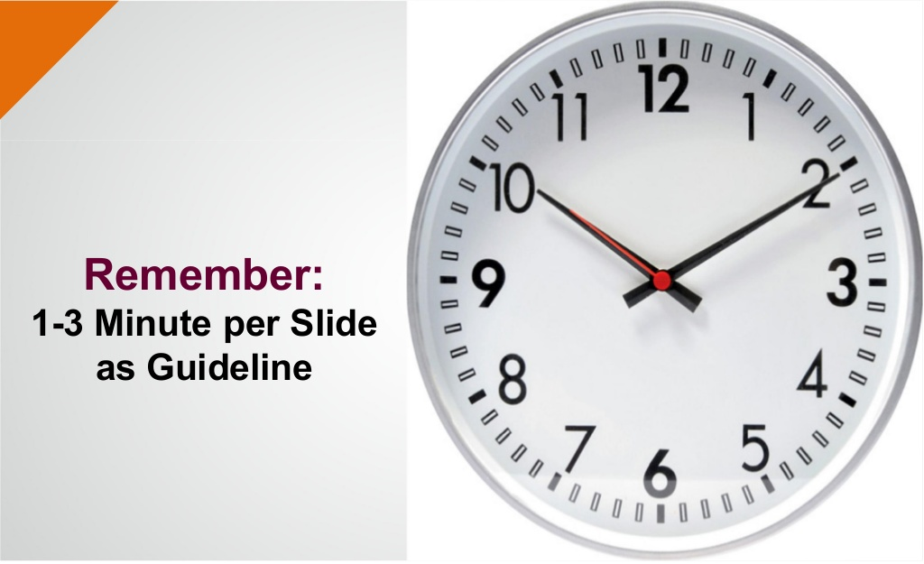

Slide 64
Use 90/20/8 Rule
A physiological research indicates that average adults can listen with understanding for 90 minutes.
However, they can listen with retention for 20 minutes.
And they need to discuss and apply what they're learning every 8 minutes.
Based on this research results, it is suggested that :
one should not teach more than 90 minutes.
The mode is changed at least every 20 minutes,
and one should try to find a way to involve participants every 8 minutes.
(Source: Robert W. Pike, Creative Training Techniques Handbook)

Slide 65
Summary - Winning Presentations
  Use your voice correctly
    Breathing, being heard, being understood, variety.
  Use your body
    Eye contact, expression, hands and arms, gestures, dress.
  Use correct language.
  Keep the audience interested.
  Demonstrate effectively.

Slide 66
Prank Call - For Refreshment

Slide 67


Slide 68
Any Questions???

Slide 69

Thank You
Contact:
Hemanta Baral (ICT Consultant)
M: 9843067142
hemanta.baral@gmail.com
www.hemantabaral.com.np
https://hemantabaral.wordpress.com

