Slide 1
MADHESH PRADESH, NEPAL
Global Innovations & the Role of ICT & Engineering in Building a Prosperous Nepal
Hemanta Baral
ICT, Data Centre & Smart City Consultant | Certified Data Centre Professional (CDCP)
www.hemantabaral.com.np

Slide 2
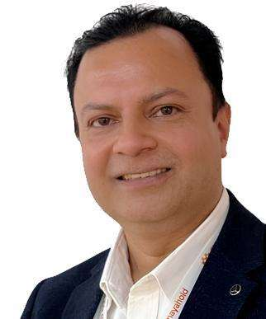



ABOUT THE PRESENTER
Hemanta Baral
Master's in IT, UK
Anglia Ruskin University
28+ years in ICT
Author of 35+ ICT books
Data Centre & ICT Consultant
Dept. of Customs, CAAN, DoTM & Sambriddha Pahad
Trainer: Smart City & Cyber Security speaker for CAN, NAST and Nepal Police
Director, Codavatar Tech.
Hemanta Baral | www.hemantabaral.com.np
2

Slide 3






TODAY
Today's Journey: 30 Minutes
Innovations
Nepal's Problems
Digital Foundation
Smart Sectors
Smart Education
Careers & Action
5 min
5 min
5 min
5 min
5 min
5 min
From inspiration, to problems, to solutions, to your career
Hemanta Baral | www.hemantabaral.com.np
3

Slide 4
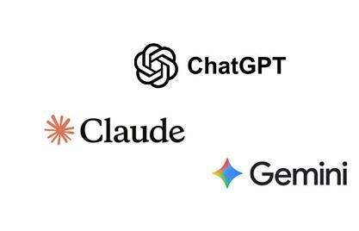


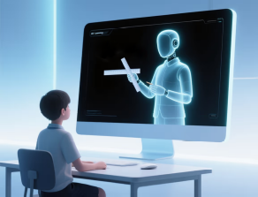
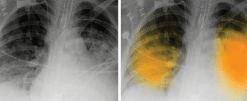

PART 1 · WORLD INNOVATIONS
Artificial Intelligence
Generative AI
ChatGPT, Gemini and Claude write, translate and explain
AI Tutors
Personalised learning at every student's pace
Tools that learn from data to write, see, speak and decide.
AI in Health
Faster reading of X-rays and scans
Nepal opportunity: Nepali-language AI, crop-disease detection and
citizen-service chatbots
Hemanta Baral | www.hemantabaral.com.np
4

Slide 5
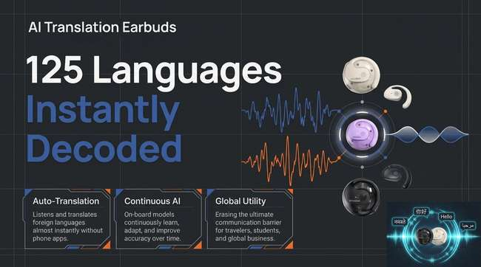
PART 1 · WORLD INNOVATIONS

Slide 6

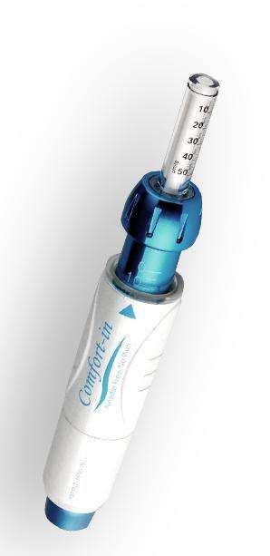
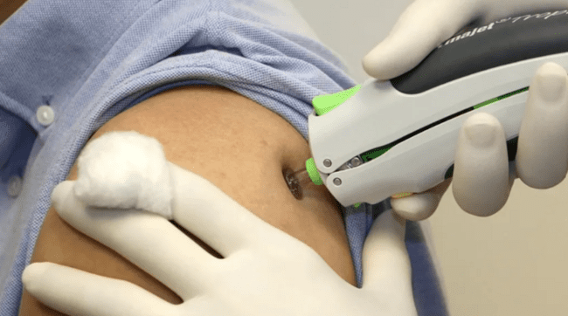
PART 1 · WORLD INNOVATIONS
Needle-free injections
Hemanta Baral | www.hemantabaral.com.np
5

Slide 7
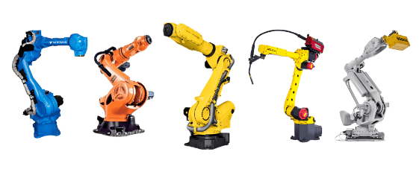

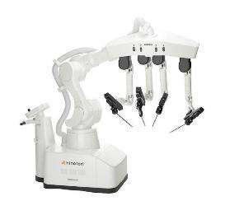


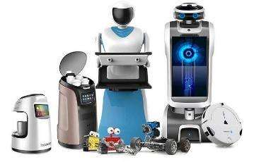

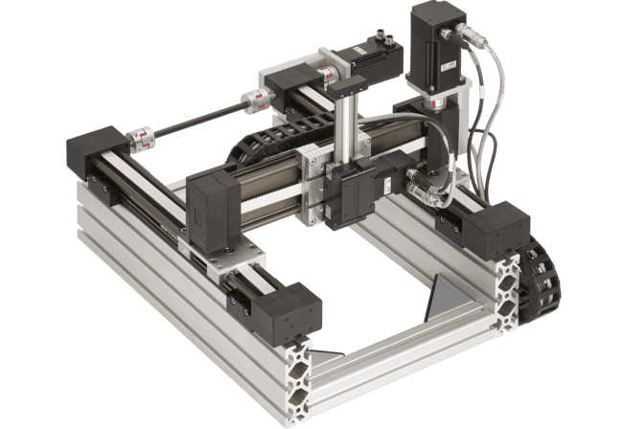
PART 1 · WORLD INNOVATIONS
Robotics
Industrial Robots
Precise, tireless work in car and electronics factories
Surgical Robots
Assist doctors in delicate,
accurate surgery
Robots are moving from factories into hospitals, farms and homes.
Service Robots
Warehouses, delivery and cleaning
Nepal opportunity: College robotics labs, farm robots
and low-cost automation
Hemanta Baral | www.hemantabaral.com.np
5

Slide 8
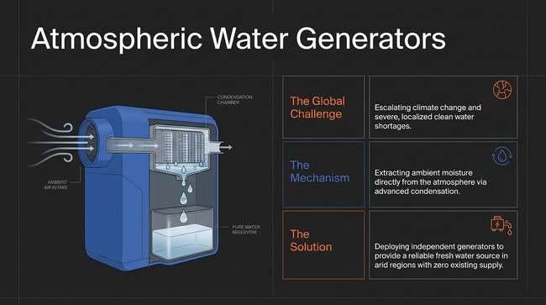
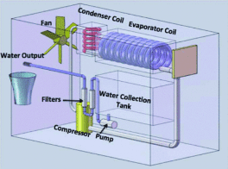
PART 1 · WORLD INNOVATIONS
PART 1 · WORLD INNOVATIONS
Solar Cooling
Cold-Storage
Hemanta Baral | www.hemantabaral.com.np
5

Slide 9
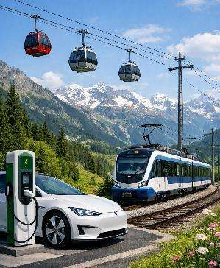



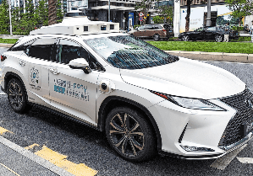
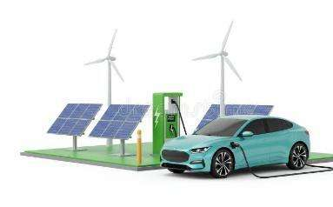
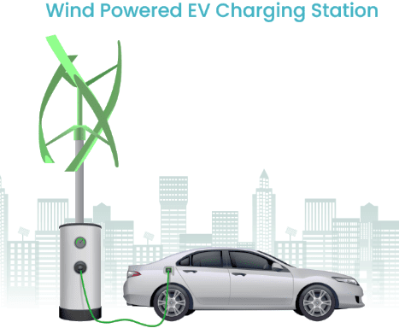
PART 1 · WORLD INNOVATIONS
Electric & Self-Driving Vehicles
Electric Vehicles
No exhaust; can run on Nepal's hydropower
Self-Driving
Robotaxis already operate in some
cities of the USA and China
Clean, quiet transport powered by electricity, guided by software.
Fast Charging
Charging networks and battery swapping
Nepal opportunity: EV assembly, charging stations,
battery recycling and fleet software
Hemanta Baral | www.hemantabaral.com.np
6

Slide 10
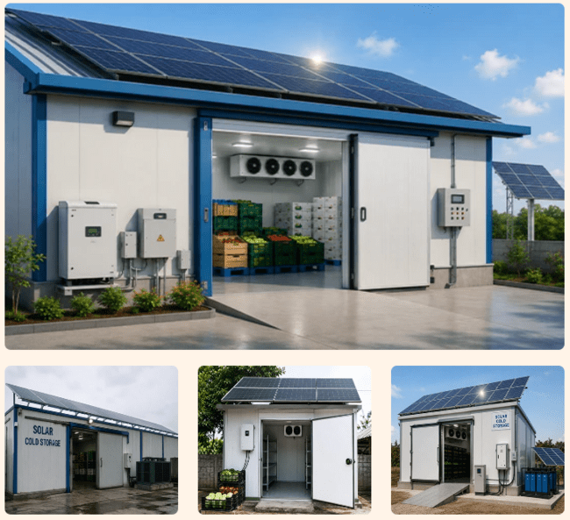
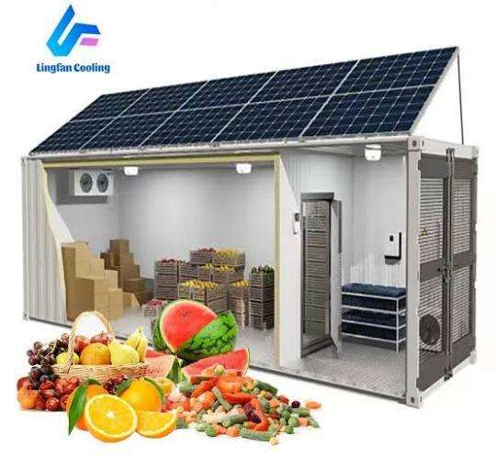
PART 1 · WORLD INNOVATIONS
Solar Cooling
Cold-Storage
Hemanta Baral | www.hemantabaral.com.np
5

Slide 11
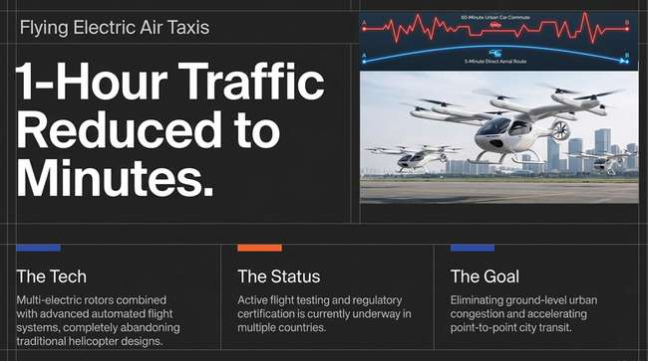
PART 1 · WORLD INNOVATIONS

Slide 12
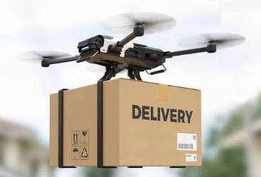
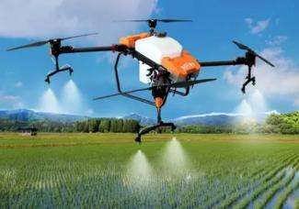
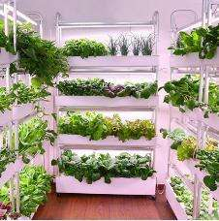


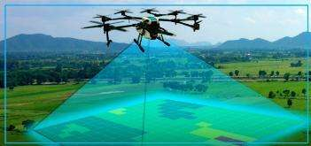

PART 1 · WORLD INNOVATIONS
Goods or Medical Delivery
Drones
Precision Farming
Crop mapping and targeted
spraying
Flying robots that deliver, spray, survey and rescue.
Survey & Mapping
LiDAR* maps land, roads and landslides
Nepal opportunity: Medicine for hill villages, disaster response, land survey, farm monitoring
*LiDAR - Light Detection and Ranging
Hemanta Baral | www.hemantabaral.com.np
7

Slide 13
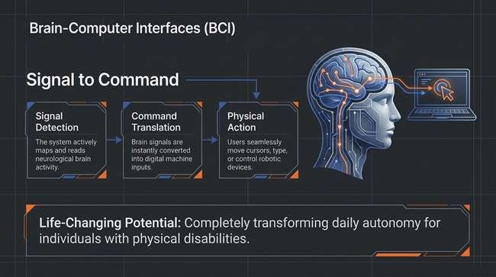
PART 1 · WORLD INNOVATIONS

Slide 14
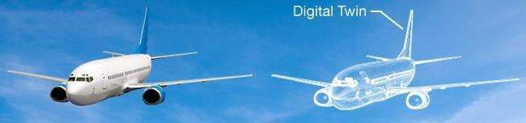
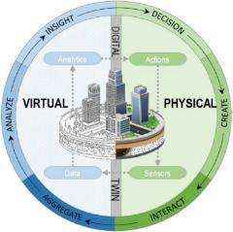


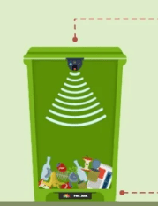
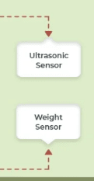

PART 1 · WORLD INNOVATIONS
Digital Twin & Smart City
Virtual City
3D city model for planning, flooding
and solar studies
Command Centre
One screen for traffic, safety and utilities
A live virtual copy of a city, used to plan before we build.
Sensors & IoT
Live data from lights, bins, water and air
Nepal opportunity: Janakpur, Birgunj and other cities can
pilot digital twins for planning
Hemanta Baral | www.hemantabaral.com.np
8

Slide 15
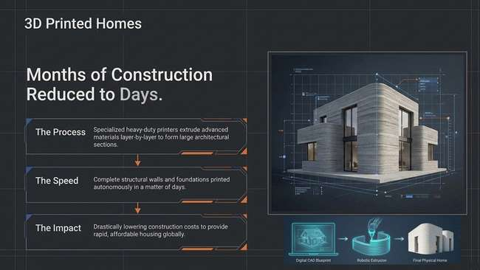
PART 1 · WORLD INNOVATIONS

Slide 16
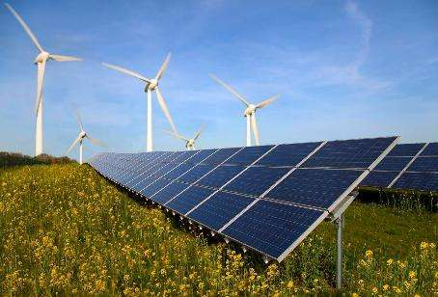


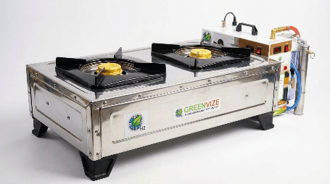

PART 1 · WORLD INNOVATIONS
Green Energy & Hydrogen
Solar & Wind
Cheapest new electricity in
many countries
Battery Storage
Keeps surplus power for peak hours
Clean power is now cheap, and storage is making it reliable.
Green Hydrogen
Clean fuel made from water
using renewable power
Nepal opportunity: Hydro, solar and storage can make Nepal a clean-energy exporter
Hemanta Baral | www.hemantabaral.com.np
9

Slide 17
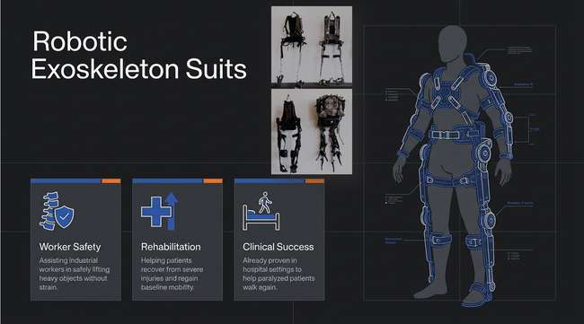
PART 1 · WORLD INNOVATIONS

Slide 18
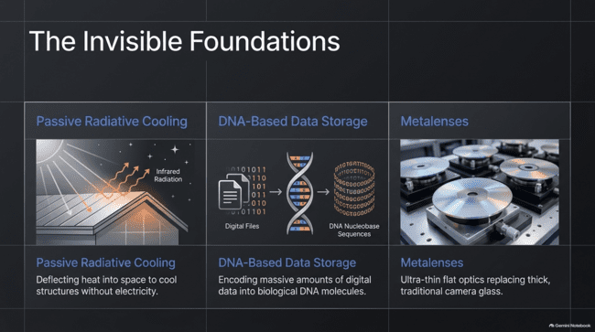
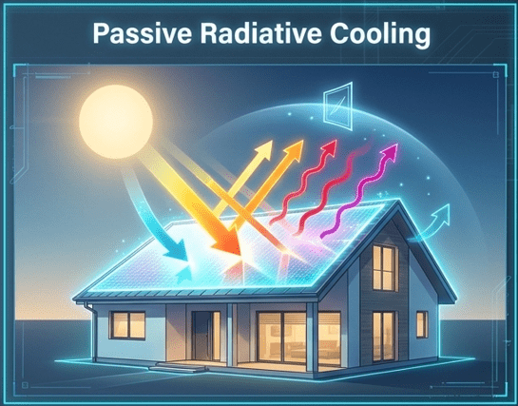
PART 1 · WORLD INNOVATIONS

Slide 19
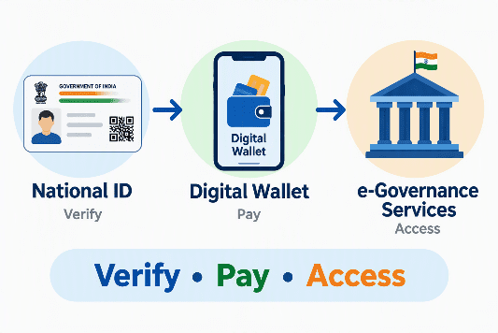



PART 1 · WORLD INNOVATIONS
Digital Public Infrastructure
National ID
Digital identity
e-Governance
Government data exchange; nearly all services online
Shared national digital systems that every service can use.
Digital Wallet
Licences and certificates on your phone
Nepal opportunity: Build ID, payment and data exchange once, reuse everywhere
Hemanta Baral | www.hemantabaral.com.np
10

Slide 20
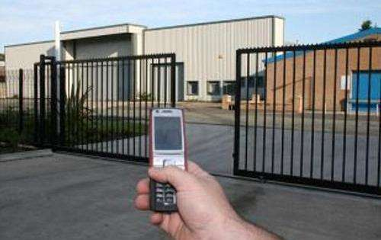
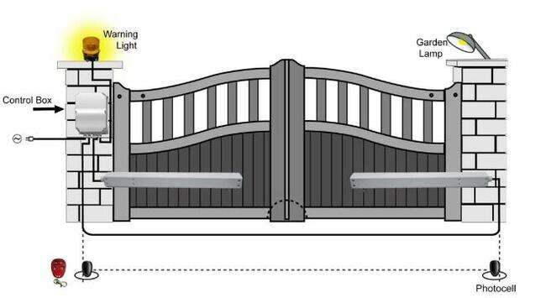
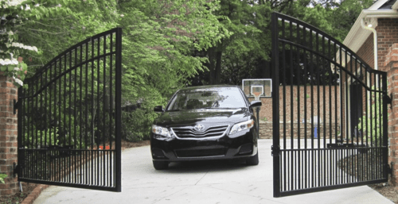
Main Gate Automation with Remote Control
PART 1 · WORLD INNOVATIONS

Slide 21
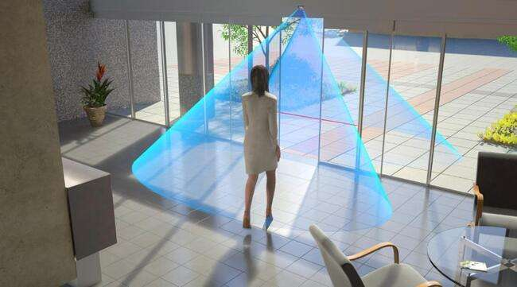
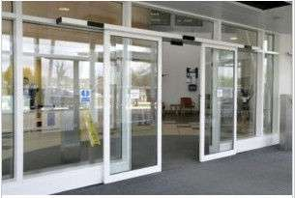
PART 1 · WORLD INNOVATIONS
Auto Swing Main Entrance Door (Sliding)

Slide 22
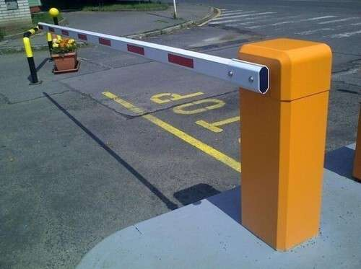
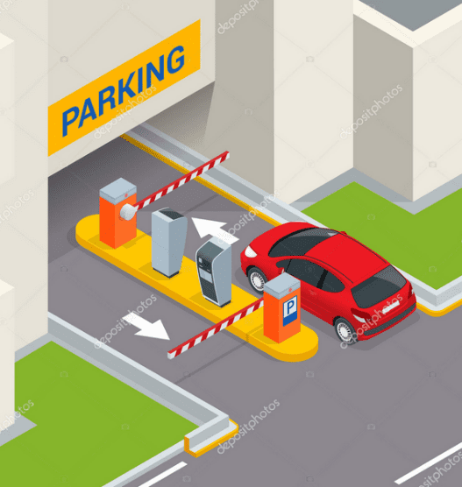
Automatic Boom
Barrier
PART 1 · WORLD INNOVATIONS

Slide 23
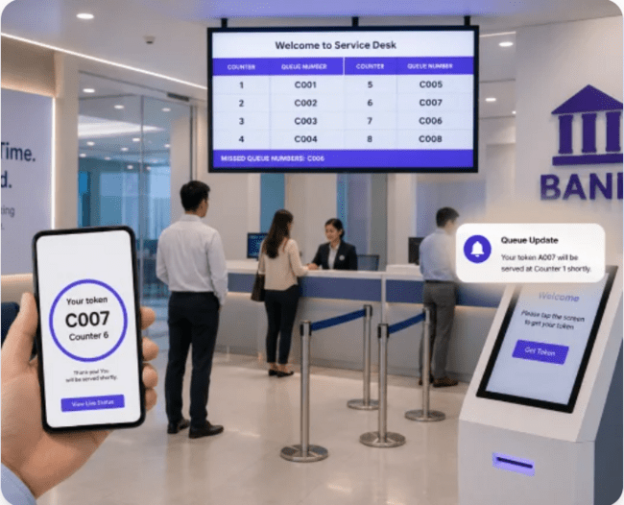
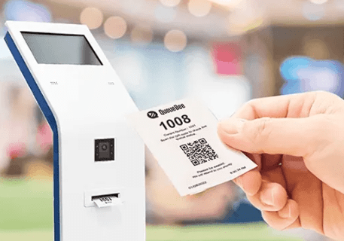
PART 1 · WORLD INNOVATIONS
Queue Management System

Slide 24
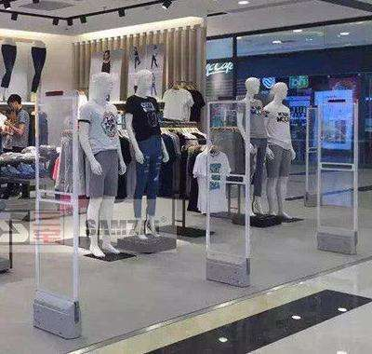
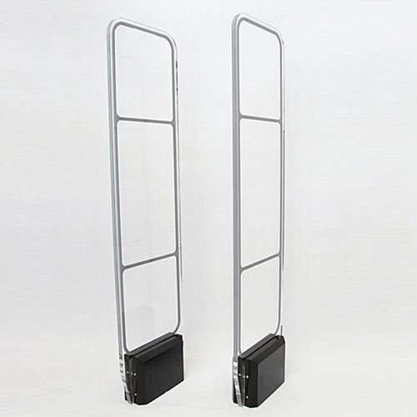
RF Antenna
PART 1 · WORLD INNOVATIONS

Slide 25

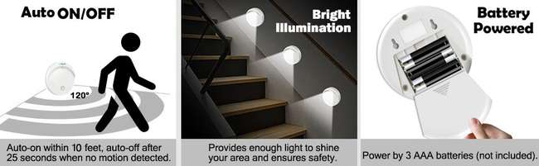
PART 1 · WORLD INNOVATIONS
Smart Blinds, Smart Lights

Slide 26
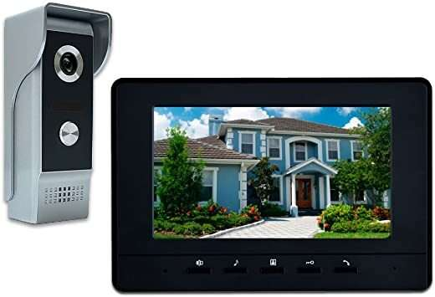
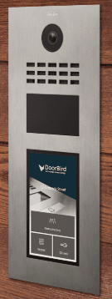

PART 1 · WORLD INNOVATIONS
Video Door Phone

Slide 27


PART 1 · WORLD INNOVATIONS
GSM & PSTN
Alarm System
Remote Control for
Building Appliances

Slide 28

PART 1 · WORLD INNOVATIONS
Smart Water Tank
(Auto Power-Cut System)

Slide 29



PART 1 · WORLD INNOVATIONS
Smart Urinal (Water Less System)

Slide 30




PART 1 · WORLD INNOVATIONS
Smart Wash Room

Slide 31




PART 1 · WORLD INNOVATIONS
Payment Kiosk Terminal, ATM, Snacks Vending Machine, RO

Slide 32


Slide 33





PART 2 · NEPAL'S PROBLEMS
Air Pollution
Smart Solution
The Problem
IoT air-quality sensors with public live dashboard
Electric vehicles and clean brick-kiln technology
Data-driven alerts and enforcement
Kathmandu Valley and Terai cities often record unhealthy air
Vehicle smoke, brick kilns, dust and waste burning
Who builds it: Environmental, Electronics and Computer Engineers; Data Scientists
Hemanta Baral | www.hemantabaral.com.np
11

Slide 34


PART 2 · NEPAL'S PROBLEMS
Unmanaged Cables
Smart Solution
The Problem
Shared underground utility ducts
GIS map of every cable and pipe
Fibre and 5G ready
networks
Tangled poles and hanging wires
Roads dug again and again
Fire and safety risk
Who builds it: Civil, Electrical, Telecom and GIS Engineers
Hemanta Baral | www.hemantabaral.com.np
12

Slide 35


PART 2 · NEPAL'S PROBLEMS
Concrete Cities
Smart Solution
The Problem
GIS master plan and digital twin
Green roofs, parks and rainwater recharge
Digital building permit and code check
Unplanned buildings; few parks and trees
Heat, flooding and poor drainage
Who builds it: Architects, Civil Engineers, Urban Planners, GIS Specialists
Hemanta Baral | www.hemantabaral.com.np
13

Slide 36


PART 2 · NEPAL'S PROBLEMS
No Cycle & Pedestrian Lanes
Smart Solution
The Problem
Protected cycle lanes and wide footpaths
Public bike sharing with a mobile app
Smart crossings with sensors
Footpaths blocked or missing
Walkers and cyclists share roads with heavy traffic
Who builds it: Civil and Transport Engineers, Mobile App Developers
Hemanta Baral | www.hemantabaral.com.np
14

Slide 37


PART 2 · NEPAL'S PROBLEMS
No Systematic Traffic Lights
Smart Solution
The Problem
Adaptive signals using cameras and AI
Green corridor for emergency vehicles
Central traffic control room
Manual, fixed-timer or missing signals
Long jams, wasted fuel, delayed ambulances
Who builds it: Electronics, Computer and Transport Engineers; AI Developers
Hemanta Baral | www.hemantabaral.com.np
15

Slide 38




PART 2 · NEPAL'S PROBLEMS
No Smart Traffic Management & Accident Response

Slide 39




PART 2 · NEPAL'S PROBLEMS
Smart Power/Water (Smart Digital Meter at Households)
Smart Water meter with
GSM SIM card
Smart Power meter with GSM SIM card

Slide 40


PART 2 · NEPAL'S PROBLEMS
No Railway Network
Smart Solution
The Problem
Electric railway on main east-west and border routes
Electric trains for people and cargo
ICT signalling, ticketing and tracking
Almost all transport is by road
High cost, accidents and fuel imports
Who builds it: Civil, Electrical, Mechanical and Signal Engineers
Hemanta Baral | www.hemantabaral.com.np
16

Slide 41


PART 2 · NEPAL'S PROBLEMS
Farm-to-Consumer Delivery
The Problem
Smart Solution
No cold chain or electric freight system
Produce spoils on long road trips
Electric freight to collection hubs
IoT-monitored cold storage
QR-code tracking from farm to shop
Who builds it: Logistics, Electrical, Mechanical Engineers; IoT Developers
Hemanta Baral | www.hemantabaral.com.np
17

Slide 42


PART 2 · NEPAL'S PROBLEMS
Unmanaged Markets & Middlemen
Today
Tomorrow
Farmers get low prices; consumers pay high
Many middlemen, no price transparency
Crowded, unregulated markets
Digital market platform with live prices
Direct farmer-to-consumer order and payment
Smart market with weighing, grading and e-payment
Who builds it: Software Developers, Data Analysts, FinTech Engineers
Hemanta Baral | www.hemantabaral.com.np
18

Slide 43








Where are these projects that we take pride in?
PART 2 · NEPAL'S PROBLEMS
Proposed electric train Network

Slide 44








lxdfn l;d]G6 sf/vfgf

Slide 45




PART 3 · DIGITAL FOUNDATION
The National Formula
ICT = Intelligence
Engineering = Build
Governance = Trust
Data, software and networks help us decide better
Roads, rail, power, water and buildings carry the nation
Rules, honesty and accountability make systems work
Technology serves people; it is never the goal
Hemanta Baral | www.hemantabaral.com.np
19

Slide 46







PART 3 · DIGITAL FOUNDATION
Digital Nepal: Building Blocks
Citizen ID
Digital Address
Central Database
Data Centre
Web & Apps
Service Delivery
Prosperity
One identity
GPS + GIS
Single record
Physical + cloud
Citizen tools
Faceless
Every sector
Build the foundation once; every sector benefits
Hemanta Baral | www.hemantabaral.com.np
20

Slide 47




PART 3 · DIGITAL FOUNDATION
Unique Digital Identity
One ID per Citizen
Log in Anywhere
Privacy by Design
Number, photo and biometrics link every record
Same secure identity for bank, school, hospital and tax
Data-protection law and consent-based sharing
Identity should follow the citizen, not paper files
Hemanta Baral | www.hemantabaral.com.np
21

Slide 48

PART 3 · DIGITAL FOUNDATION
GPS & GIS Household Address
Emergency Response
Ambulance, fire and police
reach the exact door
Service & Utilities
Post, tax, water, power and internet linked to the address
Every house gets a unique digital address with GPS coordinates on a GIS map.
Planning
Accurate data on people, land and infrastructure
Careers: GIS analyst, surveyor, remote-sensing engineer, map-app developer
Hemanta Baral | www.hemantabaral.com.np
22

Slide 49


PART 3 · DIGITAL FOUNDATION
Centralised Database & DBMS
Single Source of Truth
DBMS
Data Security
One national record per citizen; no duplicate data
PostgreSQL, MySQL, Oracle and SQL Server store data safely and quickly
Access control, encryption, backup and audit trail
Careers: Database administrator, data engineer, data analyst
Hemanta Baral | www.hemantabaral.com.np
23

Slide 50




PART 3 · DIGITAL FOUNDATION
Data Centres: Physical
& Cloud
Physical Data Centre
Cloud Data Centre
Disaster Recovery
Own servers with power, cooling and security; full control
Rent computing on demand; fast, scalable, pay-as-you-use
A backup site in another location keeps services running
Nepal needs national, provincial and local data centres, plus cloud
Hemanta Baral | www.hemantabaral.com.np
24

Slide 51



PART 3 · DIGITAL FOUNDATION
Web & Mobile Applications
Citizen Apps
Office Systems
Open APIs
Tax, licence, certificates and payments on the phone
e-Office, HR, finance and inventory replace paper files
Systems share data, so citizens submit information once
Careers: Full-stack and mobile developer, UI/UX designer, DevOps, tester
Hemanta Baral | www.hemantabaral.com.np
25

Slide 52




PART 3 · DIGITAL FOUNDATION
e-Governance in Every Sector
Government
Banking
Health
Education
Online forms, e-Office, e-Procurement
Digital payment and e-KYC
Digital patient records
Online admission, results, ID
One citizen ID, many services
Hemanta Baral | www.hemantabaral.com.np
26

Slide 53


PART 3 · DIGITAL FOUNDATION
Faceless Service Delivery
Old Way
New Way
Visit office and stand in queue
Paper file moves from desk to desk
Cash payment invites corruption
Apply online from any phone
Automated workflow with time limit
Digital payment and full audit trail
Who builds it: Paperless, queueless, cashless and faceless: technology reduces corruption
Hemanta Baral | www.hemantabaral.com.np
27

Slide 54
Digitize What Already Exists
Paper |  | Digital Data
Physical File |  | Automated Workflow
Service Counter |  | Online Portal
Cash Payment |  | Digital Payment
Wet Signature |  | Digital Authentication
Paper Certificate |  | Digital Credential
Office Visit |  | Remote Service
“Don’t create more apps. Transform existing services into smart services.”

Slide 55





PART 4 · SMART SECTORS
Smart Health
e-Health Record
One digital file linked to citizen ID
Telemedicine
Specialists consult remotely
Quality care reaching every village through data and devices.
Smart Hospital
Queue tokens, IoT monitors, AI diagnosis
Careers: Biomedical engineer, health-IT specialist, telemedicine developer
Hemanta Baral | www.hemantabaral.com.np
28

Slide 56






PART 4 · SMART SECTORS
Smart Transport
Electric Public Transport
Buses and rail powered by clean
electricity
Smart Ticketing
One card or QR for every vehicle
Clean, connected and on-time movement of people.
Intelligent Traffic
Sensors, cameras and adaptive signals
Careers: Transport engineer, EV and battery engineer, embedded developer
Hemanta Baral | www.hemantabaral.com.np
29

Slide 57




Emergency Repair and Maintenance (Smart Infra Ambulance)

Slide 58





PART 4 · SMART SECTORS
Smart Parking
Sensors & Cameras
Show free slots in real time
Mobile Booking
Reserve and pay by app
Find, pay and park without circling the street.
Efficient Space
Multi-storey and automated parking
Careers: IoT engineer, computer-vision developer, structural engineer
Hemanta Baral | www.hemantabaral.com.np
30

Slide 59






PART 4 · SMART SECTORS
Smart Waste Management
Smart Bins
Sensors report when a bin is full
Optimised Collection
GPS trucks follow the shortest route
Cleaner cities through data-guided collection and recycling.
Recycle & Biogas
Sorting, compost and waste-to-energy
Careers: Environmental engineer, IoT technician, mechanical engineer
Hemanta Baral | www.hemantabaral.com.np
31

Slide 60




PART 4 · SMART SECTORS
Smart Energy: Hydro, Solar,
Wind
Hydropower
SCADA and smart meters balance supply and demand
Nepal's rivers, sun and wind can power the nation and the region.
Solar
Rooftop and floating solar, with
net-metering
Wind
Strong wind corridors such as
Kali Gandaki valley
Careers: Electrical, power-system, renewable-energy and SCADA engineers
32
Hemanta Baral | www.hemantabaral.com.np

Slide 61



PART 4 · SMART SECTORS
Smart Agriculture
Soil & Weather Sensors
IoT guides irrigation and
fertiliser
Drones & AI
Crop-health maps and disease detection
Higher yield and better income using data on the farm.
Farm Apps
Advice, weather and prices in Nepali
Careers: Agri-engineer, IoT and drone specialist, data scientist, agri-tech founder
Hemanta Baral | www.hemantabaral.com.np
33

Slide 62




28
PART 4 · SMART SECTORS
Smart Tourism and Heritage Management
Development of Transit Hubs
Digital Booking
Uniform Fare Policy
Strategic Development of International Airports as South Asian Transit Hubs
Promotion of Online Ticketing, GPS-Based Guide Apps, and Religious & Wellness Tourism Packages
Transparent and Equal Airfare and Domestic Travel Pricing for Domestic and International Tourists

Slide 63



PART 4 · SMART SECTORS
Rebuilding Industries for Jobs
Industry 4.0
Automation, robots and sensors raise quality
Value Addition
Process food, jute, sugar and textiles locally
Modern, automated and export-oriented industry creates jobs at home.
Special Economic Zones
Ready power, roads, data and ICT services
Careers: Industrial, mechanical, mechatronics and quality engineers; IT-BPO
Hemanta Baral | www.hemantabaral.com.np
34

Slide 64



PART 4 · SMART SECTORS
Smart City Command Centre
One Dashboard
Traffic, air, waste, energy and
safety together
CCTV & Response
Quick action in emergencies
One control room that connects every smart service.
Data for Decisions
Evidence-based planning and budgets
Careers: Systems integrator, network engineer, data engineer, cybersecurity analyst
Hemanta Baral | www.hemantabaral.com.np
35

Slide 65




Prosperous Nepal
Use of Energy
Expand Hydropower: Develop surplus hydropower for domestic use and export electricity to international markets, while exploring wind and solar energy potential.
Promote Electric Mobility: Expand EVs and cable cars to reduce pollution and build cleaner cities.
Develop Electric Railways: Introduce electric trains for faster connectivity and efficient transportation of agricultural and other goods.
Enable Crypto Mining & High Computing: Utilize Nepal’s clean, reliable hydropower and naturally cool Himalayan climate for energy-efficient high-computing and data-centre operations, attracting foreign investment.

Slide 66

2. Smart Tourism and Heritage
Highway, Super Highway
International Airports (Promoting as a Transit Hub like Singapore)
Online Booking, Online Promotional Packages, Eco Tourism using Mobile Apps
Yoga/Meditation Packages, Religious tourism
Cheap Mountain Flight packages for the transit passengers
Domestic fare should be same for both Nepalese and foreigners

Slide 67


3. Amart Agriculture/ Sanitation/
Live Stock Farming)
Year-Round Production of Agricultural Crops, Vegetables & Fruits – Using scientific research on climate, fertilizers, soil, and technology to improve productivity.
Scientific Agricultural Education & Training
Market Management & Easy Delivery of Agricultural Products
Promotion of Stack/Vertical Farming

Slide 68




4. Promote Nepali Products, Processing &
Diversification for Export
Promote production and export of cardamom, ginger, pepper, tea, betel nut, cotton, cheese, medicinal herbs, pulses and other high-value products.
Brand and export Nepali liquor to international markets as premium products.
Legalize and promote Ganja for regulated industrial and international markets.
Himalayan Natural Spring Water – Develop and export premium bottled water sourced from natural Himalayan springs.
Beer Made from Natural Spring Water – Develop premium, distinctive Nepali beer using natural spring water.
Leather Footwear – Promote quality Nepali leather products for global markets.
Garments, Pashmina & Carpets – Strengthen production, branding and international exports.

Slide 69

5. Information Communication and Technology
Establishment of Foreign Outsourced Company and employment to Nepali IT
experts (availability of comparatively cheaper manpower)
ICT enabled e-Governance system (Automated and Integrated)
Faceless system-driven Government Services for Corruption Control (Zero Corruption)
6. Create Employment Opportunities & Reduce Poverty
Promote Cottage and Small-Scale Industries with local branding and market development.
Focus on Agriculture, Livestock, Handicrafts and Manufacturing Industries.
Revive and modernize traditional industries such as Gorkhali Tyres, Hetauda Textiles, Butwal Yarn, Birgunj Sugar, Bhaktapur Paper, Janakpur Cigarettes, Bamboo & Leather Footwear, Himalayan Cement, and similar industries.
Develop local production hubs to create jobs, strengthen local economies, and reduce poverty.

Slide 70








Nepal Has What the World Needs
Agriculture
Energy
Tourism
Human Talent
“Our challenge is not that Nepal has nothing. Our challenge is converting what Nepal already has into economic value.”

Slide 71









PART 5 · SMART EDUCATION
Smart Education
“The greatest infrastructure Nepal can build is not concrete — it is human capability. Don’t educate for yesterday’s jobs.”

Slide 72




PART 5 · SMART EDUCATION
What Is Smart Education?
Student-Centric
Technology-Enabled
Adaptive learning at each student's pace, with digital portfolios
ICT, IoT and cloud with digital content for all
System-Driven
Smart classroom and campus run on standard processes
Everyone happy: students, parents, teachers, staff and management
Hemanta Baral | www.hemantabaral.com.np
36

Slide 73









PART 5 · SMART EDUCATION
Building Blocks of a Smart Campus
Unique ID
Central Database
Education ERP
Smart Classroom
Remote Learning
Digital Content
Students, teachers, staff
One record
Web + mobile
Audio/video
Online classes
e-books, LMS
Start with ID and database; the rest builds on them
Hemanta Baral | www.hemantabaral.com.np
37

Slide 74









PART 5 · SMART EDUCATION
School ERP: What It Covers
Student Information
Exam Management
Biometric Attendance
Learning (LMS)
Fees & Accounts
Parent & Teacher App
Payroll & HR
SMS, Email, Reports
One system replaces registers, files and separate software
Hemanta Baral | www.hemantabaral.com.np
38

Slide 75


PART 5 · SMART EDUCATION
Unique Student ID & Paperless School
Proximity or
Contactless
ID Card
Contactless Card
Tap for attendance; parents get an SMS
RFID
ID Card
Paperless Office
Digital records, notices and reports
One smart card (RFID or QR) for attendance, library, canteen and fees.
Parent Transparency
Attendance, results and fees on the app
Benefit: Saves time, cuts paper, improves safety and trust
Hemanta Baral | www.hemantabaral.com.np
39

Slide 76






PART 5 · SMART EDUCATION
AI, AR/VR & STEM for Schools
AI Learning Assistant
AR/VR Virtual Labs
STEM & Robotics Lab
Adaptive practice, instant feedback and teacher support
Science experiments and field trips without costly equipment
Coding, Arduino, Raspberry Pi and 3D printing
Start small: one lab, one trained teacher, one project per class
Hemanta Baral | www.hemantabaral.com.np
* Augmented Reality, Video Reality, Science Technology Engineering Mathematics
40

Slide 77



PART 5 · SMART EDUCATION
Smart Classroom, Digital Contents & Remote Learning
Smart Classroom
Digital Contents
Remote Learning
Technology-enabled classrooms for interactive, personalized, and engaging learning.
High-quality, curriculum-aligned digital learning materials accessible anytime, anywhere.
Reliable online education platforms enabling students to learn from anywhere.
One platform: for accessible, engaging, and technology-driven education.
Hemanta Baral | www.hemantabaral.com.np
* Augmented Reality, Video Reality, Science Technology Engineering Mathematics
40

Slide 78


PART 5 · SMART EDUCATION
Digital Safety & Responsible AI
Safe Internet
Data Privacy
Responsible AI Use
Passwords, phishing and cyber-bullying awareness
Protect student and staff data
Use AI to learn, not to copy; always verify
Teach digital citizenship together with digital skills
Hemanta Baral | www.hemantabaral.com.np
41

Slide 79
PART 6 · CAREERS & ACTION
Sector-wise Careers (1 of 2)
Sector | Engineering & ICT fields | Careers
Governance & Digital Infrastructure | Computer, Software, Network, GIS, Cybersecurity | Software developer, data-centre and network engineer, GIS analyst, cybersecurity officer
Health | Biomedical, Health Informatics, Electronics | Biomedical engineer, health-IT specialist, telemedicine developer
Education | Software, Electronics, Instructional Design | EdTech developer, LMS administrator, e-content creator, STEM trainer
Transport & Cities | Civil, Transport, Electrical, Urban Planning | Transport engineer, urban planner, traffic-system and EV technician
Hemanta Baral | www.hemantabaral.com.np
42

Slide 80
PART 6 · CAREERS & ACTION
Sector-wise Careers (2 of 2)
Sector | Engineering & ICT fields | Careers
Energy | Electrical, Mechanical, Civil, Electronics | Hydropower, power-system and solar engineer; SCADA and smart-meter specialist
Agriculture | Agricultural, Electronics, Mechanical, Data Science | Agri-tech engineer, IoT and drone specialist, food-processing engineer
Industry | Industrial, Mechanical, Mechatronics, Chemical | Automation, quality and production engineer; supply-chain analyst
Environment & Waste | Environmental, Civil, Chemical | Environmental engineer, waste-to-energy specialist, remote-sensing analyst
Hemanta Baral | www.hemantabaral.com.np
43

Slide 81



PART 6 · CAREERS & ACTION
Skills for the Future
Technical
Problem-Solving
Communication
Ethics
Programming, data, networks, AI basics
Design thinking, research and projects
Presentation, English and Nepali writing, teamwork
Honesty, cyber ethics, service to society
Skills matter more than marks alone
Hemanta Baral | www.hemantabaral.com.np
44

Slide 82


PART 6 · CAREERS & ACTION
What Students Can Do Now
Learn
Build
Certify
Intern
Start-up
Free online courses
Apps, circuits, small projects
Industry certificates
Companies and offices
Solve a local problem
Start today: consistency beats talent
Hemanta Baral | www.hemantabaral.com.np
45

Slide 83


PART 6 · CAREERS & ACTION
What Institutions Can Do
Digitise
Upgrade Labs
Link with Industry
Adopt ERP, unique student ID and paperless records
Computer, electronics, STEM labs and reliable internet
Internships, guest talks and student incubation
Principals lead the change; students carry it forward
Hemanta Baral | www.hemantabaral.com.np
46

Slide 84


समृद्ध नेपाल, सुखी नेपाली
Education + ICT + Engineering + Good Governance = Prosperity
Thank You · Questions & Discussion
Hemanta Baral | ICT, Data Centre & Smart City Consultant | www.hemantabaral.com.np

