Slide 1

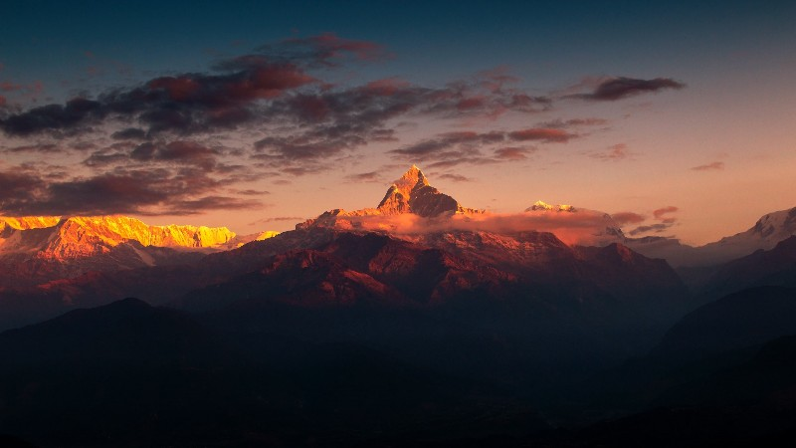

Prosperous Nepal, Happy Nepali
The Role of ICT & Engineering in Building a Smart
& Prosperous Nation
“This is not just about technology. It’s about the Nepal we can build with technology.”

Slide 2
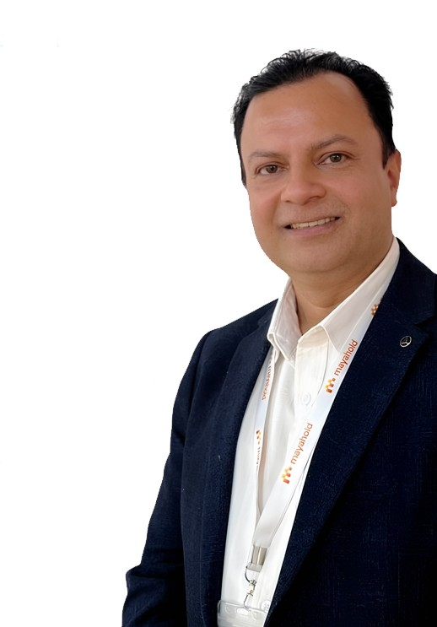


02
Introduction and Background of the Presenter
Academic Qualification
Master’s Degree in Information Technology from Anglia Ruskin University, UK
Expertise
ICT, Data Centre and Smart City Consultant — Chief Business Officer (CBO), Mayahold Group
Experience
28+ Years in ICT Sector; Writer of 35+ ICT Books
Certification
Certified Data Centre Professional (CDCP); Smart City Trainer – CAN, NAST & ABAN
www.hemantabaral.com.np

Slide 3
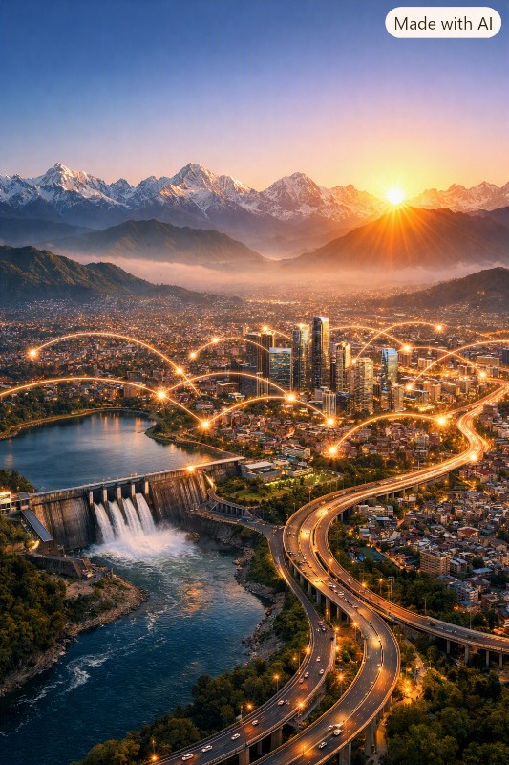
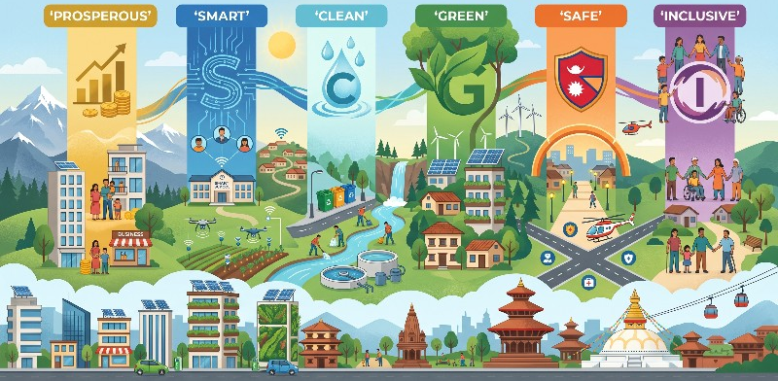
What Kind of Nepal
Do We Want?
Start with the society we want to build—not the technology we want to deploy. Technology should serve our people and outcomes, not become the goal itself.
“Before asking what technology we need, we must ask what kind of country we want.”

Slide 4
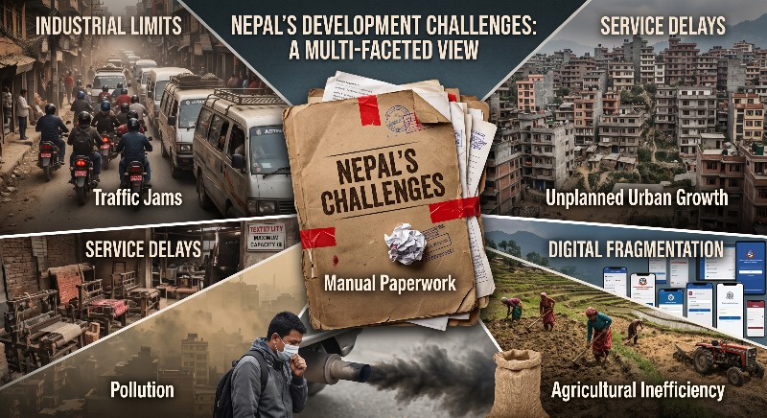








Nepal Today: The Challenges
Manual Processes
Traffic Jams
Pollution
Unplanned Growth
Agri-Inefficiency
Industrial Limits
Service Delays
Digital Fragmentation
“Potential alone does not create prosperity. Productivity, infrastructure, governance and innovation do.”

Slide 5





Nepal Has What the World Needs
Agriculture
Energy
Tourism
Human Talent
“Our challenge is not that Nepal has nothing. Our challenge is converting what Nepal already has into economic value.”

Slide 6
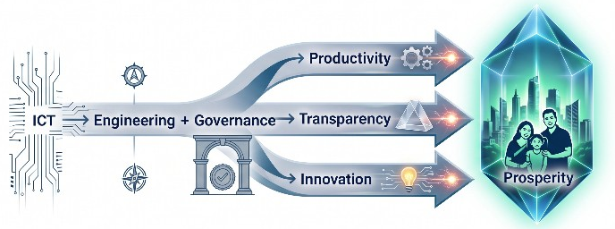

The National Formula
“ICT provides intelligence. Engineering provides infrastructure. Good governance provides trust.”

Slide 7
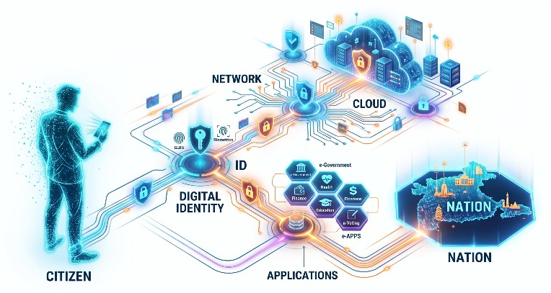
ACT II: Build the Foundation
Citizen
Digital Identity
Data
Secure Network
Cloud
Apps
Services
Nation
“Roads connect physical places. Digital infrastructure connects people, information and services.”

Slide 8
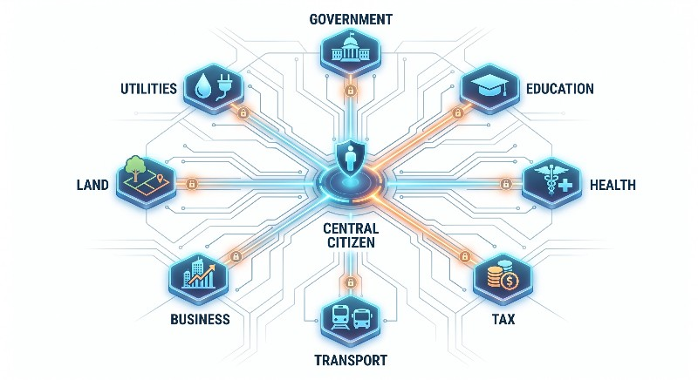
One Identity → Many Services
“Your identity should follow you — not your files.”

Slide 9

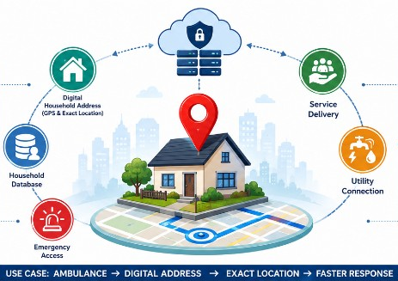
Digital Household Address
GPS & Exact Location
Household Database
Emergency Access
Service Delivery
Utility Connection
Use Case: Ambulance → Digital Address → Exact Location → Faster Response.
“Every household, every building, every location must be digitally mapped.”

Slide 10


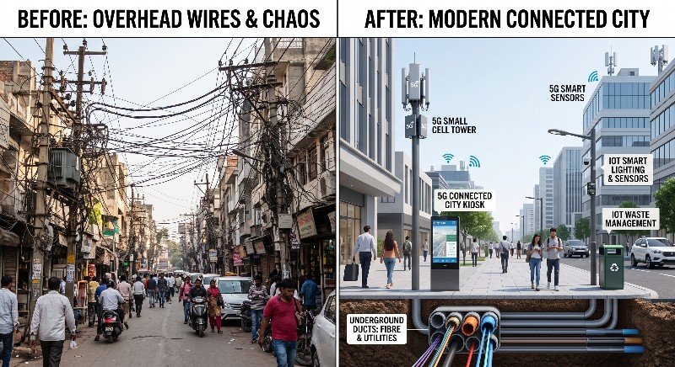
Connect the Nation
Today
Future
Tangled Poles & Wires
Underground Ducts
Repeated Digging
High-Speed Fibre
Visual Pollution
5G & IoT Integration
High Maintenance
Smart
Infrastructure
“When we build roads and cities today, we must also build the digital infrastructure required for the next 20 years.”

Slide 11
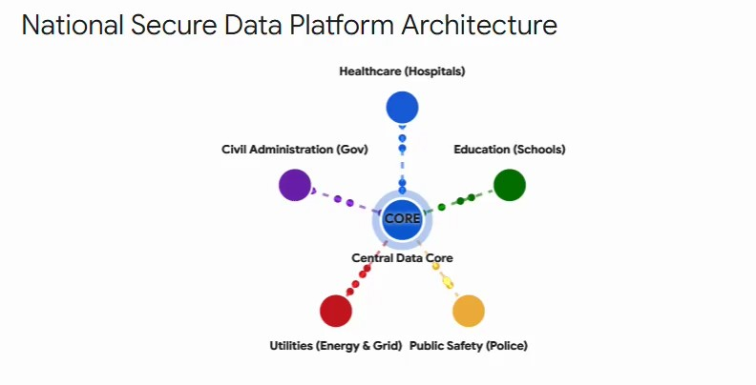



Central Nervous System
Data
Intelligence
Decision
“This is the nervous system of Smart Nepal — data driving intelligence and decisions.”

Slide 12


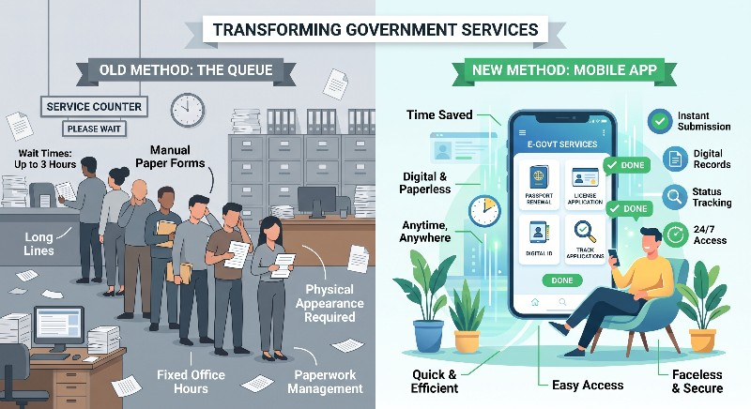
ACT III: Government Without the Queue
Old Flow
New Flow
Citizen → Office → Counter → Employee → File → Approval → Service
Citizen → App/Portal → Automated Workflow → Service
PAPERLESS • QUEUELESS • CASHLESS • FACELESS
“From office-centered to citizen-centered — services without queues, cash, or paper.”

Slide 13




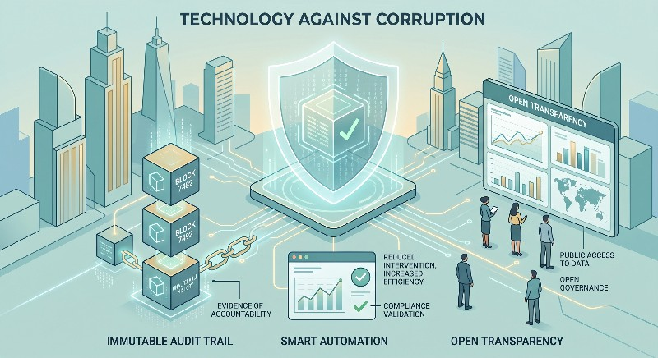

Technology Against Corruption
Audit Trail
Automation
Transparency
“Technology cannot replace ethics, but it can reduce unnecessary human intervention and make transactions traceable.”

Slide 14
Digitize What Already Exists
Paper |  | Digital Data
Physical File |  | Automated Workflow
Service Counter |  | Online Portal
Cash Payment |  | Digital Payment
Wet Signature |  | Digital Authentication
Paper Certificate |  | Digital Credential
Office Visit |  | Remote Service
“Don’t create more apps. Transform existing services into smart services.”

Slide 15
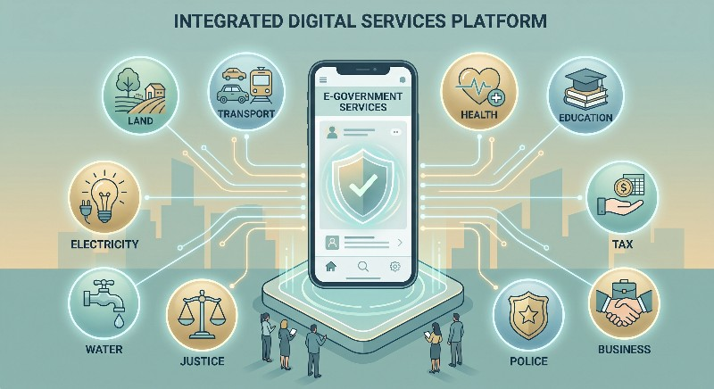







Government at Your Fingertips
One App
Transport
Education
Utilities
Tax
Justice
Land
Health
Business
“One citizen, one platform, many services — government in your pocket.”

Slide 16
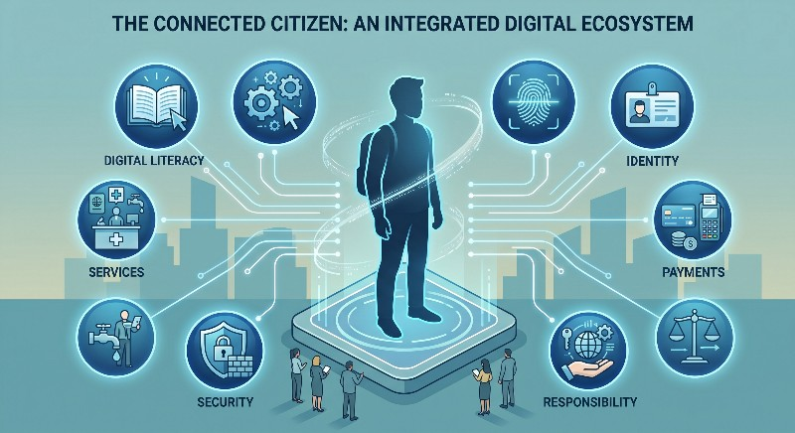






ACT IV: Smart Citizen
Digital Identity
Digital Services
Digital Security
Digital Payments
Digital Responsibility
Digital Literacy
“Technology becomes powerful only when citizens know how to use it safely, responsibly and productively.”

Slide 17




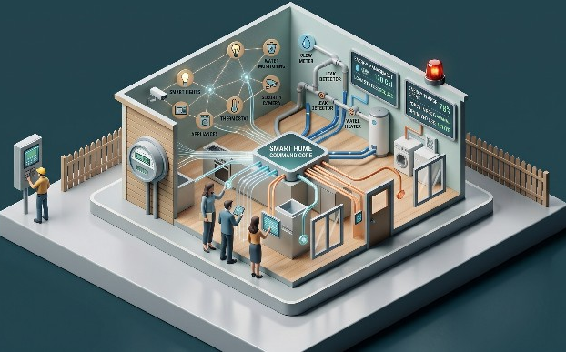
Smart Home & Office
Smart Citizen
Smart Home
Smart Office
Smart Meter
IoT Devices
Water Monitoring
Energy Management
Emergency Alerts
“The smart nation begins at home — every household becomes a hub of digital living.”

Slide 18
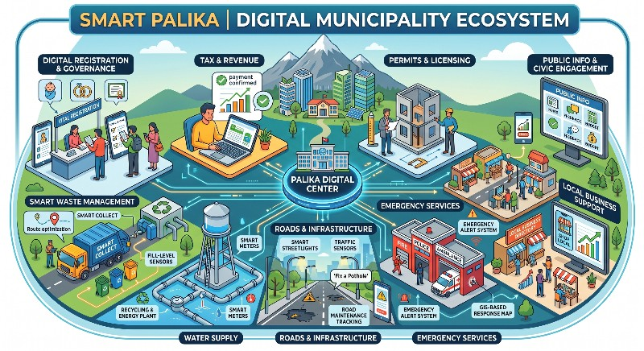
Smart Palika
Services: Digital registration, tax, permits, waste, water, roads, emergency, local business, public info.
“Transformation must start locally — smart palikas are the building blocks of Smart Nepal.”

Slide 19
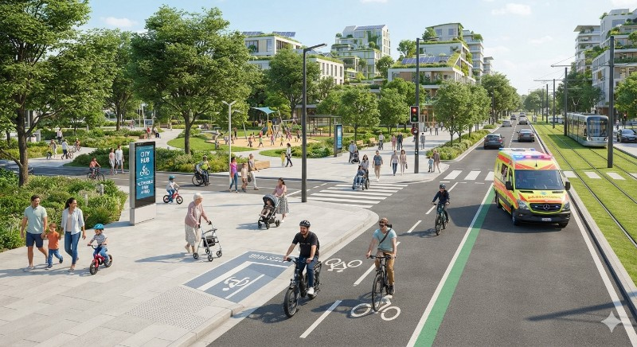







Smart City for Everyone
Technology should make cities more livable — not merely more digital.
“A smart city must be human-friendly, accessible, and green — technology should serve people, not overwhelm them.”

Slide 20
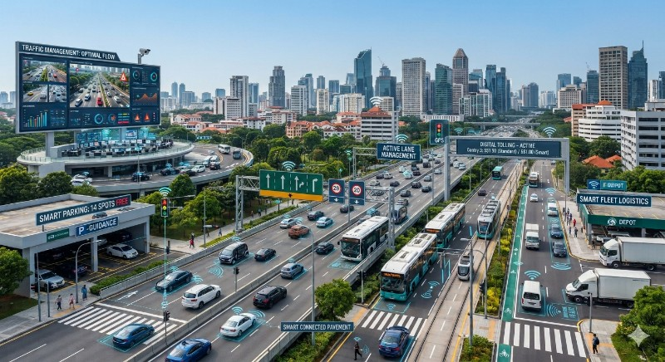
ACT V: Smart Transportation
Farm
Collection
Processing
Warehouse
Market
Consumer
Overlay: Smart roads, GPS, traffic management, smart parking, public transport, fleet management, digital tolling.
“Transportation is about moving people — but for Nepal, it’s also about moving economic value.”

Slide 21
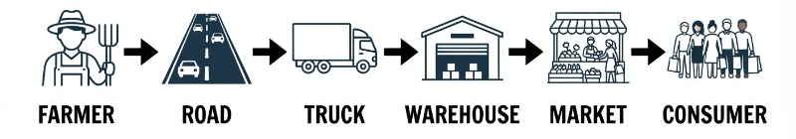


Logistics as Infrastructure
Every delay = Cost
Every improvement = Competitiveness
“Production has no value until it reaches the consumer.”

Slide 22
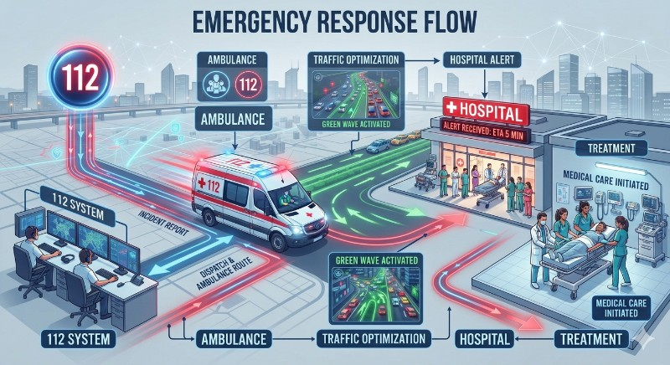
Smart Emergency Response
Emergency
112 System
Location
Ambulance
Traffic Opt.
Hospital
Treatment
“Every second matters — smart emergency systems save lives.”

Slide 23







Smart Security
CCTV & AI
Smart Lighting
Emergency Comms
Disaster Monitor
Cybersecurity
“Safer communities are built when technology and human response work together.”

Slide 24
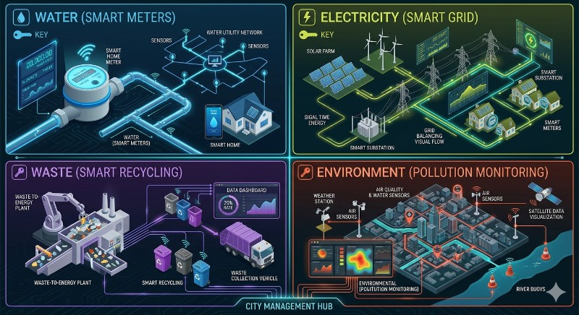




Smart Utilities
Water
Electricity
Waste
Environment
Smart meters, leak detection.
Smart meters, smart grid.
Smart collection, recycling.
Air, noise, pollution monitoring.
“Smart utilities make everyday life efficient, sustainable, and transparent.”

Slide 25
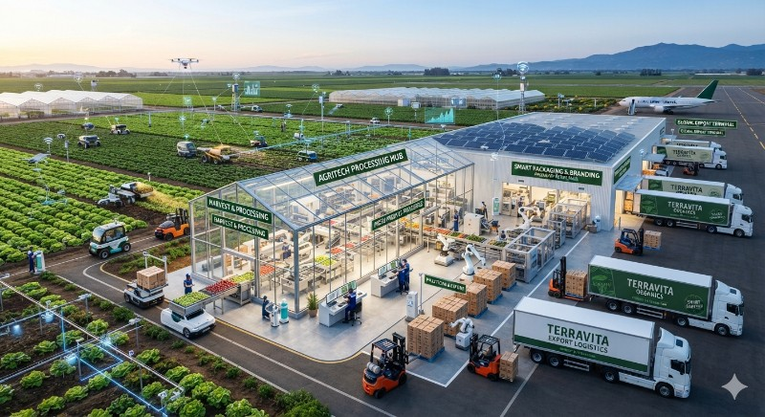
ACT VI: Agriculture
Sensors
Data
Irrigation
Mechanization
Processing
Packaging
Branding
Export
PRODUCE • PROCESS • BRAND • EXPORT
“From farming to agri-industry — technology turns agriculture into a competitive export engine.”

Slide 26
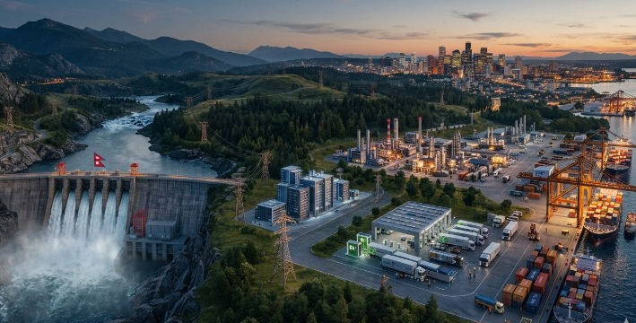
Energy
Hydropower
Reliable Energy
Manufacturing
Data Centres
EVs
Exports
Use energy to create value, not just electricity.
“Hydropower must fuel industries, jobs, and exports — not stop at generation.”

Slide 27

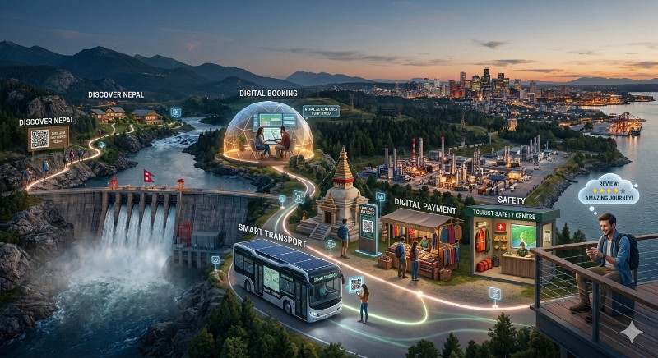

Tourism
Discover
Digital Book
Smart Trans.
QR Heritage
Digital Pay
Safety
Review
“Tourism becomes more valuable when enhanced by technology — from booking to safety to digital heritage.”

Slide 28
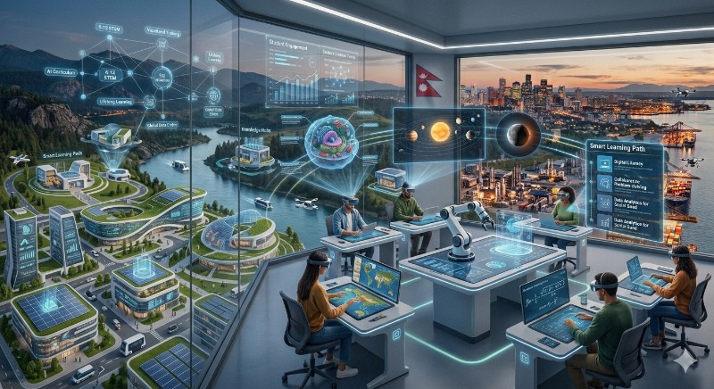








ACT VII: Smart Education
“The greatest infrastructure Nepal can build is not concrete — it is human capability. Don’t educate for yesterday’s jobs.”

Slide 29

Smart Health
Citizen
Health ID
Telemedicine
Hospital
Lab
Pharmacy
Follow-up
Features: Electronic health records, telemedicine, digital appointments, ambulance integration, AI diagnostics.
“Healthcare anywhere, anytime — technology ensures treatment is timely and accessible.”

Slide 30














Engineering for Development
Civil
Electrical
Electronics
Computer
Roads / Bridges / Cities
Energy / Grid
Sensors / IoT
AI / Software / Networks
Mechanical
Environmental
Agricultural
Architecture
Automation / Mfg.
Waste / Pollution
Smart Farming
Smart Buildings
“Every engineering discipline has a role in building Smart Nepal.”

Slide 31
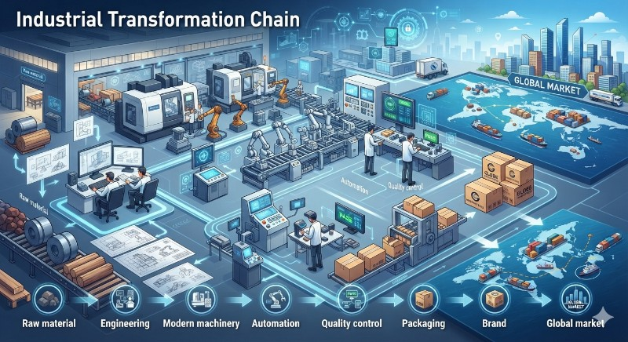
ACT VIII: Modernize Industries
Don’t just import. Build, improve, and export.
Raw Material
Engineering
Machinery
Automation
Quality Control
Packaging
Brand
Global Market
“Technology should make Nepali industries globally competitive — not dependent on imports.”

Slide 32
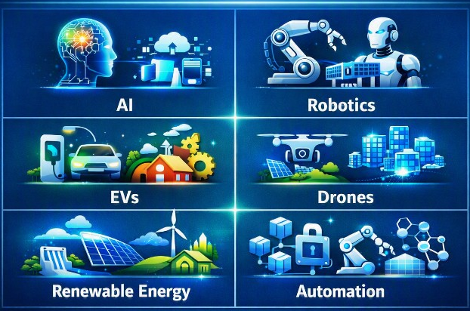










Innovation for Nepal
Don’t adopt technology because it is new. Adopt it because it solves a real problem.
“Global innovation must be applied to solve local problems — that’s how Nepal leapfrogs into the future.”

Slide 33
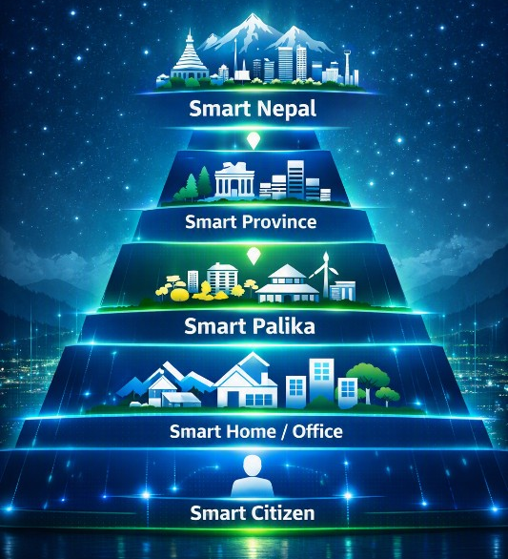
ACT IX: Smart Nepal Architecture
“Across all levels, ICT + Engineering + Data + Governance form the architecture of Smart Nepal.”

Slide 34
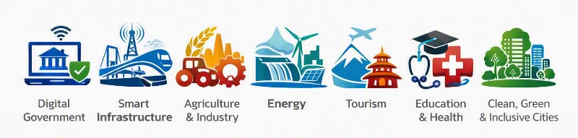







7 National Priorities
“These seven priorities define the roadmap for national transformation.”

Slide 35
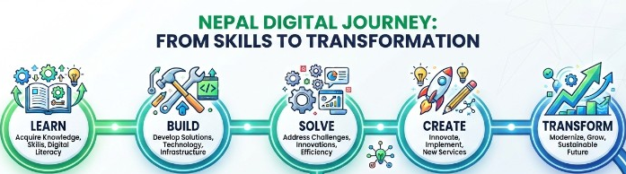
Your Role
Learn
Build
Solve
Create
Transform
Focus: University students — knowledge → technology → solving Nepal’s problems → businesses/jobs → national transformation.
“You don’t have to wait to become a minister or CEO. Start by solving one real problem today.”

Slide 36

Smart • Clean • Green • Safe • Inclusive • Transparent • Productive
“A smart Nepal is not a country full of computers. It is where a farmer earns more, a student learns more, a patient receives treatment on time, and a citizen receives services without queues or middlemen. ICT gives us intelligence. Engineering gives us infrastructure. Innovation gives us possibilities. And our young people give us the energy to make it happen. The future of Nepal will not be built by technology alone — it will be built by Nepali people who know how to use technology to solve Nepali problems. Let us engineer it. Let us digitize it. Let us build it. Prosperous Nepal. Happy Nepali.”

