Slide 1
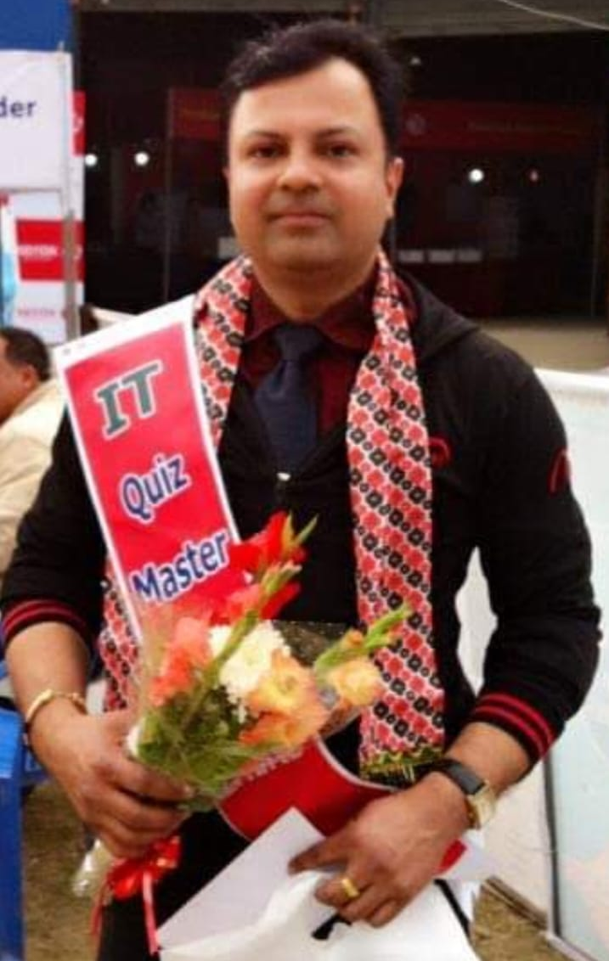
WELCOME
to
Quiz @ CODAVATAR
TRIVIA CHALLENGE 2025
Grand FINALE
Host: Hemanta Baral
Dec 29, 2025 Friday @5th Floor

Slide 2
Questions Number
1
2
3
4
5
6
7
8
9
10
11
12
13
14
15
16
17
18
19
20
21
22
23
24
25
26
27
28
29
30
31
32
33
34
35
36
37
38
39
40
41
42
43
44
45
Extra 1
Extra 2
Extra 3
Extra 4
Extra 5

Slide 3


Question 1
Most common single English word of six letters with no vowel letters (A, E, I, O, U)?
Answer ➔

Slide 4
Question 2
दायाँ हात मात्र प्रयोग गरेर टाइप गर्न सकिने सबैभन्दा लामो सामान्य शब्द कुन हो? What is the longest common word that can be typed with only the right hand?
Answer ➔

Slide 5
Question 3
कुन तापक्रममा सेल्सियस र फरेनहाइट स्केलहरूले एउटै मान देखाउँछन्? At what temperature do Celsius and Fahrenheit scales show the same value?
Answer ➔

Slide 6
Question 4
कुन कीराले खानाको स्वाद लिनको लागि आफ्नो खुट्टा प्रयोग गर्छ? Which insect uses its feet to taste food?
Answer ➔

Slide 7
Question 5
What is the first film of Nepal? नेपालको पहिलो फिल्म कुन हो?
Answer ➔

Slide 8
Question 6
कुन कुन देशहरूमा कोका-कोला आधिकारिक रूपमा व्यापार गरिँदैन वा बेचबिखनमा प्रतिबन्ध लगाइएको छ? In which countries are Coca-Cola not officially sold?
Answer ➔

Slide 9
Question 7
पुरुष शरीरको कुन बाह्य अङ्ग (बाहिरी रूपमा देखिने अङ्ग) को कुनै जैविक उद्देश्य हुँदैन? Which external organ (outer appearance organ) in the male body has no biological purpose?
Answer ➔

Slide 10
Question 8
Can you divide a cake into 8 equal pieces with only 3 cuts? → If Yes, how?
Answer ➔

Slide 11
Question 9
Who cut off the nose of Surpanakha (Ravana's sister) in the Ramayana? रामायणमा शूर्पणखा (रावणकी बहिनी) को नाक काट्ने काम कसले गरेका थिए?
Answer ➔

Slide 12
Question 10
What is the only district in Nepal where fish are not found? नेपालमा माछा नपाइने एक मात्र जिल्ला कुन हो?
Answer ➔

Slide 13
Question 11
विश्व सम्पदा सुचिमा नेपालका कति सम्पदा सुचिकृत छ्न ? How many heritage sites of Nepal are listed on the World Heritage List?
Answer ➔

Slide 14
Question 12
खसीमा पाईने तर भैसीमा नपाईने के हो?
Answer ➔

Slide 15
Question 13
न्युयोर्क कुन नदीको किनारामा छ? Which river is New York located on the bank of?
Answer ➔

Slide 16
Question 14
म Chitwan को प्रथम स्थानमा छु, Kathmandu को द्वितिय स्थानमा छु, र Butwal को त्रित्रिय स्थान मा छु भने म को हुँ?
Answer ➔

Slide 17
Question 15
Which sport is the Dolphin Kick related to? डल्फिन किक् कुन खेलसंग सम्बन्धीत छ?
Answer ➔

Slide 18
Question 16
कोतपर्व हुदा नेपालका प्रधानमन्त्री को थिए? Who was the Prime Minister of Nepal during the Kot Massacre?
Answer ➔

Slide 19
Question 17
Who was the first King of Nepal to travel Europe? सर्वप्रथम युरोप यात्रा गर्ने नेपालका राजा को हुन्‌?
Answer ➔

Slide 20
Question 18
नेपालको पहिलो राजमार्ग कुन हो ? What is the first highway of Nepal?
Answer ➔

Slide 21
Question 19
नेपालको अग्लो स्थानमा रहेको मन्दिर कुन हो? What is the highest-altitude temple in Nepal?
Answer ➔

Slide 22
Question 20
खुर्कोट कुन जिल्लामा पर्दछ? Which district is Khurkot located in?
Answer ➔

Slide 23
Question 21
महाभारतमा कर्णलाई "कवच–कुण्डल" कसले जन्मैमा दिएका थिए? In the Mahabharata, who gave Karna the "Kavacha-Kundala" (armor and earrings) at birth?
Answer ➔

Slide 24
Question 22
महाभारतमा अश्वत्थामालाई "अमरत्व" को श्राप या वरदान कसले दिएका थिए? In the Mahabharata, who gave Ashwatthama the curse or boon of "immortality"?
Answer ➔

Slide 25
Question 23
अस्ट्रेलियाको राजधानी सहर कुन हो? What is the capital city of Australia?
Answer ➔

Slide 26
Question 24
बिश्वको पहिलो महिला राष्ट्रपति कुन देशकी हुन्? Which country was the world's first female president from?
Answer ➔

Slide 27
Question 25
नेपाली शब्द कैँची लाई अंग्रेजीमा के भनिन्छ हिज्जेसहित भन्नुहोस्।? What is 'Kaichi' called in English, please state the spelling as well?
Answer ➔

Slide 28
Question 26
If you divide 30 by half and add 10, what do you get?
Answer ➔

Slide 29
Question 27
"बसन्ती“ उपन्यासका उपन्यासकार को हुन? Who is the novelist of the novel "Basanti"?
Answer ➔

Slide 30
Question 28
रिसाएको बेलामा रातो पसिना निकाल्ने जीव कुन हो? Which animal secretes red 'sweat' when it is angry (or stressed)?
Answer ➔

Slide 31
Question 29
नेपालको पहिलो जननिर्वाचित प्रधानमन्त्री को हुन ? Who was the first democratically elected Prime Minister of Nepal?
Answer ➔

Slide 32
Question 30
संसारको पहीलो रोग केलाई मानीन्छ ? What is considered the oldest disease that was documented and described?
Answer ➔

Slide 33
Question 31
Who wrote the National Anthem of India? भारतको राष्ट्रिय गान कसले लेखेका हुन्?
Answer ➔

Slide 34
Question 32
चिठ्ठाको प्रचलन कुन देशबाट भएको हो? From which country did the practice of lotteries originate?
Answer ➔

Slide 35
Question 33
विश्वमा सबैभन्दा पुरानो मूर्ति कुन देशमा छ?In which country is the oldest statue in the world located?
Answer ➔

Slide 36
Question 34
अमरसिँह थापाले देहत्याग गरेको ठाउ कुन हो? What is the place where Amar Singh Thapa passed away (died)?
Answer ➔

Slide 37
Question 35
सबैभन्दा पुरानो वेद कुन हो? Which is the oldest Veda?
Answer ➔

Slide 38
Question 36
चैनपुर कुन जिल्ला को पुरानो सदरमुकाम हो? Chainpur was the old headquarters of which district?
Answer ➔

Slide 39
Question 37
What is the nearest star to Earth after the Sun? सूर्यपछि पृथ्वीको सबैभन्दा नजिकको तारा कुन हो?
Answer ➔

Slide 40
Question 38
What is the chemical symbol for gold?
Answer ➔

Slide 41
Question 39
What is half of two plus two?
Answer ➔

Slide 42
Question 40
नेपालको पहिलो महिला सभामुख को हुन्? Who is Nepal’s first female Speaker of Parliament?
Answer ➔

Slide 43
Question 41
What is the only bird that can hover in one place? एउटै ठाउँमा स्थिर भएर उड्न सक्ने चरा कुन हो?
Answer ➔

Slide 44
Question 42
What does GDP stand for?
Answer ➔

Slide 45
Question 43
काखीको रौँ (भुत्ला) लाई नेपालीमा के भनीन्छ?? What is the Nepali term for armpit hair?
Answer ➔

Slide 46
Question 44
What part of the human body contains the smallest bone?
Answer ➔

Slide 47
Question 45
सबैभन्दा बढी जिल्लासँग सिमाना जोडिएको जिल्ला कुन हो? Which district is bordered by the largest number of other districts in Nepal?
Answer ➔

Slide 48
Question Extra ONE
Spell the word टुइजर्स in English.
Answer ➔

Slide 49
Question Extra TWO
Which country, like Nepal, has a holiday on Saturday? नेपाल जस्तै शनिबार छुट्टी हुने देश कुन हो?
Answer ➔

Slide 50
Question Extra THREE
बिश्व सबैभन्दा पुरानो बाली कुनलाई मानिन्छ ? What is considered the oldest crops in the world?
Answer ➔

Slide 51
Question Extra FOUR
औँलाका बाहिरपट्टि प्रत्येक खण्डमा उम्रिने रौँ लाई नेपालीमा के भनीन्छ? What are the small hairs that grow on the outer side of each finger segment called in Nepali Language?
Answer ➔

Slide 52
Question Extra FIVE
चारवटा बाख्रा पछाडि एउटा बाख्रा छ र चारवटा बाख्रा अगाडि पनि एउटा बाख्रा छ भने अब भन्नुहोस जम्मा बाख्रा कती होलान? If there is one goat behind four goats and one goat in front of four goats, how many goats are there in total?
Answer ➔

