Slide 1
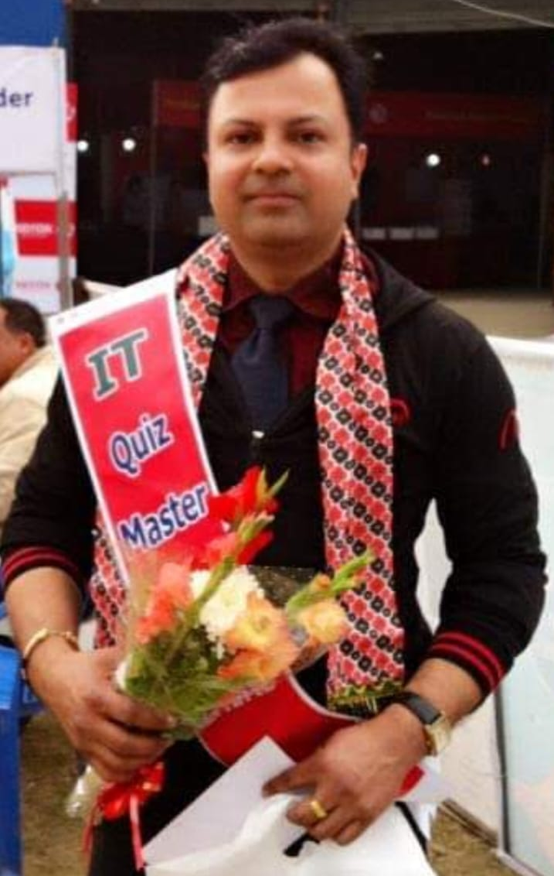
WELCOME
to
Quiz @ CODAVATAR
TRIVIA CHALLENGE 2025
Grand FINALE
Host: Hemanta Baral
Dec 29, 2025 Friday @5th Floor

Slide 2

QUIZ Rules and Regulations
Questions must be answered within the time limit; no response counts as a missed attempt.
First team gets 30 seconds; passed team gets 15 seconds.
Only one team may answer unless the question is officially passed.
Only the team leader may give the final answer.
Correct answer: 10 points; passed correct answer: 5 points.
No use of mobile phones, notes, or external help.
The quizmaster’s decision is FINAL on all matters.

