Slide 1

Smart
EDUCATION
By:
Hemanta Baral
Smart City Architect (ICT)
www.hemantabaral.com.np

Slide 2

Hemanta Baral
Masters in Computer Network Security, UK
Over 22⁺ years experience in ICT sector
Data Centre Consultant for:
DoC (Department of Customs)
CAAN (Civil Aviation Authority of Nepal
DoTM (Department of Transport Management)
Expertise/Certification:
Certified Data Center Professional (CDCP)
European Computer Driving License (ECDL)
ICT Examiner for University of Cambridge (AS & A Level)
Regular Trainer for Cyber Security to Nepal Police Senior Officers
Smart City Speaker for CAN and NAST
Designer of Voter’s ID Card (ECN)
First Modular Data Centre Architect for GIDC
M: 9843067142
E-mail: hemanta.baral@gmail.com;
hemantabaral@yahoo.com
Web:
www.hemantabaral.com.np
https://hemantabaral.wordpress.com
Writer (30+ Books)
ICT Consultant
Former IT Officer
Nepal Govt.

Slide 3
Major parameter of Smart EDUCATION?
Everyone should be happy!!
  Student/Parents
  Teachers
  Staffs
  Stakeholders
  Institution (Board/Owner)

Slide 4






Slide 5
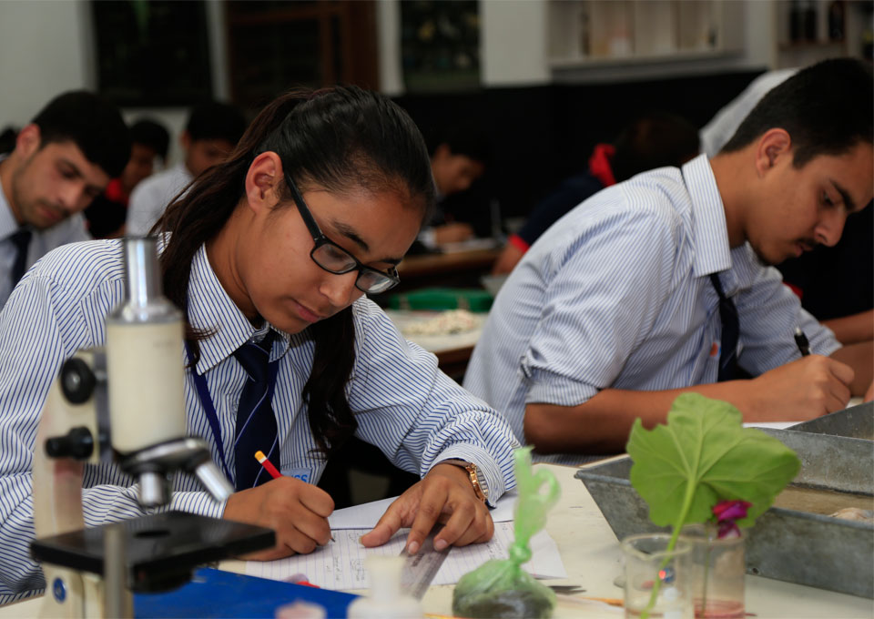
What makes Student/Parents HAPPY?
  Quality Education
  Learning Environment
  Friendly and supported Teachers/Staffs
  Facilities (Library, Canteen, Sports, Lab, Washroom, Drinking Water
  Tidiness, Hygiene
  Extra Activities: Quiz, Educational Visits, Motivational sessions, Leadership Development, Presentation/Soft Skills, Career Counseling
  Rewards, Scholarships
  Respond and Respect (Parents)

Slide 6

What makes Teacher/Staffs HAPPY?
  Remuneration as per market trend
  Growth Opportunity
  Effective Grading System
  Timely Appraisal
  Training, Workshops
  Social Involvement (Family Get-together in special occasion like Anniversary, Holi, Sripanchami, Asar15 etc..)
  Outside Refreshment Visit (Review Meeting, Family Picnic )
  Call for innovative ideas (rewards)
  Effective, fair and agreed working hours
  Enjoyable (Friendly working environment)

Slide 7

What makes Institution HAPPY?
  All the process and activities should be System-driven as per the standards and compliance
  Student/ Teacher/ Staffs Happy
  Continual Improvement (Business Growth)
  Everything should be ON-TIME
  Reputation

Slide 8


How can we achieve Smart EDUCATION?
  Implementing ICT enabled Smart Education System
  Positive Attitude
  Friendly Working Environment
  Facilities as per market standards
  Happiness
Individuals (Entity) →System (Smart Education) →Quality of Work/ Education

Slide 9
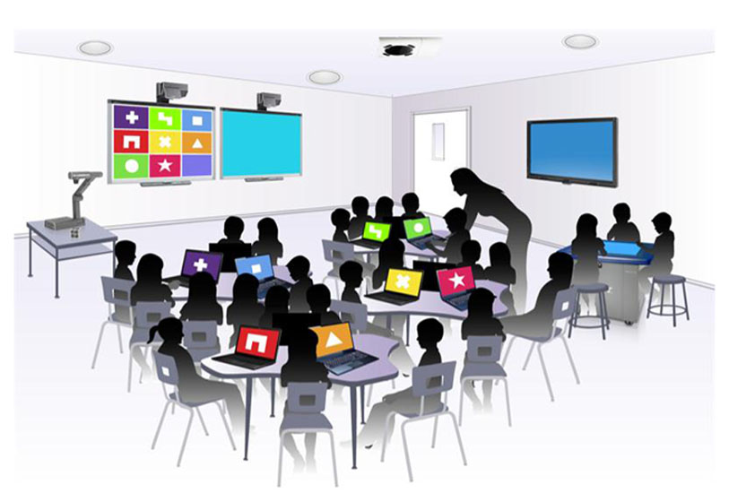
What is Smart Education?
A Smart, System-driven & Multi-Disciplinary Student-Centric Education System using:
Adaptive Learning Programs and Portfolios for students
Collaborative learning using technologies (ICT/IoT & Cloud Computing) and digital learning resources for teachers and students
Smart Class Room/ Campus
* Adaptive Learning: is the delivery of custom learning experiences that address the unique needs of an individual

Slide 10
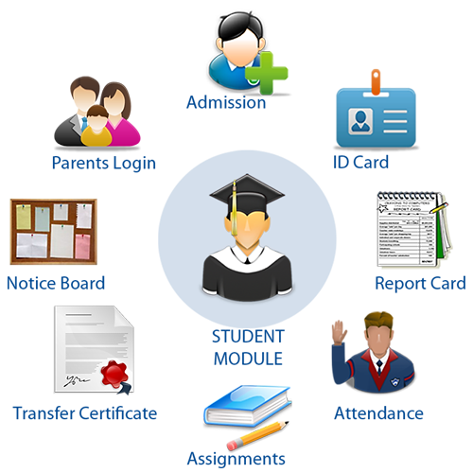
Smart Education Parameters
Unique Identity of individuals (Students, Teachers, Staffs, Stakeholders)
Centralized Database
Education ERP System with Web/Mobile Apps
Smart Individuals
Smart Class Room
Smart Campus
  Interactive learning with Audio/Video
  Remote Education
  Digital and Online Contents

Slide 11

Architecture for Smart Education System

Slide 12
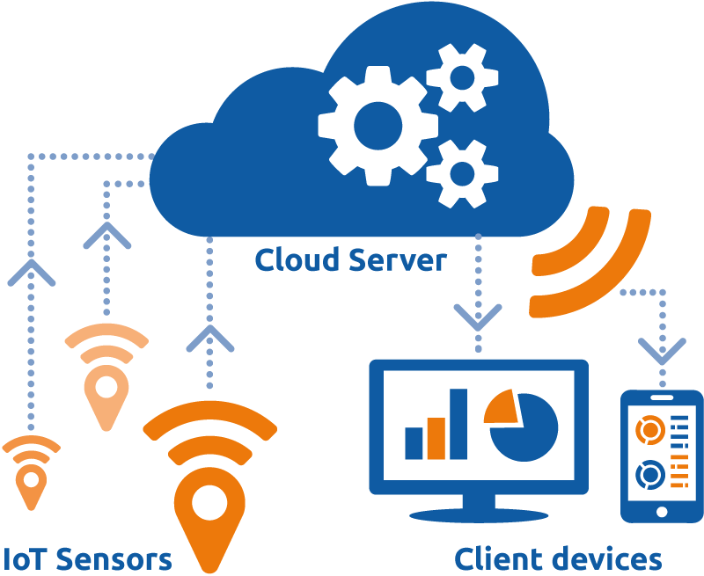
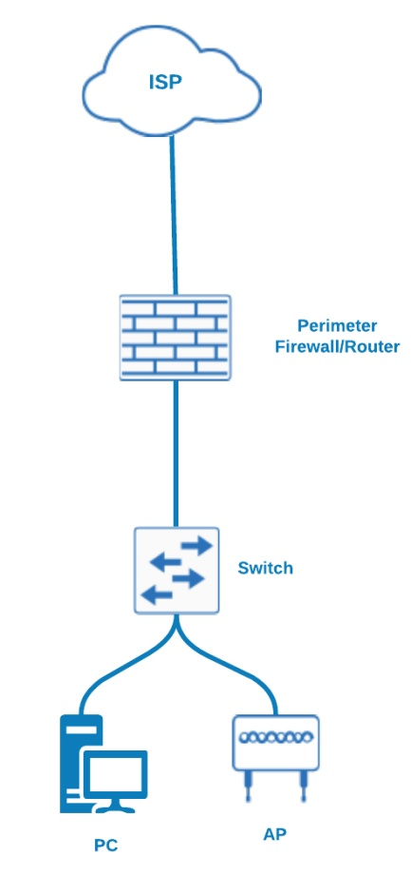
Technology:
Information Technology (IT) – Computing
Information Communication Technology (ICT) – Computing,
Networks
Internet of Things (IoT) – Sensors, Network,
Internet & Cloud
Network:
On Premises
Cloud
Today & Beyond Network
On Premises Network

Slide 13
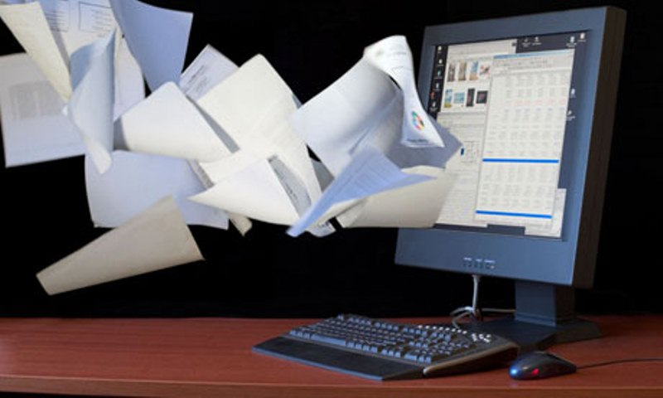

Digitization of
School Management System
[Paperless Automation system]
Think BEFORE You Print: 1 ream of paper = 6% of a tree and 5.4kg CO2 in the atmosphere. 3 sheets of A4 paper = 1 liter of water
Student ➔ e-Education (Application) ➔ Service Delivery ➔ Quality of Education

Slide 14
Infrastructure

Slide 15
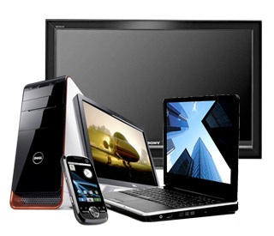
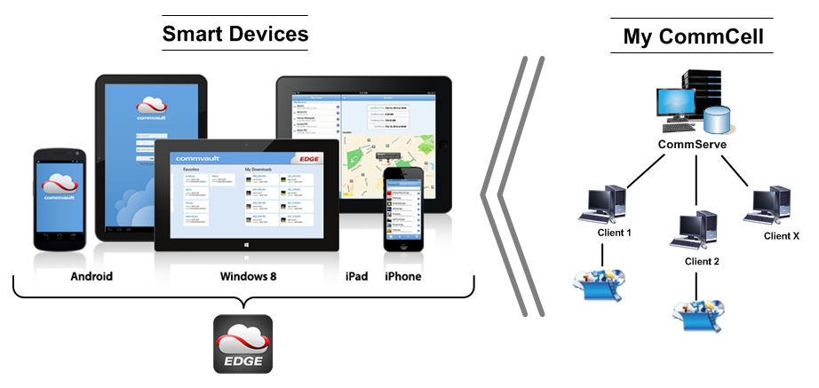
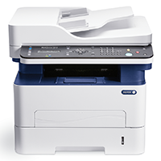
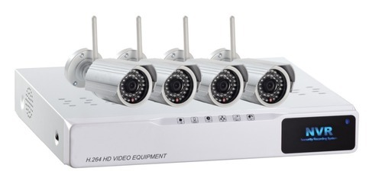
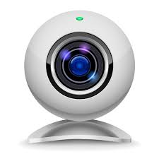
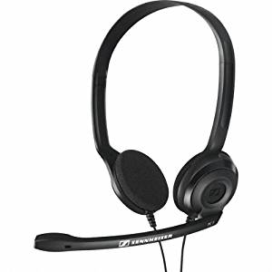
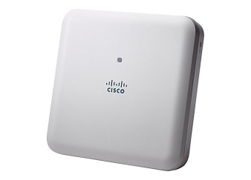
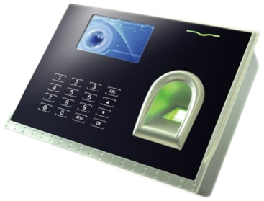
Hardware
Desktop, Laptop, Notebook, TV

Slide 16
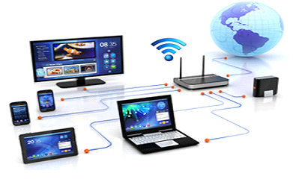
Connectivity
Intranet:
Data Link Layer (L2 Link)
Internet:
Network Layer (L3 Link)
Broadband Connection:
DSL (ADSL/ SDSL)
Cable Modem
Optical Fiber
Wireless (Radio)
Satellite (VSAT)

Slide 17
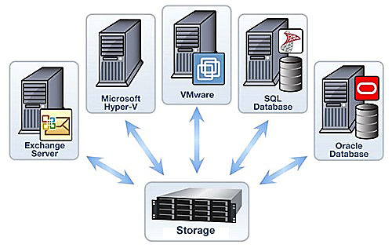
Server/Storage
Servers:
Application Servers
Database Server
Network Storage:
SAN (Storage Area Network) –
high-end servers, high-capacity disk
arrays, and Fibre Channel
NAS (Network Attached Storage) –
NAS devices onto the LAN via TCP/IP
Storage on Cloud

Slide 18
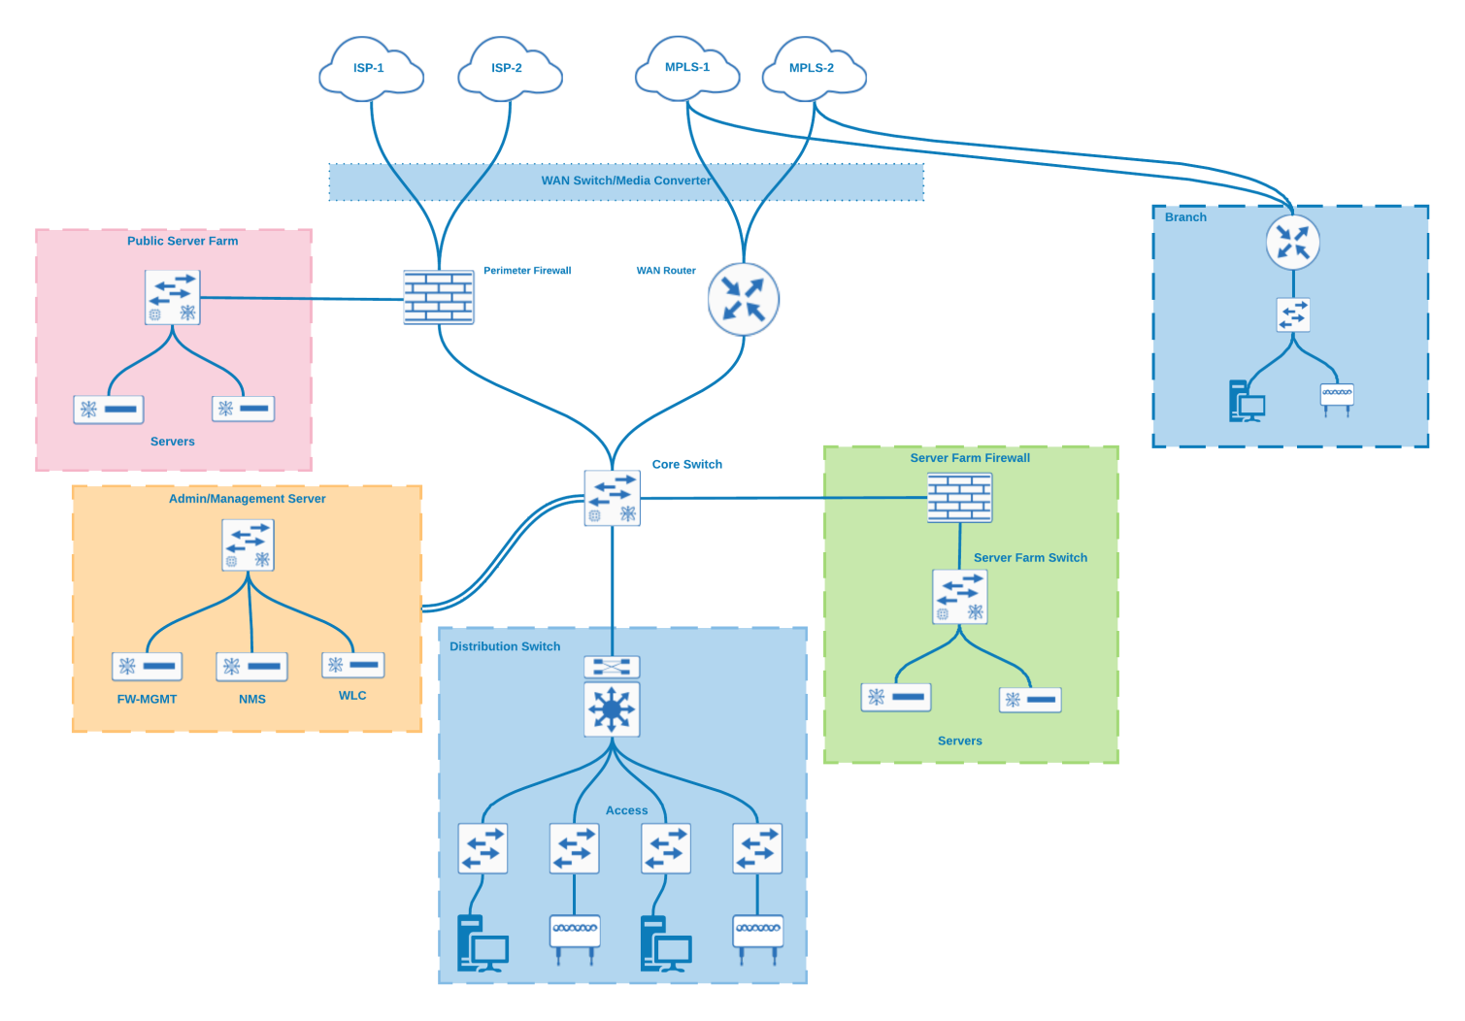
Network/Security
Group of Institutions
Campus

Slide 19
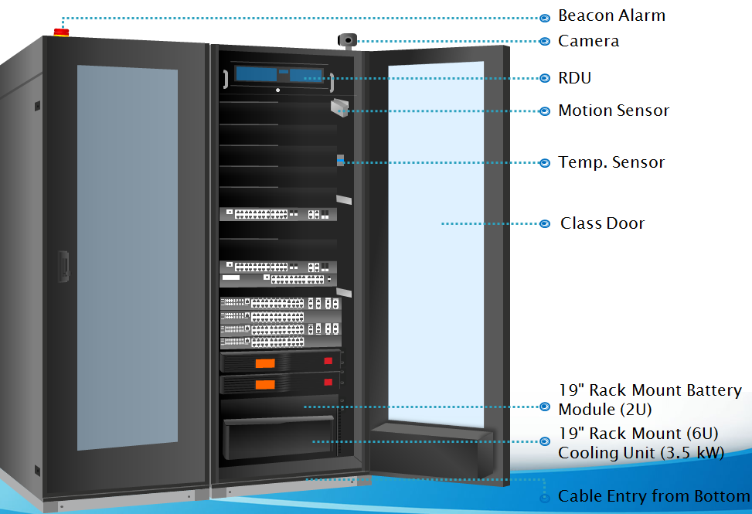
Data Centre Infrastructure (Server Room)

Slide 20
Application
School
ERP System

Slide 21
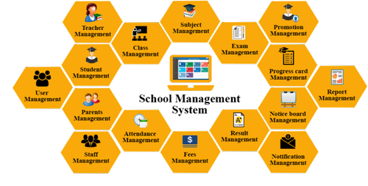
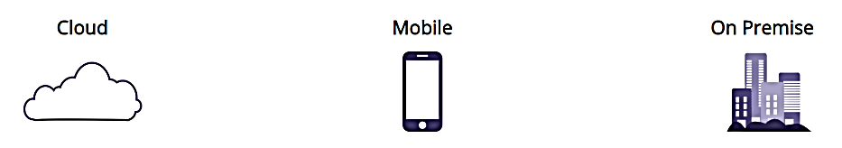
Implementation of
School ERP System

Slide 22


Slide 23

Features of School ERP System
Student Information System (SIS)
Examination Management System (EMS)
Student Billing
Mobile App
Attendance & Leave (Biometric sync)
SMS Integration
Learning Management System (LMS)
Financial Accounting
Web Portal (Teacher, Student and Parent)
Pre-admission & CRM
Payroll
Inventory
Email Integration
Custom Reports

Slide 24
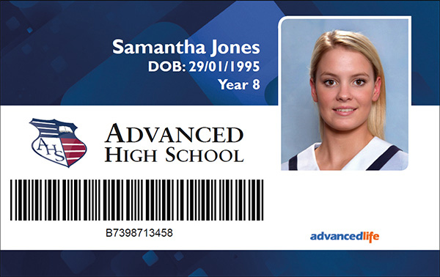
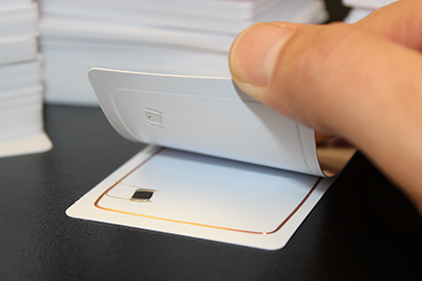
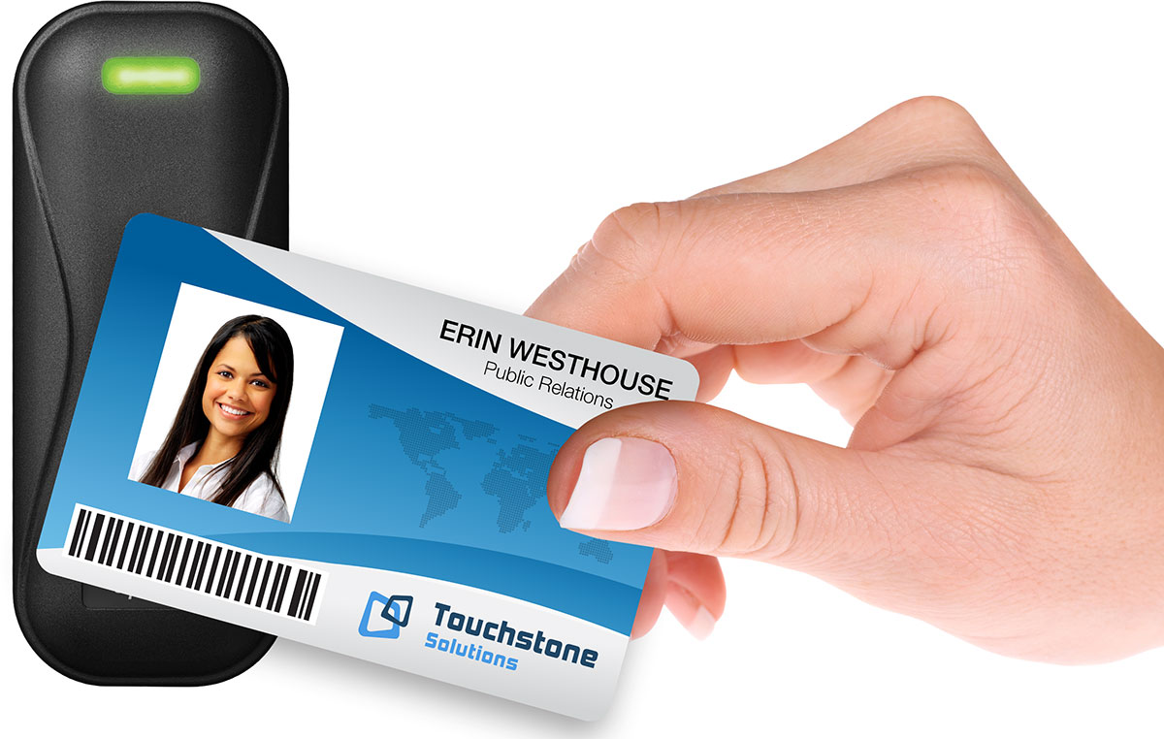
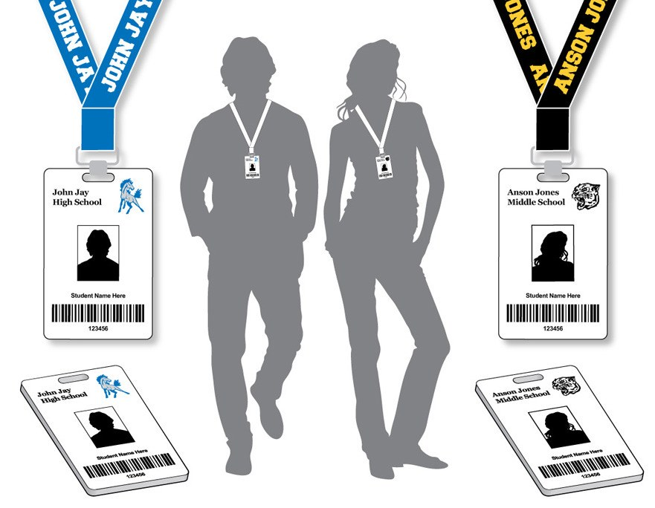
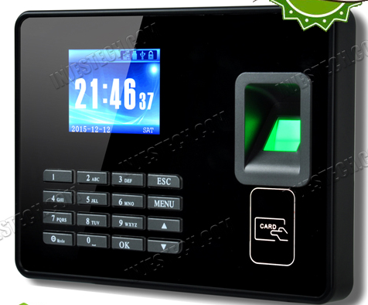
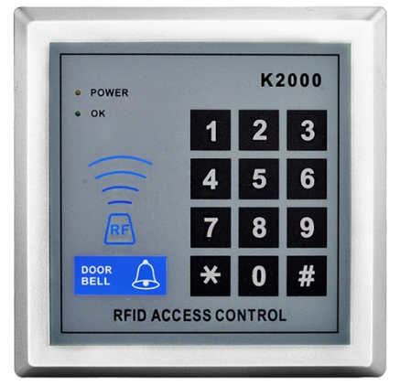
Unique Student ID Card
Proximity or
Contactless
ID Card
RFID
ID Card

Slide 25
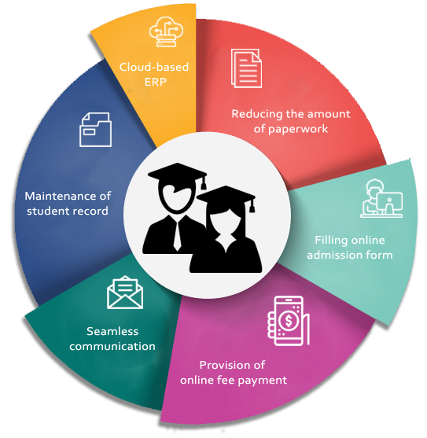
Student Information System

Slide 26
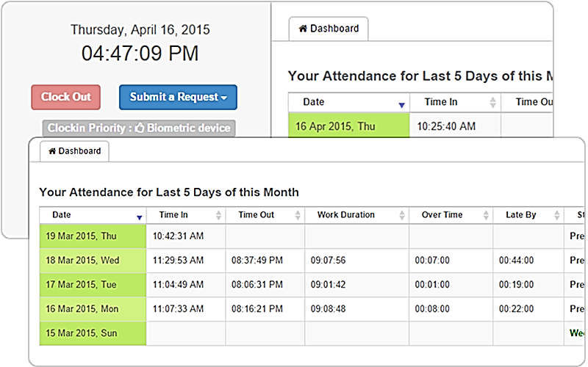
Attendance Management System

Slide 27
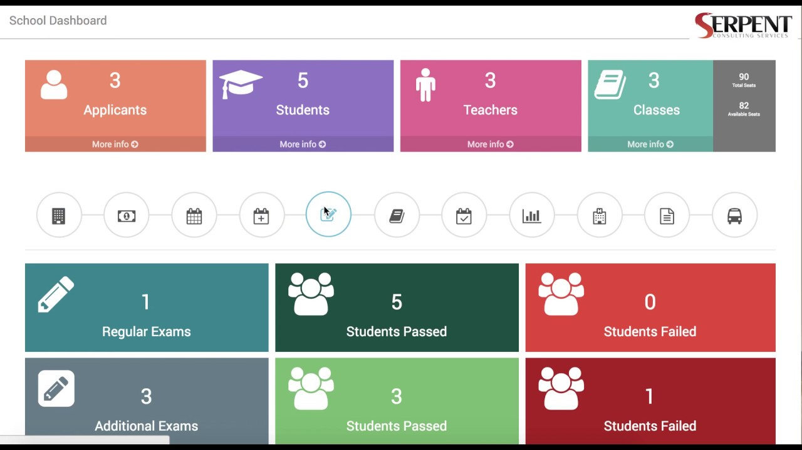
Exam Management System

Slide 28
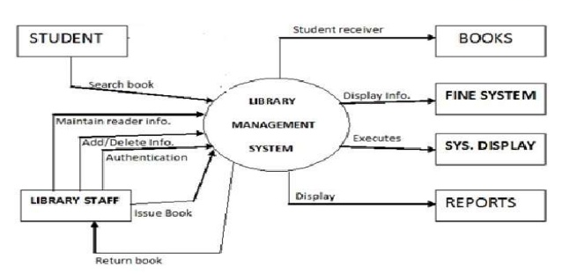
Library Management System

Slide 29
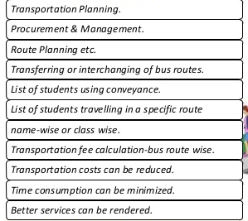
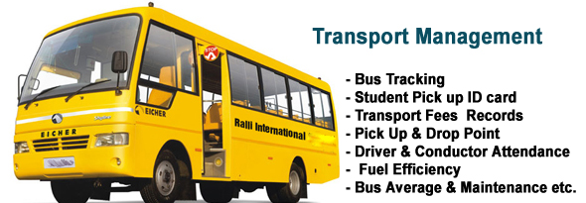
Transport Management System

Slide 30
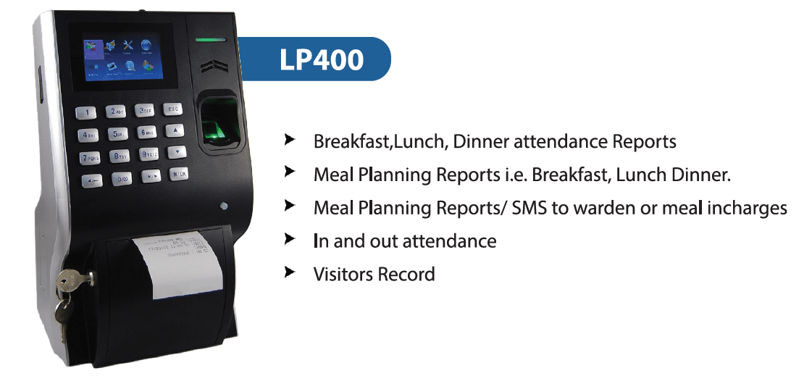
Canteen Management System

Slide 31
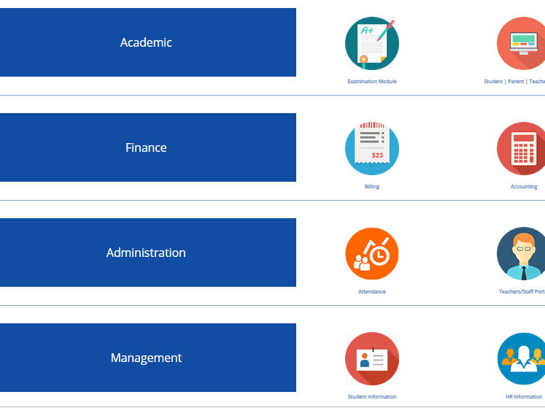
Centralized
Dashboard

Slide 32
SMART Individual
At least Smart Phone on Pocket or PC
Data Pack or Easy WiFi Access
Familiar with Technology [2G - GPRS (General Packet Radio Service), 3G, 4G)
Compatible Set, Settings to activate 3G/4G, Service Providers
Familiar with Education Activities
Familiar with available School Applications
Application download from Play Store (Android), App Store (iOS) & Others
Proper use of the available Applications (Mobile/Web apps)
Education Service Centres

Slide 33
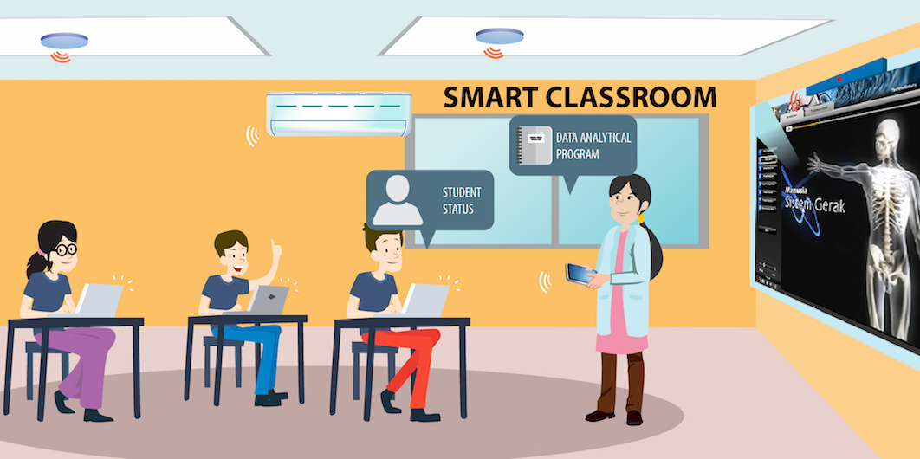
Smart Classroom

Slide 34
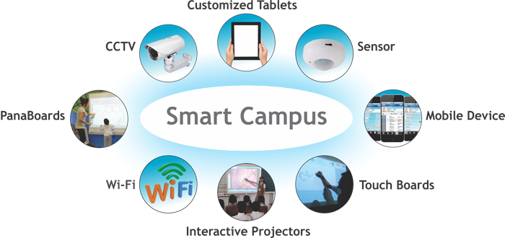
Smart Campus

Slide 35
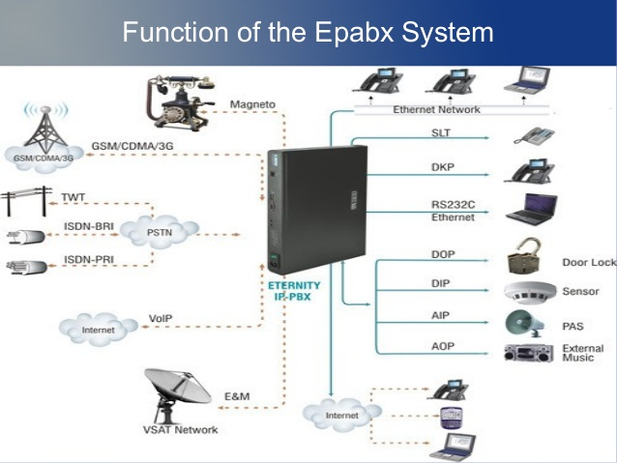
ePABX

Slide 36
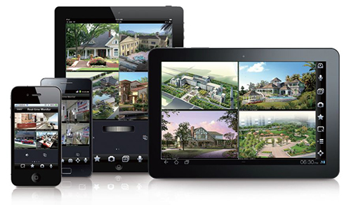
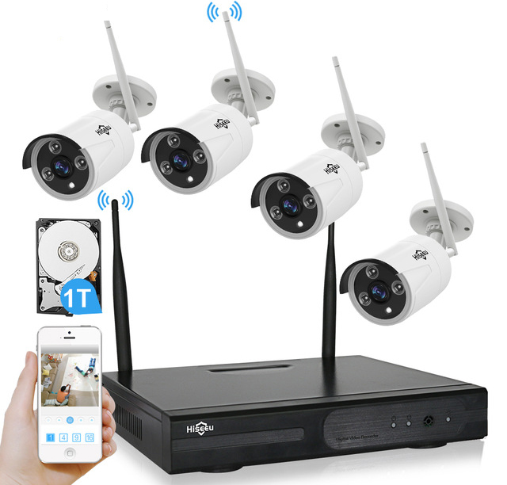
CCTV Surveillance System

Slide 37
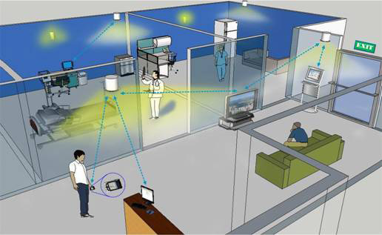
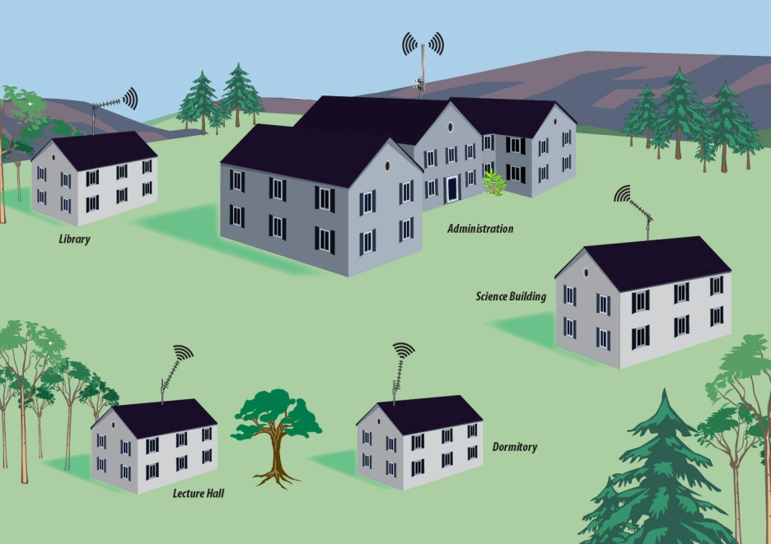
Smart WiFi
Indoor
Outdoor

Slide 38
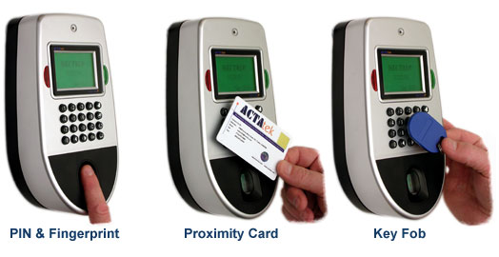
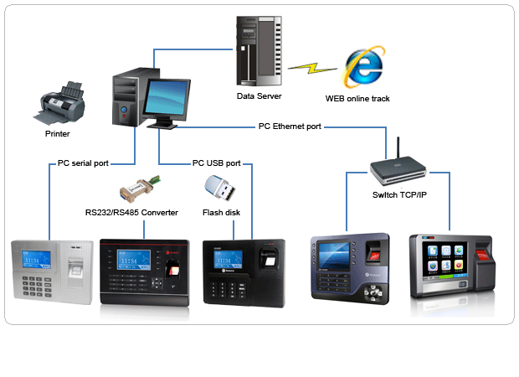
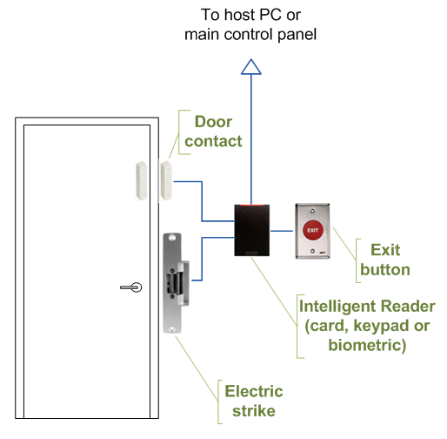
Biometric Access Control & Time Attendance System

Slide 39
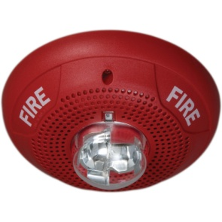
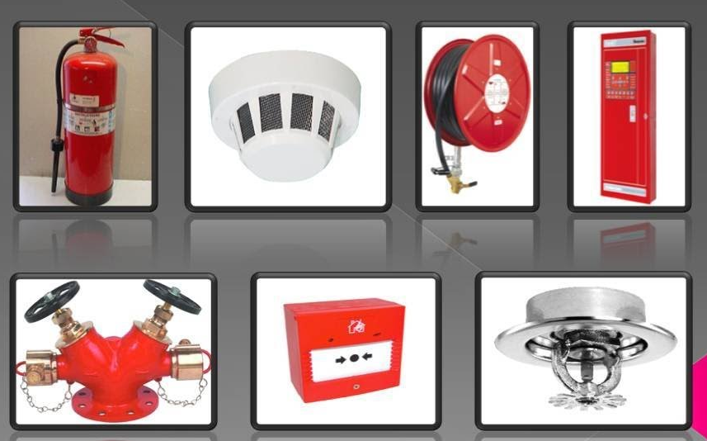
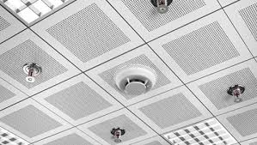
Building Fire Fighting System

Slide 40
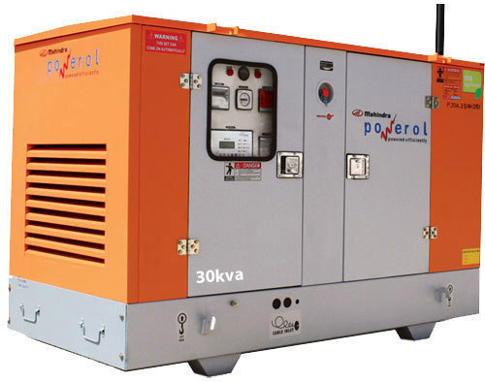
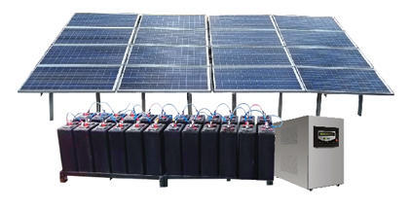
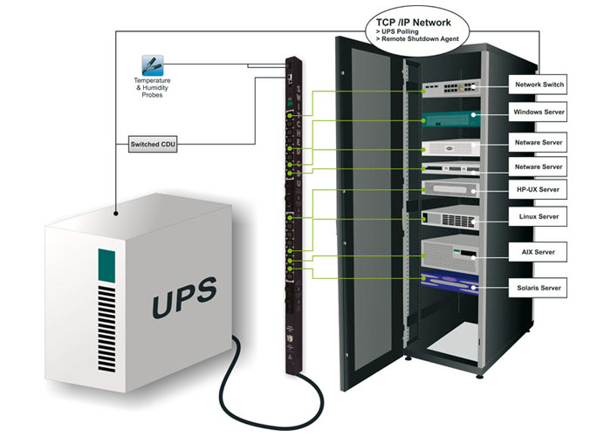

Building Power Management

Slide 41


Auto Swing Main Entrance Door (Sliding)

Slide 42


Smart Blinds, Smart Lights

Slide 43

Remote Control for Building Appliances

Slide 44




Online Payment System, Payment Kiosk Terminal and ATM

Slide 45

Drinking Water

Slide 46




Smart
Wash Room

Slide 47



Smart Urinal (Water Less System)

Slide 48


Smart Waste Management

Slide 49


Smart Transport &
Smart Parking
  Smart Bus Stops with real time information using GPS + WiFi + CCTV
  Interactive digital screens
  Smart Ticketing through
  automated ticketing machine
  Travel Cards

Slide 50


Slide 51

Real-Time Global Positioning System (GPS) Tracking System
With IoT Sensor
(GPS Tracking Device)
Internet
Computer, Laptop or Mobile
Tracking Server on Premises or Cloud

Slide 52
Other Activities
Training
Motivation
Counselling
Leadership Development
Smart Library
Smart Canteen
Project Works/ Presentation
Public Relation
Digital Marketing
Internship
Exchange Program
Global Education System

Slide 53



Educate/Aware Students/Parents through
Social Online Media
Solution:
Create Social Media Pages
  YouTube Channel
  Face book Page
  Twitter Page etc..
  Upload educational and
  awareness Contents in
  Social media pages and
  Share it publicly.
  Develop user friendly Mobile
  Apps
Association of
Academic
Institution
College & School
Principals
Parents & Societies
College & School
Teachers
Students

Slide 54



EDUCATION

