Slide 1
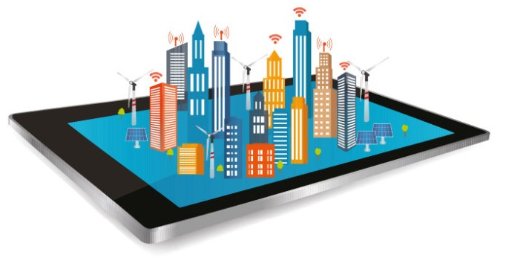

PRESENTATION
on
ICT-Enablede-Governance for a Smart
& Prosperous Society
By: Hemanta Baral
ICT/Data Centre/Smart City Consultant

Slide 2
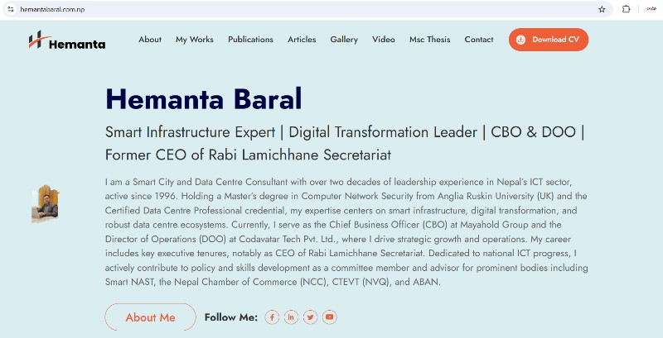
www.hemantabaral.com.np

Slide 3
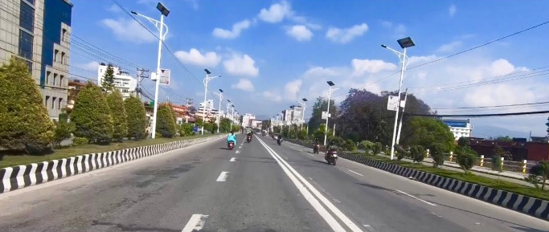
Smart Society/CITY
Smart People (Citizen) ➔ Smart Living ➔ Smart Government ➔ Smart City

Slide 4
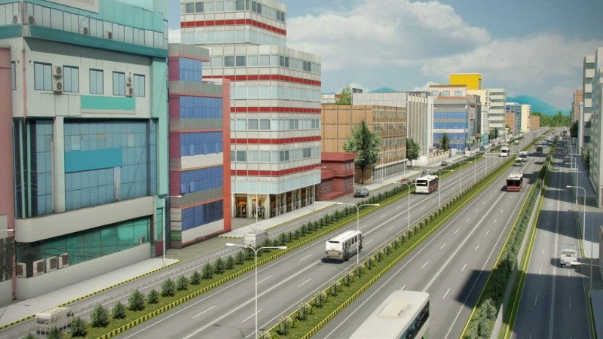
स्मार्ट सिटी के हो?
सूचना, सञ्चार तथा प्रविधिको माध्यमबाट सरकारी काम–कारबाहीलाई छिटो, सरल, पारदर्शी र सबै नागरिकले सहज रूपमा अनुभव गर्न सक्ने गरी व्यवस्थित सेवा प्रणाली स्थापना भएको शहरलाई “स्मार्ट सिटी” भनिन्छ।
A smart city is a municipality that uses information and communication technologies (ICT) to increase operational efficiency, share information with the public and improve both the quality of government services and citizen welfare.
https://www.youtube.com/watch?v=Br5aJa6MkBc

Slide 5
स्मार्ट सिटीका विशेषताहरु
१. प्रविधि सम्पन्न– Use of ICT/IoT in good governance by digitization (e-Governance)
२.सुशासन (भ्रष्टाचार रहित संयन्त्र) - Using faceless automated and integrated system
३.सफा (प्रदुषण रहित), हरियाली
४.सुन्दर (व्यवश्थित बिजुली, टेलिफोन, ईन्टरनेट, खानेपानी, भवन, ढल, बाटो, पार्किङ्ग, ट्राफिक, बसपार्क, बजार आदिको उचित व्यवश्थापन)
५. व्यवश्थित र वैज्ञानिक शिक्षा, स्वास्थ्य, हस्पिटालिटी, सम्पदा, बैंकिङ, पर्यटन, न्याय/कानून, खेलकुद
६. आर्थिक सम्पन्न (रोजगारीको अवसर- to develop Smart Citizens),गरिबी न्यूनिकरण, कलकारखाना, कृषि उत्पादन, सिंचाई, बजार व्यवश्थापन
७. सुरक्षित र बृद्घ, अपा·, महिला तथा बालमैत्री
Smart City Design: Retrofitting of existing OR New Design
Design will be based on existing Physical Infrastructure and Geographical Condition.

Slide 6
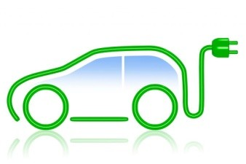
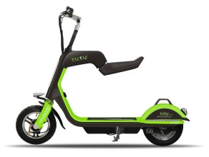


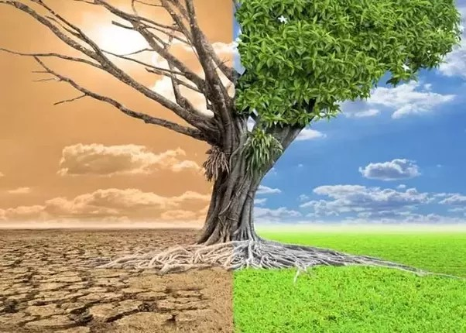
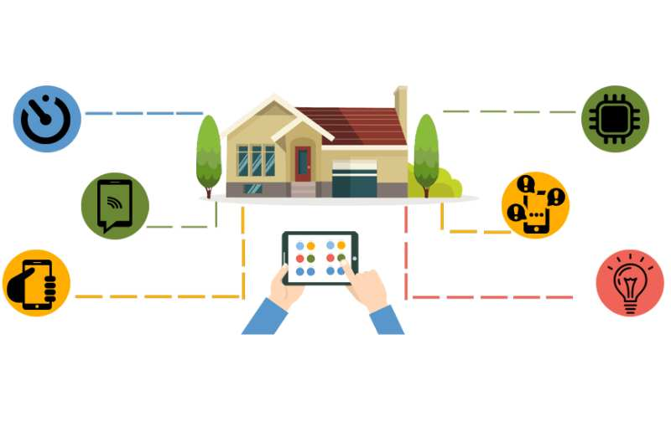
प्रविधि सम्पन्न र सुशासित
(भ्रष्टाचार न्यूनिकरण तथा अन्त्य)
Digitization of
Government Services
[Less paper (later on paperless) Automation system]
Think BEFORE You Print: 1 ream of paper = 7Kg Wood and 2.4kg CO2 in the atmosphere. 1 ream of A4 paper = 1000 liter of water
Citizen ➔ e-Governance (Application) ➔ Service Delivery ➔ No Corruption

Slide 7
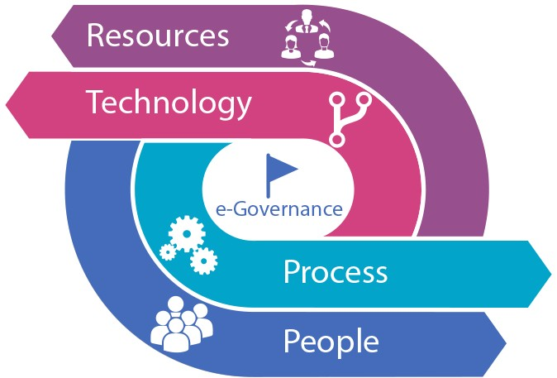
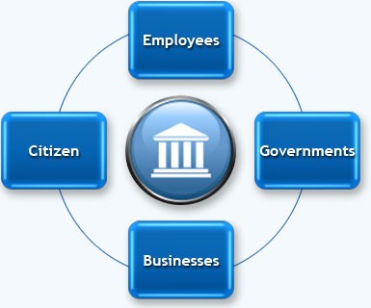
Digitizationby implementing:
e-Governance: It is the transformation of government processes to provide efficient, convenient and transparent services to the Citizens and Business through Information and Communication.
G2C:
e-Registration (National ID)
e-Citizenship, License, Passport
e-Passport, Voter's ID
e-Taxation
e-Health
e-Education
e-Transportation
e-Land Registration
e-Payment (Electricity, Telephone, Water, Internet, Mobile)
G2C, G2B, G2G, G2E, C2G
(E-Governance Models)

Slide 8
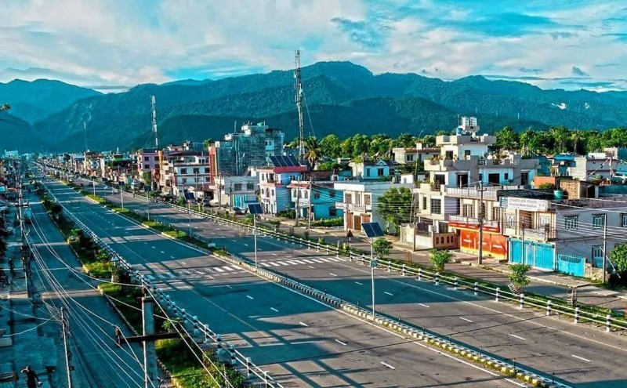
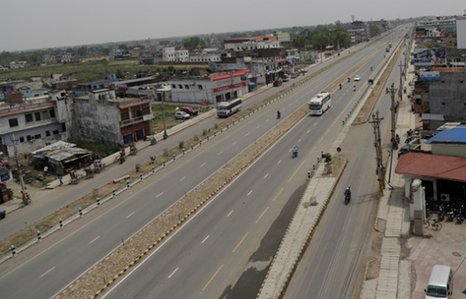
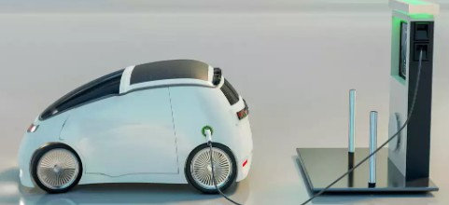
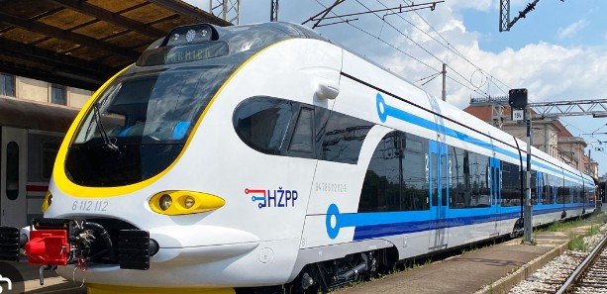
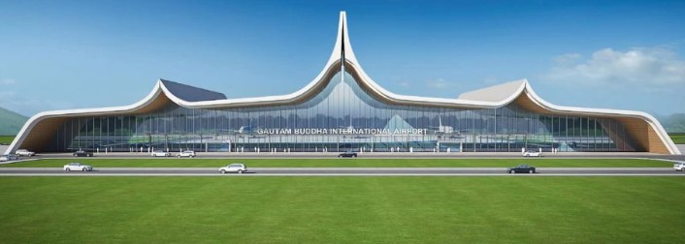
Clean &
Pollution
Free
Greenery

Slide 9
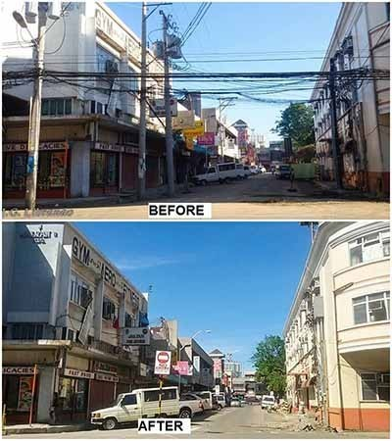
Visible Improvements
Replacing overhead wires…

Slide 10
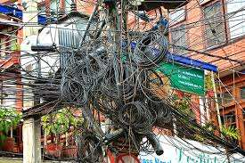
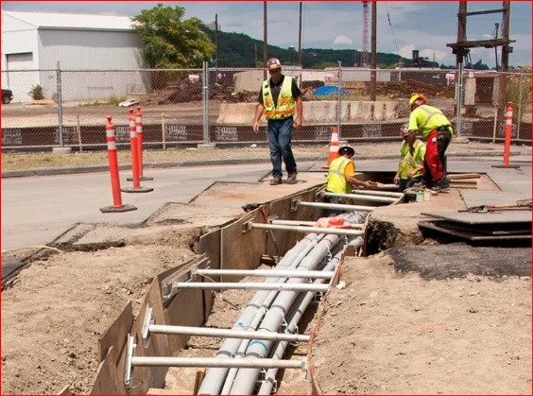
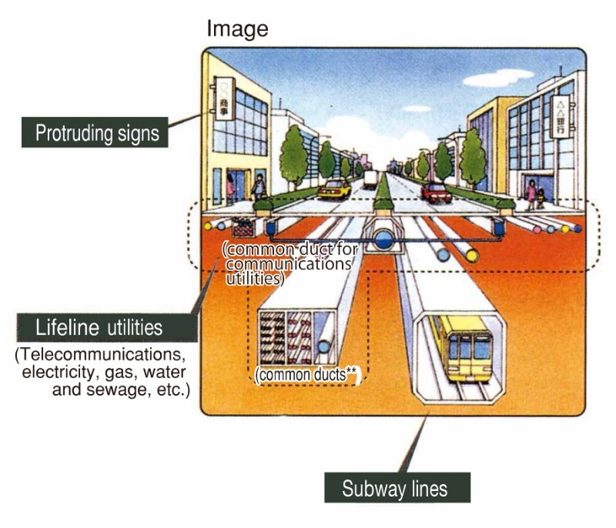
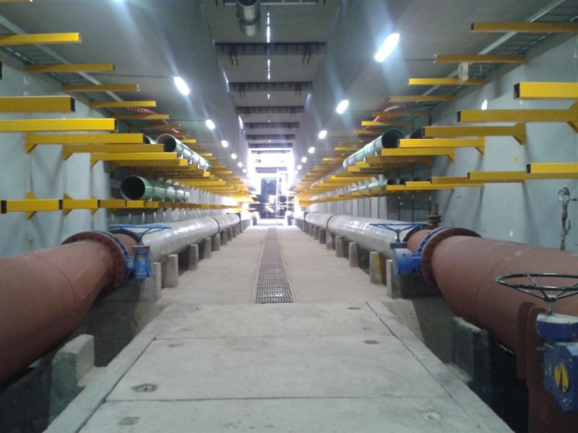
Replacing overhead with Ducting System

Slide 11
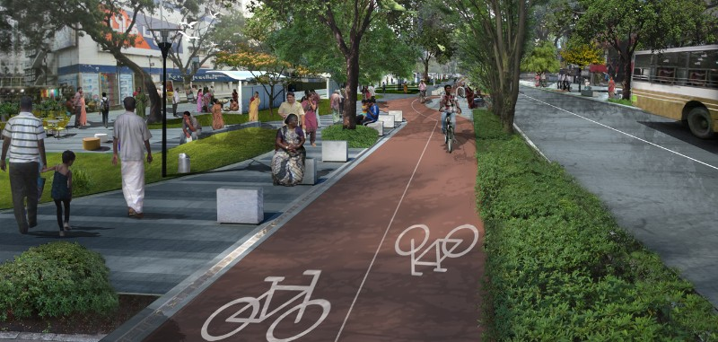
Pedestrian friendly
Road with separate Bicycle Lane

Slide 12
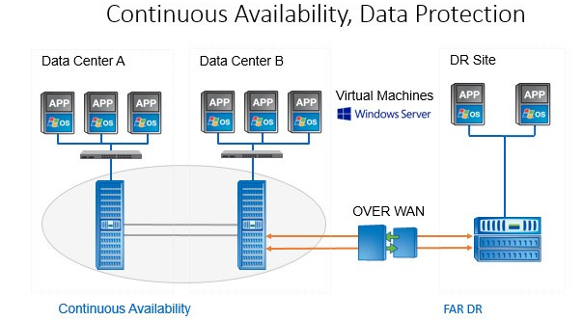
Mandatory Things to be DONE
Unique Identity – Effective Implementation of National ID
Digital Street Addressing - GIS Mapping
Centralized Database Management System (DBMS)
Cloud based Data Centre [a. Primary, b. Secondary (Near DC or Failover
DC) and c. Disaster Recovery (DR)]
  Central
  Province-wide
  Use of Applications (Automated and Integrated)
  and Mobile Applications for End-users (Android
  and iOS version)
Centralized Secured Network (Optical Fiber)
Central System for Government Website Hosting and centralized
Government E-mail system with common Email ID to each
Government Employees

Slide 13
Unique Identity & Centralized Database
Why is it important?
Get rid of scattered Data
Birth Registration (MoFALD)
Population Census (CBS)
Citizenship (MoHA)
License (DoTM)
Passport (DoP)
Voter’s ID (Election Commission)
LaalPurja (DoLRM)
VAT/PAN (IRD)
Business Registration (OCR)
EPF/CIT
Bank (KYC)
Benefits:
Centralized Data
Uniqueness
Banking
Travel
Shopping
Not necessary to fill
the form everywhere
Ease of Tracking
Crime Control

Slide 14
tTsfn ug'{kg]{ sfo{x?
Implementation of Faceless Government Services for Corruption Control
Mobile Apps for Citizen Charter and Government Services
Queue Management System in Government/Public concern offices
Easy access to Public Toilets (Waterless and odorless Urinals)
Strengthening of Public Government Schools using Smart Education
Strengthening of Government Hospitals (Smart and Centralized Healthcare System)
Mobile Infra Ambulance for instant repair and maintenance
Call center for Government Services
Automation for: Taxation, Registration, Vaccination, Old Age/Child Benefits
Educate/Aware citizens through social media and School/college level students
Output:
Smart People/Citizen - Smart Home/Office - Smart Village/Society - Smart Palika –
Smart Province/State - Smart Nation

Slide 15
Highlights
Corruption Control using automation (Faceless system – system driven)
Queue Management for Public Services
Public Toilets (waterless and odorless urinals and WC)
Public Government School Strengthening using Smart Education
Smart and Centralized Healthcare system (Strengthening Govt. Hospitals)
Mobile Infra Ambulance for instant repair and maintenance
Call Centers for Government Services, Mobile Apps for Citizen Charters
Automation system for:
  Taxation
  Registration
  Vaccination
  Old age/Child benefits
  9. Priority to Child, Women, Disable, Old Age people

Slide 16
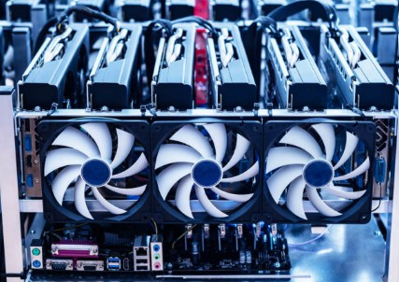
Prosperous Nepal
!= hnljB'tpTkfbgdf hf]8
a[xt ?kdfhnljB'tpTkfbg u/L g]kfnn] k|of]u u/L afFsL /x]sf] lah'nLcGt/fli6o ahf/dflaqmLljt/0f, Wind Milltyf ;f]nf/ O{ghL{sf] ;Defjgfsf] cWoog
Electric Vehicle, Cable Cars sf] k|of]udf hf]8 -h;n] k|b'if0f /lxtzx/ agfpg d2t k'/\ofp+b5_
Electric Train sf] ;+rfngdf hf]8 -h;n] Ps 7fp+af6 csf]{ 7fp+df l56f] ;dodfk'Ug / s[lifhGotyfcGopTkfbgx?nfO{ ;xhtl/sfn] ahf/;Dd k'/\ofpg
;lsg]5 .
Crypto Mining (Power and Cooling for High Computing)o;n] 7"nf]] dfqfdf j}b]lzswg/fzL g]kfnleq\ofpg d2t ug]{5 . h;sf] nflu g]kfnsf] lxdfnog If]q hxfF x/bd lr;f] x'g'sf ;fy} Dedicated Hydro Power
Plant sf] ;xfotfn] cfjZostfcg';f/sf] ljB'tcfk'lt{ ug{ ;lsg]5 .

Slide 17

@= ko{6g, ;Dkbf(Smart Tourism and Heritage)
af6f] (Highway, Super Highway)
International Airports (Promoting as a Transit Hub like
Singapore)
Cheap Mountain Flight packages for the transit passengers
Online Booking, Online Promotional Packages, Eco Tourism
Mobile Apps
Yoga/Meditation Packages, Religious tourism
Domestic fare should be same for both Nepalese and
foreigners

Slide 18
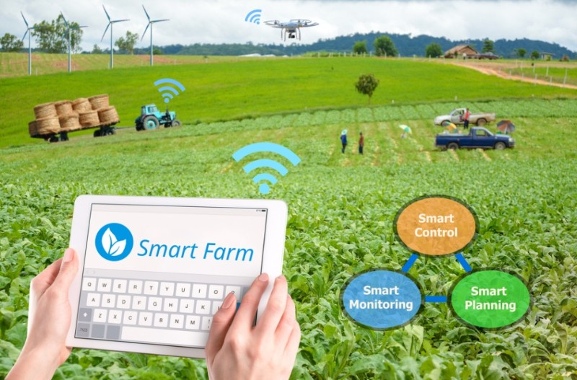
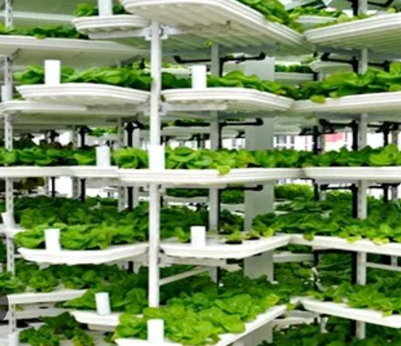
#= cfw'lgs s[lif, l;+rfO{ tyfkz'kfng(Smart Agriculture/
Sanitation/ Live Stock Farming)
s[lifhGocgfh, t/sf/L tyfkmnkm"nsf] afx|} dlxgfpTkfbg
-xfjfkfgL, dn, df6f], 6g]nsf] j}1flgs tj/n] cg';Gwfgtyf
pAhgL_
j}1flgs s[liflzIfftyftflnd
pTkfbgsf] nfluahf/ JojZyfkgtyf ;xh 8]lne/L
Stack/vertical farmingkocjwf/0ff

Slide 19
$= g]kfnLpTkfbg, k|zf]wg / pTkfbgljljlws/0f u/L ;f] sf] lgof{tdf hf]8
cn}+rL, cb"jf, d/Lr, lrof, ;'kf/L, skf;, lrhj6/, h8La'6L, bfnu]8fu'8Lsf] pTkfbgtyflgof{tdf hf]8
g]kfnL /S;LnfO{ cGt/fli6«o ahf/df a|flG8· u/L laqmLljt/0f -pbfx/0fsf] nflu g]kfndf ag]sf] v's'/L /d
cGt/fli6«o ahf/dfAnfs n]an eGbfdx+uf] bfddflaqmLeO{/x]sf]_
uf+hfnfO{ legalize u/L cGt/fli6«o ahf/dfpromote ug]{
The natural spring water direct from Himalayan
Beer made from natural spring water (tasty)
Leather foot wares
Garments/Pashmina/Carpets

Slide 20
%= ;"rgf, ;+rf/ tyfk|ljlw(Information Communication and Technology)
Establishment of Foreign Outsourced Company and employment to Nepali IT
experts (availability of comparatively cheaper manpower)
ICT enabled e-Governance system (Automated and Integrated)
Faceless system-driven Government Services for Corruption Control (Zero
Corruption)
^= /f]huf/Lsfcj;/x? >[hgf -u/LaLGo"lgs/0f_
3/fo;L s'6L/ pBf]usf] k|aw{g u/L :yflgo :t/df a|flG8ª u/L ahf/Ls/0f ug]{
s[lif, kz'kfng, snsf/vfgf, pBf]uwGbfdf hf]8
uf]/vsfnL 6fo/, x]6f}+8f sk8f, a'6jn wfuf], la/u+hlrgL, e[s'6L sfuh, hgsk'/ r'/f]6 -uf+hfsf] r'/f]6
k|jw{g_, af+;af/L 5fnf h'Qf, lxdfnl;d]G6 cflbnfO{ Ao"+tfpg] of ;f] ;/xsfsnsf/vfgfsf] :yfkgf

Slide 21
Things to be done by the Government (Local/ Province/ Central):
Purchase required Hardware (Workstations, Server, Storage, Network/Security, Database)
Strong dedicated Connectivity (Internet/Intranet) – Centralized Palika to Ward Office
Network (Own fiber network from Palika to Ward office and important places like school/
hospitals, public places)
CCTV Surveillance
WiFi (Centralized system with WiFi controller)
Building Small Size Data Centre Infrastructure (Server Room)
Mobile App/ Web App (Dedicated Public IP needed) along with own Domain
  Citizen Charter
  Government Activities
  Online Utilities Payments
  Taxation System
  Tourism/Heritage
  Transportation
  Health/ Education
  Agriculture/ Heritage
  Banking/share investment
  Employment (Job sites)
Get help from DOIT (G-Cloud) and GIDC for Application and VPS Service

Slide 22

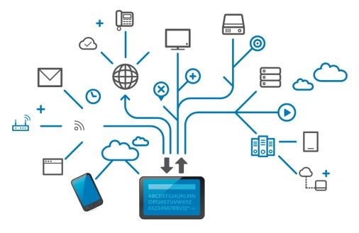
SMART CITY Parameters
Infrastructure
Hardware
Connectivity
Network
Security
Server
Storage
Data Centre
Infrastructure
Application
E-mail
Website
Mobile/ Web Apps for
Online Payment
Local Govt. Applications
Central Govt. Applications
Apps as per Smart City
Components
Smart City Components
Smart People
Smart Home/Living
Smart WiFi
Smart Communication
Smart Education
Smart Health
Smart Transport/Mobility
Smart Water/Electricity Supply
Smart Energy
Smart Agriculture
Smart Tourism/Heritage
Smart Waste Management
Smart Livestock farming
Smart Crime Control
Smart Banking

Slide 23
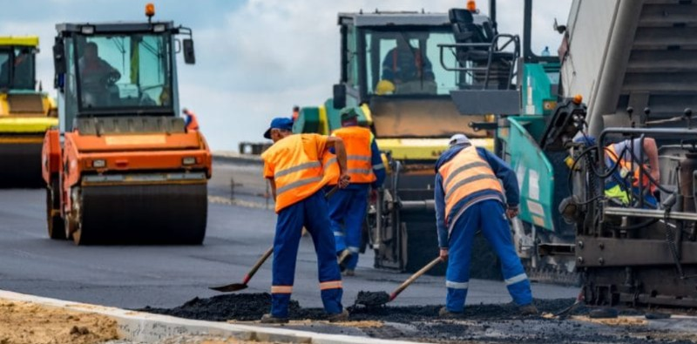
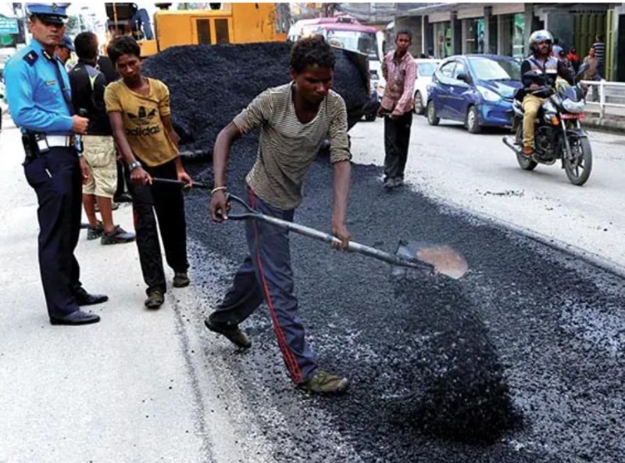
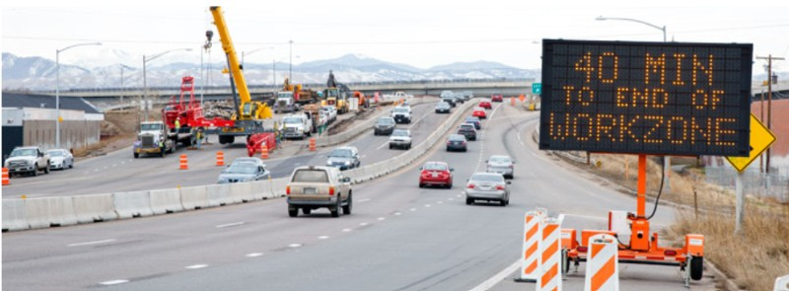
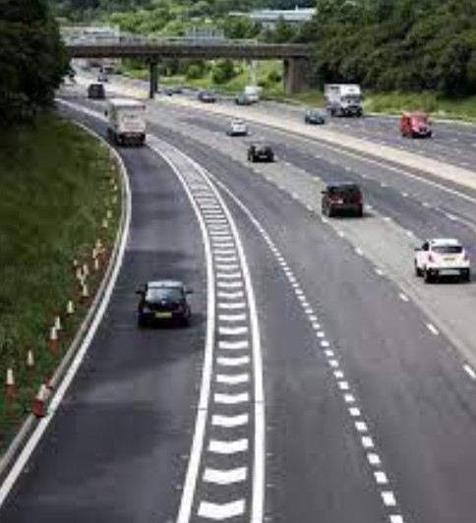
Emergency Repair and Maintenance (Smart Infra Ambulance)

Slide 24
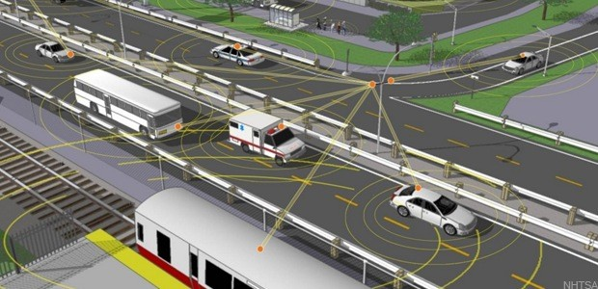
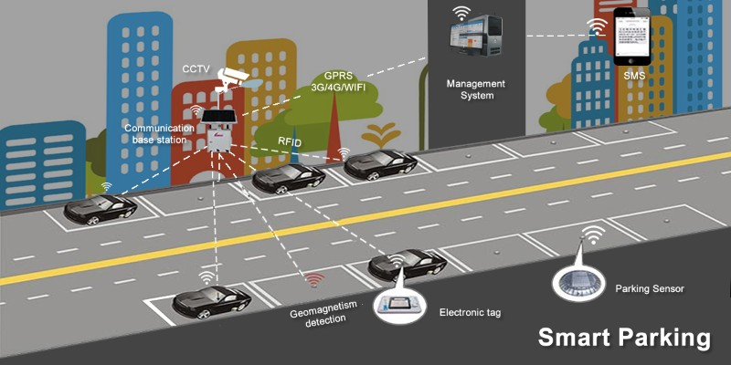
Smart Transport &
Smart Parking
  Smart Bus Stops with real time information using GPS + WiFi + CCTV
  Interactive digital screens
  Advertising
  Smart Ticketing through
  automated ticketing machine
  Travel Cards
  Use of Government owned
  Vehicles (Bus, Taxi etc..)

Slide 25
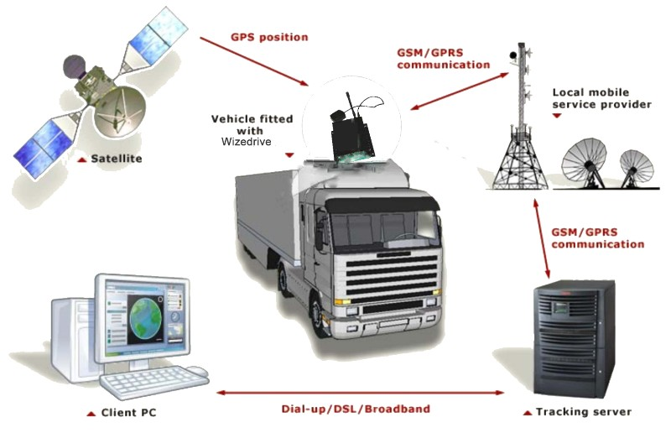
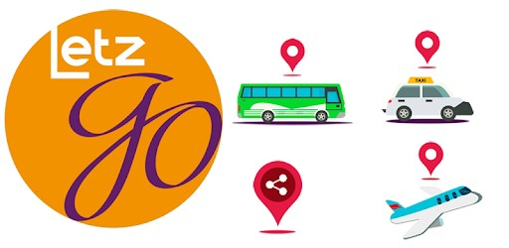
Example of IoT and Cloud: Real-Time Global Positioning System (GPS) Tracking System
With IoT Sensor
(GPS Tracking Device)
Internet
Computer, Laptop or Mobile
Tracking Server on Premises or Cloud

Slide 26
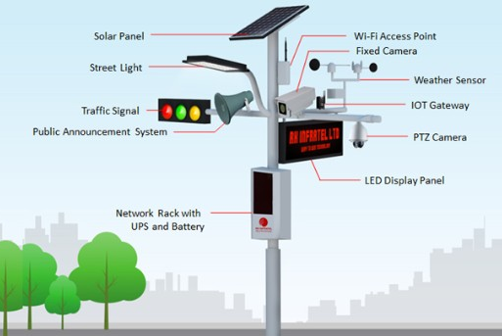
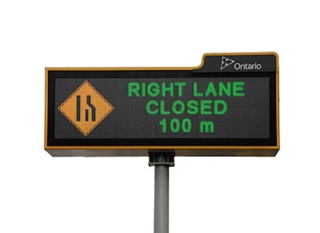
Intelligent Traffic System (Smart Traffic Light, CCTV)
Smart Lighting with photo sensing switching (Auto)
Smart Sight (CCTV)
  Main Road Junctions
  Bus Stops
  Other Public places
  like Court, Police/Traffic
  Stations
Smart Traffic Light
Digital Signage

Slide 27
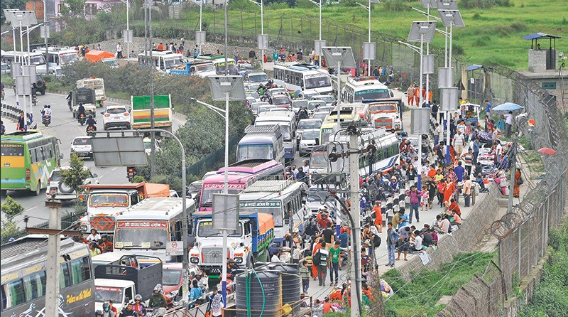
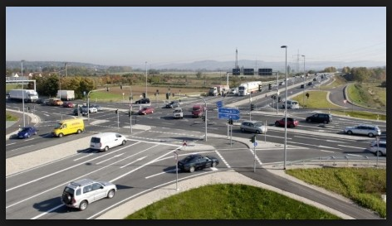
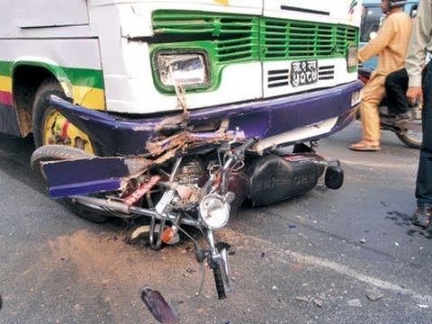
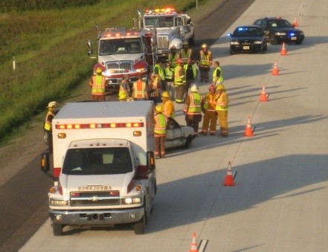
Smart Traffic Management & Accident Response

Slide 28
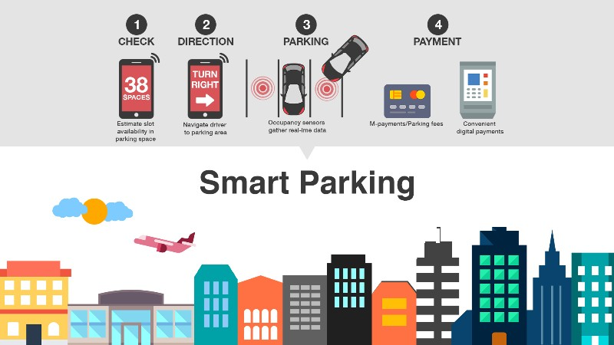

Slide 29
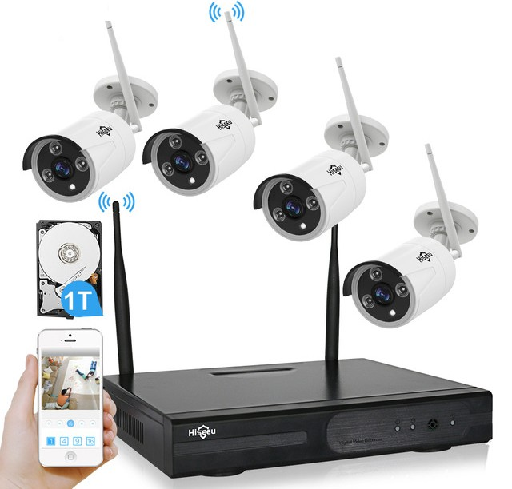
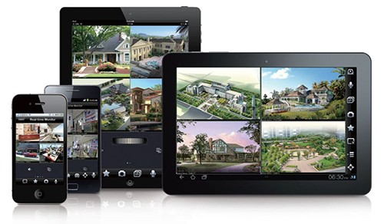
CCTV Surveillance System

Slide 30
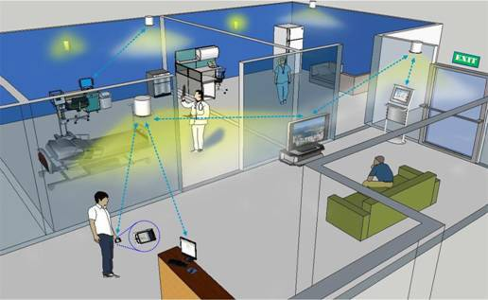
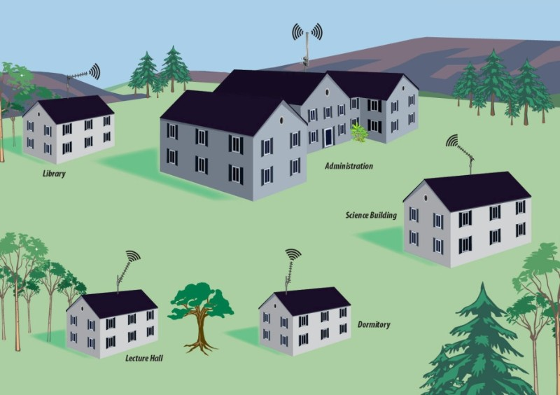
Smart WiFi (WiFi Zones - Hotspots)
Indoor
Outdoor

Slide 31
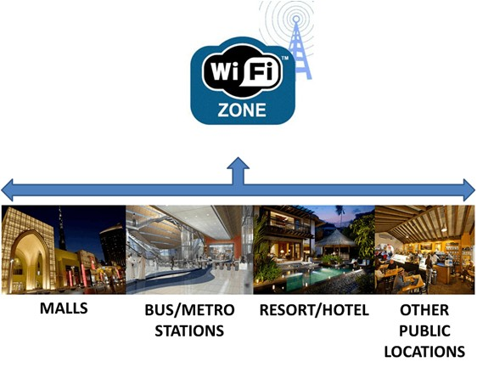
Smart WiFi (WiFi Zones - Hotspots)
  Government Offices (associated
  with e-Governance)
  Hospitals (Private, Government)
  School/ Colleges
  Public Places like Bus Stops, Traffic/ Police stations
  Municipality and Ward Offices

Slide 32

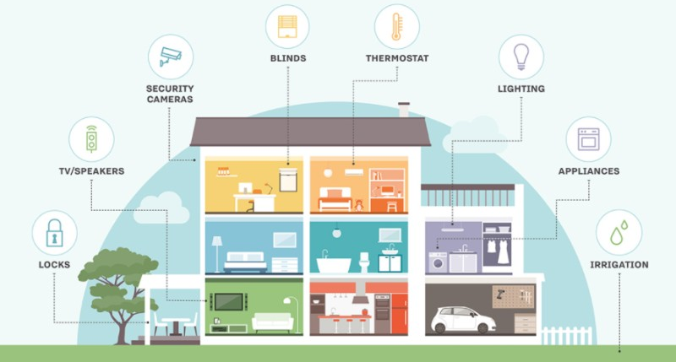
Smart Lifestyle (Building/Home
Automation System)

Slide 33
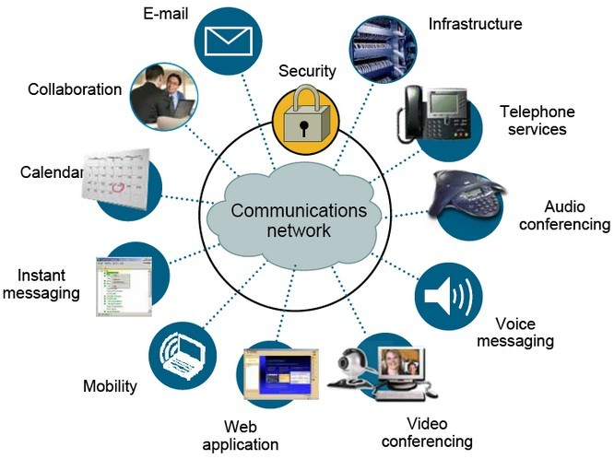
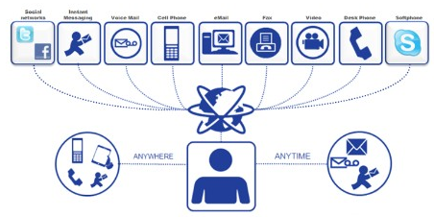
Unified Communication

Slide 34
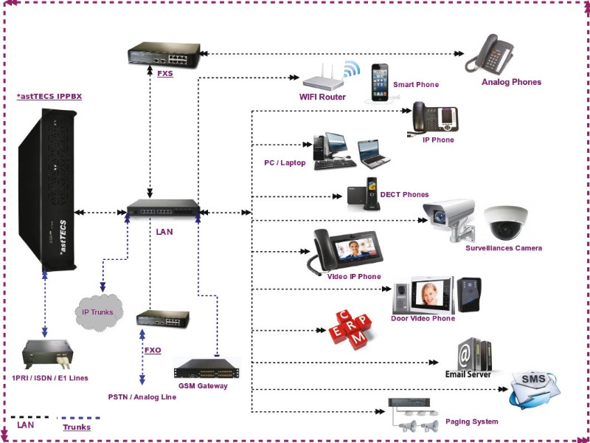
IP PBX /
ePABX
For Unified
Communication

Slide 35



Biometric Access Control & Time Attendance System

Slide 36



Building Fire Fighting System

Slide 37




Building Power Management

Slide 38



Main Gate Automation with Remote Control

Slide 39


Auto Swing Main Entrance Door (Sliding)

Slide 40


Automatic Boom
Barrier

Slide 41


Slide 42


RF Antenna

Slide 43


Smart Blinds, Smart Lights

Slide 44


Video Door Phone

Slide 45


GSM & PSTN
Alarm System
Remote Control for
Building Appliances

Slide 46

Smart Water Tank (Auto Power-Cut System)

Slide 47



Smart Urinal (Water Less System)

Slide 48




Smart Wash Room

Slide 49




Payment Kiosk Terminal, ATM, Snacks Vending Machine, RO

Slide 50



Smart Communication
Secured Inter-Connection among Government
Authorities (Voice, Chat, Video)

Slide 51


Smart Education
  Centralized Student Database
  Interactive learning with Audio/Video
  Online progress report
  Online resources
  Remote education
  Online tutorials

Slide 52

Smart Healthcare
  Online common patient and
  diagnosis recording and
  accessible from the entire
  hospitals
  Online Ambulance
  Booking
  Online Appointment to the major hospitals
  Online Report Access

Slide 53



Slide 54




Smart Shopping & Delivery

Slide 55




Smart Banking
Should have common banking societies
No ATM Service Charge for Withdrawal
Cash/Cheque Deposit Machines

Slide 56




Smart Tourism and Heritage
  Online Reservation
  Online ticketing
  Online Map
  GPS based
  real time information
  Online Information
  System for Heritage Sites
  Online Holiday Packages managed by Government Agencies
  Government Guest Houses
  Promoting Eco Tourisms/ Home Stays

Slide 57




Smart Power/Water (Smart Digital Meter at Households)
Smart Water meter with
GSM SIM card
Smart Power meter with GSM SIM card

Slide 58



Solar Power
Structure

Slide 59



Wind Power Plant

Slide 60


Smart Waste Management

Slide 61


Slide 62


Smart Agriculture
& Smart Sanitation

Slide 63

Smart Stadium

Slide 64

Smart Crime Control Mechanism

Slide 65
Infrastructure

Slide 66
IT Infrastructure
Hardware (Workstations)
Connectivity (Internet/Intranet)
Network
Security (Firewall – Network/Application)
Server – RISC (IBM, Sun), CISC (Intel based)
Storage – HDD/SSD; DAS/NAS/SAN; Cloud
Data Centre Infrastructure
VPN, Dark Fiber, Leased Line

Slide 67








Hardware
Desktop, Laptop, Notebook, TV

Slide 68


Connectivity
Intranet:
Data Link Layer (L2 Link)
Internet:
Network Layer (L3 Link)
Broadband Connection:
DSL (ADSL/ SDSL)
Cable Modem
Optical Fiber
Wireless (Radio)
Satellite (VSAT)
Broadband over
powerline (BPL)
Government owned Fibre
Network (Central Ducting
System) – Leased to all ISPs.
VPN, Dark Fiber, Leased Line

Slide 69
Connectivity among Government Entities
Ward Offices
Government
Schools
Central/ Federal
Government
Province/ State
HQ
Metropolitan City
Other
Government
Offices
DC/DR Site
Hospitals

Slide 70

Blade Servers
Storage with all SSD
HCI
Server/Storage
Servers:
Application Servers (CBS, E-mail,
Web, Mobile Banking etc…)
Database Server
Network Storage:
SAN (Storage Area Network) –
high-end servers, high-capacity disk arrays (Ethernet or Fibre Channel and SAN Switch)
NAS (Network Attached Storage) –
NAS devices onto the LAN via TCP/IP (Ethernet Based with Switch)
Storage on Cloud

Slide 71

DC-DR System (Server/Storage) Architecture

Slide 72


Network/Security

Slide 73


Data Centre Infrastructure
Dedicated and well organized space with:
Power
Cooling
Fire
Monitoring
Security
Other DC passive components

Slide 74






Minimum Rated – 2/3 Data Center; Redundant Components
(Single path for Power and Cooling with component redundancy i.e. N+1)
PAC (Cooling with redundancy)

Slide 75



क्लाउडकम्प्युटिङ
कम्प्युट- प्रोसेसर(Sales Persons)
मेमोरी (Display Area)
स्टोरेज, डाटावेस(Store/Go down)
एप्लिकेशन (Varieties of Goods)
Single PC/Laptop
Cloud Computing

Slide 76






Centralize E-mail & Web Service
Web Mail (existing solution)
e-mail Client
Read or send email through browser and the web mail interface
Or.. web mail service provided with ISP
Application that runs on PC/Tablet/Mobile
Enables to send, receive and organize e-mail
Faster and more accessible
E.g. IBM Lotus Notes, Outlook/Outlook Express, Thunderbird

Slide 77






Application
Local Government Applications

Slide 78

Implementation of E-Governance Stages at Municipality
Automation of all internal activities of Rural Municipality
(Accounting, Payroll, Inventory, HR, e-Attendance, Office Automation)
Online Registration System for Vital Registration System (Birth, Death,
Marriage, Migration)
Online Registration and Issuance of Certificates
Online Tax Payment System
Online Building Permit System
Online Bill Payment Facilities
Digital Portal of Rural Municipalities enriched with Data & Information
Online Registration and Processing System for all services to Public

Slide 79


Slide 80


Slide 81






Integration with existing Government Applications

Slide 82
Components needed for e-Governance:
Devices (Desktop/Laptop, Printer, Fax, Photocopy, TV/Monitor, Smart Devices
(Android, Windows, iOS), CCTV, Biometric Access)
Connectivity (Internet/Intranet) – Internet Service Provider
Network (Physical/Cloud) – Server, Router, Switch
Application (Software/Program)
Security (Network/Application) – Firewall (Network/Application/Database),
Load balancer, SIEM
Storage (Hard disk, NAS, SAN, Removable media)
Integration (Hardware, Application, Network, Sensors)
Monitoring
Management
# Proper Data Centre is required to manage above components.

Slide 83
How SMART CITY/ NATION
can be achieved?
1. Smart Citizen
2. Smart Home/ Office
3. Smart Society (Ward/Community)
3. Smart Palika (City)
4. Smart Province (State)
6. Smart Nation

Slide 84

SMART Citizen
At least Smart Phone on Pocket
Data Pack or Easy WiFi Access
Familiar with Technology [2G - GPRS (General Packet Radio Service), 3G, 4G)
Compatible Set, Settings to activate 3G/4G, Service Providers
Familiar with Government Activities (Citizen Charters)
Familiar with available Government Applications
Application download from Play Store (Android), App Store (iOS) & Others
Proper use of the available Applications (Mobile/Web apps)
Know about Government Service Centres

Slide 85

SMART Home/Office
(Building Automation)
PC (Desktop, Laptop), Smart TV
Internet, WiFi
Surveillance System
Access Control
Security Sensors (Smart Locks – Anti Theft, Emergency Services etc…)
Smart Light
Smart Appliances (Remote ON/OFF system)
Auto Cooling (Temperature/Humidity)
Automatic Door (Swing, Slide)
Fire Fighting System
Smart Blinds
Smart Meter (Water, Electricity) etc…

Slide 86

SMART Village/Society
(Community/Ward)
Hardware (PC, Printer, Photocopy, Attendance, Surveillance etc…)
Network with basic level of security
(Basic LAN and WAN connectivity to connect Palika)
Connectivity (Internet L3/Intranet L2)
Email Access
Paper Less system (Digitalization)
Citizen Charter through Local Government Applications (Mobile/Web Apps)
Security system to the public (Ambulance, Anti-theft alarm, public siren etc..)
Citizen to Government (Complaints/Feedback)
Awareness to the public about available government services
Government Service Centre
Facilities provided by the Government
Trained IT Officers

Slide 87
SMARTPalika
(Rural/Urban)
Hardware (PC, Printer, Photocopy, Attendance, Surveillance etc…)
Medium Level Data Centre: Network with moderate level of Security
(Basic LAN and WAN to the Province/State), Server/Storage system
Connectivity (Internet L3/Intranet L2)
Email and Website
Paper Less system (Digitalization)
Government Service Centre to facilitate Government Services
Smart City Components (Varies from one Palika to another)
  Smart WiFi
  Smart Health
  Smart Education
  Smart Agriculture and Irrigation
  Smart Waste Management
  Smart Water and Electricity

Slide 88
SMART Province (State)
Data Centre to connect entire Palikas (Rural/Urban Municipalities) with:
Wide Area Network with High level of Security (Access to Rural/Urban
Municipalities and connectivity to the Central Government)
Servers for Email (Client based email like Ms. Exchange, IBM Lotus 123, Open
Source Zimbra etc…), Web, Smart Cities Applications and Storage System
Integration with Central Government Applications like: Passport, License
Smart City Parameters rather than Smart Palikas…
  Smart Transportation using Intelligent Traffic Management System
  Smart Energy (Solar, Windmill)
  Smart Transportation
  Smart Tourism/Heritage
  Smart Payment Gateway
5. Poverty reduction
6. Employment Opportunities

Slide 89
SMART Nation
High Level of Government Cloud/ Government Integrated Data Centre
Mobile Data Centre (Incase of Huge Natural Disaster)
National ID, Smart License, Smart Citizenship (Central Database)
Smart Roads, Electric Railways
Smart Transportation and Accident Response
Smart Energy/Grids (Hydropower, Solar, Wind, Nuclear)
Smart Banking
Smart Taxation
Smart Land Reform Management
Poverty Alleviation
Employment Opportunities
Placement opportunities for highly skilled manpower

Slide 90



Educate/Aware Citizens through Digital Online Media
Solution:
Create Social Media Pages
  YouTube Channel
  Face book Page
  Twitter Page etc..
  Upload educational and
  awareness Contents in
  Social media pages and
  Share it publicly.
  Develop user friendly Mobile
  Apps
Association of
Academic
Institution
Traffic Rules Video
College & School
Principals
Parents & Societies
College & School
Teachers
Students

Slide 91








Last but not the least… Let’s not forget our past
Proposed electric train Network

Slide 92







lxdfnl;d]G6 sf/vfgf

Slide 93



Exported commodities of Nepal

Slide 94


Slide 95

SMART
CITY
Indicators
&
Phases

Slide 96




Slide 97

RESULT

Slide 98

Thank You
Contact:
Hemanta Baral (ICT Consultant)
M: 9843067142
hemanta.baral@gmail.com
www.hemantabaral.com.np
https://hemantabaral.wordpress.com
Any Questions?

